Slide 1

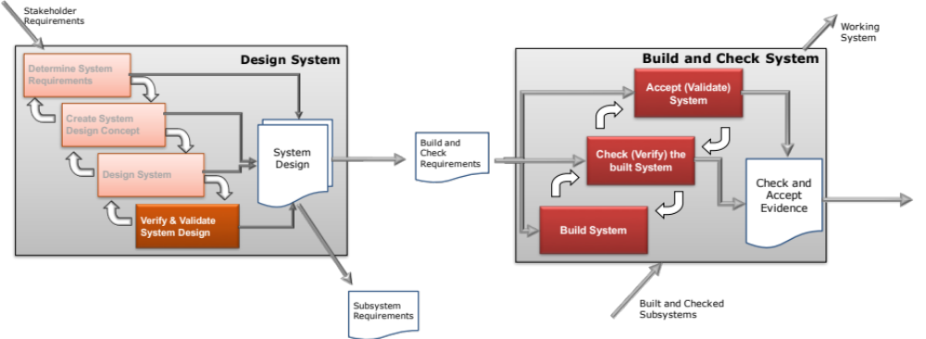
A Systems Approach To Verification and Validation
This Session:
Introduces a Systems Approach to Verify and Validate the System Design
Emphasises the importance of Determination Testing over Demonstration testing
Introduces the Verification Compliance matrix

Slide 2
Verification and Validation
The purpose of Verification and Validation is to establish confidence that the system meets its requirements
This does not mean that the system is completely free of defects, but is good enough for its intended use

Slide 3
Confusion Confusion Confusion
There is huge confusion over the terms verification and validation. Partly because in everyday language they are often used interchangeably
The Oxford English dictionary gives:
  Verify [verb]: make sure or demonstrate the (something) is true, accurate, or justified: his conclusions have been verified by later experiments (origin Latin verifcare)
  Validate [verb]: check or prove the validity or accuracy of: all analytical methods should be validated in respect of accuracy (origin Latin validus)
The distinction is subtle, indeed Oxford English Thesaurus actually says that verify can be used in place of validate and vice versa

Slide 4
Systems Engineering Definitions
Given the rather vague definitions from the Oxford English Dictionary, more pragmatic definitions of verification and validation are needed. An understanding can be obtained from various references
NASA Systems Engineering Handbook:
  Verification: It is essential to confirm that the realized product is in conformance with its specifications and design description documentation (i.e., verification)
  Validation: However, from a customer point of view, the interest is in whether the end product provided will do what the customer intended within the environment of use (i.e., validation)
These descriptions lead to the simple but pragmatic definitions:
Verification: Did we build the thing right?
Validation: Did we build the right thing?

Slide 5

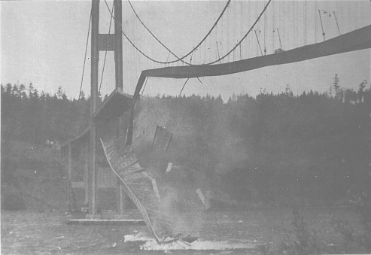
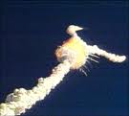
Failure to Validate
Concorde a great aeronautical achievement but the production run was for 14 and these were sold to British Airways and Air France for £1 each. There is no doubt that Concorde met its requirements but were they the right requirements? - a validation error. Concorde was a success only as a political statement, not as a business system.
The Tacoma Narrows Bridge was a scale-up of an old design! The design engineers reused the requirements for an existing bridge, so these requirements were up to the standards of the day. The bridge was built well but it was the wrong bridge for that environment, a validation error.
The Space Shuttle Challenger exploded because of low temperatures causing the O-rings to leak. The air temperature was below the design expectations, and no shuttle had ever been launched in such cold weather. The political decision was to launch in an environment for which the system was not designed, a validation mistake

Slide 6

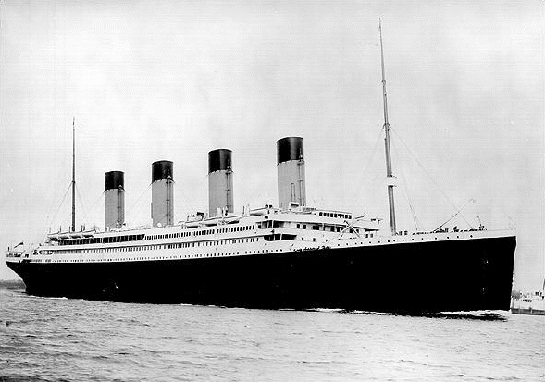

Failure to Verify
Ariane 5 blew up on its first launch, destroying a billion dollars worth of satellites. The mistakes on the Ariane 5 launch vehicle were (1) reuse of software on a scaled-up design, (2) inadequate testing of this reused software, (3) allowing the accelerometer to run for 40 seconds after launch, (4) not flagging as an error the overflow of the 32-bit horizontal-velocity storage register, and (5) allowing a CPU to shutdown if the other CPU was already shutdown. The requirements for the Ariane 5 were similar to those of the Ariane 4: So it was easy to get the requirements right. They needed a rocket with a larger payload, and that is what they got: So, that part of validation was fine. Their failure to adequately test the scaled-up software was a verification mistake.
RMS Titanic had poor quality control in the manufacture of the wrought iron rivets. In the cold water of April 14, 1912, when the Titanic hit the iceberg, many rivets failed and whole sheets of the hull became detached. Therefore, verification was bad, because they did not build the ship right.
The Hubble Space Telescope: Looking at the marvelous images we have been getting we can say that this was the right system. But during its development the guidance, navigation, and control (GNC) system, which was on the cutting edge of technology, was running out of money. So they transferred money from Systems Engineering to GNC. It was never tested. They said that the individual components all worked, so surely the total system will work. After they launched it, they found that the telescope was myopic – a verification error.

Slide 7
A Systems View
A systems view unifies these situations as examples of UNDESIRABLE
.. and is why Systems Engineering, including Verification and Validation, is absolutely essential
Emergent Behaviour

Slide 8
How do we apply Systems Thinking to Verification and Validation?
Systems Thinking can be applied to Verification and Validation at three fundamental, but interdependent, levels:

Slide 9
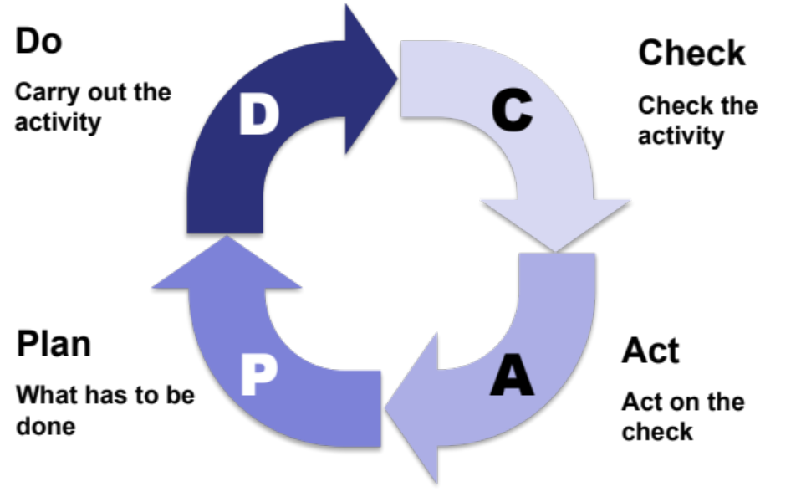
1. Verification and Validation are Types of Check
The Plan Do Check Act (PDCA) cycle attributed to Edwards Deming is a Systems Thinking meta-process
Verification and Validation are effectively an application of the “check” (and “act”) in the PDCA cycle
However, care needs to be exercised as to when this check is applied!

Slide 10
2. But you don’t fatten lambs by weighing them!
Inputs Us
Outputs Ys
System
Y = f(u, x)
Measuring the output can be too late!
If the transfer function Y = f(u, x) is understood then Y can be determine from a knowledge of x and u
If we understand Y = f(u,x) we do not have to measure Y to assure its correctness! If we control the inputs, u, and the state, x, we know what Y is.

Slide 11

My Bomber Doesn’t Bomb Very Well

Slide 12
3. Verification & Validation is a System
Determine System Requirements
Confirms
System Design
V & V
System
Evidence
Review V&V Evidence
V &V System Design
Determine V & V Requirements
This is as much a Systems Engineering activity as the design of the system

Slide 13
Methods for Verification and Validation
There are five basic methods for verification and validation
Test
  Test is a method used to confirm conformance of performance or functional characteristics with specified requirements
  Demonstration an activity to provide a demonstration of observable system actions - e.g. demonstrate that something is displayed, or demonstrate maintainability
  Inspection/Review is a visual or other examination of something to demonstrate it is present - e.g. code inspection or mechanical inspection
  Analysis is the use of a model to determine or demonstrate conformance – e.g. analysing test results or simulation results, usually where it is not possible to determine directly whether a pass or fail has taken place
  Analogy is the use of evidence of identical or similar systems in an identical or similar environment is used to confirm performance
Demon-stration
Review
Analysis
Analogy
Notes:
13
These are the standard five ways that it can be shown that requirements have been satisfied.
Each requirement must have at least one defined criterion.
The defined criterion may involve one or more of the five different ways.
There may be a choice of ways.
It should be noted that the analysis technique will generally involve one or more of the other techniques (usually test), but then require some analysis to ascertain a pass or fail. In contrast, each test performed will probably have a test/pass criterion that will be immediately obvious.
Sometimes operational requirements cannot be tested, e.g. it might require a war to test fully some or all of the operational requirements. In these cases it is appropriate to use one of the other techniques. Note that some people might think that because these requirements cannot be tested they should not be included in the requirements set! They should be included.
It should be noted that the word “test” and its derivatives (in particular “testable”) have been used throughout this course as generic words to cover all five of these approaches. For example “requirements must be testable” means requirements must be such that it is possible to show that they have been met in the system, by testing and/or by demonstration and/or by inspection/review and/or by analysis and/or by similarity.

Slide 14

Verification and Validation = Test?
We have become locked into the belief that testing is the ultimate method of verification and validation - because it is what the customer wants and expects
“.. bump, bump, bump, on the back of , his head. It is, as far as he knows the only way of coming downstairs, but sometimes he feels that there really is another way, if only he could stop bumping for a moment and think of it.
Testing in this context is often performed as a demonstration test on a pass-fail basis which is only conclusive if there is a problem! If there is no problem it is not conclusive
This reliance on demonstration testing has led to a distortion of the V diagram

Slide 15
Theoretical V
System Design
Checked
by
System Integration
tests
Sub- System Design
Checked
by
Subsystem Integration tests
Sub-Sub System Design
Sub-subystem Integration tests
.
Checked
by
.
.
.
.
.
Checked
by
Component
design
Checked
by
Unit tests
This model has been adapted from a very well known organization – Note the use of the word “tests” on the right hand side!
Questions:
If a “test” fails what happens?
Where are the resources found to “fix” the issue?
What happens to that work whose resource has been allocated to help “fix” the issue?

Slide 16
Right Drift
System Design
Checked
by
System Integration
tests
Sub- System Design
Checked
by
Subsystem Integration tests
Sub-Sub System Design
Sub-subsystem Integration tests
.
Checked
by
.
.
.
In practice the
“V” becomes
distorted
.
.
Checked
by
A Demonstration Test driven philosophy results in a “Right Shift” which results in less resource for the front end design resulting in more emphasis on testing …
Component
design
Checked
by
Unit tests
Effort
Time

Slide 17
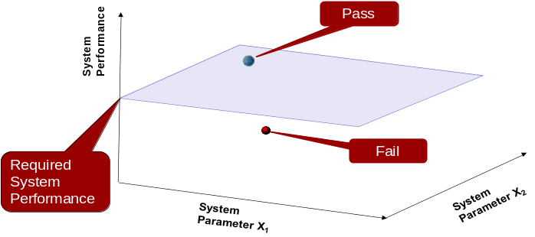
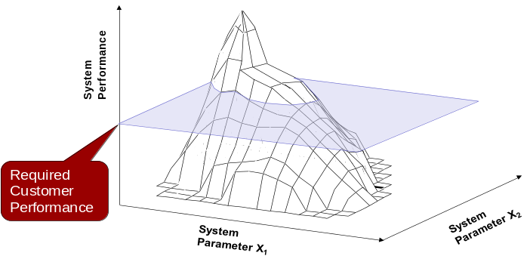
Another way
Demonstration Testing
System
Output
Demonstration Testing checks the output against some criteria to assess “pass” or “fail”. Good news is a pass but if a fail!
Determination Testing
X₁
System
Output
X₂
Determination Testing aims to characterise the system in terms of the input output relationship (the transfer function). The output is now known if the system parameters are known

Slide 18
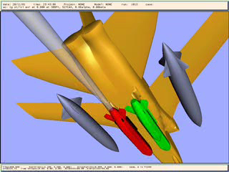

Slide 19
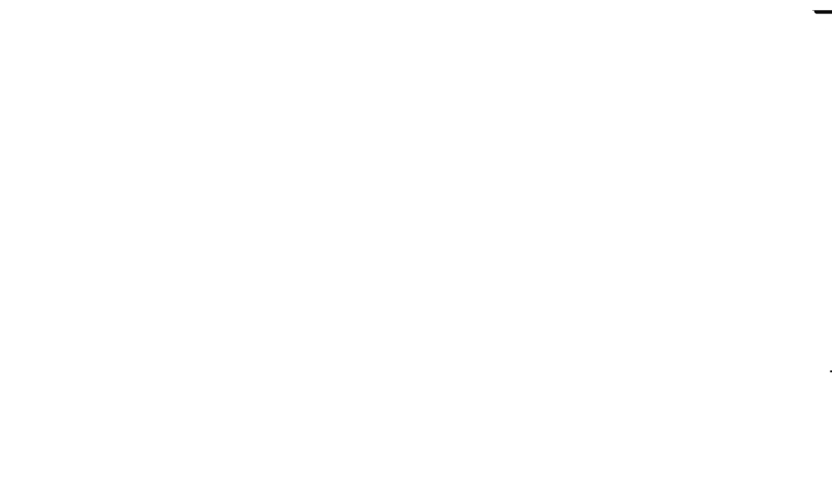
There is a shift in emphasis – we now have to Validate ???
Notes:
14
14
14

Slide 20
Implications of Determination
The potential to use models to explore and determine system behaviour (by analysis) has implications for Verification and Validation
There will be a shift in emphasis to:
  use models (analysis) on the left hand side of the V to verify designs and design activities
  use of tests/demonstration on the right hand side of the V to validate the models used to verify the system
This means we need to think about our Verification and Validation strategy and subsequent plans early

Slide 21
The Systems Approach
Cost to
Fix (£)
Reliance on Determination
Reliance on Demonstration
This is where
we should
put our effort
This is where
we currently
put our effort
Marketing and
Requirements
Design
Development
Production
Customer
use
because
BUT
because
Difficult to see
and predict
Easy to see
Difficult and
costly to fix
BUT
Easy and
cheaper to fix

Slide 22
Left Shift V
System Design
Small
V&V
Checked by Big V & V
System Integration
tests
Sub- System Design
Small
V&V
Checked by Big V & V
Subsystem Integration tests
Sub-Sub System Design
Sub-subsystem Integration tests
.
Small
V&V
Checked by Big V & V
.
.
.
.
.
Achieving the “Left Shift” requires moving some Validation and Verification activities earlier
Checked by ….
Left shifting V&V introduces “small” V&V
That is Verification and Validation activities as an integral part of the design activity
Component
design
Checked by
Big V & V
Unit tests
Small
V&V
Effort
Time

Slide 23
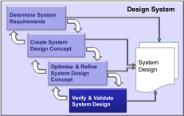
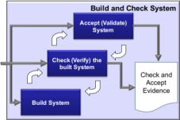
“Small” and “Big” V&V
Working
System
Stakeholder
Requirements
System Level
System
Design
Activities
System
Design
Activities
Build, Verification
and Validation
Requirements
Build and Check
System
Subsystem
Requirements
Working
Subsystems
Sub System Level
Subsystem
Design
Activities
Build, Verification
and Validation
Requirements
Build and Check
Subsystems
Component
Requirements
Working
Components
Component Level
Component
Design
Activities
Build, Verification
and Validation
Requirements
Build and Check
Components
Determination “Small” V&V is done “down” the left hand side of the V diagram
Realise
Components
Demonstration “BIG” V&V is done “up” the right hand side of the V diagram

Slide 24
Validation & Verification
Firstly, validate the requirements
  Do we have the right requirements?
    Are we designing the right system?
Secondly, verify the design
  Does the design meet the requirements?
    Have we designed the system right?
Thirdly, verify the system
  Does the system meet the design intent?
    Have we built the system right?
Finally, validate the system
  Does the customer accept the system?
    Have we built the right system?
Design V & V
Build V & V

Slide 25
Validation & Verification
Firstly, validate the requirements
  Do we have the right requirements?
    Are we designing the right system?
Secondly, verify the design
  Does the design meet the requirements?
    Have we designed the system right?
Thirdly, verify the system
  Does the system meet the design intent?
    Have we built the system right?
Finally, validate the system
  Does the customer accept the system?
    Have we built the right system?
Design V & V
Build V & V

Slide 26
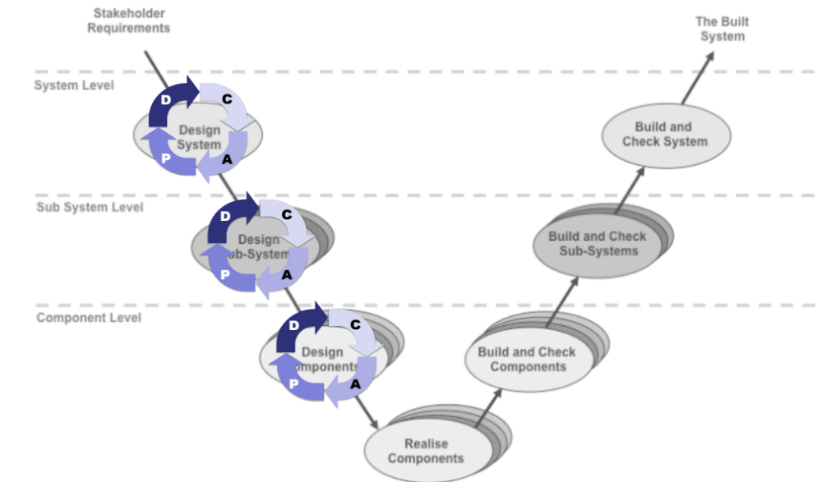
Verify and Validate Inside the V
As system elements are designed common sense dictates that we check as we progress: that the
  requirements are correct (are we designing the right system?)
  design meets the requirements (has the system been designed right?)
This checking has two forms:
  Verification – have we designed the system right
  Validation – have we designed the right system
Both are necessary to have complete confidence in the final system
By applying the PDCA within design levels provides greater confidence

Slide 27
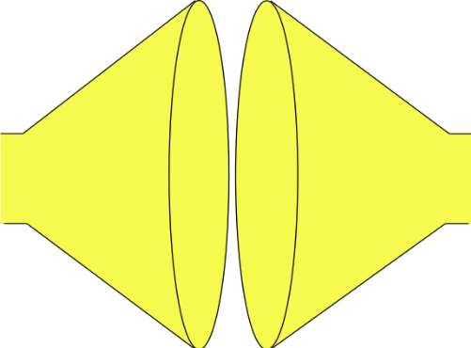
Systems Engineering uses a Systems Approach to System Design
Plan
Tailor the process, select the tools and determine the best checking strategy
Search and evaluate the solutions to determine and select the “best” solution
(Convergent Thinking)
Do
Do
Do
MAKE THE SYSTEM TO THE DESIGN
GENERATE SOLUTION OPTIONS AND SELECT
SYSTEM PROBLEM
UNDERSTAND
PROBLEM
solution
“best”
solution
solution
Built System
solution
Stakeholder needs and expectations
Understand the problem in terms of Purpose and Context
solution
Check (& Act)
Identify and document all possible solutions to the problem (Divergent Thinking)
Confirm the understanding of the problem reflects the stakeholder’s needs and expectations
Check (& Act)
Confirm that the selected solution solves the stakeholders’ problem
Check (& Act)
Confirm that the built System solves the stakeholders’ problem

Slide 28
V&V already done
Optimise System Concept
  Used DoE to explore the design space to find robust optimum (and avoid the peaks)
Determine Requirements
  Used Flow sensitivity Analysis and FFMEA to identify potential issues early and design them out
  Used QFD to V&V stakeholder – system requirements and check for completeness and consistency
Create System Concept
  Used Function Means Analysis to ensure complete system solution
  Pugh to evaluate and select system concept
  Used QFD to V&V system requirements – System solution
The important message here is that the work we have done using these tools is the evidence that is presented at DESIGN REVIEWS

Slide 29
Validation & Verification
Firstly, validate the requirements
  Do we have the right requirements?
    Are we designing the right system?
Secondly, verify the design
  Does the design meet the requirements?
    Have we designed the system right?
Thirdly, verify the system
  Does the system meet the design intent?
    Have we built the system right?
Finally, validate the system
  Does the customer accept the system?
    Have we built the right system?
Design V & V
Build V & V

Slide 30
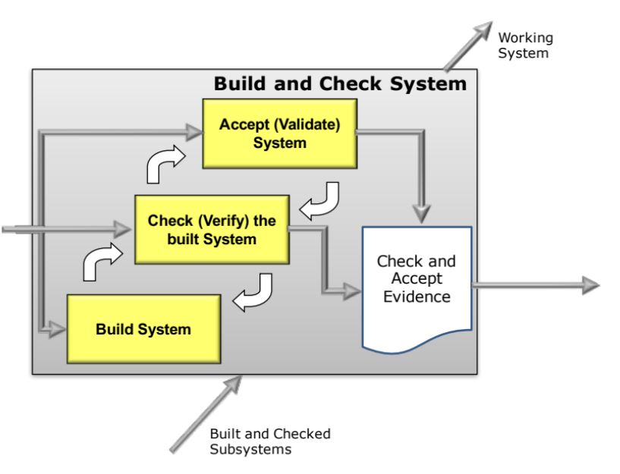
Big V & V
Purpose :
  To verify and validate that
    Has the right system been built (Validate)
    Has the system been built right (Verify)
  in the context of meeting the requirements in terms of performance and the rest of its life cycle (manufacture, support and disposal)
Outcomes :
  A verified and validated system
    Confidence that the system is
      Operational
      Reliable
      Manufacturable
      Supportable
      Disposable
      etc

Slide 31
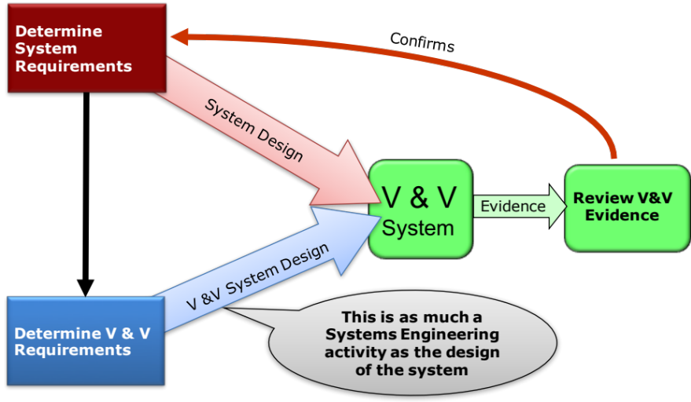
It’s about Designing Another System
The Verification and Validation system can be designed in exactly the same way as the prime system
Just as the prime system is reliant on a “good” set of design requirements, the same applies to the V & V requirements
  These need to specify for each prime system requirement corresponding V&V requirements
  V & V requirements should be written early to ensure that we V & V the system we should have built as opposed to system that was built
  A useful tool is the Verification-(Validation) Compliance Matrix (VCM)
V&V requirements fundamentally specify how a particular system requirement is to Verified or Validated as appropriate

Slide 32
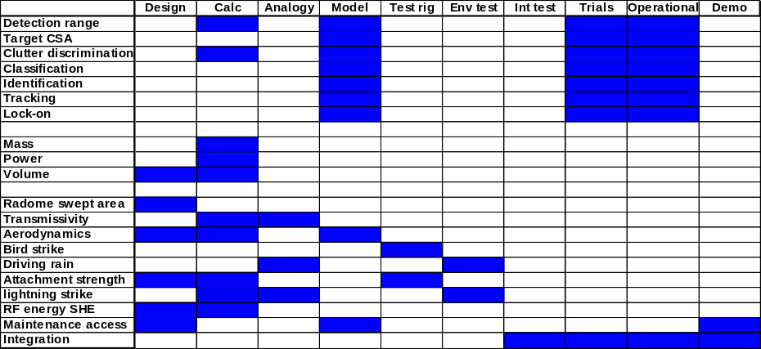
Verification and Validation Compliance Matrix
What is it?
  A simple tool that can assist in the planning and management of V & V activities by:
    Recording the method by which each prime system requirement will be shown to have been met in the final system
    Capturing maturing compliance evidence
  Assists in ensuring that all requirements
    have one or more defined confirmation methods
  May be a by-product of the requirements management software being used
Notes:
32
BAE SYSTEMS does not have a mandated standard for recording Compliance Matrix information.
Typical information that might be held within the Compliance Matrix includes for each requirement:
Requirement or requirement identifier
Level at which the acceptance testing will take place (i.e. at the system level, or at a lower level)
Acceptance mechanism criteria
Acceptance mechanism details or references to Test Plans, procedures, (etc)
Compliancy status (e.g. fully compliant, partially compliant, not compliant, not tested yet)
Justification (to explain compliances where necessary, or to justify non-compliances)
Notes
If a requirements management database tool is being used, the Compliance Matrix should ideally be a by-product of that database, thus not requiring much additional effort.
The Compliance Matrix is sometimes referred to as:
VCRI - Verification/Valdiation Cross Reference Index (pronounced “vick-ree”)
VCRM - Verification/Validation Cross Reference Matrix

Slide 33
V&V Planning: How to do it
Step 1: Identify requirements to be verified or validated
Step 2: Review requirement quality
Step 3: Determine appropriate V & V methods
Step 4: Specify V & V requirements
Step 5: Update V & V Compliance Matrix

Slide 34
Step1: Identify Requirements to be Verified or Validated
It is important remember the purpose of verification and validation:
This can be achieved by confirming that requirements have been met
System Validation is concerned with confirming those requirements that are important to the “customer” have been met
System Verification is concerned with confirming that other system requirements have been met. Verification therefore provides the opportunity to establish that Validation will be successful
All requirements should therefore be identified and allocated either as part of the Validation set or Verification set
It is important to agree the validation requirements with the respective stakeholders. These are sometime called Acceptance Requirements if the stakeholder is the economic customer, Qualification Requirements if the stakeholder is a legislator.
The purpose of Verification and Validation is to establish confidence that the system meets its requirements

Slide 35
Step 2: Review Requirement Quality
The key to using a VCM is to recognise that:
All requirements must be measurable
so that they can be confirmed
Requirements must therefore be specified quantitatively - i.e. present/not present, or have a measurable value - and there must be a means to measure this
Notes:
All requirements must be measurable and quantitatively specified, and agreed with the customer.
All requirements must be capable of being measured so that they can be tested. If a requirement cannot be measured it cannot be tested and therefore compliance cannot be claimed. It should be noted that “test” is used generically to refer to any of the standard approaches that can be used to show that a requirement has been met in the system (test, demonstration, inspection/review, analysis, similarity).
To be measurable a requirement must be specified either as:
something which is either present or not (e.g. a function), or
something with an associated value (and tolerance if relevant).
In addition there must be a means available to measure either the presence of the required function or the associated value.
It is therefore important that qualitative requirements either be:
assigned an appropriate measurable value, or
rewritten to something that is measurable.
Requirements are sometimes expressed in non-quantifiable terms, leading to difficulties in accepting against them. These requirements need to be converted to an equivalent quantified form.
This is referred to as the “Fit Criteria” in
Suzanne Robertson & James Robertson, Mastering the Requirements Process, Addison-Wesley, 1999.

Slide 36
Example of an Un-measurable Requirement
“The washing machine must be easy to use”
This is not measurable so it cannot be confirmed quantitatively
Need to quantify it somehow
Notes:
“User friendly” and many similar expressions are not very useful in requirements, yet they are quite common and must be addressed. They therefore need converting to something which can be measured.
However as a first line of defence, we should not accept a contract nor a requirement specification that includes such requirements.

Slide 37
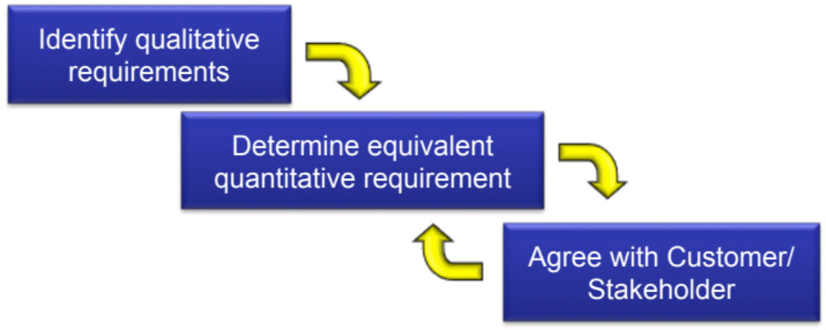
Review Process and Example
Non Quantitative Requirement
“The washing machine must be easy to use”
“Equivalent” Quantitative Requirement
At least 95% of novice users shall be able to wash the standard load correctly without recourse to the user guide.
Associated Definitions
A novice user is defined as someone who has used a conventional automatic washing machine before.
The Standard Load is defined in IS999 - 2013
Notes:
Perhaps the easiest way of quantifying a requirement is simply to rewrite it as one or more “equivalent” textual requirement statements.
In the above example, it should be noted that the use of a defined term, namely “novice user”, is needed else the requirement itself would be ambiguous and open to interpretation.
Also, the above requirement is not complete, the following need to be addressed:
The exact form of “using the toilet flush request mechanism correctly”.
The use of the toilet by disabled people,
If any instructions or labels are used to assist the user - the use by those users who cannot read them or understand them.

Slide 38
Step 3: Determine Appropriate V&V Methods
Test
Once we are confident that we have a measurable prime system requirement it is necessary to consider the most appropriate method or methods to be used to confirm the particular requirement
It is important to note that V&V is about showing how a particular prime system requirement is to be shown to have been met in an evidence-based fashion
It is equally important to note that V&V is not an activity that is “left” to the end! It can be a continuous activity that occurs throughout the development cycle
Demon-stration
Review
Analysis
Analogy

Slide 39
Step 4: Specify V&V Requirements
“I keep six honest serving-men: (they taught me all I knew) Their names are What and Where and When and How and Why and Who.”
The Elephants Child 1902
V&V requirements are concerned with documenting:
  The justified (WHY) method or methods (HOW): demonstration, test, analysis, inspection or analogy, most suited to the particular prime system requirement under consideration. Note that several methods may be employed. Indeed, the systems approach emphasises analogy, analysis and review.
  The requirements applicable to the chosen methods (WHAT) and the acceptance criteria. They should also specify what evidence is to be gained and how it should be reported
  WHEN the V & V activity is to be carried
  WHERE are the V & V activities to be performed
  WHO is responsible for performing the V & V activity

Slide 40
V&V Requirements Example
Requirement (based on the meta solution of a vacuum toilet)
T001.1 The flush toilet function shall only be activated when
a flush has been requested
no-one is sat on the toilet at the time of the flush request
V&V Requirements
Requirement T001.1 shall be confirmed by:
  Analogy during design with existing designs
  Design Review of the concept and detailed design
  Demonstration through a series of tests being performed on the development system
During design the selected solution shall be examined and evidence collected for suitable carry-over from previous successful designs. Evidence shall also be gathered to show that known failure modes have been adequately addressed and avoided.
The demonstration tests will involve activating the flush request when:
  no-one is sat on the seat
  a series of different sized individuals from a small child to a range of adults are sat on the seat
Note: Sizes of individuals to be consistent with 95 percentile standards
Expected Results: the demonstration will show the system to NOT to perform a vacuum flush when any person is seated and a successful flush when no person is seated
Systems Test will be responsible for developing, performing and recording the test
Notes:
Associated with these qualification criteria will also be a more detailed qualification specification, which will specify the exact tests to be performed, together with the expected results, including the pass/fail criteria.
In the above example, it might be argued that the second part of the qualification criteria (in parentheses) is too detailed to be part of the qualification criteria.

Slide 41

Exercise :Verifying Requirements
In pairs consider the case study exercise:
  Use one of the requirements you generated in the “Specify Requirements” exercise and determine suitable verification requirements
Time 20 minutes
Notes:
This exercise is described in the exercise trainer notes.

Slide 42
Generating V &V Requirements is itself a V &V activity
The very act of writing V & V requirements for a particular system requirement often highlights deficiencies in that requirement!
In essence the activity serves as a “check” on the quality of the system requirement
It is also important to guard against over “checking”. V & V is a cost and we are seeking to determine the minimum acceptable action necessary to confirm that a particular system requirement has been met
It can also be useful to specify what actions are necessary if a particular requirements is not met or partially met
Finally, if a system requirement is subject to change, then the corresponding V & V requirements will need to change

Slide 43
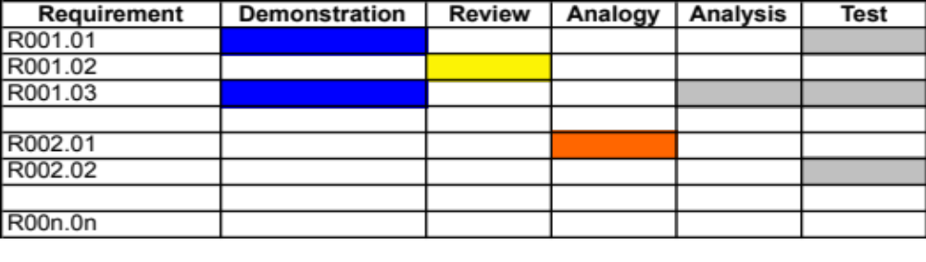
Managing V&V Maturity
The VCM can also be used to capture the ongoing verification (and validation) maturity
Each requirement has one or more V&V methods and requirements declared, together dates to present a complete V&V plan. This VCM can be used to form the basis of a plan for demonstrating compliance and agreeing early payment plans with the customer.
It can also be used as a simple method for monitoring progress can be indicated using colours, e.g.:
Planned
Achieved to plan
Risk to plan
Late to plan
This capability is often and integral part of Requirements Management software

Slide 44
Summary
Both Verification and Validation are necessary
There are 5 basic methods of performing Verification and Validation
Verification and Validation is itself a system that needs designing from a set of requirements derived from the system requirements
Verification and Validation should be evidence based
Verification and Validation happens on both the left and right hand sides of the V – key message start V & V early

