Slide 1
Hi-lights from
The Fundamentals of Systems Engineering
(Training Conducted by Burge Hughes Walsh)
Jaaffar Ismail
October 2017

Slide 2
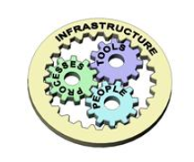
Systems Engineering
Systems Engineering is about applying a Systems Approach to the realization of a new system or the modification of an existing one. Ultimately, the purpose of Systems Engineering is to provide the best solution to a customer's problem, although from an internal viewpoint it is about managing risk.
Systems Engineering can itself be viewed as a system for creating systems and as such comprises four main sub-systems:
People: Systems Engineering demands teamwork and cooperative working
Process: Clearly defined, systematic but pragmatic ways of working
Tools: Powerful but simple tools that aid communication and systems thinking
Infrastructure: Facilities and environments that support and reinforce systems thinking
Getting the right blend of People, Process, Tools and Infrastructure is the key to good Systems Engineering and where Burge Hughes Walsh can help. We have over 50 years of in-house practical Systems Engineering experience to draw up on as well as probably the best associate list of any systems company worldwide.

Slide 3
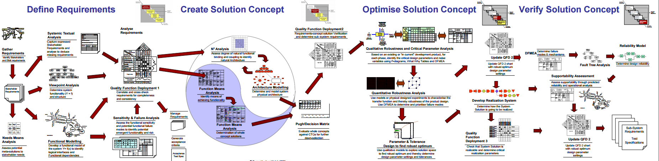

Slide 4
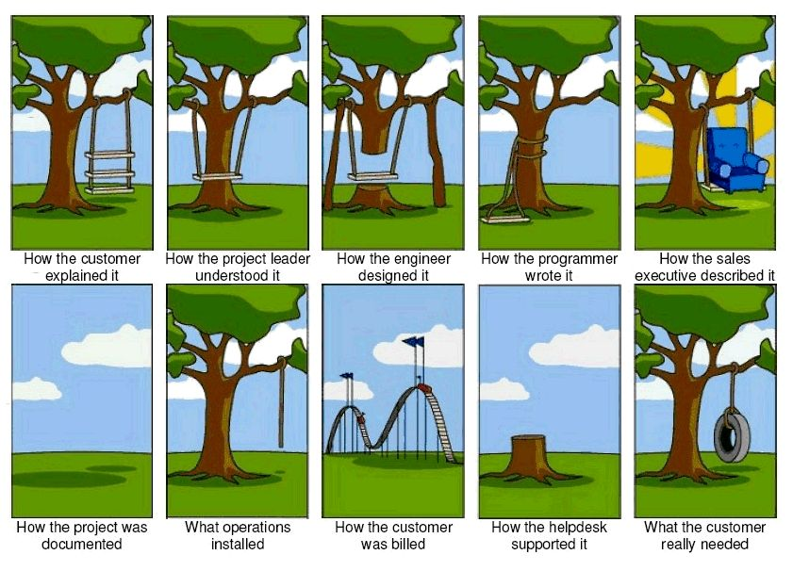
Define Requirements

Slide 5
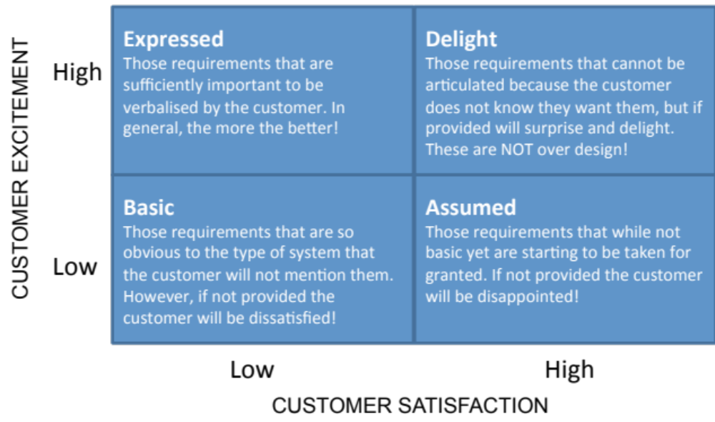
Define Requirements
Kano Model

Slide 6
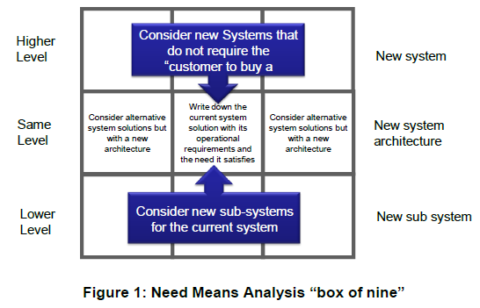
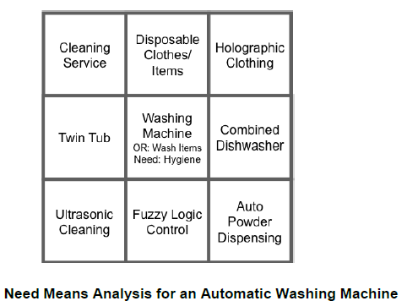
Define Requirements
Need Means Analysis

Slide 7
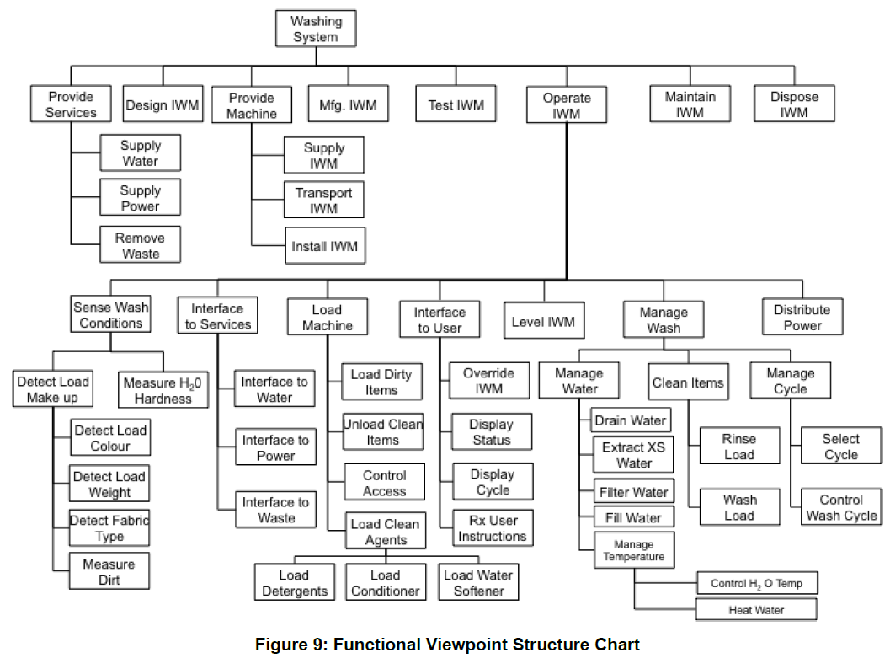
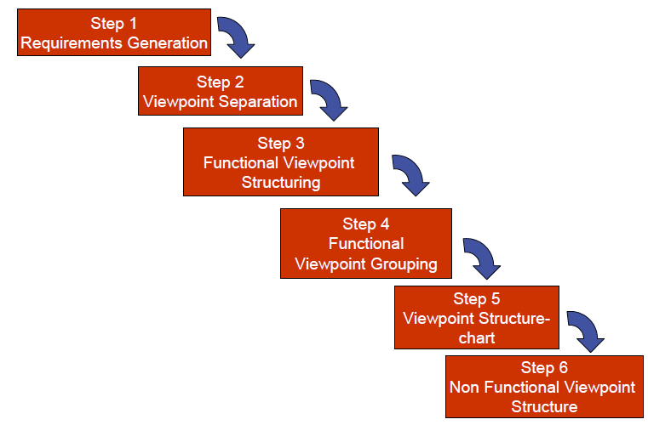
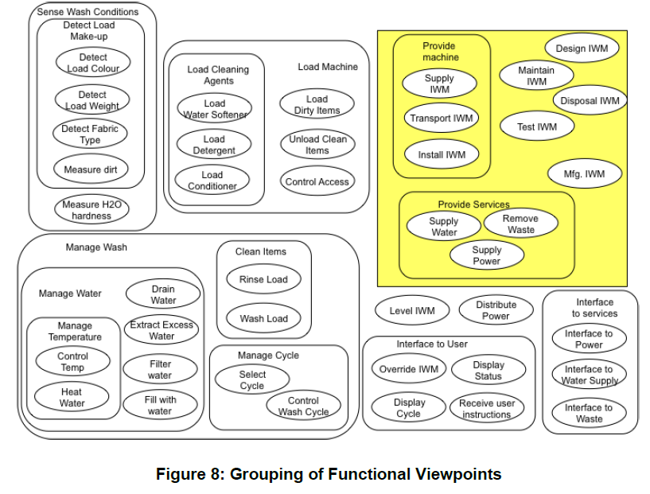
Define Requirements
Viewpoint Analysis

Slide 8
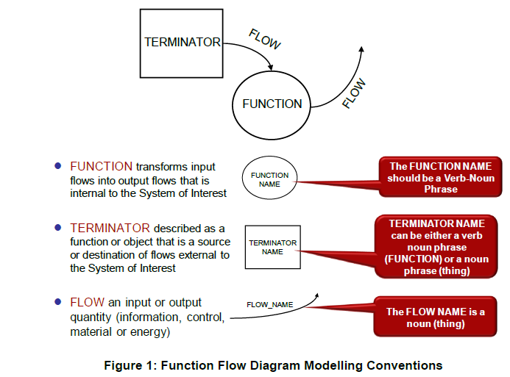
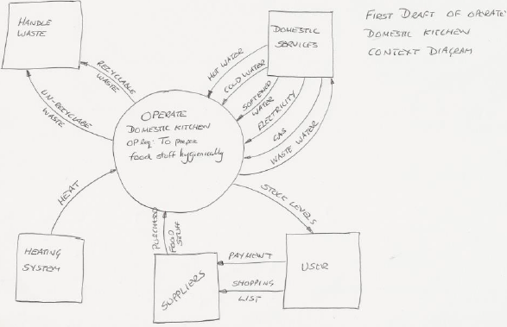
Define Requirements
Viewpoint Analysis

Slide 9
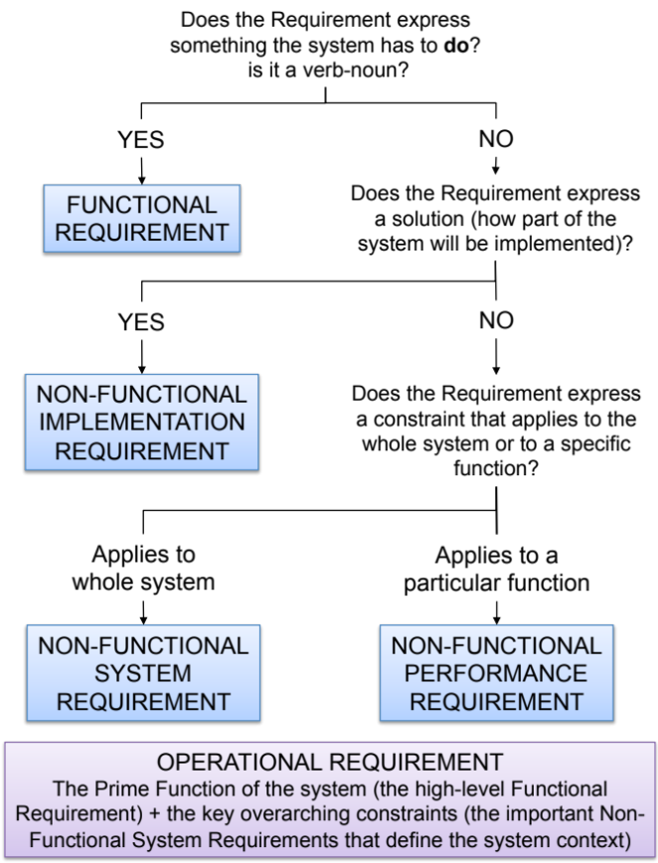
Define Requirements
Using the Holistic Requirements Model
The flowchart opposite can help in consistently and correctly categorizing a set of source requirements
Its use does require practice BUT it can provide a fast method to identify the deficiencies in a set of source requirements
Even experienced users will “get it wrong” on the first pass – but know subsequent iteration will address any mis-categorization

Slide 10
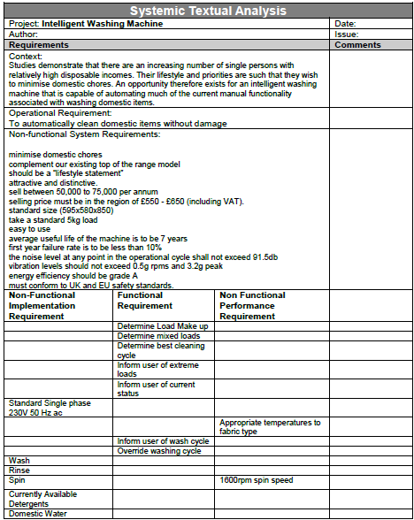
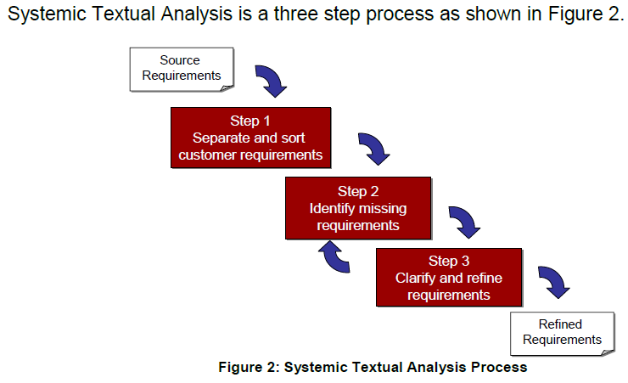
Define Requirements
Systemic Textual Analysis

Slide 11
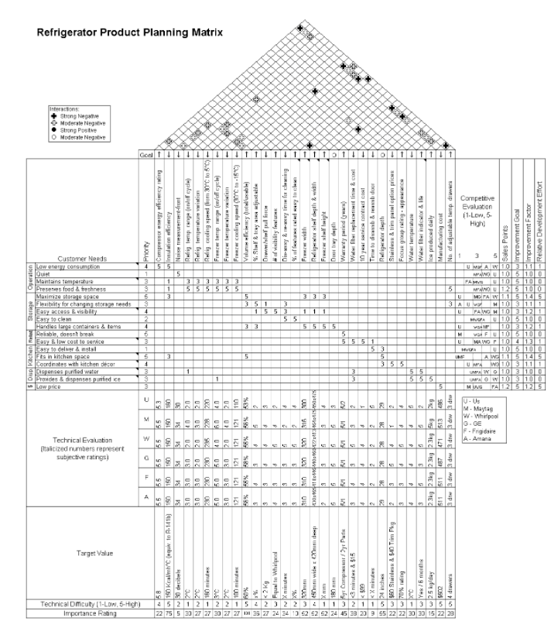
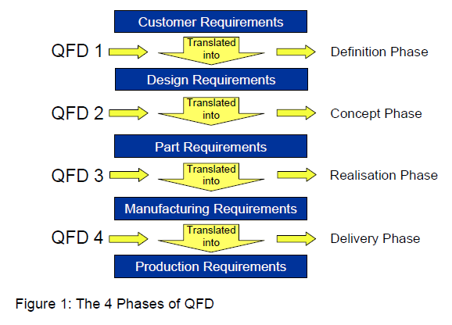
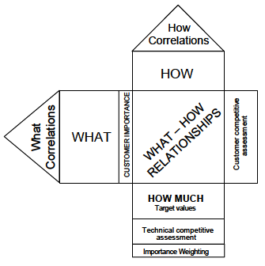
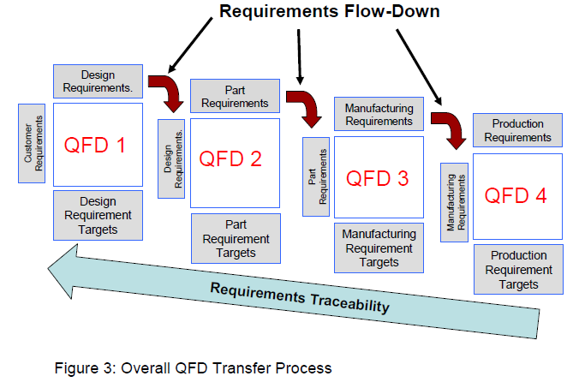
Quality Function Deployment (QFD)

Slide 12
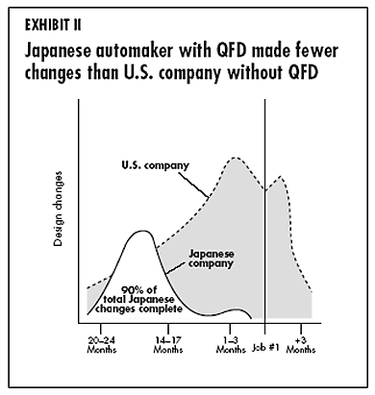
Systems Engineering

Slide 13
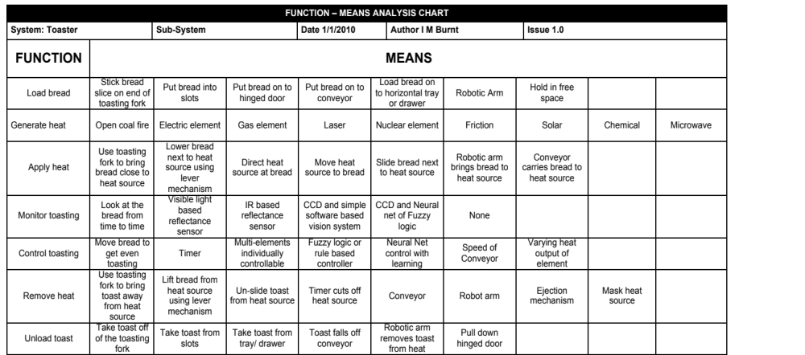
Solution Concept
Create Holistic Solutions

Slide 14
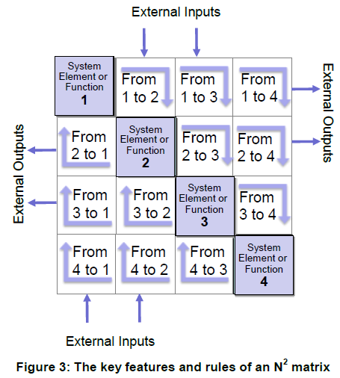
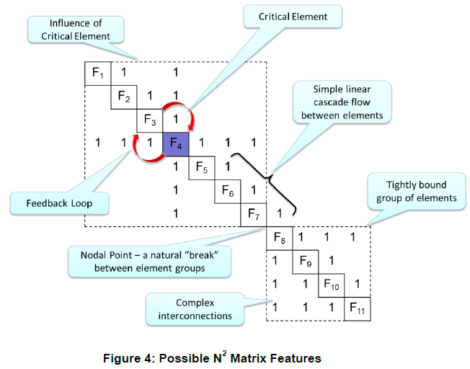
Solution Concept
N² Analysis

Slide 15
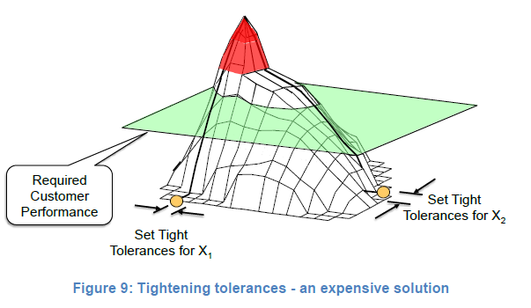
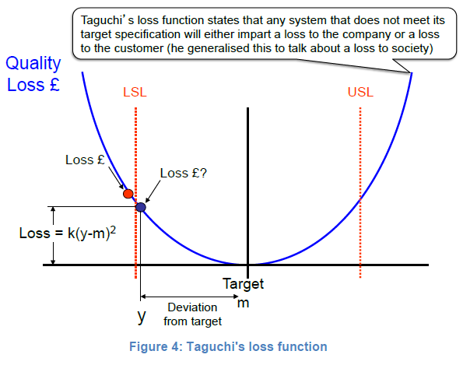
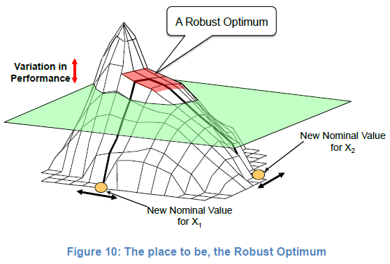
Design Robustness

Slide 16
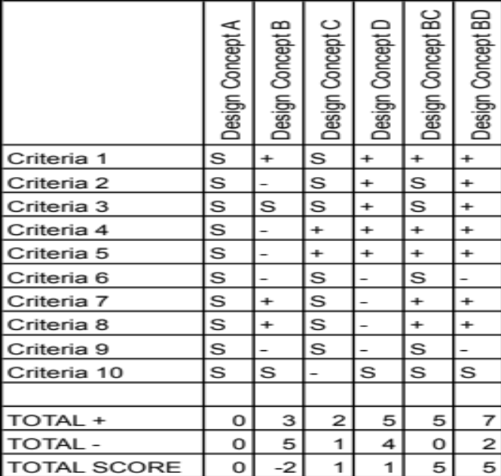
The Pugh Matrix
What is it?
The Pugh Matrix is a form of Matrix Diagram that is useful when comparing a number of alternatives and for finding which best meets a set of requirements/criteria
Why do it?
To quickly identify the best concept or eliminate the weaker ones
When to use it?
Whenever attempting to decide between a number of alternate system concept designs
Particularly useful when there is relatively large number of key customer requirements/criteria
Who Does it?
Best performed by a team that includes all interested disciplines and functions

Slide 17
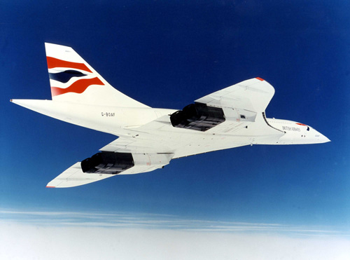
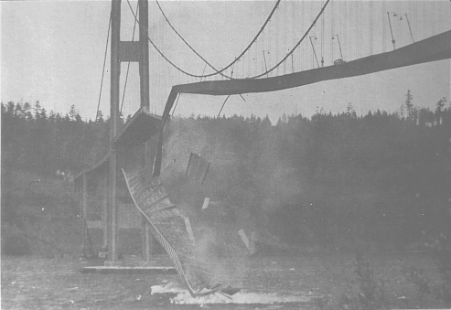
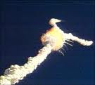
Failure to Validate
Concorde a great aeronautical achievement but the production run was for 14 and these were sold to British Airways and Air France for £1 each. There is no doubt that Concorde met its requirements but were they the right requirements? - a validation error. Concorde was a success only as a political statement, not as a business system.
The Tacoma Narrows Bridge was a scale-up of an old design! The design engineers reused the requirements for an existing bridge, so these requirements were up to the standards of the day. The bridge was built well but it was the wrong bridge for that environment, a validation error.
The Space Shuttle Challenger exploded because of low temperatures causing the O-rings to leak. The air temperature was below the design expectations, and no shuttle had ever been launched in such cold weather. The political decision was to launch in an environment for which the system was not designed, a validation mistake

Slide 18
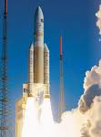
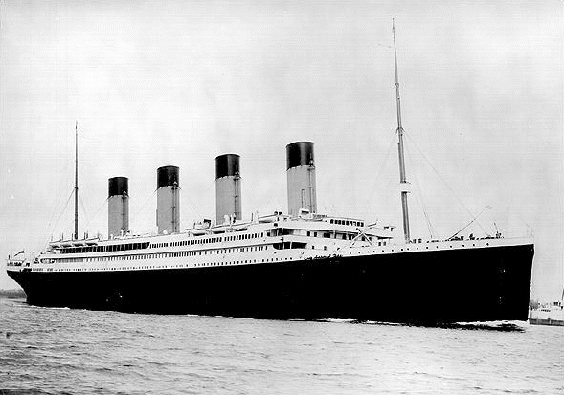

Failure to Verify
Ariane 5 blew up on its first launch, destroying a billion dollars worth of satellites. The mistakes on the Ariane 5 launch vehicle were (1) reuse of software on a scaled-up design, (2) inadequate testing of this reused software, (3) allowing the accelerometer to run for 40 seconds after launch, (4) not flagging as an error the overflow of the 32-bit horizontal-velocity storage register, and (5) allowing a CPU to shutdown if the other CPU was already shutdown. The requirements for the Ariane 5 were similar to those of the Ariane 4: So it was easy to get the requirements right. They needed a rocket with a larger payload, and that is what they got: So, that part of validation was fine. Their failure to adequately test the scaled-up software was a verification mistake.
RMS Titanic had poor quality control in the manufacture of the wrought iron rivets. In the cold water of April 14, 1912, when the Titanic hit the iceberg, many rivets failed and whole sheets of the hull became detached. Therefore, verification was bad, because they did not build the ship right.
The Hubble Space Telescope: Looking at the marvelous images we have been getting we can say that this was the right system. But during its development the guidance, navigation, and control (GNC) system, which was on the cutting edge of technology, was running out of money. So they transferred money from Systems Engineering to GNC. It was never tested. They said that the individual components all worked, so surely the total system will work. After they launched it, they found that the telescope was myopic – a verification error.

Slide 19
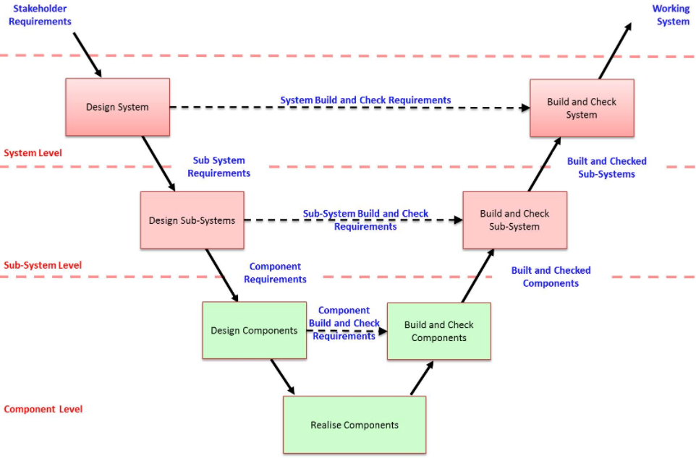

Slide 20
Methods for Verification and Validation
There are five basic methods for verification and validation
Test
  Test is a method used to confirm conformance of performance or functional characteristics with specified requirements
  Demonstration an activity to provide a demonstration of observable system actions - e.g. demonstrate that something is displayed, or demonstrate maintainability
  Inspection/Review is a visual or other examination of something to demonstrate it is present - e.g. code inspection or mechanical inspection
  Analysis is the use of a model to determine or demonstrate conformance – e.g. analysing test results or simulation results, usually where it is not possible to determine directly whether a pass or fail has taken place
  Analogy is the use of evidence of identical or similar systems in an identical or similar environment is used to confirm performance
Demon-stration
Review
Analysis
Analogy
Notes:
20
These are the standard five ways that it can be shown that requirements have been satisfied.
Each requirement must have at least one defined criterion.
The defined criterion may involve one or more of the five different ways.
There may be a choice of ways.
It should be noted that the analysis technique will generally involve one or more of the other techniques (usually test), but then require some analysis to ascertain a pass or fail. In contrast, each test performed will probably have a test/pass criterion that will be immediately obvious.
Sometimes operational requirements cannot be tested, e.g. it might require a war to test fully some or all of the operational requirements. In these cases it is appropriate to use one of the other techniques. Note that some people might think that because these requirements cannot be tested they should not be included in the requirements set! They should be included.
It should be noted that the word “test” and its derivatives (in particular “testable”) have been used throughout this course as generic words to cover all five of these approaches. For example “requirements must be testable” means requirements must be such that it is possible to show that they have been met in the system, by testing and/or by demonstration and/or by inspection/review and/or by analysis and/or by similarity.

