Slide 1
HPLC Fundamentals & Troubleshooting
Chromatography, Columns
HPLC Systems and Troubleshooting
Neil J Lander
neil_j_lander@waters.com
Ext 8692

Slide 2
Table of Contents
Information Page
Chromatography Background 4
Major Types of Chromatography 13
High Performance Liquid Chromatography 19
Liquid Chromatography Separations Modes 21
Column Technology 37
Packing Material 42
Separation Mechanism 58
Separation of Compounds 76
Why are the so many types of columns? 82
Why do we need different size columns? 101
Sample Preparation 111
Information Page
HPLC & UPLC Systems 116
Solvent Delivery 119
Mobile Phase Recommendations 128
Autosampler / Injector 142
Column Heaters 158
Proper System Plumbing 162
Tubing Volume and Flow Rate 167
Detectors 171
HPLC Troubleshooting 202
Retention Time Reproducibility 204
Sensitivity Problems 213
Peak Problems 217
Detector Problems 238
General Recommendations 250
More Information 252

Slide 3
Course Objective
Provide you with fundamental chromatographic knowledge
Help you better understand High Performance Liquid Chromatography
Enable you to make more informed choices about chromatography experiments
Help you troubleshoot and solve common HPLC problems
Note: Table of Contents is linked to each sections and a few specific pages.
This icon is will take you back to the Table of Contents.

Slide 4
Chromatography Background
The origins of chromatography
Uses of chromatography
Types of chromatography

Slide 5
Origin and Definition of Chromatography
First documented by the Russian scientist, Tswett, 1903-1906
Analytical Science of Chemical Separation
Chromatography: Word definition
  CHROMATO = Color
  GRAPHY = Writing, Study or Science of

Slide 6


Uses of Chromatography
One of the most powerful tools for the analytical chemist in many different fields. Here are a few examples:
  Research and development of compounds
  Isolation of compounds, e.g. natural products
  Reaction monitoring
  Quality control
  Drug monitoring, e.g. therapeutic or illegal
  Pollution monitoring
Chromatography can be used for compound
  Identification
  Quantitation
  Purification

Slide 7
Requirements for Chromatography
Chromatography needs only three things
Sample contains compounds, analytes, that you want to separate
Stationary phase retains the compounds
Mobile phase dissolves the compounds according to their solubility and elutes them from the stationary phase

Slide 8
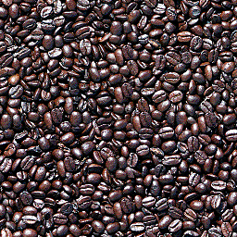

Terminology - Sample
The original representative material to be analyzed or separated by the column.
  Also called Sample Matrix
  Contains analyte(s) and other compounds
Example: Coffee

Slide 9
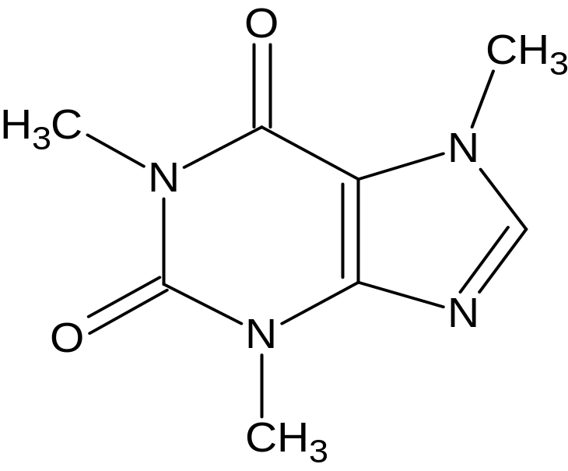
Terminology – Compound, Analyte, Standard
Compound is a pure chemical component (molecule) in a sample.
  Solute = Compound
Analyte specific compound in the sample which is to be separated and analyzed.
Standard is an pure compound whose identity and amount is known.
Example: Caffeine

Slide 10
Terminology – Stationary Phase or Packing Material
Stationary Phase is held in a fixed position
  It is a solid material
  If it is placed in a tube, a column, it is referred to as Packing material
Performs the chemical separation along with the mobile phase
The stationary phase and the mobile phase should have OPPOSITE chemical properties to set up a competition for sample analytes. The compounds which bind more tightly to the stationary phase elute later than ones which do not bind well.

Slide 11
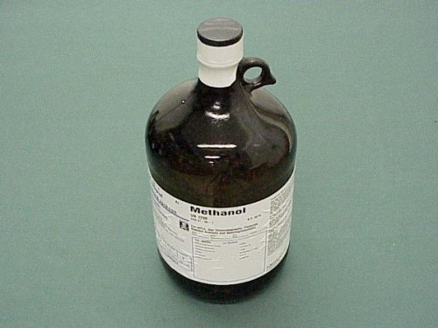
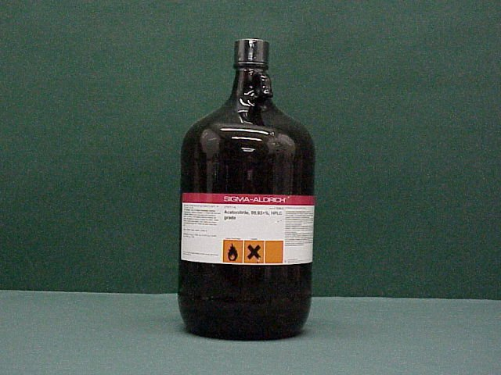
Terminology – Mobile Phase & Solvent
The liquid flowing through the chromatographic column
Carries the sample, moving it through the stationary packing material.
  Sample must be completely soluble in the liquid.
Solvent is a liquid (e.g. water, acetonitrile) which dissolve compounds.
Mobile phase may be
  Pure solvent
  Solvent with the additions of other additives to enhance chromatography
    Acids or bases
    Buffers
    Salts
For more about solvents: Waters eLearning Course: Part number 750000657

Slide 12
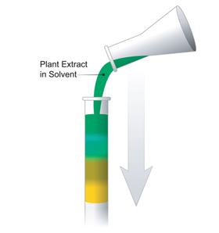
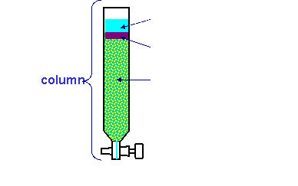
Tswett’s Experiment
The first chromatography
Stationary phase is contained in a column: Tall glass open column filled with sand-like particles
Mobile phase: Liquid for separation
Sample: Ground-up plant extract
Separation:
  Sample is poured into column
  Colored bands developed as the extract percolated down the column
  Each band contains different compounds
Mobile phase
Sample
Stationary phase

Slide 13
Major Types of Chromatography
Paper Chromatography
TLC – Thin Layer Chromatography
GC – Gas Chromatography
SFC – Supercritical Fluid Chromatography
LC – Liquid Chromatography
  HPLC – High Performance Liquid Chromatography
  UPLC – Ultra Performance Liquid Chromatography
More information HPLC Primer: Part number 715001531

Slide 14
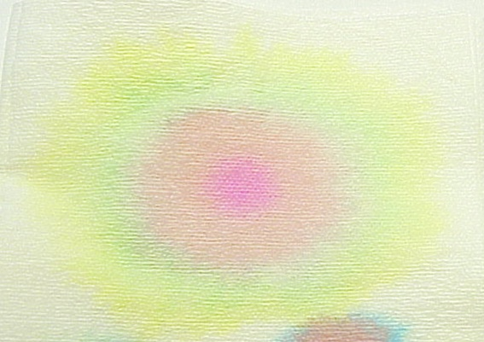
Paper Chromatography
Solid phase: Paper
Liquid: Solvent or mobile phase is added to the center of the spot (e.g. alcohol-water mixture)
Sample: Dyes
  Yellow 5
  Blue 1 & Yellow 5 mixture = green
  Red 40
  Red 3
Separation into colored bands
Origin
Direction of separation (radially)

Slide 15
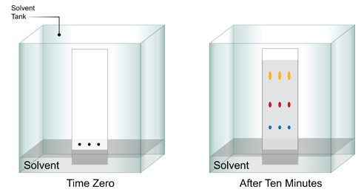
Thin Layer Chromatography - TLC
Solid phase: Plate coated with an adsorbent material
Liquid: Solvent or mobile phase (e.g. alcohol-water mixture)
Sample: Dyes
Separation into colored spots
Sample
Direction of separation

Slide 16
Gas Chromatography
Solid phase
Mobile phase is a gas
Samples must be volatile
GC Column
Injector
Data
GC Oven
GC Gas Cylinder
Exhaust Gas
Detector

Slide 17
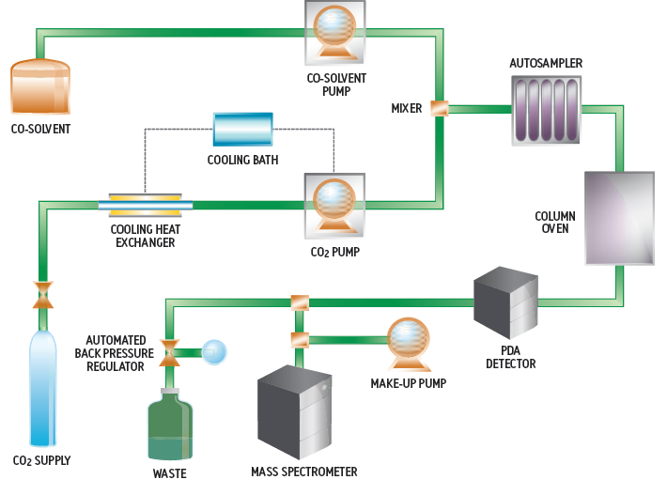
Supercritical Fluid Chromatography
Solid phase: Column contains a charged surface (e.g. silica) or other specialty materials
Liquid phase: Supercritical fluid, liquid carbon dioxide (CO₂) combined with organic solvent(s)
Samples: Soluble in liquid CO₂

Slide 18
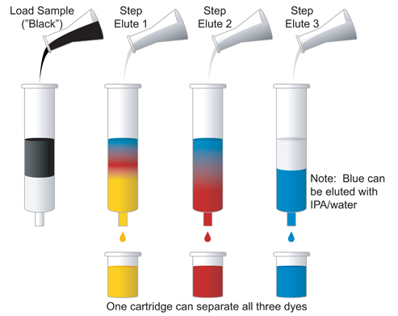
Liquid Chromatography - Column Chromatography
Solid phase is packed in a tube to make a column
Mobile phase is a liquid (e.g. IPA/water)
Sample: 3 Dyes
Separation of dyes into bands which are collected.
For more information: HPLC Primer: Part number 715001531

Slide 19
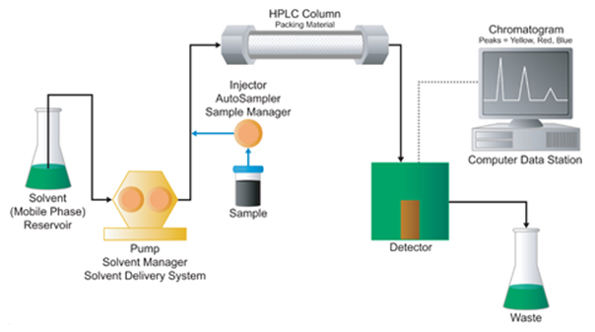
HPLC - High Performance Liquid Chromatography
HPLC:
  Term coined by Professor Csaba Horváth in 1970.
  Originally High Pressure Liquid Chromatography (500 psi) using a pump.
High Performance Liquid Chromatography in 1972: 6000 psi
Automation
  Solvent delivery
  Injector, Autosampler
  Column
  Detector
  Data System

Slide 20
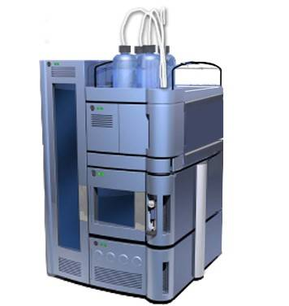
Ultra Performance Liquid Chromatography
UPLC: Ultra Performance Liquid Chromatography (2004)
  Performance improvements due to advances in
    Columns
    Instrumentation
Improvements in chromatography
  Increased peak resolution
  Increased sensitivity
  Increased speed of analysis and sample throughput

Slide 21
Liquid Chromatography (LC)
Separations Modes
There are a number of different modes of liquid chromatography. The chemistry of the column and the mobile phase will be different.
Some different LC separation modes
  Normal phase chromatography
  Reversed phase chromatography (RP)
  Hydrophilic interaction chromatography (HILIC)
  Size exclusion (SEC) & gel permeation chromatography (GPC)
  Ion exchange chromatography (IEC or IC)
  Affinity chromatography
  Chiral chromatography

Slide 22
Terminology – Chemical Properties
Selectivity
  The ability of a packing material to separate one compound from another and create the elution order of the peaks.
Resolution of peaks
  Amount of separation between peaks
Hydrophobic
  Phobia for water: dislikes water
  Non-polar
  Examples: Oil, fatty acids, steroids
Hydrophilic
  Friend of water: likes water
  Polar
  Examples:
    Low molecular weight acids, DNA, ionic compounds
    Compounds which have + or – charge(s)

Slide 23

Normal Phase & Reversed Phase Chromatography
Analytes are polar or non-polar depending on their molecular structure.
Separation mechanism:
  Analytes bind to the stationary phase and are removed in the order of their solubility in the solvent of the mobile phase
  Analytes that are more like the mobile phase elute more quickly.
For more information: HPLC Primer: Part number 715001531

Slide 24
Normal Phase Chromatography
The original mode of liquid chromatography.
Samples:
  Dissolve in primarily organic solvents
    Non-polar compounds, e.g. Petroleum products
Stationary phase: Polar, hydrophilic material, e.g. silica
Mobile phases: Solvents + additives
  Organic solvents (e.g. hexane, heptane, methylene chloride)
    Organic solvent is the “weak” solvent
  Polar solvent (e.g. methanol, isopropanol)
    Polar solvent is the “strong” solvent

Slide 25
Reversed Phase Chromatography
Most commonly used mode of liquid chromatography (~90%) and will be discussed in detail later
  Call Reversed Phase because it is the opposite of Normal Phase
Samples:
  Dissolve in primarily aqueous (water) solutions
  Bind to hydrophobic stationary phase
  Analytes
    Low molecular weight compounds: e.g. drugs, pesticides, additives, pollutants
    Macromolecules: e.g. proteins, peptides, DNA

Slide 26
Reversed Phase Chromatography
Stationary phase: Non-polar, hydrophobic material, e.g. C18
Mobile phases: Solvents + additives
  Water
    Water is the “weak” solvent
  Organic solvents: methanol, acetonitrile
    Organic solvent is the “strong” solvent

Slide 27
Hydrophilic Interaction Chromatography (HILIC)
HILIC is complementary to reversed phase chromatography. It is good for polar compounds which do not retain in reversed phase chromatography.
Samples
  Polar compounds and metabolites
    Food industry: Melamine, acrylamide, wheat glutens
    Biopharma: N-glycosylated proteins, polar peptides, oligonucleotides
Stationary Phase
  Polar material: silica, cyano, amino, diol materials
Mobile Phase
  Weak mobile phase is an organic solvent
  Strong mobile phase is an aqueous solvent
Reference: HILIC Primer: Part Number 715002531

Slide 28
Size Exclusion (SEC), Gel Filtration, &
Gel Permeation (GPC) Chromatography
GPC and SEC are size separations for large molecular weight polymers that give
  Molecular weight distributions (MWD)
  Estimates of average molecular weight
For plastic polymer there is a correlation between molecular weight distribution (MWD) and physical properties:
  Softness or hardness
  Flexibility
  Melting point
  Fatigue
  Moldability
Separation mechanism
  Stationary phase has pores which separate analytes by size

Slide 29
Size Exclusion (SEC), Gel Filtration, &
Gel Permeation (GPC) Chromatography
Samples: Large molecular weight polymers
  Plastic polymers, e.g. polyethylene, polystyrene
  Water soluble polymers, e.g. proteins, starch
Stationary phase: Columns are packed with rigid polymeric particles with specially controlled pore sizes.
Mobile phases:
  Plastic polymers separated with specialty columns with organic solvents (i.e. toluene) at high temperatures order to keep these polymers soluble.
  Aqueous solvents are used with specialty columns for water soluble polymers.

Slide 30

Size Exclusion – GPC
Mobile Phase
Analytes Molecules
Big Ones Come Out First
BOCOF
Porous Particle
  Depending on particle pore size, some analytes will partially enter the pores. Smaller molecules will diffuse a greater distance into the pore
As the sample passes through the column:
  Smaller molecules get slowed down as they go in and out of the pores in which they can fit.
  Larger molecules move along with the mobile phase, around the particles since they cannot fit into the pores, and come out first.

Slide 31
GPC or SEC – Calibration Curve
Calibration Curve
Molecular Weight Distribution or”Finger Print”
Big Ones
Mol. Wt.
Retention Time

Slide 32
Ion Exchange Chromatography
Ion exchange chromatography separates compounds based on charge. The stationary phase has the opposite charge to the analytes
Samples:
  Anionic molecules with negative charge (-)
    Acids: e.g. acetic acid
    Inorganic anions: e.g. chloride, sulfate, nitrate
  Cationic molecules with positive charge (+)
    Bases: e.g. amines, proteins
    Inorganic cations: e.g. sodium, calcium

Slide 33
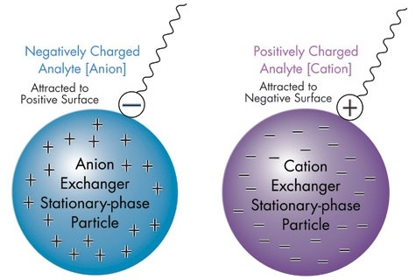
Ion Exchange Chromatography
Stationary phase:
  “Anion Exchanger” has a positive charge (+) to separate anions
  “Cation Exchanger” has negative charge (-) to separate cations
Mobile phases:
  Increasing salt concentration to displace the analytes from the stationary phase
  Changes in pH to reduce the stationary phase’s or analytes’ charge and decrease the binding of the analytes
For more information: HPLC Primer: Part number 715001531

Slide 34
Affinity Chromatography
Proteins separated by their biospecific interaction with immobilized ligand
Sample: e.g. antibody mixture
Stationary phase: e.g. bound antigen
Mobile phase: Water with an additive that will break the antibody-antigen complex

Slide 35
Affinity Chromatography
Advantages
  High selectivity
  High resolution
  High capacity
  Good recovery of activity
  Significant purification in one step
Limitations
  Stationary phases can be expensive or require custom synthesis
  Column cannot be cleaned using aggressive chemicals
  Ligand leakage

Slide 36
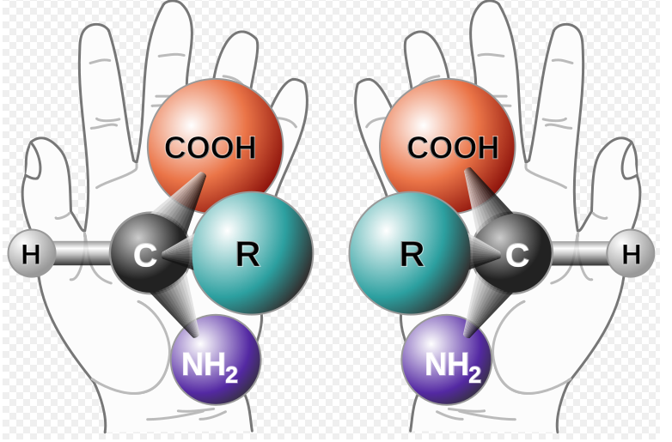
Chiral Chromatography
Chiral compounds
  Made of the same elements
  (C, H, N, etc.)
  Have the same molecular weight
  They have two configurations like a pair of hands - mirror images, enantiomers.
Special chiral columns are usually required to separate them.
Separation of chiral compound into its enantiomers is important because only one form may be biologically active, e.g. L-amino acids are incorporated into proteins, not R-amino acids.
Generic Amino Acid
From Wikipedia

Slide 37
Column Technology
Column hardware
Column construction
Packing materials = stationary phase

Slide 38
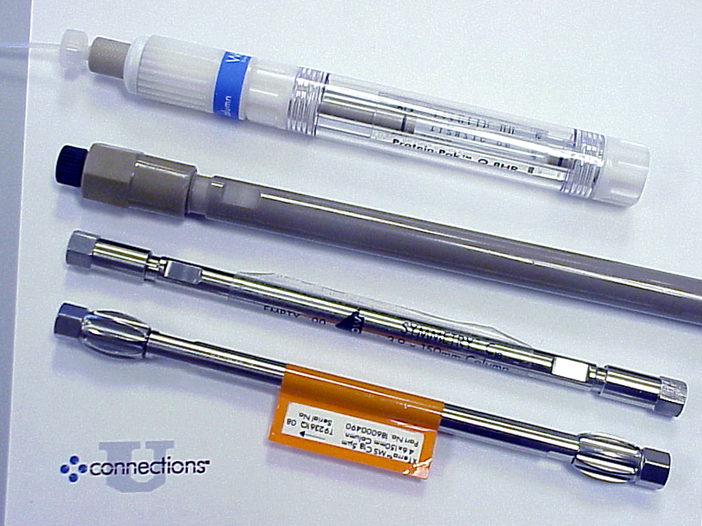
Column Hardware – Materials of the tube
Stainless Steel
Glass
Plastic (PEEK)
Fused Silica

Slide 39

Column Construction
HPLC Column Tube
Space for Packing Material
End-Fitting
Steel Filters / Frits
Internal Diameter, ID
Inlet
Outlet
LENGTH
Direction of Flow

Slide 40
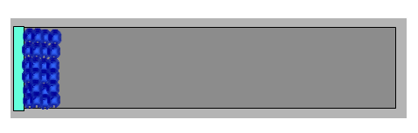
Column Packing
Direction of flow
to pack column
Packed Bed of Particles (Stationary Phase)
Frit
Direction of Flow
Columns are packed under high pressure.
The inlet of the column is indicated on the column or the column label has the direction of mobile phase flow.

Slide 41
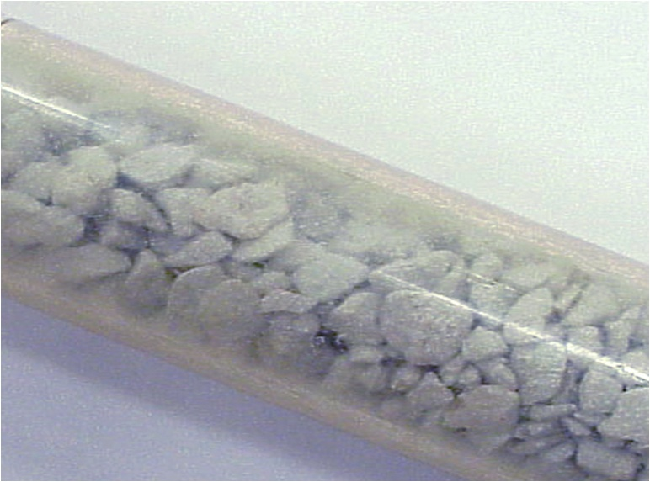
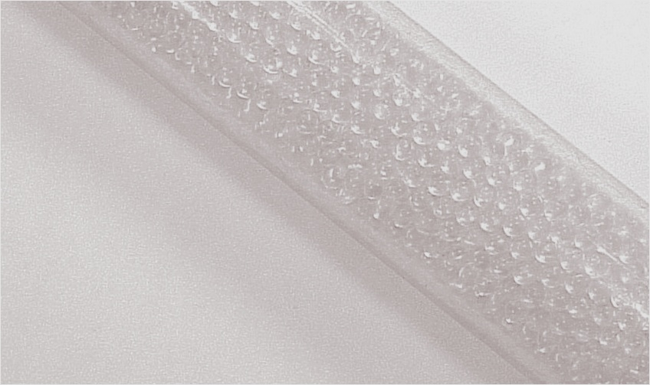
Irregular & Regular Particles
Regular spherical particles pack more evenly.
Regular particles results in more reproducible chromatography.
Today’s packing materials use spherical particles.
Irregular
Regular Spherical

Slide 42

Packing Material
Particle
Pores
Bonded phase
Packing material forms the stationary phase for chromatography.
Packing material particles may consist of one or more of the following:
  Particle
  Pores in the particle
  Ligand attached to the particle (more later)

Slide 43
Packing Materials – Particles Materials
Silica
  Silicone Dioxide
  pH 2 – 8
Alumina
  Aluminum Oxide
  pH 1 – 14
Zirconia
  Zirconia Oxide
  pH 1 – 13
Polymeric
  Polystyrene divinyl benzene
  pH 1 – 14
Monolithic
  Silica
  pH 2 – 7.5
Hybrid: Silica and Polymer
  pH 2 – 12
    Waters ACQUITY BEH
    XBridge
Non–porous resins
  Bonded phase on silica
    Eichrom Technologies
  Bonded phase on polymer
    Sepax Technologies
    pH 2 – 12
Others
  Graphitic Carbon
  Hydroxyapatite

Slide 44
Silica Packing Material
Chromatographic silica is the most widely used packing material for HPLC.
Advantages
  Strong
  Rigid
Disadvantages
  Dissolves at basic pH (stable from pH 2-8)
  Silanol activity results in peak tailing in many basic analytes.
Silica is used for many of these types of columns.
  Normal phase
  Reversed phase

Slide 45
Polymeric Packing Material
Advantages
  pH stable in acids and bases
  Synthesized with controlled pore size
Disadvantages
  Not very rigid
  Collapses under excessive pressure
Polymeric packing material is used for
  Gel permeation and size exclusion columns

Slide 46
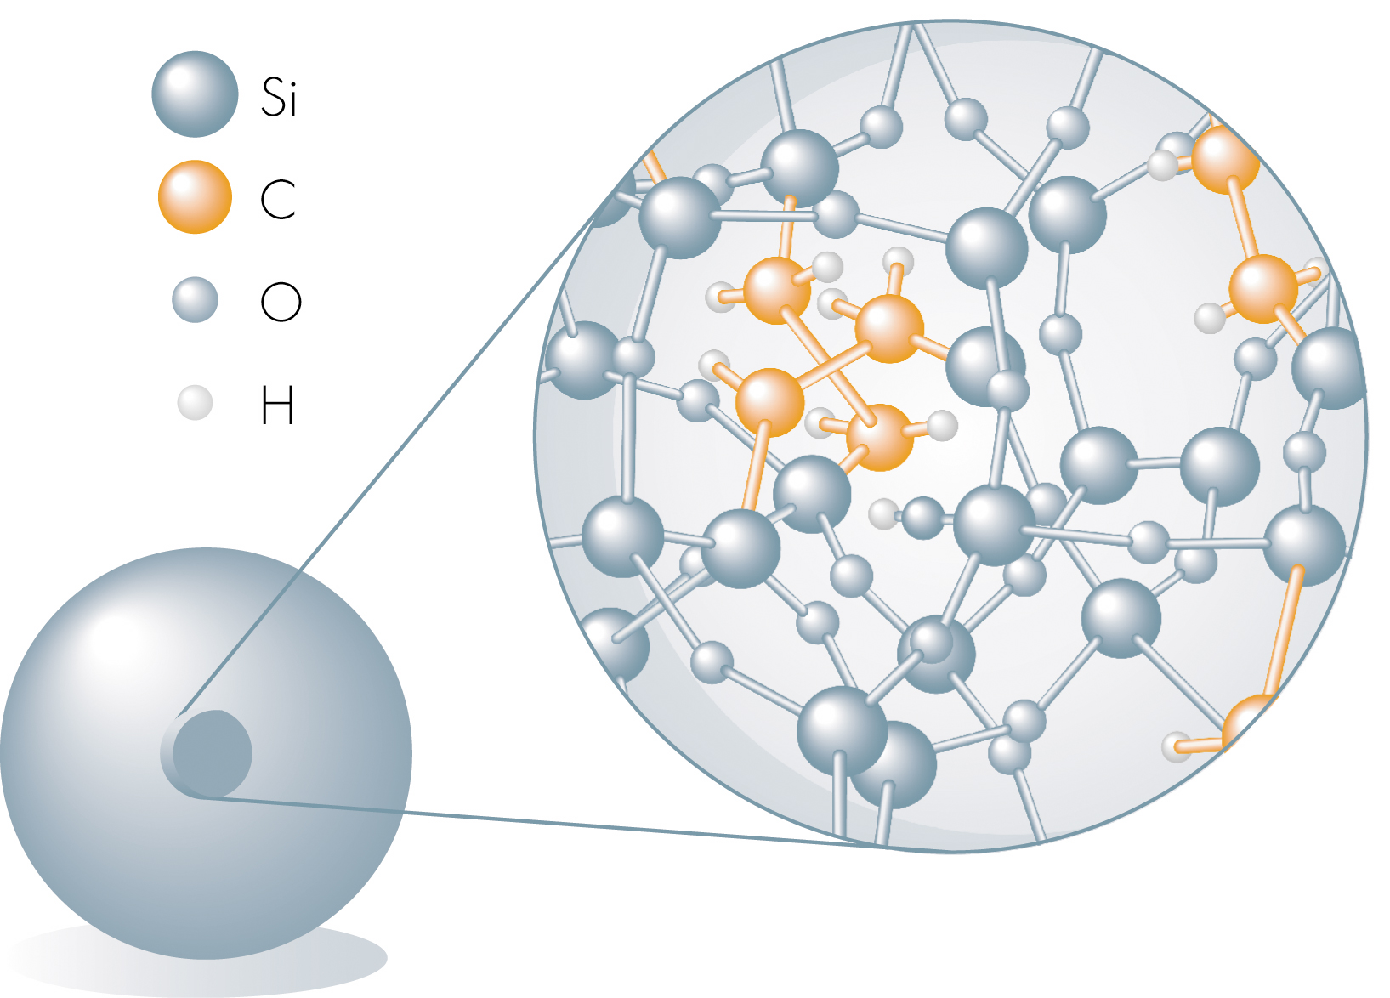
Bridged Ethane-Silicon Hybrid Particles
Si
C
Si
O
Si
C
C
C
Si
O
C
O
C
Si
O
Si
Si
O
This particle is used in the Waters ACQUITY BEH columns.
Patented Technology
Anal. Chem. 2003, 75, 6781-6788

Slide 47
Hybrid Packing Material
Advantages
  Strong and rigid
  pH stable in acids and bases (BEH stable pH 1-12)
  Synthesized with controlled pore size
  Symmetrical peak shape
  None of the silica or polymeric packing materials disadvantages
Used primarily for reversed phase and HILIC chromatography.

Slide 48
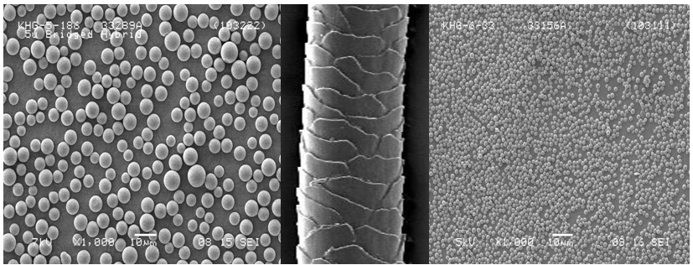
Particle Sizes
5 μm
Analytical Particles
60 μm Human Hair
1.7 μm
ACQUITY UPLC™ Particles
Particle size is measured in microns (μm) where 1 micron is 10^{–6} meter.
Today, the smallest particles used in columns are 1.7 μm.
Particle size is an average size of a narrow distribution of particle sizes.

Slide 49
Particle Size Effects on Chromatography
Smaller particles pack into a column tube more tightly producing very reproducible chromatography.
Smaller particles have more surface area for analyte binding.
The smallest particles produce the highest efficiency columns which have the highest peak separation (resolution).

Slide 50
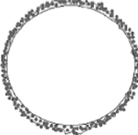
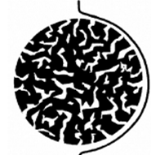
Particle Pores
Analytes can not penetrate a non-porous particle.
  Analysis time will be shorter
Porous particles have more surface area than non-porous ones (e.g. 185 m²/g)
  Separation efficiency increases with surface area
Typical analytical packing material particles have pores ranging from 80 – 125 Å (10⁻⁸ meters).
  Large molecules, e.g. proteins, require pore sizes of 300 Å or larger
  For GPC and SEC columns the pore sizes determines the molecular weight range of the separation.
Non-porous Particle
Porous Particle

Slide 51
Bonded Phases - Ligands
Bonded phases are modifications to the particles.
Bonded phases also referred to as ligands.
The chemical characteristics of the bonded phases give the packing material (stationary phase) the selectivity to separate different compounds.
Topics
  Bonding of chromatographic material
  Different bonded phase ligands
  Behavior of different brands of packing materials

Slide 52
List of Some Ligands
REVERSED PHASE
C18
C8
C4
Phenyl
Cyano, -CN
HILIC
Amide, -NH2
Fluorophenyl
Some of the differences will be discussed later.
ION EXCHANGE
SAX (Strong Anion Exchange)
WAX (Weak Anion Exchange)
SCX (Strong Cation Exchange)
WCX (Weak Cation Exchange)

Slide 53
C18 Bonded Phase
C18 bonded phase is the most widely used bonded phase for reversed phase chromatography.
  About 80% of the applications use C18.
C18 refers to a carbon-hydrogen chain that is 18 carbons long.
  C18 is also called ODS, octadecyl silane (octadecyl = 18) or RP18
  In the pharmaceutical industry, the US Pharmacopeia calls this an L1 column.
C18 chemical characteristics
  Non-polar, hydrophobic
  Oily and non-polar compounds will be retained longer
  Ionic compounds will elute earlier

Slide 54
Terminology - Carbon Loading
Carbon loading is the amount of bonded phase attached to the particles.
Increased carbon loading may affect the amount of analyte that can be bound or how tightly a compound is bound.
Example: C18 bound to a silica particle
Si
Si
C18
C18
19%
7%

Slide 55
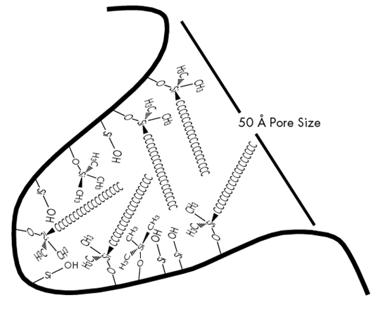
Terminology – End Capping
End capping is a chemical process further modifies a silica packing material.
Silica has an active surface The silanol groups can bind compounds, as well as the ligand, e.g. C18. This can cause poor peak shape for basic compounds.
End capping cover some
of the silanol sites improving
peak shape.
Ligand
-S-OH
Silanol
C1
Endcap

Slide 56
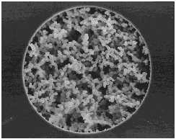
Monolithic HPLC Packing Material
Silica-based monolithic HPLC columns contain a novel chromatographic support in which the traditional particulate packing has been replaced with a single, continuous network (monolith) of porous silica. The main advantage of such a network is decreased backpressure due to macropores (2 µm) throughout the network. This allows high flow rates, and fast analyses that are unattainable with traditional particulate columns.
Product of Merck: http://www.xirallic.com/servlet/PB/menu/1209750/index.html

Slide 57
Packing Materials are Different
Chromatographic performance is very dependent on how the column is manufactured.
  There are many column manufacturers
Not all columns are the same even if the labels are similar because of many factors:
  Column dimensions
  Particle type, size
  Carbon loading
  Endcapping
  Type of packing: silica, polymeric or hybrid particle material
More about the differences in packing materials in the next section.

Slide 58
Separation Mechanism
Some theory about how columns work
What affects peak shape?
What determines the separation of compounds?

Slide 59
Terms & Symbols Used in Chromatography
Name | Symbol
Void Volume | t₀ or V₀
Retention Time | t_{r} or V_{t}
Retention Factor (capacity) | k
Selectivity (separation factor) | α
Resolution | R_{s}
Plate Count | N

Slide 60

Mechanism of Separation
Sample mixture
Separate analytes
Blue Red Yellow
Mobile phase flow
Mobile phase flow
Why do they separate?
  Yellow “likes” the mobile phase, moves as fast as the mobile phase and comes out first.
  Red “likes” the stationary phase somewhat and slows down.
  Blue “likes” the stationary phase best and slows down the most.
The competition for the compounds is between the mobile phase to dissolve them and the stationary phase binding and retaining them.

Slide 61
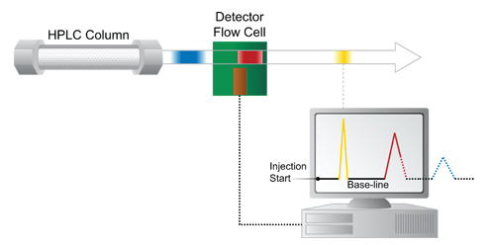
HPLC Chromatographic Separation
Essential components
  Sample
  Mobile phase
  Column – stationary phase
Hardware to aid in the separation
  Solvent delivery system for mobile phase
  Detector for “seeing” the peaks
  Computer for collecting data and processing it
The most important part is the column

Slide 62
What makes a good column?
The most efficient columns produce the sharpest peaks, which gives better separation by minimizing bandspreading.
  A tight narrow sample “band” is produced when a columns’ stationary phase is uniformly packed.
  The packing material may cause “chemical” bandspreading (tailing, pore depth etc.) which broadens the sample band.
BENEFITS: A narrow band of sample produces narrow peaks to give:
  Better separation, more peak resolution
  Better resolution leads to better quantitation
  Better sensitivity for lower levels of detection

Slide 63
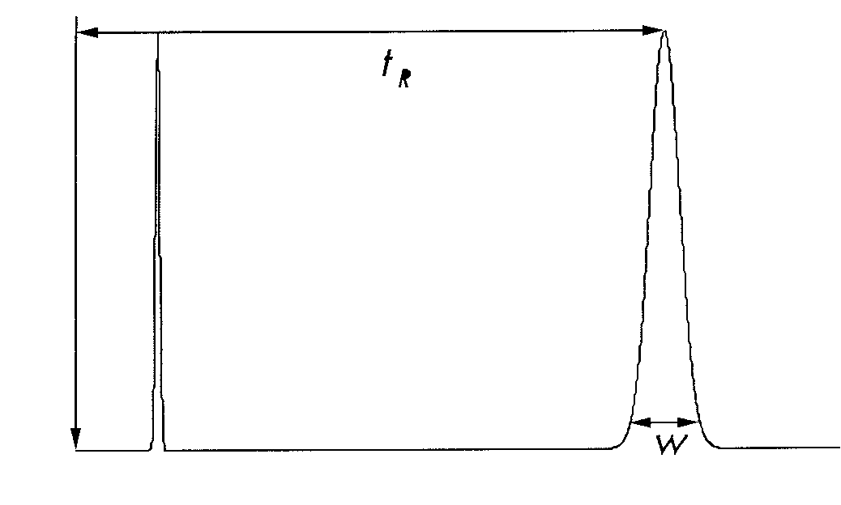
Column Efficiency – Plate Count
Column efficiency is measured as plate count (N)
The higher the number of plates, the more efficient the column.
  Narrower the peak → more plates
  More symmetrical the peak → more plates
Typical Plate Count Values
  12,000 – 15,000 plates for HPLC columns
  >35,000 for UPLC columns
The number of plates are measured under specific conditions.
  A sample is injected on to a column and the retention time and peak shape are measured.
  Factors like flow rate of the mobile
  phase effects the plate count value.

Slide 64
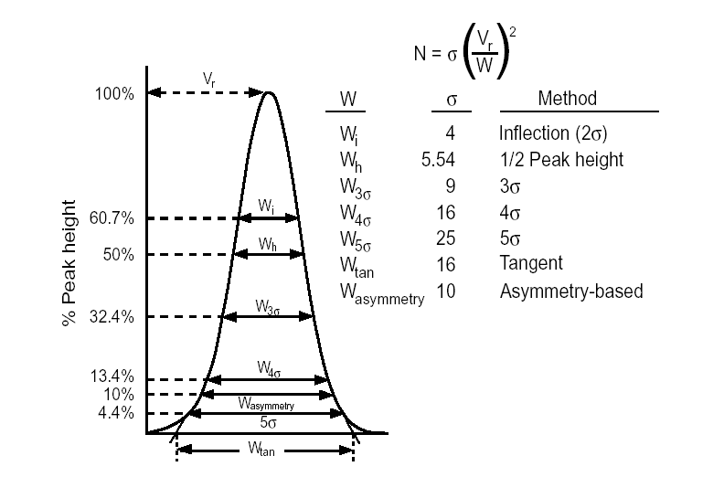
Theoretical Plates (N)
For more information: Neue, U.D., “HPLC Columns”, Wiley-VCH, 1997

Slide 65
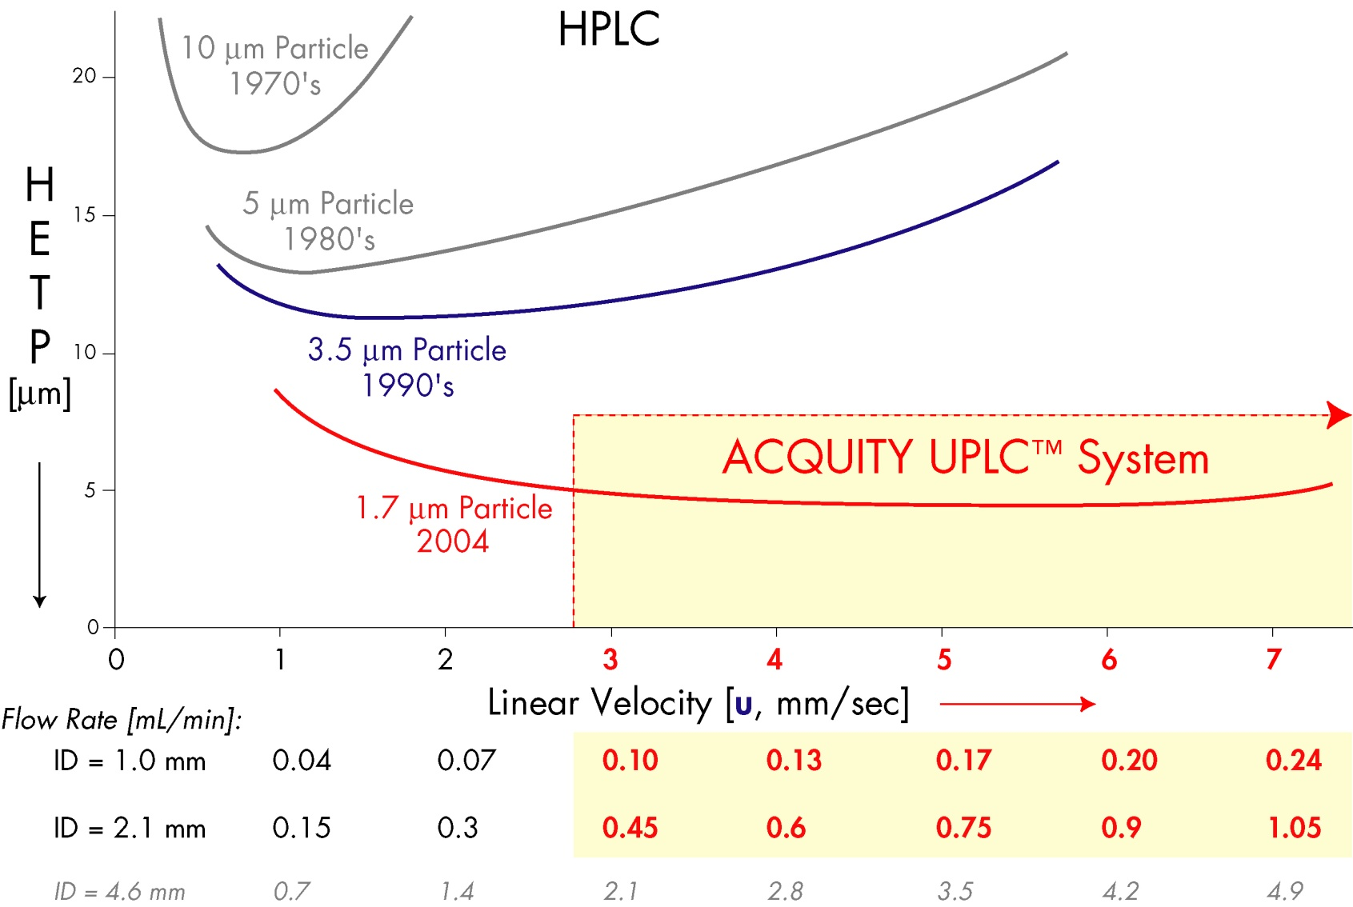
Plate Count – Effect of Particle Size and Flow Rate
Plate Count
Increasing
Particle size decreased over the years from 10 µm to 1.7 µm, increasing plate count.
The best columns have low HETP and high plate count.
The column efficiency has improved over the years.

Slide 66
Plate Count – Effect of Particle Size and Flow Rate
Plate Count
Optimal flow rate range
Increasing
HETP (height equivalent theoretical plates) is inversely related to plate count.
The best columns have low HETP, high plate counts and work optimally over a large flow range.

Slide 67
Effect of Particle Size on Chromatography
0.08
Particle size = 4.8 µm
Peaks = 70
0.06
AU
0.04
0.02
0.00
0.08
Particle Size 1.7 µm
Peaks = 168
0.06
AU
0.04
0.02
0.00
0.00
5.00
10.00
15.00
20.00
25.00
30.00
35.00
40.00
45.00
50.00
55.00
60.00
Minutes
Grumbach, Diehl, Mazzeo
Same sample separated on the same material of different particle sizes.
Smaller particle size produced higher, narrower peaks and better peak separation, better peak resolution.
More peaks are separated with the greater column efficiency and plate count.
It is easier to detect low levels of compounds in a mixture.

Slide 68
Factors Affecting Plate Count
Mechanical conditions
  HPLC instrument used
  Tubing and fittings
    More about this later
  How well the column was packed
Chemical conditions
  Chromatographic conditions – solvents
  Packing material manufacturing
Flow rate and test compound used

Slide 69
Why do we need good Resolution?
Resolution is the separation of the peaks in a sample mixture.
Quantitation requires peaks be separate in order to determine the peak area correctly.
  Exception: Mass spectrometers where unique masses are known
Purification requires removal of impurities.
Compound identification is easier if the compounds are well separated.

Slide 70
Resolution
Rs =
2 (t₂ - t₁)
(W₁ + W₂)
T_{x} = retention time
W_{x} = peak width
t₁ = 2
t₂ =7
2 (7-2)
10
= 2
W₁= 2
W₂= 3
W₂
Rs =
=
(2+3)
5
0
0
t₁ = 2
t₂ = 3.1
2(3.1-2)
2.2
Rs =
=
= 2
(0.5 + 0.6)
1.1
Narrow peaks (smaller W) allows you to maintain Resolution and go faster!
W₁= 0.5
W₂= 0.6

Slide 71
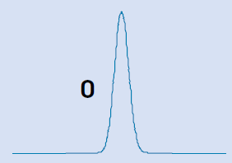
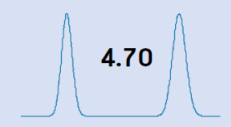
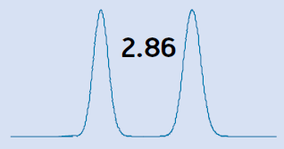
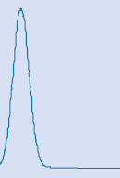

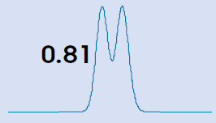
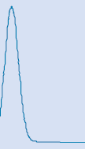
Resolution & Separation
1.5
1.0
Larger resolution value the greater the peak separation.
If Rs =1.5, the peaks are baseline resolved.
If Rs = 0, the peaks are coeluting with no separation.
For quantitation, greater separation is best.
Neue, U.D., “HPLC Columns”, Wiley-VCH, 1997

Slide 72
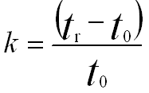
Retention Equation (k)
Peak 2
Solvent
0
PEAK 1
V₀
t₀
V₁
t₁
V₂
t₂
Vo = Void volume where the unretained solvent comes out t₀
V1 = Volume to elute Peak 1 at time t₁
V2 = Volume to elute Peak 2 at time t₂
k = Retention factor
t_{r} = Retention time of a peak

Slide 73
Example of k’ Calculation
Peak 2
t₂ = 1.7
Solvent
t₀ = 0.5
Peak 1
t₁ = 1.0
0 0.5 1.0 1.5 2.0
Time
1.0 – 0.5
0.5
1.7 – 0.5
0.5
k’ =
k’ =
= 1
= 2.4

Slide 74
Why do we need Selectivity?
Selectivity or separation factor, is the ability of the column and mobile phase to separate a pair of analytes.
Different columns have different selectivity because of the bonded phase differences.
Column selection is part of methods development for a chromatographic method.

Slide 75
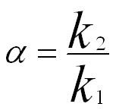
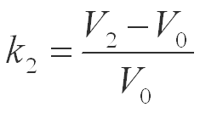
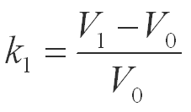
Selectivity Equation
2
1
0
V₀
t₀
V₁
t₁
V₂
t₂
=

Slide 76
Separation of Compounds
Up to now there was a lot of information about columns
This section will explain how compounds are separating on the those columns.

Slide 77
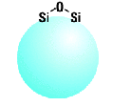
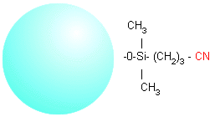
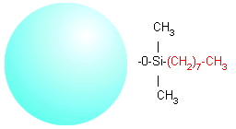
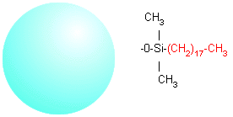
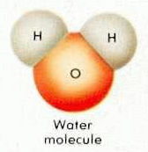
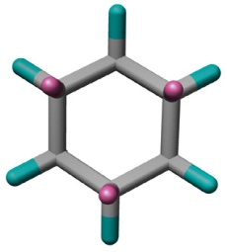
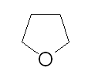
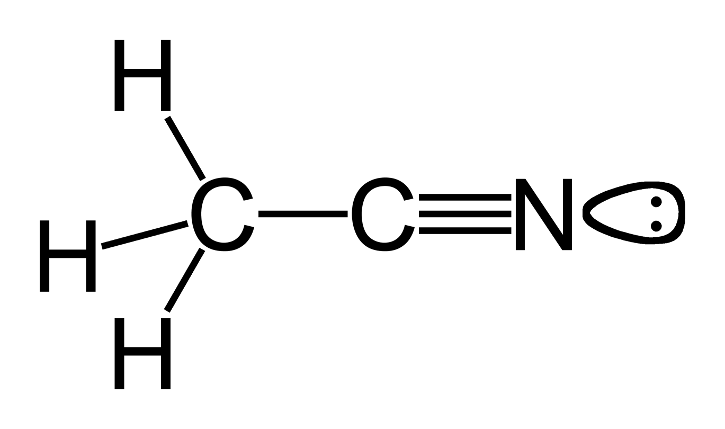
Polarity of Stationary and Mobile Phases
POLAR
NON-POLAR
STATIONARY PHASE
Silica - - - - - -CN - - - - - - - - - - C8 - - - - - - C18 ODS
MOBILE PHASE
Cyclohexane
Water - - - - - -- Acetonitrile - - - - THF - - - - - - - Hexane
10.20 6.2 4.2 0.06

Slide 78
Normal & Reversed-Phase Chromatography
Normal Phase
  Non-Polar Mobile Phase
  Polar Stationary Phase
  The “Original Type” - Used by Tswett
Reversed Phase – Most Commonly used
  Polar Mobile Phase
  Non-Polar Stationary Phase
  The mobile phase and stationary phases are “reversed” from normal phase.

Slide 79
Why do they separate? – Normal Phase
Blue Red Yellow
Mobile Phase: Non-Polar (Hexane)
Flow
Yellow is non-polar: Yellow is the most soluble in the mobile phase. It comes out first.
Red is somewhat polar: Red is less soluble the yellow in the mobile phase and binds somewhat to the stationary phase. It elution from the column is slowed down a little.
Blue is very polar: Blue binds the best to the stationary and is the least soluble in mobile phase. It elutes last.

Slide 80
Why do they separate? – Reversed Phase
Yellow Red Blue
Mobile Phase: Polar (Water)
Flow
Yellow is non-polar: Yellow binds the best to the stationary phase best and comes out LAST.
Red is somewhat polar: Red is somewhat soluble in the mobile phase and binds somewhat to the stationary phase. It’s elution slows down a little.
Blue is very Polar: Blue is the most soluble in the mobile phase best and comes out FIRST.
Reversed phase chromatography is the MOST used separation mode.

Slide 81
Comparison of Normal and Reversed Phase
 | NORMAL PHASE | REVERSED PHASE
Packing Polarity | Polar > Moderate | Non-polar > Moderate
Solvent Polarity | Non-polar > Moderate | Polar > Moderate
Elution Order | Most non-polar elutes first | Most polar elutes first
Effect of Increasing solvent polarity | Reduces retention time | Increases retention time

Slide 82
Why are the so many types of columns?
The many different analytes in many different samples that must be separated.
Column packing material provide the selectivity.
Each functional group, the ligand, is designed to work best in certain situations.
The examples and discussion will be limited to reversed phase columns.

Slide 83
Examples of Reversed Phase Ligands
Ligand
C18 | Octyldecyl or ODS
C8 | Octyl
C6 | Hexyl
C4 | Butyl
Phenyl
Fluorophenyl
Cyano | CN
Amino | NH2
Straight chain ligands, C18-C4, (CH)₂ based ligands:
  Shorter chain length gives less retention with similar selectivity.
  Shorter chain length, less stable at low pH
Phenyl will give selectivity difference relative to C6 because it is a ring structure.
Amino gives greater selectivity difference because it is a polar ligand.

Slide 84
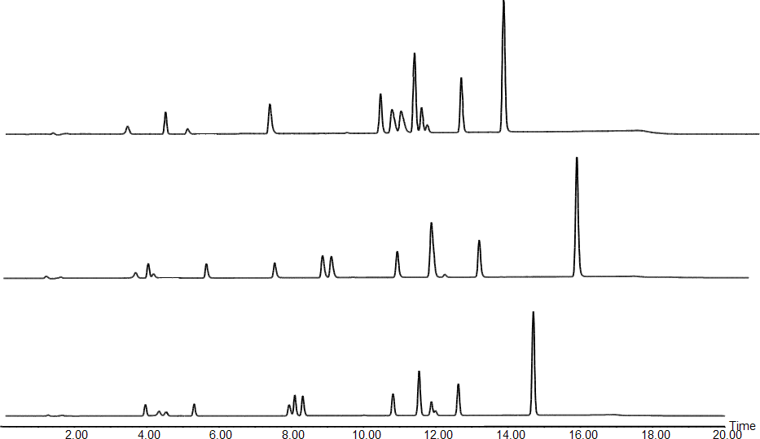
Ligand Selectivity:
XBridge™ Phenyl, C₁₈ & Shield RP₁₈
12
9
XBridge™ Phenyl
Low pH, ACN
11
4,5
8
10
2
67
1
3
12
XBridge™ C₁₈
9,10
8
11
6
2
4
5
7
1
3
12
XBridge™ Shield RP₁₈
9
11
6
8
2
4
5
7
10
1 3
Changes in selectivity can be observed with different ligands on the same particles.
Phenyl ligand has significantly more retention for the tricyclic antidepressants (peaks 6,7).

Slide 85
Ligand Selectivity: ODS vs. Phenyl vs. Cyano
12
Low pH, ACN
YMC-Pack ODS-A
amitriptyline
YMC-Pack Phenyl
YMC-Pack CN
0
10
20
30
40
50
Minutes
Changes in selectivity can be observed with different ligands on the same particles.
Cyano ligand has good peak shape compared to ODS (C18).
Retention times are shorter with the cyano column because it is less hydrophobic.

Slide 86
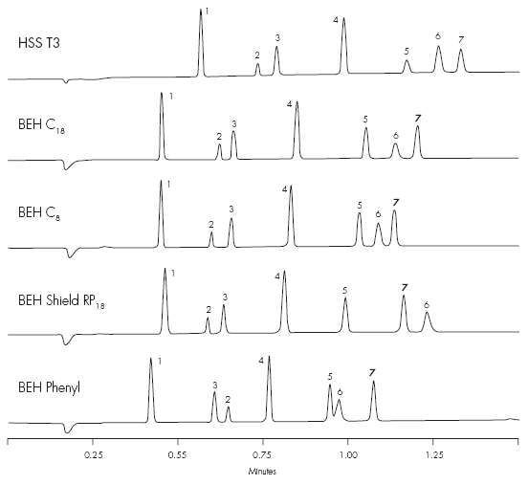
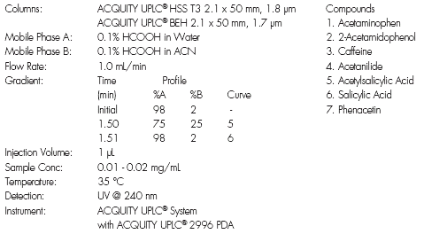
Ligand Selectivity: ACQUITY Columns
Different ACQUITY columns give different separations.
Peaks move and can change elution order (circled peaks).

Slide 87
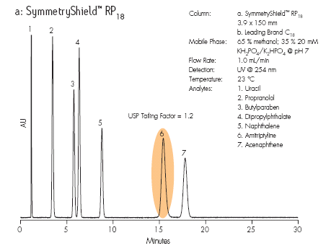

Ligand Selectivity and Peak Shape
Different column ligands give different separations. Peaks move and can change elution order (peak 6).
Different ligands may alter the peak shape. A symmetrical, narrow peak is best for resolution and sensitivity.

Slide 88
Many different brands with the same ligand
A manufacturer may make several different brands of C18. Each was designed to achieve different chromatographic goals:
  High efficiency
  No tailing
  Unique selectivity
  High hydrophobicity
  High silanol activity
Each type of C18 column will have different selectivity because
  They can use different manufacturing methods.
  They can use different raw materials to make a C18 column.
WARNING: All types of C18 columns do not perform the same.

Slide 89

Selectivity Differences: Silica vs. Hybrid Particle
Low pH, ACN
9,
10
12
11
2,
1
6
7
SunFire™ C₁₈
Silica particle
8
4
5
3
9,
10
11
12
8
XBridge™ C₁₈
Hybrid particle
6
7
2
4
5
1
3
Selectivity differences between Waters silica and hybrid particles
  Coelution of peaks 1 and 2 on SunFire, and peaks 9 and 10 on XBridge
  Change of elution order of peaks 3 and 5

Slide 90



Selectivity Differences: Silica vs. Hybrid Particle
Hybrid
High strength silica
Different ACQUITY columns give different separations.
HSS T3 C18 column retains all compounds longer. It makes separation of some hydrophilic, early eluting, compounds possible.

Slide 91
Selectivity Chart
µBondapak™ C18
Waters Spherisorb® ODS2
Decreasing Silanol Activity
YMC J’Sphere™ ODS-L80
(ln [α] amitriptyline/acenaphthene)
YMC J’Sphere™ ODS-M80
YMC J’Sphere™ ODS-H80
Nova-Pak® C18
YMC-Pak™ Pro C18™
Sunfire™ C18
Increasing Hydrophobicity
Symmetry® C18
(ln [k] acenaphthene)
This is a way to compare and find similar reversed phase columns.
Test compounds are used for the comparison, acenaphthene and amitriptyline.
Reference: For an interactive Chart go to www.Waters.com and search “Selectivity Chart”

Slide 92
Reversed Phase Column Selectivity Chart
3.6
Waters Spherisorb® S5 P
3.3
3
ACQUITY UPLC™ BEH
XBridge™
C18
ACQUITY UPLC™ BEH
XBridge™
Phenyl
2.7
Waters Spherisorb® S5CN
2.4
Nova-Pak® CN HP
Inertsil® Ph-3
Waters Spherisorb® ODS1
Hypersil® Phenyl
Resolve® C18
2.1
(ln [α] amitriptyline/acenaphthene)
Waters Spherisorb® ODS2
1.8
µBondapak™ C18
Hypersil® CPS Cyano
Inertsil® CN-3
YMC-Pack™
YMC J'sphere™
1.5
Phenyl
ODS–L80
Nucleosil® C18
1.2
Nova-Pak® Phenyl
YMC J'sphere™ ODS–M80
Hypersil® BDS Phenyl
YMCbasic™
XTerra ®
Phenyl
Chromolith™ RP-18
Nova-Pak®
C18
YMC J'sphere™ ODS–H80
0.9
Luna™
Phenyl Hexyl
YMC-Pack™ CN
YMC-Pack™ Pro C4™
Nova-Pak®
C8
YMC-Pack™ ODS–AQ™
ACQUITY UPLC™ BEH
XBridge™ C8
YMC-Pack™ Pro C8™
Atlantis® dC18
0.6
ACT Ace® C18
YMC-Pack™ ODS-A™
Luna®
C8 (2)
Symmetry® C8
Zorbax® XDB C18
XTerra® MS C8
YMC-Pack™ Pro C18™
Inertsil® ODS-3
0.3
SunFire™ C8
Luna®
C18 (2)
SunFire™ C18
XTerra® MS C18
Symmetry® C18
0
SymmetryShield™ RP8
Zorbax® SB C18
XTerra® RP18
SymmetryShield™ RP18
-0.3
XTerra® RP8
YMC-Pack™ PolymerC18™
ACQUITY UPLC™ BEH
XBridge™
Shield RP18
-0.6
-1.5
-0.5
0.5
1.5
2.5
3.5
(ln [k] acenaphthene)
Columns that are the most similar are near each other on this map.

Slide 93
Selectivity: Other Factors
The column is a major determinant of selectivity.
Other chemical factors can affect the separation.
  Mobile phase solvent
  pH
  Temperature

Slide 94

Selectivity Differences: Mobile Phase
Steroids
A steroid mixture separated under different mobile phase conditions.
The compounds have different solubility in the mobile phase solvents.
Snyder, L.D., Kirkland, J.J., Glajch, J.L., “Practical HPLC Method Development”, 2nd ed., John Wiley & Sons, Inc.,1997

Slide 95
Selectivity Differences: Mobile Phase pH
pH Limit of Silica gel
100
Acid
(Un-Ionized)
Base
(Un-Ionized)
10
log (k')
Neutral
1
Base (Ionized)
Acid (Ionized)
0.1
0
2
4
6
pH
8
10
12
14
Compounds retain better on reversed phase columns when they are not ionized.
An acid is less ionized in an acid mobile phase.
A rugged method allows the pH to vary a little without affecting the retention time (k’). This is where the curves are flat.
Silica dissolves above pH 8. Hybrid particles are best stable pH 1-12.

Slide 96
Selectivity Differences: Mobile Phase pH
4
pH 2.5
pH 5.0
1 Acetaminophen
2 Lidocaine
3 Doxepin
4 Imipramine (B)
5 Nortriptyline
6 Ibuprofen (A)
3
2
3
1
1
5
2
4
5
AU
AU
6
6
Time (min)
28
12
Time (min)
6
1
pH 8.0
1
pH 10.6
6
AU
2
3
AU
2
5
4
5
3
4
20
50
Time (min)
pH has a dramatic effect on some of the compounds.
Ibuprofen (acidic) and Imipramine (basic) and the most affected by pH.
Time (min)

Slide 97



Selectivity Differences: Mobile Phase pH
Basic compounds are retained more at high pH, Peaks 1 and 4.
Acidic compounds are retained more at acid pH, Peak 3.
Non-ionic compounds do not move with changes in pH, Peak 2.

Slide 98

Selectivity Differences: Column Temperature
30°C
40°C
50°C
60°C
The primary effect of increasing column temperature is to decrease the
retention time.

Slide 99

Selectivity Differences: Column Temperature
Polyaromatic hydrocarbons
Small changes in temperature can alter the selectivity for some
compounds.
Snyder, L.D., Kirkland, J.J., Glajch, J.L., “Practical HPLC Method Development”, 2nd ed., John Wiley & Sons, Inc.,1997

Slide 100
Why do we need different size columns?
Different size columns provide options for the separation.
Column dimensions are:
  Length in cm or mm
  Internal diameter in mm or µm

Slide 101
Different Length Columns
Columns come in different lengths from 1 to 30 cm
ADVANTAGES
Longer column
  Increased peak resolution
  Increased sample loading capacity
Shorter column
  Shorter run times
  Higher sample throughput
  Lower solvent consumption
DISADVANTAGES
Longer column
  Increased peak retention times
  Longer run times
  Increased backpressure
Shorter column
  Decreased peak resolution
  Decreased sample loading capacity

Slide 102

Increased Column Length for Resolution
30mm
50mm
100mm
150mm
The large change in resolution is the result of increasing the column length when the particle size is the same.

Slide 103
Equivalent Resolution
Column Length (L) to Particle Size (dp) Ratio
Separation Time
1970’s ~ 40 min.
1980’s ~15 min.
1990’s ~ 5 min.
2004 ~ 1 min.
300mm
30,000
=
10
μ
m
150mm
=
30,000
L
5
μ
m
=
dp
90mm
=
30,000
3
μ
m
50mm
1.7μm
= 29,500
100mm
1.7μm
= 58,820
For equivalent peak resolution, use the same L/dp ratio.
For more resolution, use a longer column or smaller particle size.
L/dp Separations Guide
Difficult 30,000
Moderate 20,000
Easy 10,000

Slide 104
Equivalent L/dp Ratio
0.15
Run Time
(Min)
35.0
9.5
4.5
1.1
The same L/dp provides the same resolution.
Smaller particles requires a shorter column and a shorter run time.
Smaller particles give narrower, sharper peaks.
  Y-axes are the same.
  X-axis times scales are different.
Smaller particles result in greater sensitivity with greater peak height.
0.10
10 µm – 250 mm
AU
0.05
0.00
0.00
5.00
10.00
15.00
Minutes
20.00
25.00
30.00
0.15
0.10
5 µm – 150 mm
AU
0.05
0.00
0.00
1.00
2.00
3.00
4.00
5.00
6.00
7.00
8.00
Minutes
0.15
3.0 µm – 100 mm
0.10
AU
0.05
0.00
0.00
0.50
1.00
1.50
2.00
Minutes
2.50
3.00
3.50
4.00
0.15
1.7 µm – 50 mm
AU
0.10
0.05
0.00
0.00
0.10
0.20
0.30
0.40
0.50
0.60
0.70
0.80
0.90
1.00
Minutes

Slide 105
Different Internal Diameter Columns
Columns come in many different sizes:
  Analytical: 3.0 to 4.6 mm
  Narrowbore: 2.1 mm
  Microbore: 0.5-1.0 mm
  Capillary: 0.300 mm
  Nanoflow: 0.075 to 0.150 mm
  Preparative: >4.6 mm to meters
Internal diameters permits scaling the size of the separation for:
  Sensitivity (lower limit of detection)
  Size of the sample
    Limited sample volume
    Preparative amounts for purification
  Saving solvents with smaller diameter columns to save money

Slide 106
Column Internal Diameters (ID) - Calculations
Flow rate and sample load are scaled to the column ID to maintain the retention times and the peak heights.
Definitions
  Column 1 diameter = D₁ = 4 mm
  Column 2 diameter = D₂ = 2 mm
  R = radius
Area of the column cross-section is a circle = A
  A = π R² = π (D/2)²
Ratio of the areas of the two columns is the scaling factor
A₁/A₂ = (D₁ / D₂)² = 4
Calculate flow rate change
  Column 1 is 1 mL/min
  Column 2 is 0.25 mL/min
Sample load is scaled the same way.
4 mm
2 mm

Slide 107

Changing Column Diameter
Flow rates scaled to column id.
Sample injection scaled to column id.
Columns are all the same length.
Retention times are the same.
Sensitivity is the same.
mL/min
1.4
1.0
0.6
0.29
Neue, U.D., “HPLC Columns”, Wiley-VCH, 1997

Slide 108

Decreased Column Diameter for Sensitivity
mL/min
1.4
1.0
0.6
0.29
Sample amount is the same.
  Sensitivity increased
  Some loss of resolution on 2.1 mm id column
Retention times are the same because the flow rates are scaled.
Neue, U.D., “HPLC Columns”, Wiley-VCH, 1997

Slide 109

Column Diameter and Particle Size
Analytical chromatography benefits from smaller particle sizes
  Data, quantitation [high sensitivity]
  Increased resolution and sensitivity
Preparative chromatography is purification of an analyte on a large scale.
  Requires larger particle sizes for increased flow rates
  Semipreparative: Data and small quantity, (milligrams to grams, of analyte
  Preparative: Large scale purification (kilograms) [high capacity]

Slide 110
Summary of Column Geometry
Diameter
  Smaller diameter INCREASES sensitivity.
  Larger diameter INCREASES column capacity.
Length
  Longer column has a HIGHER resolving power and capacity.
  Shorter column has FASTER speed of separation and LOWER sample capacity.

Slide 111
Sample Preparation
Why do you need sample preparation?
  Removes other components (matrix) from the sample
  Concentrates the sample for better sensitivity
  Removes particulate material
    Particles clog tubing and filters
    Particles clog columns
Protects the column for longer column life from these things:
  Contamination from adsorbed materials
  Debris from instrument seals
  Particulate contamination (precipitation of sample)
  Chemical degradation
    Dissolution of stationary support (silica, etc.)
    Hydrolysis (cleavage) of bonded ligand (ODS, etc.)

Slide 112
Techniques to Protect the Column
On-Line Technique
In-line Filter between the injector and column
Guard Column between injector and column
Off-line Technique
Sample filtration
Sample Cleanup
  Solid Phase Extraction (SPE)
  Liquid-Liquid extraction
  Centrifugation
  Precipitation
Protection or Effect
Removes particulate debris from sample, solvents, pumps, etc.
  Protects against particulate debris and chemical interferences
Protection or Effect
Removes particulate debris from sample and diluent, not from solvents or pumps.
  Protects against chemical interferences
  Selective removal of interferences
  Extraction of analyte into a liquid
  Removes of particles
  Removes insoluble material

Slide 113





Filters and Guard Column
Off-line Filter
On-line Filter
On-line Guard Column
Off-line Sample Preparation

Slide 114


Other Sample Cleanup Techniques
Precipitation adds a solvent to the sample which causes some of the compounds to fall out of solution as particulates. The analyte stays in solution. Filtration or centrifugation is then required to separate the liquid with analyte from the precipitated material.
Liquid-Liquid Extraction: An immiscible solvent is added to the sample which then separates into 2 liquid phases. Some compounds will go in one phase, some will separate into the other phase.
Solid Phase Extraction: Column chromatography in a small, single use, disposable cartridge format.
  Can perform chemical separation
  Concentration
  Fractionation

Slide 115
Summary
The column is the smallest component in an HPLC system, but it is the place where the separation occurs.
Methods development starts with the choice of a column.
Things to consider:
  What column has been used previously
  Packing material that will separate the analytes
  Complexity of the sample
  Column diameter and length
  Desired run time
  HPLC or UPLC system available
Methods Development courses: Part numbers WAT099328, WAT091011, 750000164

Slide 116
HPLC & UPLC Systems

Slide 117
HPLC System Components
Each of the hardware components will be discussed
  Solvent delivery
  Injectors, Autosamplers
  Detectors

Slide 118
System Components Topics
This section will discuss the hardware used for HPLC or UPLC systems.
  Solvent delivery
  Sample injection
  Detectors
  Data acquisition
Examples will be Reversed Phase chromatography because it is the most commonly used separation mode.

Slide 119
Solvent Delivery
How we get the mobile phase from the bottles to the column
What is important

Slide 120
Solvent Delivery - Terminology
Solvent: Liquid
Mobile phase: Solvent with or without additives
Pump: Moves the mobile phase to the column
Solvent Management module includes:
  Pump or pumps
  In-line degasser
  Filter/mixer
Types of solvent delivery
  Isocratic: Same mobile phase composition for the separation
  Gradient: Mobile phase composition changes during the separation
Chromatographic terms
  Run time: Separation time + column reequilibration time
  Reequilibration time: Needed to bring the column to initial condition
  Cycle time: Injection to injection time – longer than run time

Slide 121






Isocratic System
HPLC Column
Injector
AutoSampler
Data
Solvent
Pump
Detector
Waste
1 solvent or mobile phase is used for the entire run.
1 pump required if the mobile phase is premixed by the analyst.
Gradient solvent delivery system can be used to mix the mobile phase (e.g. 60% water (A) – 40% methanol (B).

Slide 122
Isocratic Separation - Examples
Response
Time
The later eluting peaks are broader than the early peaks because of diffusion.
Greater sensitivity is achieved with better peak shape.
  Ideal peak shape is tall, narrow and symmetrical.
  A symmetrical peak has less tailing. The shaded peak is a tailing peak.
Different solvent mixtures are required to optimize the separation.

Slide 123
Gradient Chromatography
Gradient chromatography varies the solvent strength throughout the separation.
  Solvents go from “weak” to “strong” to separate the peaks.
  Reversed phase chromatography:
    Weak solvent = water
    Strong solvent = organic solvent, typically acetonitrile or methanol
Gradients are generated be mixing two (typical) or more solvents.
  Gradients provide control of solvent composition at all times
  Peaks elute at specific percentages of organic solvent

Slide 124

Isocratic vs. Gradient Chromatography
Isocratic
  Peaks get broader the later the elution time.
Gradient
  Peaks have about the same peak width.
  Gradients can provide better control of the separation.
  Advantages
    Better separations
    Better peak shape
  Disadvantages
    2 or more mobile phases
    Reequilibration time
Isocratic
%B
60:40 MeOH-H₂O
Response
Gradient
%B
Time

Slide 125
Two Types of Solvent Delivery
Binary Gradient System
  2 pumps
  2 solvents in a method
  Optional solvent select valves
    Choice of A1 or A2 and B1 or B2
High pressure solvent mixing occurs AFTER the pumps
Advantages
  Most precise gradient
  Best for very fast chromatography
  Best for very shallow gradients (e.g. 1%/minute change)
Quaternary Gradient System
  1 pump
  1 to 4 solvents
  Additional solvent selection modules available
Low pressure solvent mixing occurs BEFORE the pump
Advantages
  4 solvents for easier methods development
  Blending more than 2 solvents
  Less pump maintenance

Slide 126
Binary Gradient System
HPLC Column
Solvent
Injector
AutoSampler
Data
B
A
Pump
Detector
Pump
Waste
High pressure mixing of solvents occurs AFTER the pumps at a mixing tee.

Slide 127
Quaternary Gradient System
HPLC Column
GPV
Injector
AutoSampler
Data
A
D
Pump
B
C
Detector
Waste
Solvents
Low pressure solvent mixing occurs BEFORE the pump.
Solvents are blended by the Gradient Proportioning Valve (GPV).
2 or more solvents can be blended.

Slide 128
Mobile Phase Recommendations
Mobile phase is important for best chromatography and lowest baseline noise
Use the highest purity organic solvents, water and additives
  LC/MS-grade is generally better quality than HPLC-grade
  Some of the best solvents have certificates of analysis available
  Some LC/MS-grade solvents are prefiltered to 0.2 micron
    DO NOT filter these solvents. The filters are “dirtier” than the solvents.
Other important things
  ONLY use dedicated bottles and other glassware for HPLC
    NEVER wash HPLC glassware in a dishwasher with detergent.
    ONLY rinse bottles in mobile phase quality water and solvents
  DO NOT top off bottle with more mobile phase.
    Old mobile phase will have changes in concentration (evaporation).
    Empty, clean bottle, refill.
  Cover solvent bottles with proper caps, not tape, Parafilm, etc.

Slide 129
Solvent Degassing
Why do we need solvent degassing?
  Proper degassing is required for optimal system performance.
  Dissolved gas (air) in solvents makes the liquid compressible which leads to:
    Poor retention time reproducibility
    Poor peak area reproducibility
On-line degassers are typically in today’s HPLC systems, between the solvent bottle and the inlet of the pump(s).
  A semi-permeable tube allow gas exit while the liquid remain
  A vacuum pump draw the gas out of the solvent
  Other methods of degassing solvents are less convenient
    Off-line vacuum filtration
    Off-line sonication
    On-line helium sparging

Slide 130
Gradient Profiles – Waters Curves
Step at beginning
Linear (Default)
%B
Step at end
Time
The CURVE is the programmed path the %B changes will occur.
You program the time when the gradient should reach a certain %B and the curve number.
The time the gradient gets to the column will depend on the system volume which will be discussed next.

Slide 131


Gradient Programming Examples
Initial
Run time = 9 minutes
Initial
Run time = 25 minutes

Slide 132
Gradient Separation - Simple
6
%B
5
7
Gradient must separate the critical peak pair, Peaks #4 and #5.
1
Response
9
8
3
2
4
10
11
Time

Slide 133
Gradient Separation – Amino Acid Hydrolysate
Ile
Thr
Val
Leu
Phe
Arg
Met
Ala
Tyr
%B
Response
His
Lys
Glu
Ser
Pro
Asp
Gly
NH3
AMQ
Cys
15
Time
25
This application has a number of critical pairs that need to be separated.
  Arg, Thr (arginine, threonine)
  Ile, Leu (leucine, isoleucine)

Slide 134
Gradient Separation – Complex Peptide Mixture
0.08
0.06
AU
0.04
0.02
0.00
0.00
5.00
10.00
15.00
20.00
25.00
30.00
35.00
40.00
45.00
50.00
55.00
60.00
Minutes
Separation of complex mixtures requires:
  Correct choice of gradient
  Choice of the appropriate column
  Optimized HPLC system

Slide 135

System Volume
System volume is the volume from where the solvents first come together to the inlet of the column. Smaller is better.
  Binary system: Mixing tee
  Quaternary system: Gradient proportioning valve (GPV)
Effects of system volume
  Gradient shape
  Retention times
  Column reequilibration time
System volume of Waters HPLC and UPLC systems

Slide 136
System Volume & Gradient Delay
Programmed Gradient
No column
Larger id column
Smaller id column,
lower flow rate
%B
Re-equilibration Time
Injection
Gradient Delay
Minutes
System Volume
Gradient delay is the time for the gradient to reach the column.
  Other terms: delay volume, system volume, dead volume
Gradient delay is a function of the system volume and the flow rate.

Slide 137

Effect of System Volume on Gradient Delay
Higher vs. Lower Flow Rate
6
AllianceHT 2795
System Volume = 350 µL
5
3
4
3.9 x 150mm
1.0 mL/min
V₀
1
2
7
6
5
Gradient Delay
V₀
3
2.1 x 150mm
0.29 mL/min
2
4
7
1

Slide 138

Effect of System Volume
ACQUITY System Volume = 110 µL
BEH 2.1x50mm, 0.29 mL/min, 1.7µm
The best chromatography at a low flow rate (0.29 mL/min) is obtained with:
  Low system volume
  Binary gradient system
  Column with small particle size (1.7µm)
9
10
2
3
5
6
4
8
7
1
11
AllianceHT 2795 System Volume = 350 µL
XTerra 2.1x50mm, 0.29 mL/min, 3.5µm
9
10
5
7,8
2
3
4
6
11
1

Slide 139
System Volume & Column Reequilibration
Programmed Gradient
No column
Larger id column
Smaller id column,
lower flow
%B
Reequilibration Time
Injection
Gradient Delay
Minutes
System Volume
Reequilibration Time is the time required for a column to reach the initial mobile phase conditions.
Sufficient reequilibration time is required for retention time reproducibility.
Reequilibration is a function of the HPLC system volume and the flow rate.

Slide 140

Column Reequilibration Times - Guidelines
Equilibration Time = [3x system volume + 5x column volume] / flow rate
  Column volume = π (D/2)²L , where D = diameter and L = length
  Note: These are conservative values. To determine if shorter reequilibration times can be used, experiments are required to ensure stable retention times.

Slide 141
Summary of Solvent Delivery
Binary Gradient System
High pressure solvent mixing occurs AFTER the pumps
Advantages
  Lowest system volume
  Most precise gradient
  Better for very fast chromatography
  Better for very shallow gradients (e.g. 1%/minute change)
  Used for low flow rates (0.2 mL/min or lower)
Waters binary systems
  ACQUITY (Classic) & I-Class
  nanoACQUITY
  Breeze
Quaternary Gradient System
Low pressure solvent mixing occurs BEFORE the pump
Advantages
  Methods development – scouting solvents
  Auto-Blend
  Running different methods requiring different solvents
  Best at higher flow rates (greater than 0.2 mL/min)
Waters quaternary systems
  ACQUITY H-Class
  Alliance /2695 & AllianceHT (2795)
  Waters 600

Slide 142
Autosampler / Injector
How the sample is drawn up and delivered to the column
How the different injection modes work
Some recommendations

Slide 143
Autosampler / Injector - Terminology
Sample: Everything in the vial
  Analyte(s): Compounds to be analyzed
  Diluent: Liquid which dissolves the compounds
  Matrix: Everything that is not the an analyte
Injector: Delivers the sample to the column
Autosampler: Allows multiple samples to be run unattended
Sample Manager contains
  Injector
  Autosampler
  Column Heater
  Needle wash

Slide 144
2 Types of Injectors
Fix Loop (FL)
  Sample must be placed within a sample loop before it is injected on to the column
  Several choices of injection modes are available
Flow Through Needle (FTN)
  Sample is drawn into the needle and delivered directly to the column

Slide 145
Fixed Loop Injection Modes
3 Injection modes
  Full Loop
  Partial Loop
  Partial Loop Needle Overfill (PLUNO) for ACQUITY only
Flow diagrams for each mode will be shown followed by advantages and disadvantages of each mode
  Note: These are the diagrams for ACQUITY, but other fixed loop injector work similarly.

Slide 146
Full Loop
Loop is filled with more than 1X sample
Only sample in loop is injected (ports 1 to 4).
Excess sample goes to waste.
Air gap
Sample in Loop
2
1
Sample
Syringe
3
6
Needle
Column
4
5
Injector
valve
Solvent
delivery
Sample
Mobile phase
Needle wash (weak)

Slide 147
Summary - Full Loop Injection
ADVANTAGES
Best peak area reproducibility
DISADVANTAGES
Large amount of sample required for overfills
Smaller loops require more overfills
To change volumes, loop must be changed and recalibrated
Loop volumes are nominal and may vary ± 20%
  Fixed loop are reproducible but not necessarily accurate.
  2 HPLC systems with the same size loop could give different peak areas.

Slide 148
Partial Loop
Syringe measure the sample.
No excess sample is drawn up.
Sample must be placed in the Loop (ports 1 to 4).
Sample
2
1
Sample
Syringe
3
6
Column
Needle
4
5
Injector
Solvent
delivery
What is Injected
Weak
wash
Sample
Sample
Mobile phase
Weak needle wash
Weak needle wash
Air gap

Slide 149
Summary - Partial Loop Injection
ADVANTAGES
Only required volume of sample drawn up
Faster injection cycle with Partial Loop
DISADVANTAGES
Less reproducible than full loop or partial loop needle overfill
Weak wash solvent injected on to column
Sample contacts weak needle wash solvent
Recommended only for larger loops (10 and 50µL)
  Note: In partial loop mode, the loop does not measure the sample, the syringe does. A smaller loop has no real advantage.

Slide 150
Partial Loop Needle Overfill
Available only on ACQUITY
Excess sample is drawn up
Valve is switched.
Syringe measures the sample into the loop.
Sample
2
1
Sample
Syringe
Needle
3
6
Air
Column
4
5
Solvent
delivery
Injector
Sample
Mobile phase
Weak needle wash

Slide 151
Summary - Partial Loop Needle Overfill Injection
ADVANTAGES
This is the DEFAULT method and recommended for most applications.
No weak wash or air gaps injected
Sample does not contact weak wash.
Better accuracy and precision than Partial Loop with pressure assist.
Wide linear range: 25-75% of loop volume
DISADVANTAGES
Larger amount of sample required
  Default 15µL + injection volume
  Overfill amount programmable, use at least 3µL
Less reproducible than full loop
Slower injection cycle than Partial Loop with Pressure Assist

Slide 152
Flow Through Needle
INJECTOR
Waste
Sample is drawn up into the needle by the syringe.
Mobile phase flows down through the needle to the column.
2
1
3
6
Column
Sample Syringe
4
5
Sample in Needle
A
Needle
B
Inject Port
Solvent delivery
Vial
Sample
Mobile phase
Purge solvent

Slide 153
Summary - Flow Through Needle
ADVANTAGES
All sample drawn up is injected
Good accuracy and precision
No weak needle wash or air gaps injected
No decisions about which injection mode to use
Inside of the needle is cleaned by the mobile phase gradient
DISADVANTAGES
Needle is part of the flow path during the run, adding to the system volume

Slide 154
Optimizing Peak Area Reproducibility
General Rules
Prime needle wash or purge solvents before starting analyses to have degassed solvents in the injector tubing and sample syringe. This removes compressibility due to dissolved air, making the injection volume more reproducible.
Injectors will deliver 0.1 µL. However, peak area standard deviations improve with larger injection volumes because of a constant error within an injector.
Air gaps are required for Partial Loop injections to prevent sample diffusion and maintain a narrow sample band.
Partial Loop mode injections require the appropriate weak needle wash solution for good chromatography.
  Initial mobile phase is an appropriate choice.

Slide 155
Minimizing Carryover - Recommendations
Make sure the analytes are soluble in the
  Weak needle wash solution (Fixed Loop)
  Purge solution (Flow Through Needle)
  Initial mobile phase
Choose needle wash or strong needle wash solvent which dissolve both the analytes and the sample matrix.
Do not fill vials too full, into the neck of vial.
Fixed Loop injector – Partial loop mode tends to have less carryover than PLUNO mode because the sample contact fewer parts of the injector.
A PEEK needle is standard on ACQUITY Fixed Loop. Some hydrophobic (sticky) compounds can bind to the PEEK. Change to a stainless steel needle.

Slide 156
Summary of Injectors
Fixed Loop
Sample is drawn up and placed in a loop.
Advantages
  Several choices of injection modes
  More choices of solvents to wash the inside and outside of the needle
Waters Fixed Loop injectors
  ACQUITY Classic and I-Class
  nanoACQUITY
  AllianceHT / 2795
  CapLC
  Waters 2707
  Waters 2777 (CTC PAL)
  Waters 2747, 2757, 2767
  Rheodyne manual injector
Flow Through Needle
Sample is drawn up and injected directly on to the column.
Advantages
  Only sample injected is used up
  No decisions about which injection modes to use
Waters Flow Through Needle injectors
  ACQUITY H-Class
  ACQUITY I-Class
  Alliance / 2695
  Waters 717plus, 715

Slide 157
Summary
Fixed Loop and Flow Through Needle injectors are excellent injectors designed for good peak area reproducibility and low carryover.
Each injector mechanism has advantages and a few disadvantages.
During methods development, the characteristics of the injector should be considered in order to create the most rugged and reproducible methods.

Slide 158
Column Heaters
Why do you need one?
  For the best chromatography
Advantages heating column provide
  Retention time reproducibility
  Better peak shape
  Shorter retention times
  Lower system pressure

Slide 159

Advantages of Higher Temperature
Isocratic separation
Faster separation
Narrower peaks
Greater sensitivity
50
40
30
AU
25° C
50°C
25°C
0
1
2
3
4
Minutes
Peaks #4 Overlaid

Slide 160
Effect of Temperature – Gradient Retention Times
30°C
40°C
50°C
60°C

Slide 161
Effect of Temperature on Solvent Viscosity
Water-solvent mixtures have varying viscosities with composition.
Pressure increases with increased viscosity.
Temperature reduces solvent viscosity and pressure.
Reducing pressure extends column life.
Methanol doubles the pressure at 50:50 methanol-water compared to methanol

Slide 162
Proper System Plumbing
For optimal chromatography the correct tubing and fittings are required
  Tubing sizes
  Fittings
Recommendations
Potential problems

Slide 163

Peak Bandspreading
Bandspreading in a column is normal.

Slide 164
Minimize Bandspreading
Less bandspreading gives
  Best peak shape
  Highest sensitivity
  Best peak resolution
0
0
Mobile
Phase
Mobile
Phase
Mobile
Phase
Mobile
Phase
More
Concentrated

Slide 165
Extra-Column Bandspreading
Extra-column bandspreading occurs outside the column
Extra-column bandspreading is bad for chromatography
Things affecting extra-column bandspreading are:
  Tubing diameter
  Tubing length
  Cutting tubing
  Fittings

Slide 166

Sample Band Dispersion Inside Tubing
Larger diameter (ID) tubing, the more bandspreading.

Slide 167

Tubing Volume and Flow Rate
Narrower internal diameter (ID) tubing has less volume:
  Less bandspreading
  Higher back pressures
To minimize bandspreading, make tubing as SHORT as possible.

Slide 168

Tubing Cutting
Precut by vendor Cut with a tubing cutter Cut with a file
Cutting stainless steel tubing to get a flat end is difficult.
  ACQUITY systems require Waters ACQUITY tubing
PEEK tubing must also be cut correctly.
Incorrectly cut tubing creates voids.

Slide 169
Fittings
0.080”
0.119”
The length of tubing protruding from the ferrule varies
  HPLC vendors
  Column types
  Column vendors
Ferrule shapes differ. Use the correct ones for your system.
Make NEW fittings when you change columns for proper fit.

Slide 170



Column Fittings – Extra-column Bandspreading
If the void is = 0.5 mm for a 1/16” OD tube
  Volume Calculation (µL) = V = p R² L = 3.14 x (0.795)² x 0.5
  V = 0.99 µL
This void will cause:
  Peak bandspreading
  Carryover

Slide 171

Detectors
Instrument in the chromatographic system which senses the presence of a compound passing through, and provides an electronic signal to a computer data station or recorder.
Output is a chromatogram where analytes appear as peaks when detected.
Response
Time

Slide 172








Types of Detectors
UV – Ultraviolet light
PDA – Photo Diode Array
RI – Refractive Index
FD – Fluorescence
EC – Conductivity
ECD – Electrochemical
ELSD – Evaporative Light Scattering
MS – Mass Spectrometer
Ultraviolet Light
Photodiode Array
Refractive Index
Fluorescence
Conductivity
Electrochemical
ELSD
Mass Spectrometer

Slide 173
UV Detector
Ultraviolet detection
  Analyte must have UV chromophore
  Solvent may change throughout separation - gradient
  Not very temperature sensitive
  Not flow sensitive
UV detection is the most commonly used mode.

Slide 174

Compounds Detected by UV
Chromaphores
  Compounds with double bonds
    –C=C-, -C=CH-CH=C-
  Compounds double bonds in rings structures
  UV detectors can also “see” compounds in the visible range, the ones you can see.
A chromaphore absorb the light at specific wavelength, λ_{max}.

Slide 175

Light Path of a Tunable UV (TUV) Detector
Light from a deuterium lamp (190-700nm) is split at the grating to give the programmed wavelength.
The wavelength, e.g. 254nm ± 2.5nm, goes through the flow cell.
The analytes absorbs the light.
The detector measure the difference between the sample and reference transmitted light.

Slide 176
Photodiode Array Detector (PDA)
Photodiode Array
  PDA is a form of UV detection
  Analyte must have UV chromophore
  Solvent may change throughout separation - gradient
  Not very temperature sensitive
  Not flow sensitive
  Spectral analysis possible
    Library matching
    Peak homogeneity or “purity” (This is a measure of spectral homogeneity not chemical purity.)

Slide 177

Light Path of the PDA
All light from a deuterium lamp (190-800nm) goes through the flow cell.
Analytes absorbs some of the light.
Diffraction grating splits the light into the wavelengths.
Each wavelength, 1.2 nm, is monitored by one of 512 diodes.
Programmed wavelengths determine what data is stored.

Slide 178

Data from PDA Detector
3D
Chromatogram
λ1
Absorbance
λ2
Spectrum
Absorbance
Time
Wavelength
PDA detectors acquire 3D data,
2D data can be extracted
  Chromatograms
  Spectra

Slide 179
Refractive Index Detector (RI)
Refractive Index (RI)
  Universal analyte detector
  Measures the change in refractive index when the sample passes through flow cell
  Solvent must remain the same throughout separation - isocratic
  VERY temperature sensitive - sometimes difficult to stabilize baseline
  Less sensitivity than other detectors
Used when compounds do not have other properties, e.g. chromophores, that allow use of other detectors.
  Lipids
  Carbohydrates
  Polymers

Slide 180

RI Detector
Detection depends on differences in refractive index (RI) between the sample and solvent.
The sample bends the light.
RI detectors are less sensitive than other detectors.
Can not be used for gradient chromatography

Slide 181
Fluorescence Detectors
Fluorescence
  Excitation wavelength generates fluorescence emission at a higher wavelength.
  Analytes must have fluorophore group.
    Fluorophore groups are usually ring structures.
    Can derivatize the analyte with fluorophore reagent (tag)
  Very sensitive and selective
  More difficult methods transfer
  Detector response can vary dependent upon separation conditions.

Slide 182
Why Use Fluorescence?
When other detection techniques, such as UV/Vis, are too insensitive or not selective.
Fluorescence detectors (FLDs) are among the most sensitive of the modern HPLC detectors.
Typical FLR sensitivity is 10-1000 times greater than that of UV/VIS.
  Sensitivity is such that the presence of even a single analyte molecule can be detected in the flow cell.
FLR detectors are very specific and selective when compared to other optical detectors.
May require derivatizing sample analytes with a fluorescent tag.

Slide 183
Compounds Analyzed by Fluorescence
Environmental
  Polyaromatic hydrocarbons (PAH)
  Phenols
  Carbamates
Food and Beverage
  Alfatoxins
  Mycotoxins
  Vitamins (B2, B6)
  Dyes
Biotech and Pharmaceuticals
  Drugs and their metabolites
  Derivatized amino acids (AccQ-Tag) or (OPA)

Slide 184

Fluorescence Detector
The lamp is mercury-xenon.
Light goes to an excitation grating where the programmed wavelength is selected.
This wavelength excites the fluorescent analyte.
The specific emitted wavelength is monitored.

Slide 185
Conductivity Detector
Conductivity
  The conductivity of the column effluent is continuously measured and the appearance of the analyte in the cell is indicated by a change in conductivity.
  Analytes must have a positive or negative charge to be detected.
  Response is linear with concentration over a wide range.
  Conductivity detectors are most successful in ion-exchange chromatography for inorganic anions, cations and small organic ions.
  Best use is made of this detector in isocratic analysis since solvent gradients will cause a proportional shift in the baseline.

Slide 186
Conductivity Detection
+
–
Mobile phase
+
–
Mobile phase and solute(s)
Conductivity cell has 2 electrodes with a potential between them.
Ions migrate to the electrode of opposite polarity.
  + (cation) migrates to – electrode
  – (anion) migrates to + electrode

Slide 187
Electrochemical Detector (ED)
Electrochemical detection
  Sensitive and selective technique
  Not frequently used
  Compounds must be undergo either oxidation or reduction reaction.
    Electrical potential causes the reaction to occur
    Electrical current resulting from the oxidation or reduction of the analyte is measured
    Requires selection of the appropriate type of electrode
  Generally requires an isocratic separation.

Slide 188
Electrochemical Detection Applications
Amino acids
  Amino acid neurotransmitters, L-tyrosine
Biogenic amines
  Noradrenaline, adrenaline and dopamine in plasma and serum
  Total and free catecholamines in urine,
Carbohydrates
  Carbohydrates using DC amperometric detection
  Lactose, sucrose and maltose using pulsed amperometric detection
DNA adducts
  7-Methylguanine
Phenols
  Phenols in drinking water
Vitamins
  Vitamin A, D3 and E, Vitamin K in human plasma
Ions
  Cyanide, chloride, bromide and iodide

Slide 189
Evaporative Light Scattering Detector (ELSD)
Evaporative Light Scattering
  “Universal Detector”
    Analytes do not need to have specific chemical structures
    Analytes must be non-volatile
  Mobile phase must be volatile
  Particles are formed by the removal of solvent. These scatter light which is measured by the detector.
  Solvent may change throughout separation with gradients.
  Applications
    Carbohydrates
    Lipids
    Triglycerides
    Pharmaceuticals

Slide 190

Evaporative Light Scattering Detector
To detector cell
Detection
Nebulization
Desolvation
Nebulization forms small droplets.
Desolvation removes the solvent
Particles of analytes drift to the detector.

Slide 191
Mass Spectrometers (MS)
Mass Spectrometry
  Measures the mass-to-charge ratio (m/z)
    Compounds must have a charge (+ or -) associated with them to be detected.
    The compound can acquire a charge, e.g. acid contributing H⁺ (protonation).
  MS detection occurs in a high vacuum environment .
    In LC/MS analytes must go from a liquid to a gaseous environment.
    Mobile phase must be volatile so it can be removed.
  Mass spectrometers perform these steps:
    Desolvation – removal of the liquid (mobile phase)
    Ionization – create ions
    Analysis – separation of ions and/or fragment ions
    Detection – measure the quantity and mass of ions
Reference: The Mass Spectrometry Primer, M.P. Balogh, Waters Corporation [Part number 715001940] or Mass Spectrometry Primer: www.Waters.com > Education & Events > Primers > MS

Slide 192
Mass Spectrometry Applications
Compound identification
  Molecular weight
  Elemental composition
  Molecular structure
  Sequencing
Quantitation
Compound purity
Molecular shape

Slide 193
Mass Spectrometer – Ionization Techniques
Electrospray Ionization (ESI)
  Most widely used technique
  Electrical current and neubulizing spray release the ions.
  Analytes must be polar and have a charge (+ or -) or acquire a charge.
    Drugs
    Peptides, proteins
    Pesticides
ESI positive mode
H
H
H
N
N
N
N
C
H
3
+ H+
+
C
H
3
O
O
Lidocaine
C
H
3
C
H
3
ESI negative mode
Ibuprofen
C
H
3
C
H
3
C
H
O
C
H
O
+ H+
3
3
H
C
OH
H
C
O
3
3

Slide 194
Mass Spectrometer – Ionization Techniques
Atmospheric Pressure Chemical Ionization (APCI)
  Ionization
    Analytes are vaporized in a heated stream.
    Electrical current creates a plasma from the solvent and transfers charge species from the solvent to the analyte.
    Not commonly used
    Requires high flow rates
  Analytes
    Molecular weight < 1000 amu
    Cholesterol and some steroids
Electron Ionization (Electron Impact or EI)
  Interaction of an high energy electron (70keV) with the analyte disrupts chemical bonds, creating fragment ions of the analyte.
  Analytes most be low molecular weight (<1000 amu).
  Interfaces with gas chromatography better than LC.

Slide 195
Mass Spectrometer – Ionization Techniques
Atmospheric Pressure Photoionization (APPI)
  Use of krypton gas lamps to ionize non-polar analytes
    Photons ionize solvent molecules
    A proton (H⁺) is transferred from the solvent to the analyte
  Analytes
    Non-polar analytes which do not ionize well in ESI or APCI
    Molecular weight <1000 amu
    Fatty acids, cholesterol, PAH’s
Matrix Assisted Laser Desorption Ionization (MALDI)
  Photons interact with a reagent which transfers energy to the analyte, ionizing it.
  Ionizes high molecular weight analytes up to 500,000 amu, e.g. proteins.
  This technique does not interface with an HPLC system.

Slide 196

Z-Spray Source
HPLC liquid enters at the left.
Liquid is removed.
Ions are created in the source.
Only ions enter the transfer optics to the analyzer region.
From HPLC
Sprayer
Transfer to Analyzer region

Slide 197
Quadrupole Analyzer
Prefilter
Quadrupole Mass Filter
Ion with
Stable Trajectory
Rejected Ions
From Source
To Detector
0
-1
If the correct voltages are applied to the rods, ions with the desired mass will pass down the middle of the quadrupole and on to the detector.
All other ions will spiral out and be lost.

Slide 198
Triple Quadrupole MS
Quadrupole MS1
Quadrupole MS2
Collision Cell
DETECTOR
ESP or APCI Probe
ANALYZER
Vacuum pumps
MS1 is used to select an ion.
Collision cell fragments the analyte ion into smaller ions.
MS2 selects specific ions to monitor.
Detector counts the ions.

Slide 199
Quadrupole – Time-of-flight MS (QTOF)
FLIGHT TUBE
Source and Quadrupole regions are similar to the Quadrupole MS.
Analyte and fragment masses are separated in the flight tube (red “V”).
The time required for an ion to reach the detector determines its mass.

Slide 200
Time-of-Flight Theory
Pusher accelerates a group of ions toward the detector.
Ions fly down the Flight Tube.
Smallest, lightest, ions reach the detector first.
Time to reach the detector determines the mass.
Pusher
Detector
Detector
Signal
0
Time from Push

Slide 201
Choosing a Detector
Detector | Response |  | Sensitivity |  |  | Linear Range | Destructive Technique
UV | Selective | Chromaphore | 10⁻⁹ g | ng/µL | ppm | 10⁵ | No
Photodiode Array | Selective | Chromaphore | 10⁻⁹ g | ng/µL | ppm | 10⁵ | No
Refractive Index | Universal | Refractive index | 10⁻⁶ g | µg/µL |  | 10⁴ | No
Fluorescence | Selective | Fluorophore | 10⁻¹² g | pg/µL | ppb | 10³ | No
Evaporative Light Scattering | Universal | Particle | 10⁻⁷ g | 100 ng/µL | ppm | n/a | Yes
Mass Spectrometry | Selective | Ion | 10⁻¹⁴ g | 50 pg/µL | ppt | 10⁵ | Yes
Physical and chemical properties of the analytes are important.
Sensitivity requirements must be considered.
If multiple detectors are connected in series to the LC, the non-destructive ones must be first.
Some flow cells are pressure sensitive (RI, FL) and must be last.

Slide 202
HPLC Troubleshooting
When things go wrong, what can I do?
Troubleshooting steps:
  Diagnose
  Test
  Fix

Slide 203
Troubleshooting Outline
This section will address the most common problems.
  A suggested fix will be listed – this is not a complete list
  Examples of the problem may be presented.
Subjects
  Retention time reproducibility
  Sensitivity
  Peak resolution
  Peak shape
  Peak area reproducibility
  Baseline problems
  Column problems

Slide 204
Retention Time Reproducibility
Solvent considerations
Column temperature
Reequilibration time
Data rate
Pump hardware problems

Slide 205

Retention Time Reproducibility
Mean (X_{mean})
= (1.43+1.43+1.44+1.44+1.44+1.43) /6
= 1.435
Standard deviation
√
Σ
2
(X_{i} –X_{mean})²
=
(N-1)
Why is retention time reproducibility important?
  If you have any detector, except a mass spectrometer, the retention time identifies the analyte peaks when compared to known standards.
  Regulatory agencies, (FDA, EPA) require good reproducibility
Definition of retention time reproducibility
  Mean (average) and Standard deviation (SD) of 6 replicates injections

Slide 206
How are the retention times varying?
From day-to-day: Mixing solvents in different ways will give different % composition
POSSIBLE CAUSES
Was new mobile phase mixed?
A different analyst
Old mobile phase (evaporation)
Using a system with larger
  system volume
THINGS TO DO
Check the method
Check if everything done the same way
Make new mobile phase
Nothing is broken

Slide 207
System Volume or Delay Volume
ACQUITY
<120 µL
The gradient will be delayed as the system volume increases.

Slide 208
How are the retention times varying?
Replicates in the same batch or in the same day
POSSIBLE CAUSES
No pattern to retention times
Retention get longer with time
Retention time get shorter with time
Insufficient data rate
THINGS TO DO
Prime pumps
Equilibrate the column (TFA or Ion Pairing – it can take time to equilibrate)
Equilibrate the column and/or let the column heater warm up
Increase the data rate to 20 points across the peak

Slide 209
Advantages of Higher Temperature
Isocratic separation
50°C
25°C
50
40
30
AU
25° C
Peaks #4 Overlaid
0
1
2
3
4
Minutes
Advantages
  Faster separation
  Narrower peaks
  Greater sensitivity
Small changes in temperature can cause retention time shifts.

Slide 210

Temperature Effect on Different Compounds
Run 1 (black): Lower temperature
Run 2: (blue): Higher temperature
  Ionic compounds are more susceptible to moving with temperature changes.

Slide 211
Data Acquisition Rate
5
9
17
Time
Ideally you need 15 to 20 points for quantitation
You also need 15 to 20 points to define the peak apex where retention time is recorded
Black dashed line is the same chromatographic peak
  Red dots are the data points
  Red line shows peak shape

Slide 212
How are the retention times varying?
Possible hardware problems
POSSIBLE CAUSES
Leaks
Worn pump parts
  Pump piston seals
  Pistons
Check valves not working
THINGS TO DO
Check for fittings for leaks
Perform a PM on pump
Degas solvents and prime pump
Change check valve

Slide 213
Sensitivity Problems
Signal-to-noise
Peak shape
System bandspreading

Slide 214
Sensitivity: Signal-to-Noise Ratio (S/N)
Sensitivity definitions
  Signal-to-noise ratio
  Limit of detection (LOD)
Limit of detection
  S/N = 3:1
Limit of quantitation
  S/N = 10:1
Increasing sensitivity
  Increase injection volume
  Concentrate sample
  Use smaller ID column
  Improve peak shape
  DECREASE baseline noise
6:1
8:1
3:1

Slide 215
Decrease Baseline Noise
Use the highest quality solvents and water.
  HPLC grade is not pure enough for LC/MS. LC/MS grade.
Use the lowest concentration of mobile phase additives, acid, buffers, etc. that gives stable chromatography.
Pay attention to cleanliness
  Use dedicated glassware for the HPLC system.
  DO NOT wash the glassware in a dishwasher
  DO NOT use detergent. Rinse with the high quality solvents and water.
  Wear powderless nitrile or latex gloves
Optimize the detector

Slide 216

Peak Shape for Highest Sensitivity
Highest sensitivity
Broad Peaks
Asymmetrical
Fronting Tailing
Symmetrical
The best peak shape is tall, narrow and symmetrical. It is easier to detect than the other shapes.
  Short, wide and symmetrical
  Fronting peak
  Tailing peak

Slide 217
Peak Problems
No peaks
Peak shape problems
Peak resolution
Peak area and height reproducibility

Slide 218
Peak Problem
No peaks
POSSIBLE CAUSES
Sample is degraded
Wrong sample injected
Insufficient sample in vial
No flow
Injector malfunction
Detector malfunction
THINGS TO DO
Make up new sample
Check vial position and sample list
Check the level of liquid in vial. Occur most often when multiple injections are made from one vial.
Check for flow & correct pressure
Test & perform maintenance
Test & perform maintenance

Slide 219
Peak Shape Problem
Peak Fronting
POSSIBLE CAUSES
Injection volume or sample concentration too high, column overload.
  Sample diluent is too high in organic solvent.
  Needle weak wash (fixed loop injector) is too high in organic solvent.
  Column or precolumn is degraded, voided.
THINGS TO DO
Dilute sample (1:10) and reinject sample.
If possible, dilute sample in initial mobile phase.
Make it the same as the initial mobile phase.
Replace column.

Slide 220


Peak Fronting
Diluent = high in organic solvent
Fronting was caused by sample diluent too high in organic solvent
High organic diluent caused
  1st peak fronting
  All peaks broad
  Loss of sensitivity
Response
Diluent = initial mobile phase
Time

Slide 221

Peak Shape Problem
Tailing Peak
POSSIBLE CAUSES
Poorly made fittings or poorly cut tubing
Tubing ID too large
Connecting tubing is too long
Column contaminated or degraded (voided)
Coeluting peaks
Competing separation mechanisms (reversed phase & ion exchange)
THINGS TO DO
Remake fittings on new tubing.
Use the recommended tubing ID.
Use minimal length of tubing.
Try a new column.
Improve separation.
Try a current generation column or one from a different vendor.

Slide 222
Effect of poor fittings in injector sample loop
Poor fittings on sample loop
Response
Good fittings
Time

Slide 223
Tubing that is too long
Complaint: Lack of sensitivity
Replumbing
  Removed excess tubing
  Replaced fittings
Results:
  2X increase in sensitivity, peak height
  Better peak resolution revealed a small peak
After replumbing
Response
Original peak
7.00
7.50
8.00
Time

Slide 224

Possibly voided column
If a column is voided, all peaks are usually tailed or split.
The major cause of column voiding is silica column run at pH higher than 8.

Slide 225
Peak Shape Problem
Broad Peaks
POSSIBLE CAUSES
ALL PEAKS
Larger system or dwell volume
Tubing ID too large
Detector filter/time constant is too large.
Too much smoothing
ONE PEAK
Long retained peak from a previous sample
Junk peak from contaminated solvent
THINGS TO DO
Use a HPLC with lower volume
Use the recommended tubing ID
Set filter/time constant at 1/data rate.
Decrease the amount of smoothing. Smoothing should reduce noise, but not broaden the peak.
Add a high organic wash step at the end of the gradient and extend the run time.

Slide 226
Effect of Detector Time Constant
0.12
Proper time constant
0.10
0.08
Time constant too high
AU
0.06
0.04
0.02
0.00
0.00
0.20
0.40
0.60
0.80
1.00
1.20
1.40
1.60
1.80
2.00
2.20
2.40
Minutes
Time Constant that is too high results in
  Broad peaks
  Tailed peaks
  Loss of sensitivity

Slide 227
System Efficiency – System Volume & Column
ACQUITY UPLC
System volume = 120µL
BEH C18, 2.1x50mm, 1.7µm
0.29 mL/min
5µL injection
Factors affecting system efficiency
  System volume
  Tubing ID
  Tubing length
  Fittings
  Column size
More efficient system
  Better sensitivity
  Better resolution
5.0min
AllianceHT HPLC
System volume = 350µL
XTerra C18, 2.1x50mm, 3.5µm
0.29 mL/min
5µL injection
Coelution
7.0min

Slide 228
Broad peak in the middle
Broad peak
Time
Broad peak in the middle of a chromatogram is a peak from a previous run or many runs ago.

Slide 229
Peak Resolution Problems
Peak Coelution
POSSIBLE CAUSES
Tailing or broad peaks
Column size
Column particle size
Gradient slope is too steep
THINGS TO DO
See previous slides
Try a longer column
Try a column with smaller particle size, e.g. 1.7 or 2.5 µm, instead of 5 µm
Try a shallower gradient (lower % per minute change)

Slide 230

Peak Area Reproducibility
Mean (X_{mean})
= (5248+5354+5357+5360+5335) / 6
= 5351
% Relative Standard deviation
= (SD / Mean) x 100
= (9 / 5351) x 100
= 0.17
Why is peak area reproducibility important?
  Good reproducibility of a standard ensures the system is functioning properly and you will obtain good data.
  Regulatory agencies, (FDA, EPA) require good reproducibility (<1%RSD)
Definition of peak area or height reproducibility
  Mean (average) and Percent Relative Standard deviation (%RSD) of 6 replicates injections

Slide 231
Peak Reproducibility Problems
POSSIBLE CAUSES
Injector not purged or primed
  Air bubble in sample syringe
Insufficient sample in vial
Very small peak (low S/N)
Injection volume too small
Poor peak shape
Data rate too low
Integration parameters not set properly.
THINGS TO DO
Purge or prime before starting work
Fill vial with enough sample for multiple injections. Crimp top vials can create a vacuum which leads to poor reproducibility.
Increase amount of sample injected. Small injection volumes, e.g. 1 µL, are less reproducibility than 5µL or higher.
Improve peak shape
Set 15 to 20 data points across the peak.
Set integration parameters for the smallest peak.

Slide 232
Data Acquisition Rate
5
9
17
Time
Ideally, you need 15 to 20 points for quantitation.
You also need 15 to 20 points to define the peak apex where retention time is recorded.
Black dashed line is the chromatographic peak
  Red dots are the data points
  Red line shows peak shape

Slide 233
Peak Integration
A B
D
C
Vo
Peak A is easily integrated and quantitated
Peak B can be integrated and quantitated (S/N = 10:1).
Peak C is detected but should not be quantitated (S/N <10:1).
Peak D is difficult to integrate and quantitate because it is too close to Vo, the negative dip caused by sample diluent.

Slide 234
Peak Reproducibility Problems
POSSIBLE CAUSES
Using a different type of detector
Shift in mobile phase pH can shift compound UV absorbance
Incorrect choice of wavelength or detector parameters
Leak
  Sample syringe worn
  Between injector and column not tight
Injector malfunction
THINGS TO DO
Determine that detector’s reproducibility. Some detectors are more reproducible.
Remake mobile phase.
Optimize detector
Check for leaks
  Replace sample syringe
  Eliminate leak
Test and repair injector

Slide 235

Different Detectors Peak Area Reproducibility
UV signal-to-noise is much greater than MS.
UV Reproducibility
  <0.5 or 1.0% RSD acceptable
  0.2% RSD can be achieved
MS reproducibility
  Typically <5% RSD
  15% RSD acceptable for low concentrations
Caffeine standard
Detectors in series

Slide 236
Shift in Absorbance with pH
pH changes can shift a UV spectrum significantly, changing the absorbance which affects the peak height and area.

Slide 237

PDA Monitoring Wavelength Problem
Injection Peak Area
1 5771854
2 5750559
3 5733515
4 5701284
5 5255396
6 5299653
Average 5585376
%RSD 4.30
PDA Settings
Current Recommended
Wavelength 254 nm 304 nm
Resolution 1.2 nm 4.8 nm
To make a TUV and a PDA produce equivalent data, set PDA resolution at 4.8 nm.
Peak area not reproducible
  2 groups of data
Best choice of monitoring wavelength is a flat point on the spectrum, 304 nm.
A small shift in wavelength shifts, with 1.2 nm resolution, causes a large shift in the data at 254 nm (lower table).
COMPOUND SPECTRUM
Resolution 1.2nm
nm AU
252.8 = 0.4997
254.0 = 0.4356
255.2 = 0.3898
254 nm
304 nm

Slide 238
Detector Problems
Sensitivity
Linearity
Baseline noise

Slide 239
Detector Sensitivity Problems
POSSIBLE CAUSES
Different compound analyzed
Baseline noise is high (low signal-to-noise ratio).
Wrong flow cell pathlength
Ion suppression in MS detection
THINGS TO DO
Do nothing. Sensitivity may be compound specific – some may be more easily detected.
Decrease baseline noise
Use the correct length flow cell. Absorbance is proportional to pathlength. 10 mm is standard.
Remove suppressing compound from mobile phase.
  Contaminant
  Additives (e.g. TFA or TEA)

Slide 240
Detector Linearity Problems
POSSIBLE CAUSES
Exceed the detector linear range
High baseline noise
  Contaminated solvent
  Too much mobile phase additive
Detector malfunction
THINGS TO DO
Dilute the sample or inject less
Reduce noise
  Buy higher quality solvent
  Reduce concentration of additive
Repair detector

Slide 241
Background Effect on UV Detector Linearity
Ideally
  >2 AU linearity
  No background absorbance
  Full linear range is shown in by the left most Y-axis.
Non-ideal
  Background absorbance = 1AU (lower box)
  Working range of 1 AU is shown in upper blue box
You do not “see” the background because of detector Autozero.
Ideal
Actual
2
1
Working range
Absorbance
1
0
Background Absorbance
0
Concentration

Slide 242

Mobile Phase Absorbance - Background
Lower absorbance is best for UV / PDA detection
  Acetonitrile, phosphoric acid, and phosphate buffers are the traditional choices for UV methods
“v” = volatile, appropriate for mass spectrometers
Working at higher wavelengths also reduces background absorbance.

Slide 243

Detector Baseline Problems
Random Noise
POSSIBLE CAUSES
Gas in mobile phase
Solvent outgassing at exit of detector
Leak
Dirty flow cell
Old lamp that has low energy
Electronic noise
THINGS TO DO
Make sure solvent is degassed
Add backpressure regulator or tubing on exit of flow cell
Check for leak and fix
Clean flow cell
Replace lamp
Shield cables, remove source (e.g. next to a centrifuge)

Slide 244

Detector Baseline Problems
Spikes
POSSIBLE CAUSES
Bubbles in flow cell
Loose wiring, poor connection
Electronic noise
Defective lamp
THINGS TO DO
Degas solvent, prime pump, flush flow cell
Check connections and wire for damage
Remove source
Replace lamp

Slide 245

Detector Baseline Problems
Cyclic Noise – Long term (e.g. 10 minutes)
POSSIBLE CAUSES
Room temperature changes
Contaminated mobile phase
Bad UV lamp
THINGS TO DO
Move HPLC system away from the ventilation or air conditioning system, and windows to a thermally stable place.
Make fresh mobile phase
Replace lamp

Slide 246

Detector Baseline Problems
Cycling Noise – Short term (e.g. several cycles per minute)
POSSIBLE CAUSES
Mobile phase mixing problem observed by the detector
Malfunctioning pump – cycles related to pump strokes
  Gas in solvents
  Check valve problem
  Leak within pump
High solvent viscosity
THINGS TO DO
Increase the volume of the mixing device
  Degas solvent and reprime pumps
  Clean or replace check valve
  Perform pump maintenance
Decrease viscosity by increasing column heater temperature

Slide 247

Detector Baseline Problems
Baseline Drift
POSSIBLE CAUSES
UV Gradient: B solvent absorbs more than A
Long retained compounds (junk) eluting from column
Thermal drift in RI, ECD, conductivity detectors
Change in pressure
  Particles from solvents
  Dirty column
Solvent viscosity increasing
Leak
THINGS TO DO
Make the additive in both A and B the same concentration.
Flush the column with high organic or replace it.
Regulate flow cell temperature.
  Use filtered solvents or filter solvents
  Replace column
Increase column heater temperature.
Check for leak and fix.

Slide 248

Detector Baseline Problems
Negative Peaks
Vo
POSSIBLE CAUSES
Sample diluent (Vo) eluting, first “peak”
RI detector: Function of analyte differential RI with solvent
UV detector: Analyte is less absorbent than the mobile phase
Air bubble in flow cell
THINGS TO DO
Make diluent the same as initial mobile phase
Normal behavior for some compounds
Change to a less absorbent mobile phase
Degas mobile phase and prime pumps

Slide 249
Column Problems
POSSIBLE CAUSES
High pressure
Contaminated solvent
Precipitated sample
Broad peaks
Degraded column
Contaminated column
Fittings connecting column to injector and detector
THINGS TO DO
Purchase higher quality solvent
  Purchase solvent prefiltered to 0.2 microns
Filter or centrifuge sample
Replace column
Clean column or replace it
Check fittings and replace

Slide 250
General Recommendations
Use the highest quality solvents and water
Keep everything clean – dedicated glassware
Maintain your instruments or have a Maintenance / Service plan
Keep good instrument use and repair records
Daily
  Empty waste containers
  Check computer harddisk space
  Make up fresh mobile phases and needle wash solvents
  Prime pumps and autosampler
  Turn on column heater and detectors – 30 minute warm-up time
  Flush column at high organic (reversed phase)
  Reequilibrate column
  Make a test injection
  Run the samples

Slide 251
QUESTIONS?
HPLC Column
6
%B
Solvent
5
Injector
AutoSampler
7
Data
Response
1
B
9
A
8
Pump
2
3
4
Detector
10
11
Pump
Waste
Time

Slide 252
More Information
Beginners Guide to Liquid Chromatography, Waters Corporation [Part number 715001531]
  HPLC Primer: www.Waters.com > Education & Events > Primers > HPLC
Beginners Guide to UPLC Ultra-Performance Liquid Chromatography, Waters Corporation [Part number 715002099]
The Mass Spectrometry Primer, M.P. Balogh, Waters Corporation [Part number 715001940]
  Mass Spectrometry Primer: www.Waters.com > Education & Events > Primers > MS
Beginner’s Guide to SPE (Solid-Phase Extraction) [Part Number 715003405]
  SPE – Sample Enrichment and Purification using Solid-Phase Extraction: www.Waters.com > Education & Events > SPE – Eample Enrichment
Comprehensive Guide to HILIC [Part Number 715002531]
Neue, U.D., “HPLC Columns – Theory, Technology, and Practice”, Wiley-VCH, 1997 [Waters part number WAT038216]
Snyder, L.D., Kirkland, J.J., Glajch, J.L., “Practical HPLC Method Development”, 2nd ed., John Wiley & Sons, Inc., 1997
Waters eLearning Courses: More in depth discussions on specific topics
  www.Waters.com > Education & Events > Training > eLearning on Demand courses > General Chromatography
Waters Courses and Onsite Training
  www.Waters.com > Education & Events > Training > Course Catalog

