Slide 1
HPLC Review of Concepts
20 August 2015

Slide 2
Reversed Phase

Slide 3
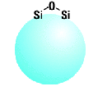
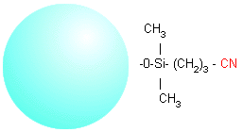
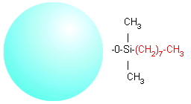
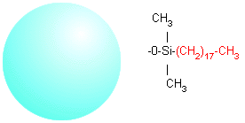
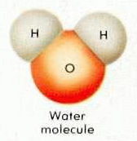
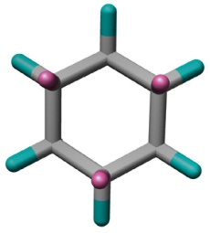
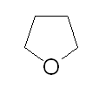
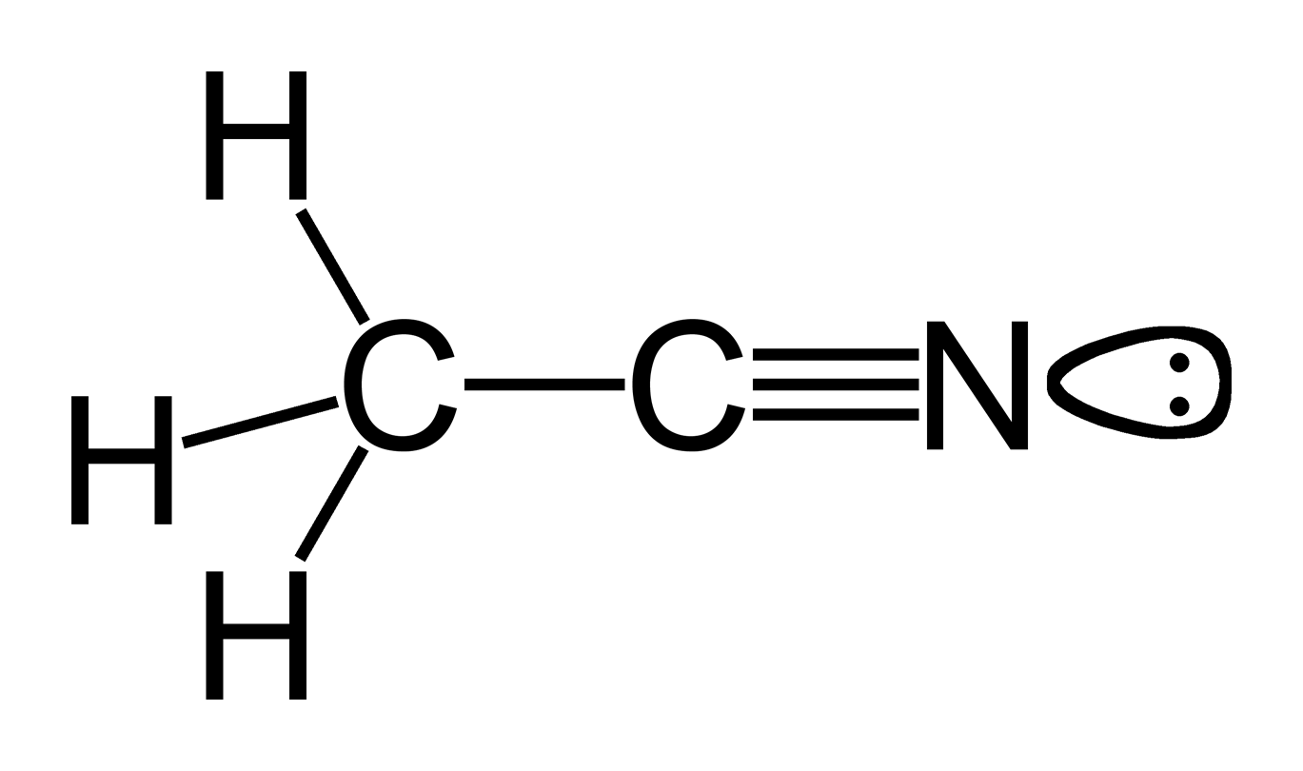
Polarity of Stationary and Mobile Phases
POLAR
NON-POLAR
STATIONARY PHASE
Silica - - - - - -CN - - - - - - - - - - C8 - - - - - - C18 ODS
MOBILE PHASE
Cyclohexane
Water - - - - - -- Acetonitrile - - - - THF - - - - - - - Hexane
10.20 6.2 4.2 0.06

Slide 4
Normal & Reversed-Phase Chromatography
Normal Phase
  Non-Polar Mobile Phase
  Polar Stationary Phase
  The “Original Type” - Used by Tswett
Reversed Phase – Most Commonly used
  Polar Mobile Phase
  Non-Polar Stationary Phase
  The mobile phase and stationary phases are “reversed” from normal phase.

Slide 5

Why do they separate? – Normal Phase
Blue Red Yellow
Mobile Phase: Non-Polar (Hexane)
Flow
Yellow is non-polar: Yellow is the most soluble in the mobile phase. It comes out first.
Red is somewhat polar: Red is less soluble the yellow in the mobile phase and binds somewhat to the stationary phase. It elution from the column is slowed down a little.
Blue is very polar: Blue binds the best to the stationary and is the least soluble in mobile phase. It elutes last.

Slide 6
Why do they separate? – Reversed Phase
Yellow Red Blue
Mobile Phase: Polar (Water)
Flow
Yellow is non-polar: Yellow binds the best to the stationary phase best and comes out LAST.
Red is somewhat polar: Red is somewhat soluble in the mobile phase and binds somewhat to the stationary phase. It’s elution slows down a little.
Blue is very Polar: Blue is the most soluble in the mobile phase best and comes out FIRST.
Reversed phase chromatography is the MOST used separation mode.

Slide 7
Mobile Phase, pH, Temperature and Column Dimensions
What effect does it have on my chromatography?

Slide 8
Selectivity: Other Factors
The column is a major determinant of selectivity.
Other chemical factors can affect the separation.
  Mobile phase solvent
  pH
  Temperature

Slide 9
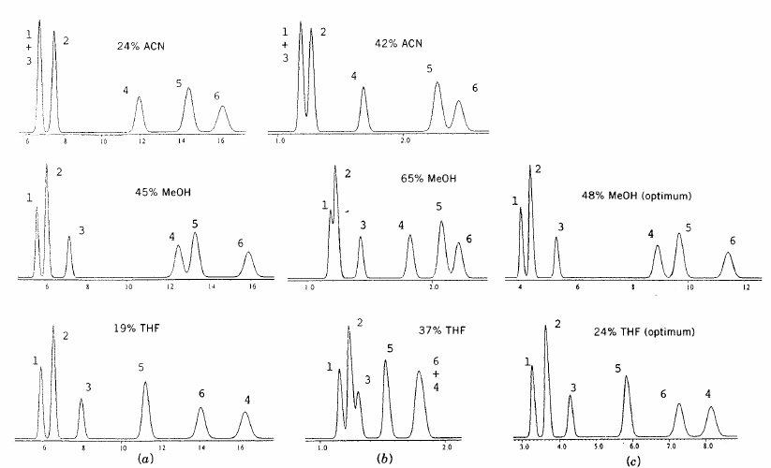
Selectivity Differences: Mobile Phase
Steroids
A steroid mixture separated under different mobile phase conditions.
The compounds have different solubility in the mobile phase solvents.
Snyder, L.D., Kirkland, J.J., Glajch, J.L., “Practical HPLC Method Development”, 2nd ed., John Wiley & Sons, Inc.,1997

Slide 10
Selectivity Differences: Mobile Phase pH
pH Limit of Silica gel
100
Acid
(Un-Ionized)
Base
(Un-Ionized)
10
log (k')
Neutral
1
Base (Ionized)
Acid (Ionized)
0.1
0
2
4
6
pH
8
10
12
14
Compounds retain better on reversed phase columns when they are not ionized.
An acid is less ionized in an acid mobile phase.
A rugged method allows the pH to vary a little without affecting the retention time (k’). This is where the curves are flat.
Silica dissolves above pH 8. Hybrid particles are best stable pH 1-12.

Slide 11
Selectivity Differences: Mobile Phase pH
4
pH 2.5
pH 5.0
1 Acetaminophen
2 Lidocaine
3 Doxepin
4 Imipramine (B)
5 Nortriptyline
6 Ibuprofen (A)
3
2
3
1
1
5
2
4
5
AU
AU
6
6
Time (min)
28
12
Time (min)
6
1
pH 8.0
1
pH 10.6
6
AU
2
3
AU
2
5
4
5
3
4
20
50
Time (min)
pH has a dramatic effect on some of the compounds.
Ibuprofen (acidic) and Imipramine (basic) and the most affected by pH.
Time (min)

Slide 12
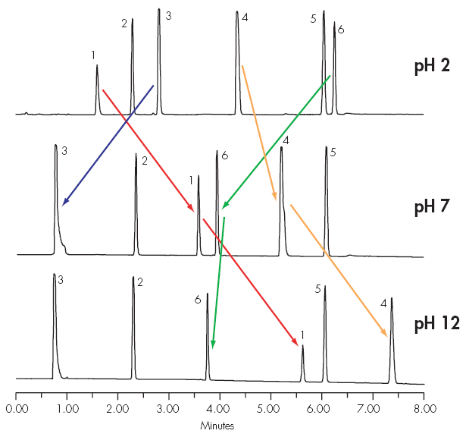
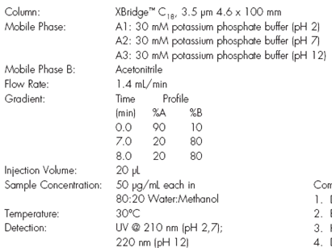
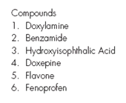
Selectivity Differences: Mobile Phase pH
Basic compounds are retained more at high pH, Peaks 1 and 4.
Acidic compounds are retained more at acid pH, Peak 3.
Non-ionic compounds do not move with changes in pH, Peak 2.

Slide 13
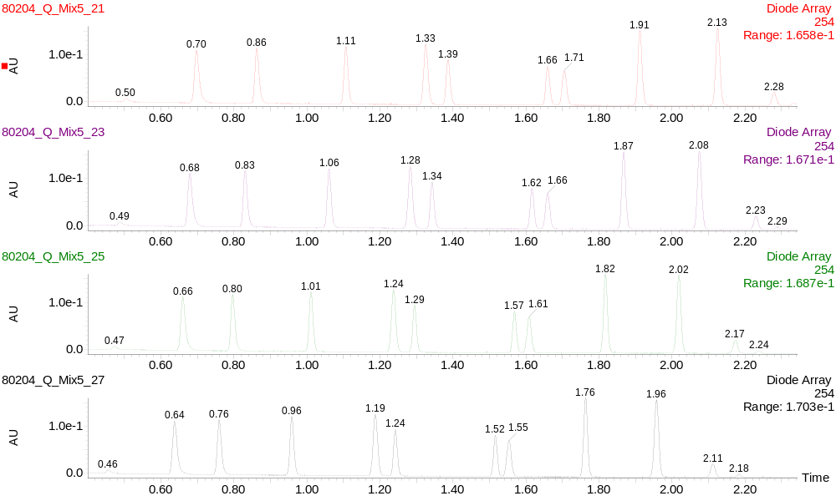
Selectivity Differences: Column Temperature
30°C
40°C
50°C
60°C
The primary effect of increasing column temperature is to decrease the
retention time.

Slide 14
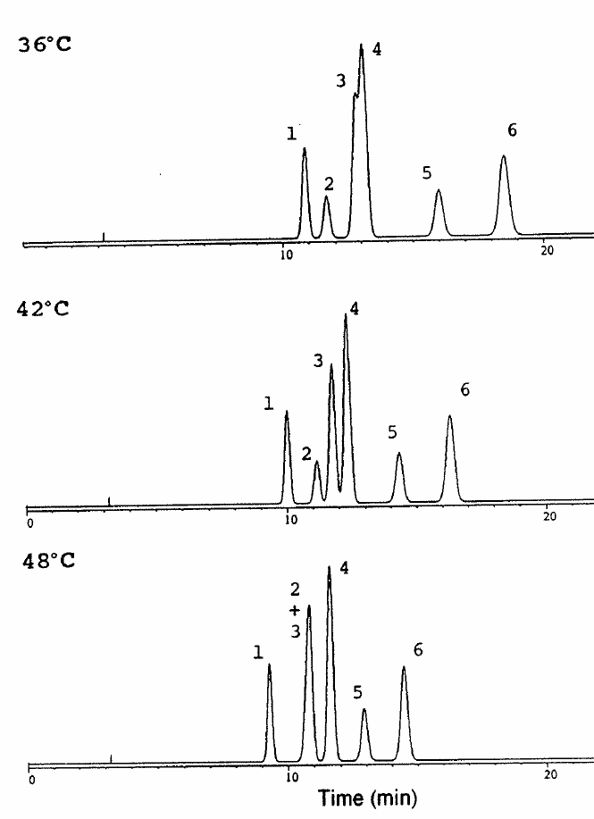
Selectivity Differences: Column Temperature
Polyaromatic hydrocarbons
Small changes in temperature can alter the selectivity for some
compounds.
Snyder, L.D., Kirkland, J.J., Glajch, J.L., “Practical HPLC Method Development”, 2nd ed., John Wiley & Sons, Inc.,1997

Slide 15
Why do we need different size columns?
Different size columns provide options for the separation.
Column dimensions are:
  Length in cm or mm
  Internal diameter in mm or µm

Slide 16
Different Length Columns
Columns come in different lengths from 1 to 30 cm
ADVANTAGES
Longer column
  Increased peak resolution
  Increased sample loading capacity
Shorter column
  Shorter run times
  Higher sample throughput
  Lower solvent consumption
DISADVANTAGES
Longer column
  Increased peak retention times
  Longer run times
  Increased backpressure
Shorter column
  Decreased peak resolution
  Decreased sample loading capacity

Slide 17
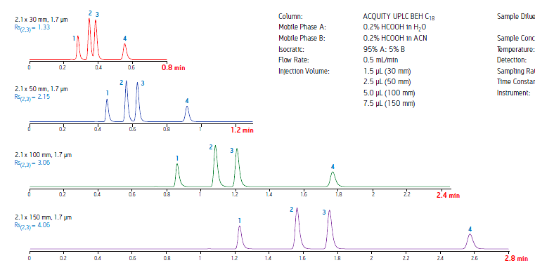
Increased Column Length for Resolution
30mm
50mm
100mm
150mm
The large change in resolution is the result of increasing the column length when the particle size is the same.

Slide 18
Equivalent Resolution
Column Length (L) to Particle Size (dp) Ratio
Separation Time
1970’s ~ 40 min.
1980’s ~15 min.
1990’s ~ 5 min.
2004 ~ 1 min.
300mm
30,000
=
10
μ
m
150mm
=
30,000
L
5
μ
m
=
dp
90mm
=
30,000
3
μ
m
50mm
1.7μm
= 29,500
100mm
1.7μm
= 58,820
For equivalent peak resolution, use the same L/dp ratio.
For more resolution, use a longer column or smaller particle size.
L/dp Separations Guide
Difficult 30,000
Moderate 20,000
Easy 10,000

Slide 19
Equivalent L/dp Ratio
0.15
Run Time
(Min)
35.0
9.5
4.5
1.1
The same L/dp provides the same resolution.
Smaller particles requires a shorter column and a shorter run time.
Smaller particles give narrower, sharper peaks.
  Y-axes are the same.
  X-axis times scales are different.
Smaller particles result in greater sensitivity with greater peak height.
0.10
10 µm – 250 mm
AU
0.05
0.00
0.00
5.00
10.00
15.00
Minutes
20.00
25.00
30.00
0.15
0.10
5 µm – 150 mm
AU
0.05
0.00
0.00
1.00
2.00
3.00
4.00
5.00
6.00
7.00
8.00
Minutes
0.15
3.0 µm – 100 mm
0.10
AU
0.05
0.00
0.00
0.50
1.00
1.50
2.00
Minutes
2.50
3.00
3.50
4.00
0.15
1.7 µm – 50 mm
AU
0.10
0.05
0.00
0.00
0.10
0.20
0.30
0.40
0.50
0.60
0.70
0.80
0.90
1.00
Minutes

Slide 20
Different Internal Diameter Columns
Columns come in many different sizes:
  Analytical: 3.0 to 4.6 mm
  Narrowbore: 2.1 mm
  Microbore: 0.5-1.0 mm
  Capillary: 0.300 mm
  Nanoflow: 0.075 to 0.150 mm
  Preparative: >4.6 mm to meters
Internal diameters permits scaling the size of the separation for:
  Sensitivity (lower limit of detection)
  Size of the sample
    Limited sample volume
    Preparative amounts for purification
  Saving solvents with smaller diameter columns to save money

Slide 21
Column Internal Diameters (ID) - Calculations
Flow rate and sample load are scaled to the column ID to maintain the retention times and the peak heights.
Definitions
  Column 1 diameter = D₁ = 4 mm
  Column 2 diameter = D₂ = 2 mm
  R = radius
Area of the column cross-section is a circle = A
  A = π R² = π (D/2)²
Ratio of the areas of the two columns is the scaling factor
A₁/A₂ = (D₁ / D₂)² = 4
Calculate flow rate change
  Column 1 is 1 mL/min
  Column 2 is 0.25 mL/min
Sample load is scaled the same way.
4 mm
2 mm

Slide 22
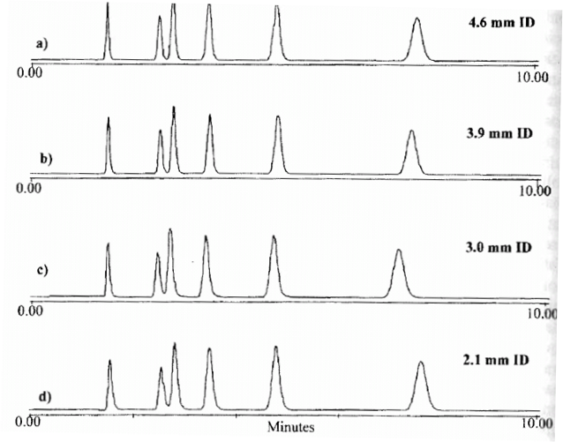
Changing Column Diameter
Flow rates scaled to column id.
Sample injection scaled to column id.
Columns are all the same length.
Retention times are the same.
Sensitivity is the same.
mL/min
1.4
1.0
0.6
0.29
Neue, U.D., “HPLC Columns”, Wiley-VCH, 1997

Slide 23
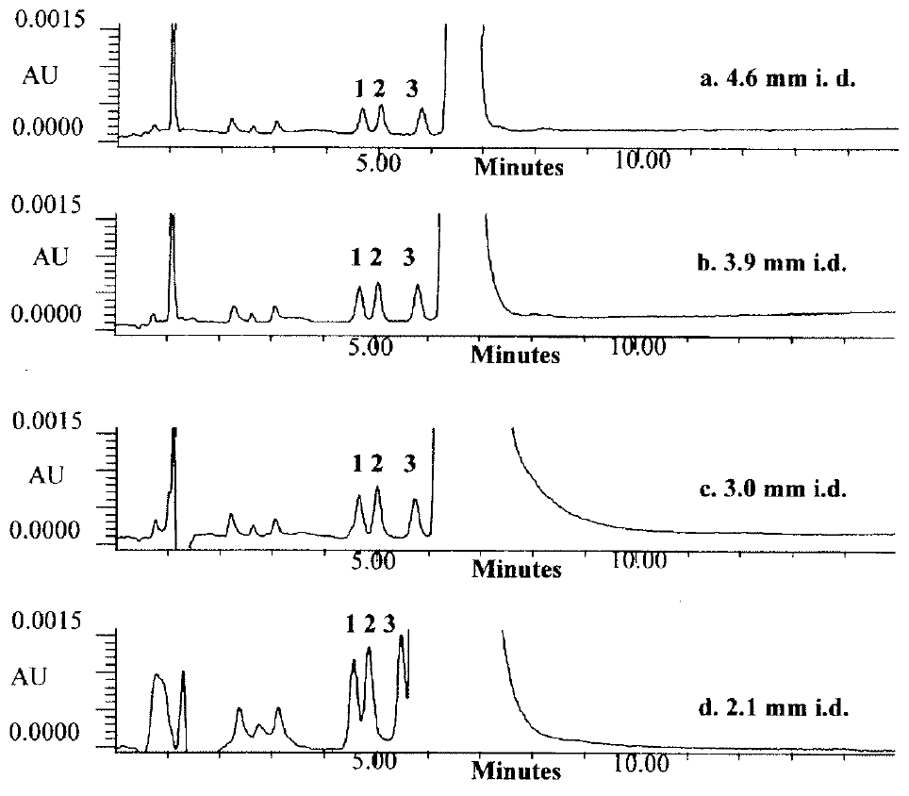
Decreased Column Diameter for Sensitivity
mL/min
1.4
1.0
0.6
0.29
Sample amount is the same.
  Sensitivity increased
  Some loss of resolution on 2.1 mm id column
Retention times are the same because the flow rates are scaled.
Neue, U.D., “HPLC Columns”, Wiley-VCH, 1997

Slide 24
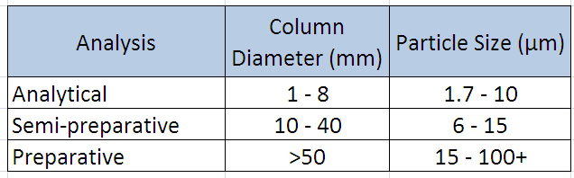
Column Diameter and Particle Size
Analytical chromatography benefits from smaller particle sizes
  Data, quantitation [high sensitivity]
  Increased resolution and sensitivity
Preparative chromatography is purification of an analyte on a large scale.
  Requires larger particle sizes for increased flow rates
  Semipreparative: Data and small quantity, (milligrams to grams, of analyte
  Preparative: Large scale purification (kilograms) [high capacity]

Slide 25
Summary of Column Geometry
Diameter
  Smaller diameter INCREASES sensitivity.
  Larger diameter INCREASES column capacity.
Length
  Longer column has a HIGHER resolving power and capacity.
  Shorter column has FASTER speed of separation and LOWER sample capacity.

Slide 26
Isocratic Separation

Slide 27






Isocratic System
HPLC Column
Injector
AutoSampler
Data
Solvent
Pump
Detector
Waste
1 solvent or mobile phase is used for the entire run.
1 pump required if the mobile phase is premixed by the analyst.
Gradient solvent delivery system can be used to mix the mobile phase (e.g. 60% water (A) – 40% methanol (B).

Slide 28
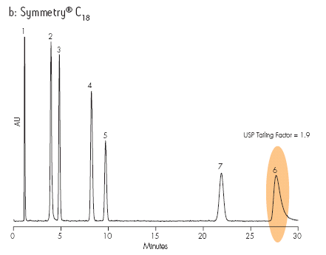
Isocratic Separation - Examples
Response
Time
The later eluting peaks are broader than the early peaks because of diffusion.
Greater sensitivity is achieved with better peak shape.
  Ideal peak shape is tall, narrow and symmetrical.
  A symmetrical peak has less tailing. The shaded peak is a tailing peak.
Different solvent mixtures are required to optimize the separation.

Slide 29
Pump Types

Slide 30
Two Types of Solvent Delivery
Binary Gradient System
  2 pumps
  2 solvents in a method
  Optional solvent select valves
    Choice of A1 or A2 and B1 or B2
High pressure solvent mixing occurs AFTER the pumps
Advantages
  Most precise gradient
  Best for very fast chromatography
  Best for very shallow gradients (e.g. 1%/minute change)
Quaternary Gradient System
  1 pump
  1 to 4 solvents
  Additional solvent selection modules available
Low pressure solvent mixing occurs BEFORE the pump
Advantages
  4 solvents for easier methods development
  Blending more than 2 solvents
  Less pump maintenance

Slide 31
Binary Gradient System
HPLC Column
Solvent
Injector
AutoSampler
Data
B
A
Pump
Detector
Pump
Waste
High pressure mixing of solvents occurs AFTER the pumps at a mixing tee.

Slide 32
Quaternary Gradient System
HPLC Column
GPV
Injector
AutoSampler
Data
A
D
Pump
B
C
Detector
Waste
Solvents
Low pressure solvent mixing occurs BEFORE the pump.
Solvents are blended by the Gradient Proportioning Valve (GPV).
2 or more solvents can be blended.

Slide 33
Plumbing

Slide 34
Proper System Plumbing
For optimal chromatography the correct tubing and fittings are required
  Tubing sizes
  Fittings
Recommendations
Potential problems

Slide 35
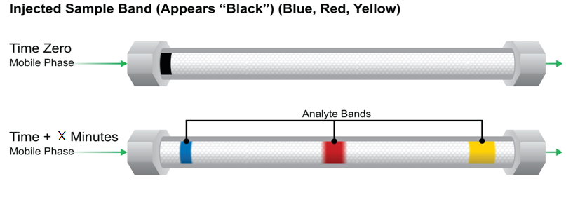
Peak Bandspreading
Bandspreading in a column is normal.

Slide 36
Minimize Bandspreading
Less bandspreading gives
  Best peak shape
  Highest sensitivity
  Best peak resolution
0
0
Mobile
Phase
Mobile
Phase
Mobile
Phase
Mobile
Phase
More
Concentrated

Slide 37
Extra-Column Bandspreading
Extra-column bandspreading occurs outside the column
Extra-column bandspreading is bad for chromatography
Things affecting extra-column bandspreading are:
  Tubing diameter
  Tubing length
  Cutting tubing
  Fittings

Slide 38
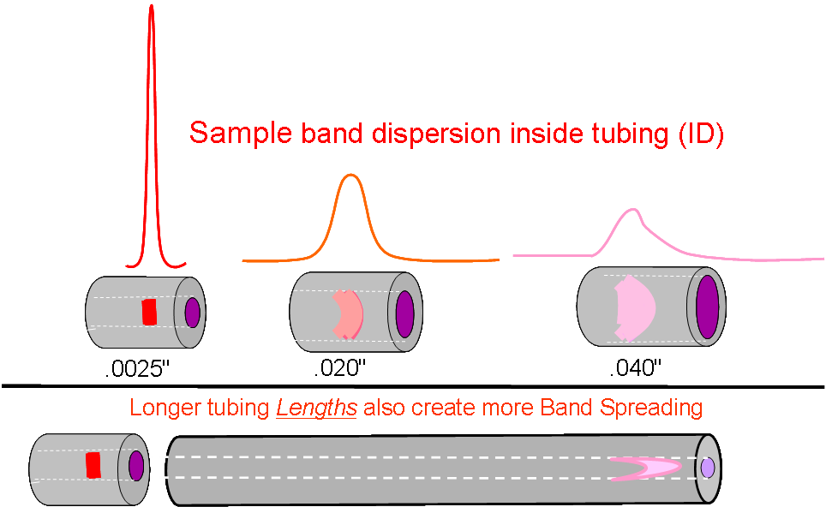
Sample Band Dispersion Inside Tubing
Larger diameter (ID) tubing, the more bandspreading.

Slide 39
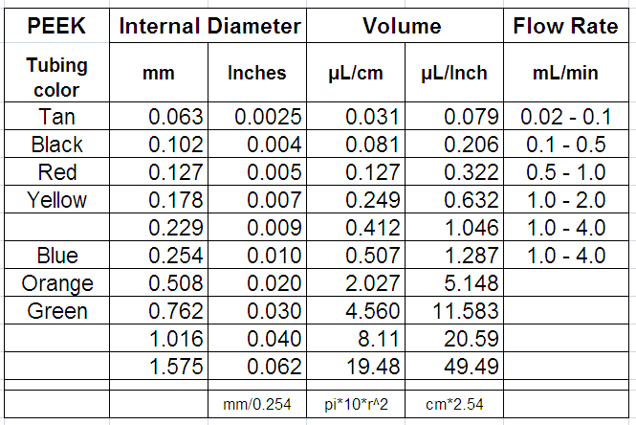
Tubing Volume and Flow Rate
Narrower internal diameter (ID) tubing has less volume:
  Less bandspreading
  Higher back pressures
To minimize bandspreading, make tubing as SHORT as possible.

Slide 40
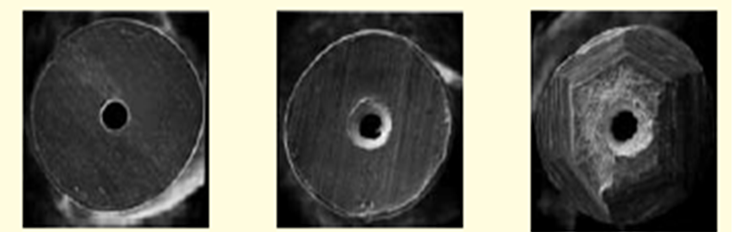
Tubing Cutting
Precut by vendor Cut with a tubing cutter Cut with a file
Cutting stainless steel tubing to get a flat end is difficult.
  ACQUITY systems require Waters ACQUITY tubing
PEEK tubing must also be cut correctly.
Incorrectly cut tubing creates voids.

Slide 41
Fittings
0.080”
0.119”
The length of tubing protruding from the ferrule varies
  HPLC vendors
  Column types
  Column vendors
Ferrule shapes differ. Use the correct ones for your system.
Make NEW fittings when you change columns for proper fit.

Slide 42
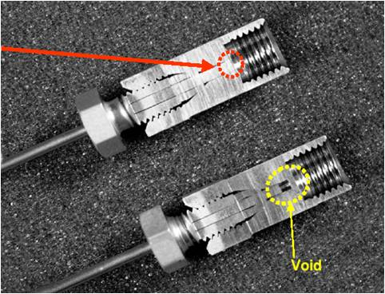
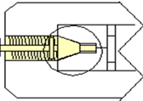
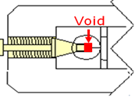
Column Fittings – Extra-column Bandspreading
If the void is = 0.5 mm for a 1/16” OD tube
  Volume Calculation (µL) = V = p R² L = 3.14 x (0.795)² x 0.5
  V = 0.99 µL
This void will cause:
  Peak bandspreading
  Carryover

Slide 43
Detectors

Slide 44
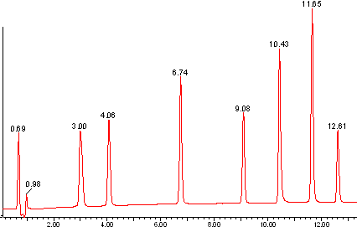
Detectors
Instrument in the chromatographic system which senses the presence of a compound passing through, and provides an electronic signal to a computer data station or recorder.
Output is a chromatogram where analytes appear as peaks when detected.
Response
Time

Slide 45
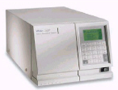
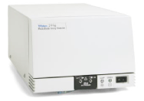
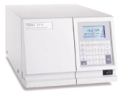
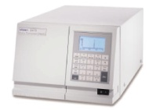
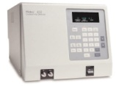
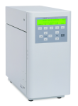
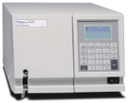
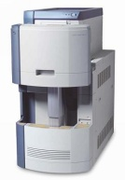
Types of Detectors
UV – Ultraviolet light
PDA – Photo Diode Array
RI – Refractive Index
FD – Fluorescence
EC – Conductivity
ECD – Electrochemical
ELSD – Evaporative Light Scattering
MS – Mass Spectrometer
Ultraviolet Light
Photodiode Array
Refractive Index
Fluorescence
Conductivity
Electrochemical
ELSD
Mass Spectrometer

Slide 46
UV Detector
Ultraviolet detection
  Analyte must have UV chromophore
  Solvent may change throughout separation - gradient
  Not very temperature sensitive
  Not flow sensitive
UV detection is the most commonly used mode.

Slide 47
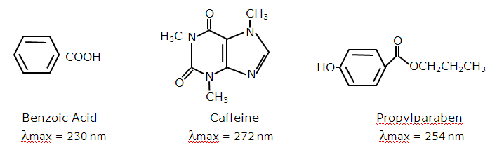
Compounds Detected by UV
Chromaphores
  Compounds with double bonds
    –C=C-, -C=CH-CH=C-
  Compounds double bonds in rings structures
  UV detectors can also “see” compounds in the visible range, the ones you can see.
A chromaphore absorb the light at specific wavelength, λ_{max}.

Slide 48
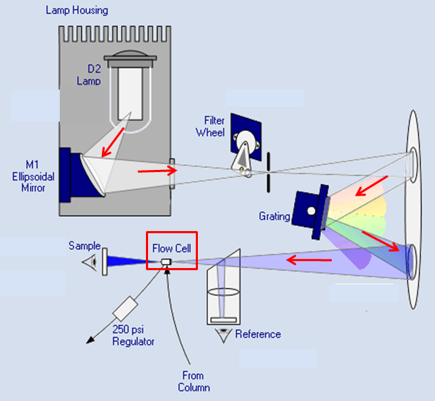
Light Path of a Tunable UV (TUV) Detector
Light from a deuterium lamp (190-700nm) is split at the grating to give the programmed wavelength.
The wavelength, e.g. 254nm ± 2.5nm, goes through the flow cell.
The analytes absorbs the light.
The detector measure the difference between the sample and reference transmitted light.

Slide 49
Photodiode Array Detector (PDA)
Photodiode Array
  PDA is a form of UV detection
  Analyte must have UV chromophore
  Solvent may change throughout separation - gradient
  Not very temperature sensitive
  Not flow sensitive
  Spectral analysis possible
    Library matching
    Peak homogeneity or “purity” (This is a measure of spectral homogeneity not chemical purity.)

Slide 50
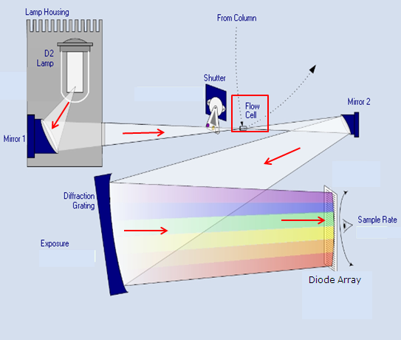
Light Path of the PDA
All light from a deuterium lamp (190-800nm) goes through the flow cell.
Analytes absorbs some of the light.
Diffraction grating splits the light into the wavelengths.
Each wavelength, 1.2 nm, is monitored by one of 512 diodes.
Programmed wavelengths determine what data is stored.

Slide 51
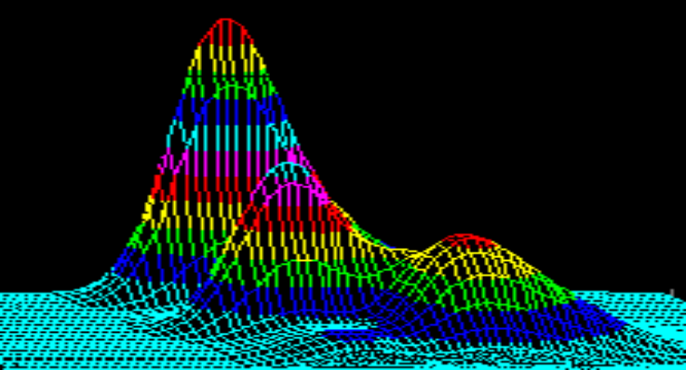
Data from PDA Detector
3D
Chromatogram
λ1
Absorbance
λ2
Spectrum
Absorbance
Time
Wavelength
PDA detectors acquire 3D data,
2D data can be extracted
  Chromatograms
  Spectra

Slide 52
Refractive Index Detector (RI)
Refractive Index (RI)
  Universal analyte detector
  Measures the change in refractive index when the sample passes through flow cell
  Solvent must remain the same throughout separation - isocratic
  VERY temperature sensitive - sometimes difficult to stabilize baseline
  Less sensitivity than other detectors
Used when compounds do not have other properties, e.g. chromophores, that allow use of other detectors.
  Lipids
  Carbohydrates
  Polymers

Slide 53
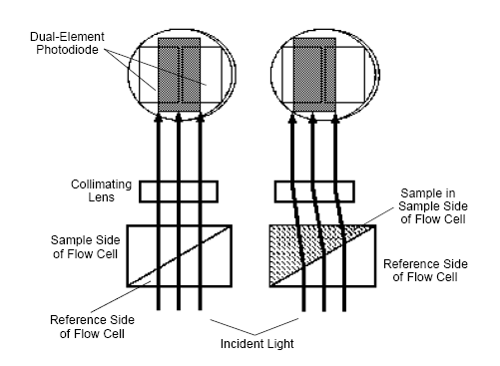
RI Detector
Detection depends on differences in refractive index (RI) between the sample and solvent.
The sample bends the light.
RI detectors are less sensitive than other detectors.
Can not be used for gradient chromatography

Slide 54
Fluorescence Detectors
Fluorescence
  Excitation wavelength generates fluorescence emission at a higher wavelength.
  Analytes must have fluorophore group.
    Fluorophore groups are usually ring structures.
    Can derivatize the analyte with fluorophore reagent (tag)
  Very sensitive and selective
  More difficult methods transfer
  Detector response can vary dependent upon separation conditions.

Slide 55
Why Use Fluorescence?
When other detection techniques, such as UV/Vis, are too insensitive or not selective.
Fluorescence detectors (FLDs) are among the most sensitive of the modern HPLC detectors.
Typical FLR sensitivity is 10-1000 times greater than that of UV/VIS.
  Sensitivity is such that the presence of even a single analyte molecule can be detected in the flow cell.
FLR detectors are very specific and selective when compared to other optical detectors.
May require derivatizing sample analytes with a fluorescent tag.

Slide 56
Compounds Analyzed by Fluorescence
Environmental
  Polyaromatic hydrocarbons (PAH)
  Phenols
  Carbamates
Food and Beverage
  Alfatoxins
  Mycotoxins
  Vitamins (B2, B6)
  Dyes
Biotech and Pharmaceuticals
  Drugs and their metabolites
  Derivatized amino acids (AccQ-Tag) or (OPA)

Slide 57
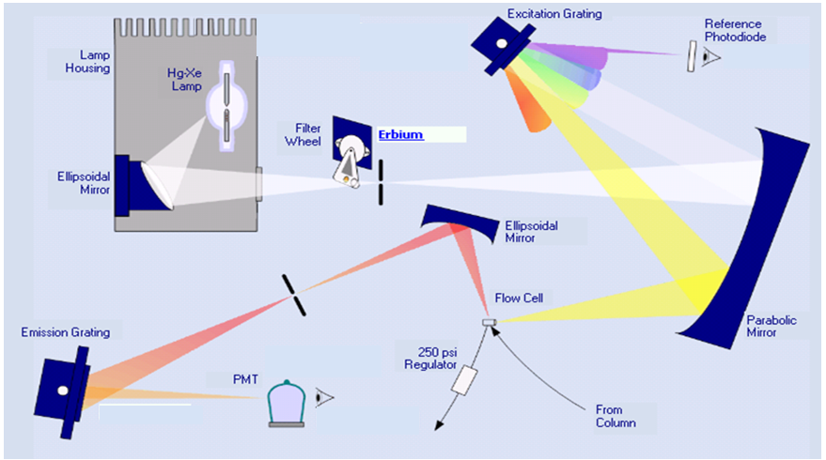
Fluorescence Detector
The lamp is mercury-xenon.
Light goes to an excitation grating where the programmed wavelength is selected.
This wavelength excites the fluorescent analyte.
The specific emitted wavelength is monitored.

