Slide 1
Test Engineering Deep Dive
In-Circuit Test

Slide 2
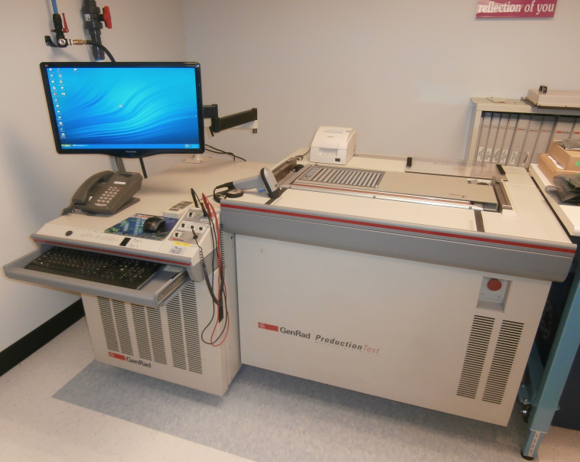
In-Circuit Test (What is it?)
In-circuit test (ICT) It's a tester that tests each component on a printed circuit board (PCB), one at a time. And it does this while the component is "in-circuit," that is, while it's connected to other components on the board.
It performs this task using a custom fixture with a bed of nails connecting the tester to each node.
The program will check for shorts and opens, verify the values of resistors, capacitors etc.
ICT will also power up the board under test to verify voltage levels check some analog and digital chip functionality.
Finally any program parts on the unit under test (UUT) can be programed as required.
The goal of ICT is 100% part coverage.
Genrad 2287i In-Circuit Test System
Located in the TE Lab

Slide 3
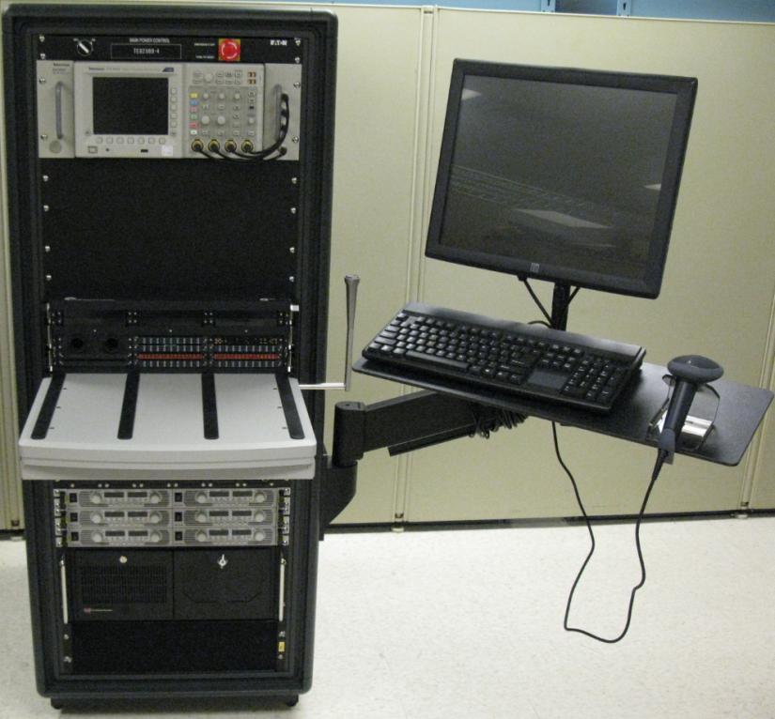
Vs. Functional Test (What is it?)
Functional Test (FCT) ensures that circuitry functions as designed within specifications. Testing is usually done “at speed” through UUT connectors.
Uses high speed instrumentation to characterize signals to and from the UUT.
More specialized, requiring more knowledge of the UUT’s intended use/application.
Waters Global Test System
(Functional PCBA Tester)

Slide 4
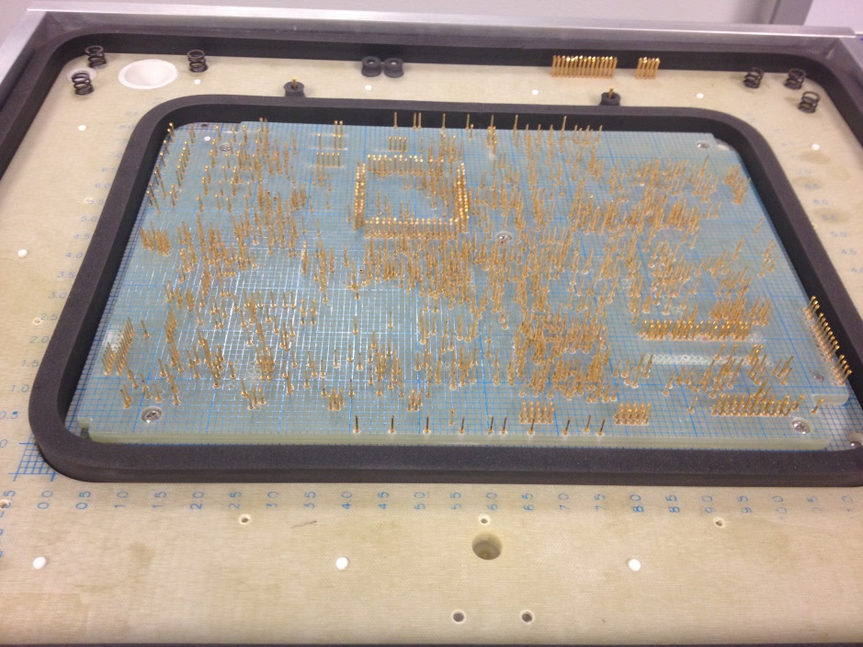
How connections are made
Test pins inserted into holes in a fiberglass composite material (G10) make up a ‘bed of nails’. The pins contact test points on the UUT and are connected to test system instrumentation by wires.
Board is lowered onto pins using vacuum.

Slide 5
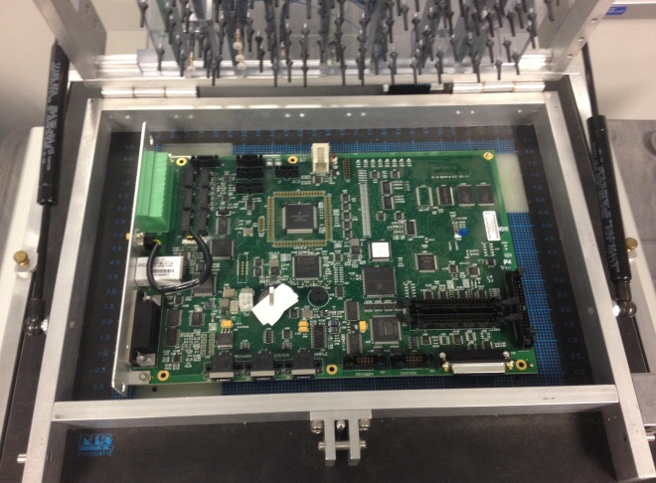
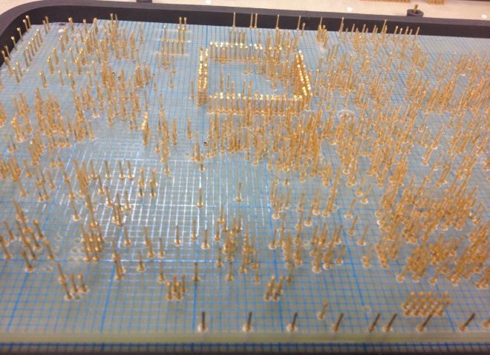
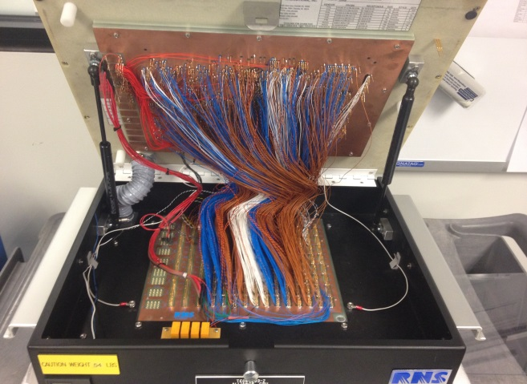
ICT Test Fixture for 210000411 Alliance CPU Board
1300 Node count
5 Program parts

Slide 6

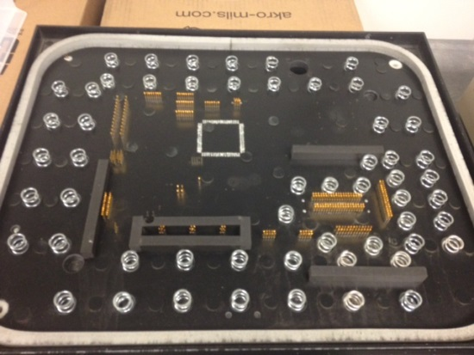

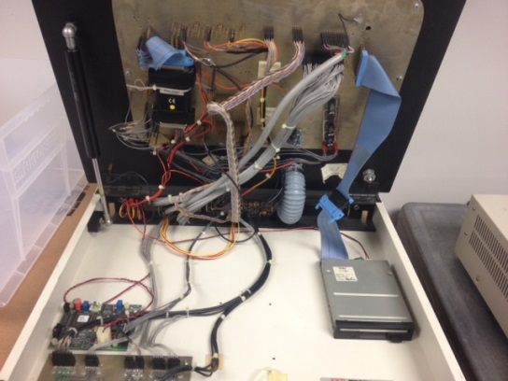
ICT vs FCT Fixtures
FCT
ICT
ICT and FCT fixtures shown are both for the 210000411 board

Slide 7
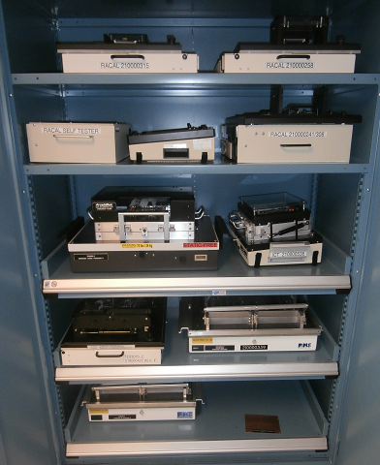
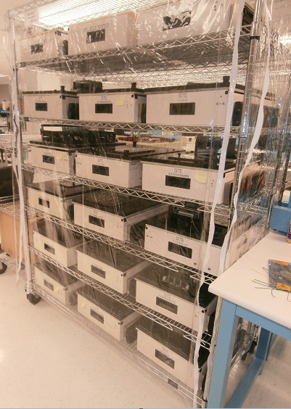
Waters PCBA Test Fixtures
Cabinet,
Assorted Fixtures
(ICT and FCT)
Rack,
GTS Fixtures
(FCT)

Slide 8
ICT History at Waters
In-Circuit Test development & support was previously a full-time job.
Test Engineer worked with the ECAD group to ensure testability.
Based on design output files, fixture was quoted and ordered.
Custom test code was created by Test Engineer for each PCBA/fixture.
Debug was performed as necessary.
Test Engineering supported the testers until product end-of-life.

Slide 9

ICT (more recent) History at Waters
In-Circuit Test development is now partially outsourced.
For each new PCBA, a Test Engineer:
Works with ECAD group to ensure testability (~2 hours)
Requests quote (fixture and code development) based on design output (~2 hours)
Creates CEA and PO Request (~1 hour)
Works with fixture and code upon arrival to ensure testability (~40 hours)
Create ID# add to calibration database and TE fixture spreadsheet (~1 hour)
Prepares fixture and program files for shipment including TRF (~2 hours)
ECR changes are hard to quantify. Time spent is variable & may require fixture to be returned
Total amount of time spent depends on PCBA activity

Slide 10

ICT Future at Waters - Option 1
The Hybrid Model
In-Circuit Test development completely outsourced with Test Engineering involvement.
For each new PCBA, Test Engineer:
Will work with ECAD group to ensure testability (~2 hours)
Send Files and get fixture and program quote from international vendor (~.5 hours)
Review testability report of the vendors program (~.5 hours)
Program vendor will install fixture and program at the CM
ECR Changes would be processed by vendor and any fixture work done in Singapore
The amount of time spent would depend on the new PCBA pipeline.
The time savings would be roughly 1 week/PCBA assembly.

Slide 11
ICT Future at Waters – Option 2
Contract Manufacturer Model
In-Circuit Test development could be completely outsourced.
For each new PCBA, Test Engineer:
Will work with ECAD group to ensure testability (~2 hours)
Send files to the CM (~.5 hours)
Review CM’s program coverage and testability report (~.5 hours)
ECR changes would be the CM’s responsibility to incorporate
The amount of time spent would depend on the new PCBA pipeline.
The time savings would be over 1 week/PCBA assembly.

Slide 12
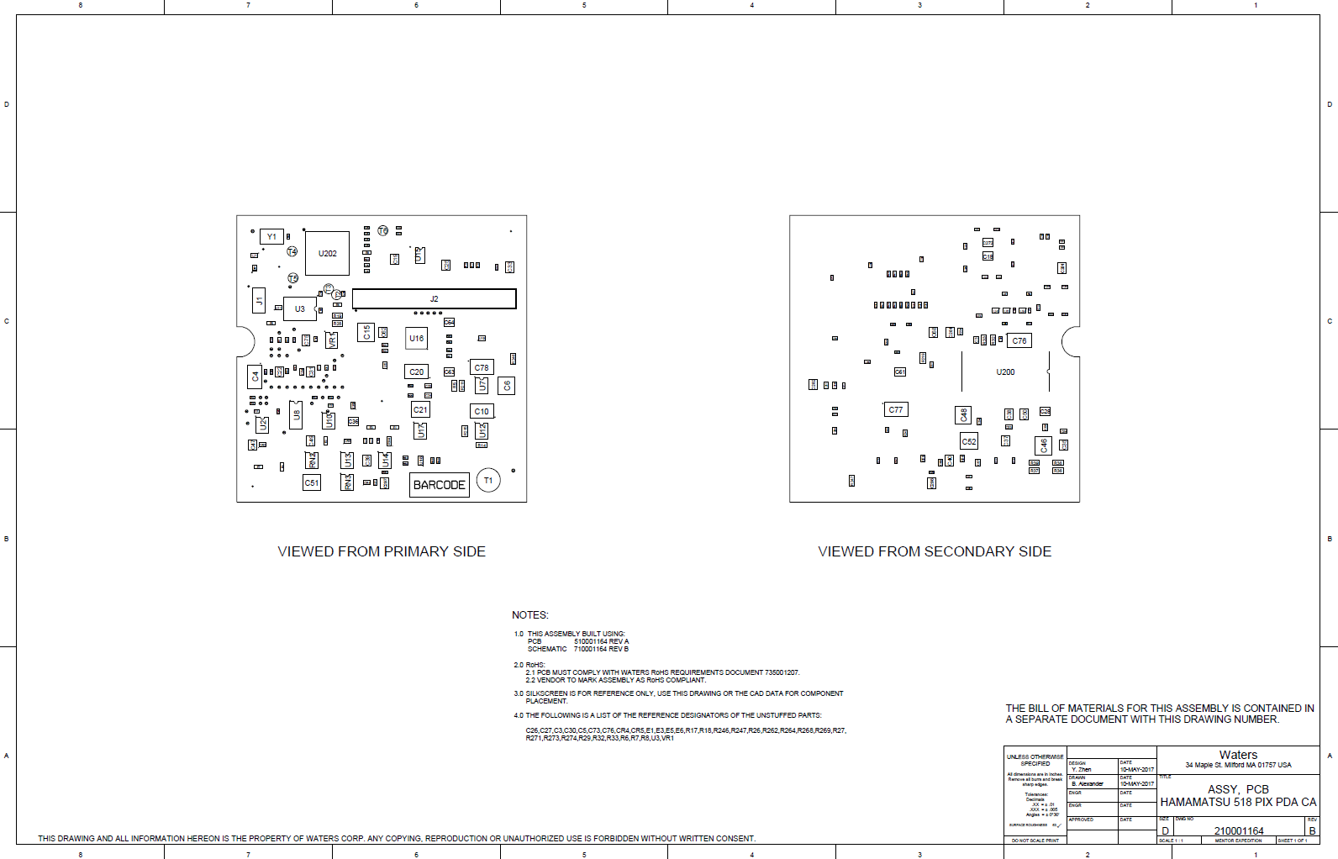
Pilot Board Project
210001164 - ASSY, PCB, HAMAMATSU 518 PIX PDA CA
Current Project
High Volume PCBA
Low Node-Count PCBA

Slide 13
Cost Analysis
TDI, FL (Current Supplier)
$15,200.00 (Lead Time = 6 weeks, plus roughly 1 week of Test Engineering work)
Solution Sources, CA (turn-key solution)
$14,161.50 (Lead Time = 4 weeks) hybrid solution installed at CM
Pertracarbon PTE – Flextronics solution (CEI also uses Petracarbon*)
$XX,XXX (Lead Time = XX days)
* Waters has used Petracarbon for repairs successfully in the past

Slide 14
Looking Forward (possible candidates)
210000355 - ASSY, PCB, 2489 TUV PERSONALITY RHS (possibility)
High Volume PCBA
Older Fixture/Program. Fixture could use refreshing
Longer-Term:
New Products
PCBA Updates (e.g. Altera Project)

Slide 15
Altera Project present scheduled timeline
Project | Date
Classic RI | 11-Oct-18
Classic TUV | 19-Oct-18
Acquity TUV | 19-Oct-18
Acquity Sample/HDX Manager | 19-Oct-18
BGM, 1525/1515 | 14-Jun-19
Acquity/Classic ELSD | 26-Mar-20
Classic 2998 | 3-Apr-20
Classic 2475 FLR | 20-Nov-20
Sample Organizer, 2200 | 27-Nov-20
Acquity Column Manager | 23-Jul-21
PCM II | 9-Sep-21
TCM II | 30-Dec-21
Alliance H/C | 18-Mar-22
515 | 13-May-22
Complete with all products | 13-May-22

Slide 16
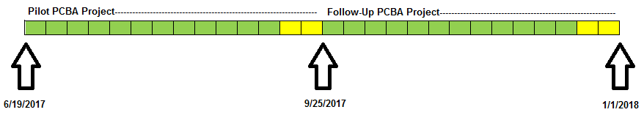
Project Timeline
12 Weeks - Develop and install ICT Test Program and Fixture
2 Weeks - Review Installation, Assess Outcome, Measure Success
Repeat
Ready for projects in 2018 and beyond including: Alliance, Orien & Altera PCBA Updates

Slide 17
Challenges/Obstacles
Waiting over 2 weeks for a quote from the CM to put into the price comparison
If we require a fixture here (duplicate, etc.), fixture & shipping will add some cost

Slide 18

Any Questions?

