Slide 1
Test Engineering Deep Dive
In-Circuit Test

Slide 2
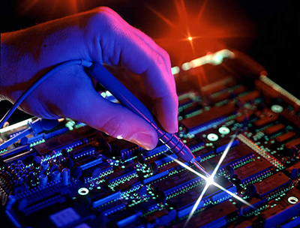
In-Circuit Test (What is it?)
In-circuit test (ICT) is a form of testing where an electrical probe tests a populated printed circuit board (PCB), checking for shorts, opens, resistance, capacitance, and other basic quantities which will show whether the assembly was correctly fabricated.
Also:
Tests Functionality of individual devices, IC’s
Programs devices
Performs functional power-up test (check voltages, etc.)
(an automated version of this)

Slide 3
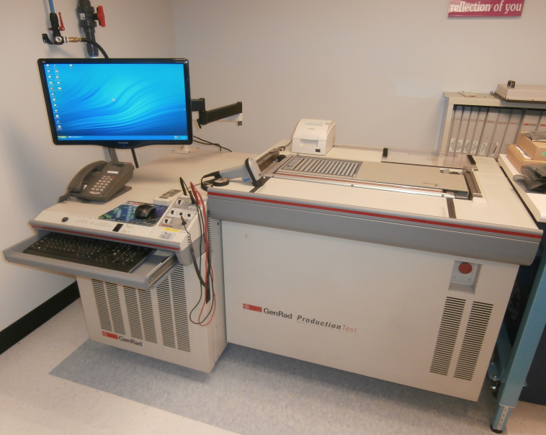
Waters’ GenRad 2287I Production Test System
Accepts custom test fixtures and runs specific, custom test program for each unique part number (PCBA).
Similar to systems at contract manufacturers.

Slide 4
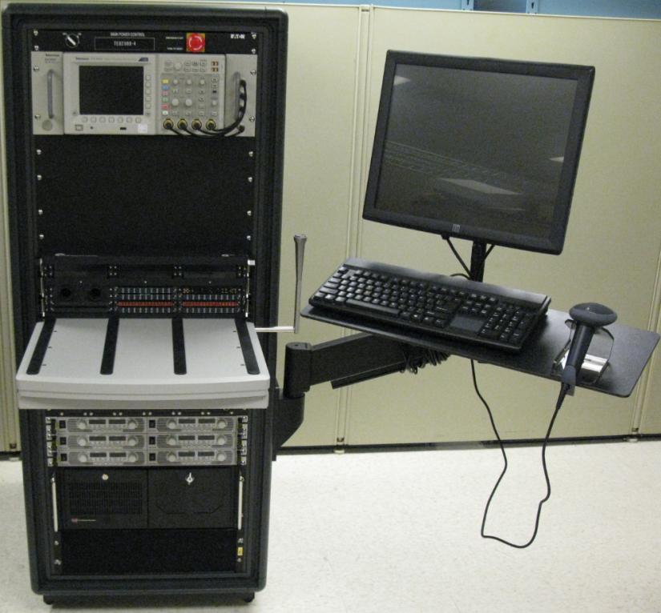
Vs. Functional Test (What is it?)
Functional Test (FCT) ensures that circuitry functions as designed within specifications. Testing is usually done “at speed” through UUT connectors.
Uses high speed instrumentation to characterize signals to and from the UUT.
More specialized, requiring more knowledge of the UUT’s intended use/application.
Waters Global Test System
(Functional PCBA Tester)

Slide 5
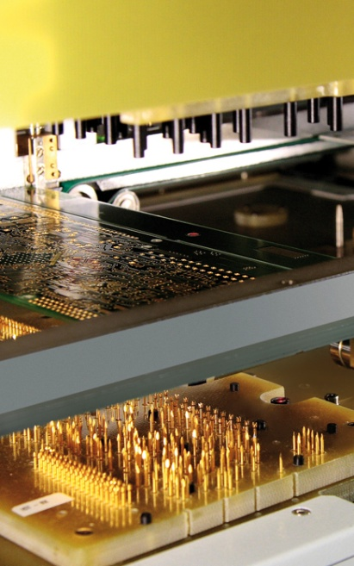
How connections are made
Test pins inserted into holes in a fiberglass composite material (G10) make up a ‘bed of nails’. The pins contact test points on the UUT and are connected to test system instrumentation by wires.
Board may be lowered onto pins mechanically (overclamp) or pulled down using vacuum.

Slide 6
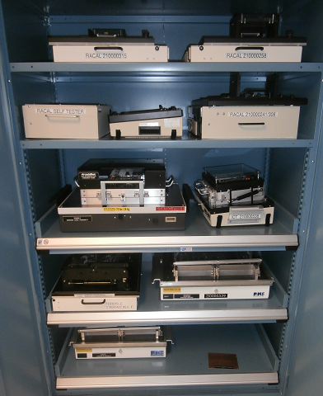
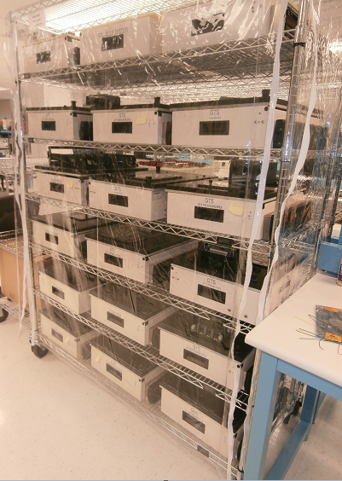
Waters PCBA Test Fixtures
Cabinet,
Assorted Fixtures
(ICT and FCT)
Rack,
GTS Fixtures
(FCT)

Slide 7
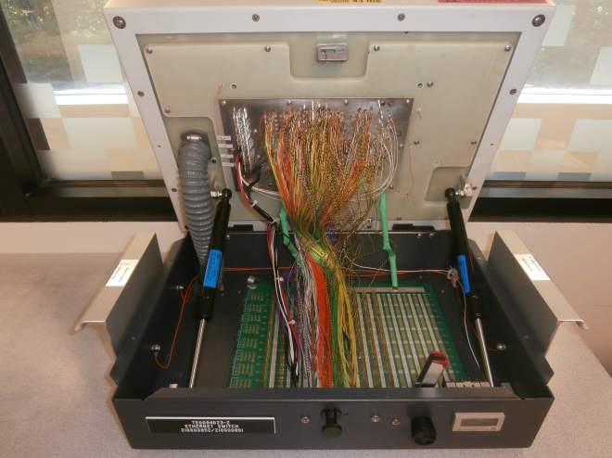
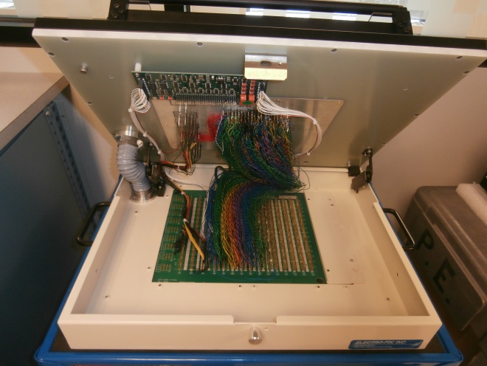
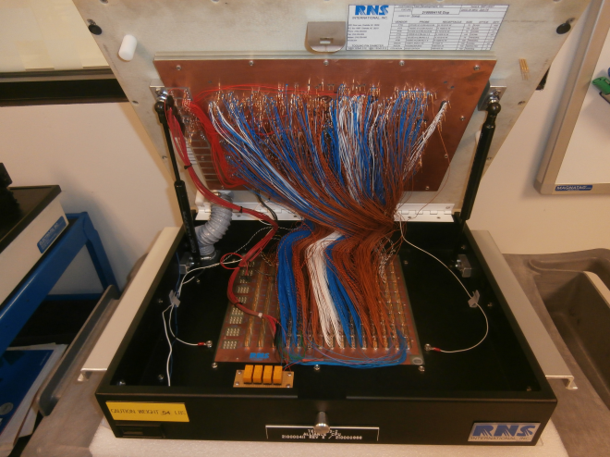
ICT Test Fixtures, under the hood

Slide 8
ICT History at Waters
In-Circuit Test development & support was previously a full-time job.
Test Engineer worked with the ECAD group to ensure testability.
Based on design output files, fixture was quoted and ordered.
Custom test code was created by Test Engineer for each PCBA/fixture.
Debug was performed as necessary.
Test Engineering supported the testers until product end-of-life.

Slide 9

ICT (more recent) History at Waters
In-Circuit Test development is now partially outsourced.
For each new PCBA, a Test Engineer:
Works with ECAD group to ensure testability (~2 hours)
Requests quote (fixture and code development) based on design output (~2 hours)
Works with fixture and code upon arrival to ensure testability (~40 hours)
Prepares fixture and program for shipment (~2 hours)
The amount of time spent depends on the new PCBA pipeline:

Slide 10

ICT (possible) Future at Waters
In-Circuit Test development could be more-completely outsourced.
For each new PCBA, Test Engineer:
Would work with ECAD group to ensure testability (~2 hours)
Would requests quote (fixture and code development) based on design output (~2 hours)
The amount of time spent would depend on the new PCBA pipeline.
The time savings would be roughly 1 week/PCBA assembly.

Slide 11
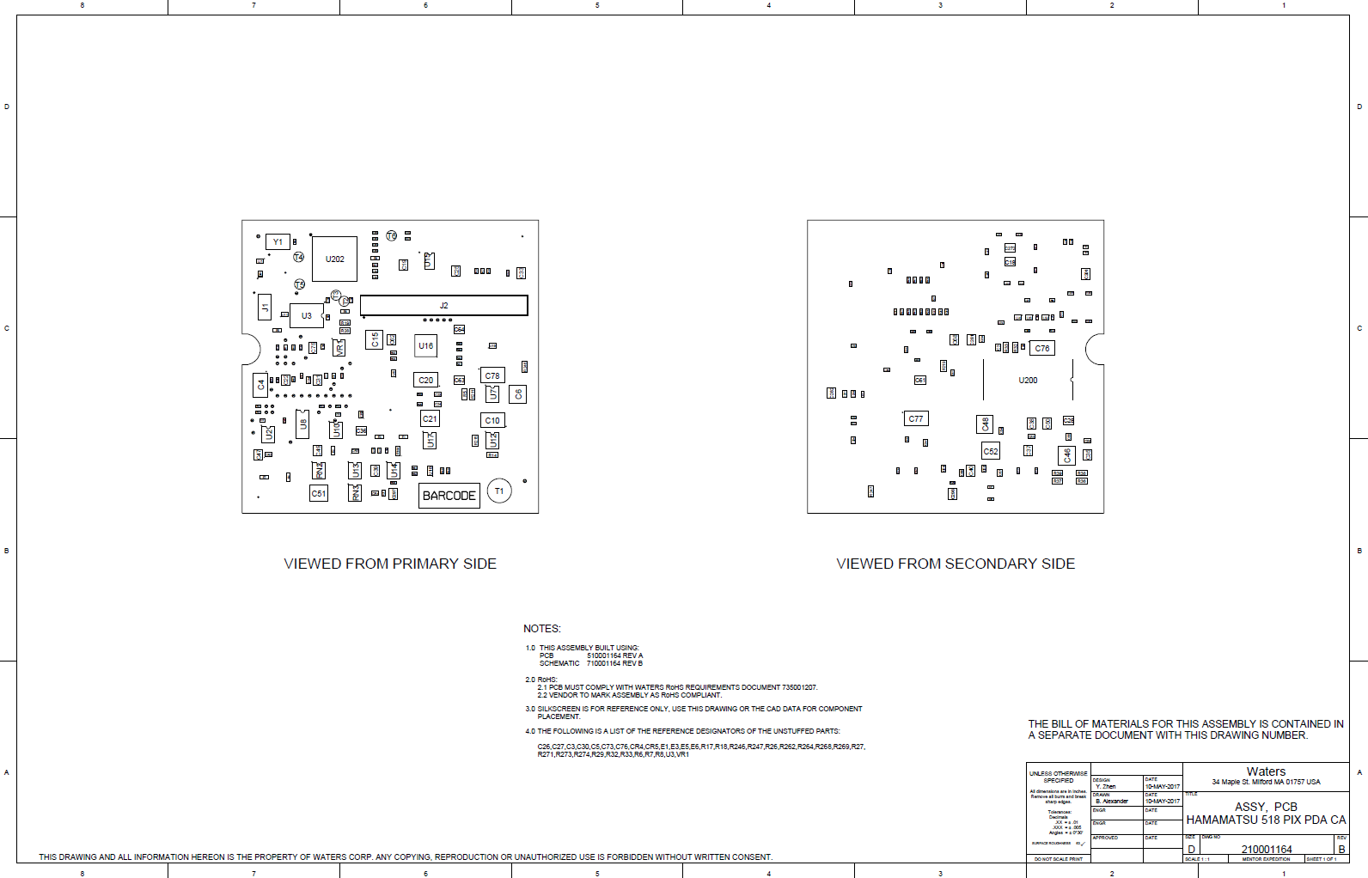
Pilot Board Project
210001164 - ASSY, PCB, HAMAMATSU 518 PIX PDA CA
Current Project
High Volume PCBA

Slide 12
Cost Analysis
TDI, FL (Current Supplier)
$XX,XXX (Lead Time = XX days, plus roughly 5 days of Test Engineering work).
Solution Sources, CA (turn-key solution)
$XX,XXX (Lead Time = XX days)
Pertracarbon PTE – Flextronics solution (CEI also uses Petracarbon*)
$XX,XXX (Lead Time = XX days)
* Waters has used Petracarbon for repairs sucessfully in the past

Slide 13
Looking Forward (possible candidates)
210000355 - ASSY, PCB, 2489 TUV PERSONALITY RHS (possibility)
High Volume PCBA
Older Fixture/Program. Fixture could use refreshing
Longer-Term:
New Products
PCBA Updates (Altera Project)

Slide 14

Any Questions?

