Slide 1

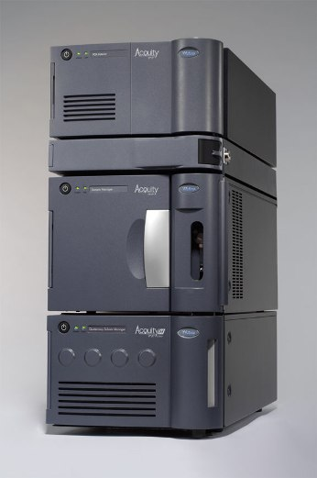
ACQUITY H-Class System Overview
Chris Proehl Rev. 1.5 2/01/2010

Slide 2
ACQUITY H-Class System
New addition to the ACQUITY family
Allows customers to move up to UPLC while making it easier to run existing HPLC methods on the same instrument
The ACQUITY H-Class System consists of the following:
  Quaternary Solvent Manager (QSM)
    Four solvent low pressure gradient mixing
    Supports UPLC Pressures
    Low gradient delay volume
  SM-FTN (Sample Manager-Flow Through Needle)
    One injection mode- direct inject type
    Much simpler- Just specify injection volume
    Excellent recovery and precision
  CH-A
    High temperature column heater with active pre-heating
  Normal choice of detectors
  More options to be added

Slide 3
Marketing Message
Performance that transforms your lab. Not your methods
  Introducing ACQUITY UPLC H-Class from Waters. Now your laboratory can get the market-leading performance of Waters UltraPerformance Liquid Chromatography (UPLC). Choosing the ACQUITY UPLC H-Class System enables you to continue running your existing HPLC methods – now on a forward-looking platform that allows you to confidently and seamlessly scale to UPLC separations when you’re ready, using integrated system tools that makes the migration simple.
The principles are the same. The performance is not.
Feels like HPLC, acts like UPLC.
Identical method transfer – not equivalent.
Multi- solvent blending
Direct inject sampling
Newly redesigned column compartments

Slide 4
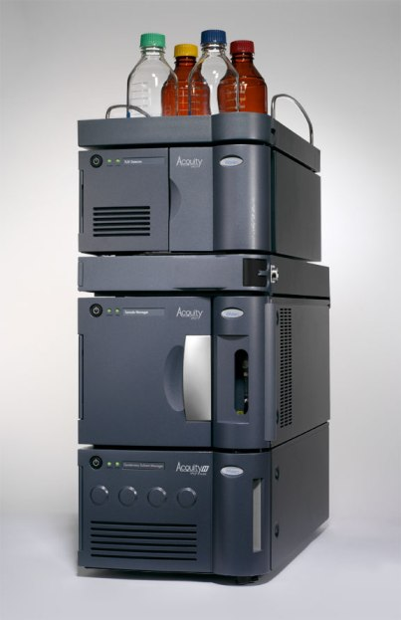
ACQUITY H-Class System
Detectors
TUV, PDA eλPDA, FLR, ELSD
CH-A
High Temperature Column Heater
Active Pre-Heating
SM-FTN
Sample Manager-Flow Through Needle
QSM
Quaternary Solvent Manager

Slide 5
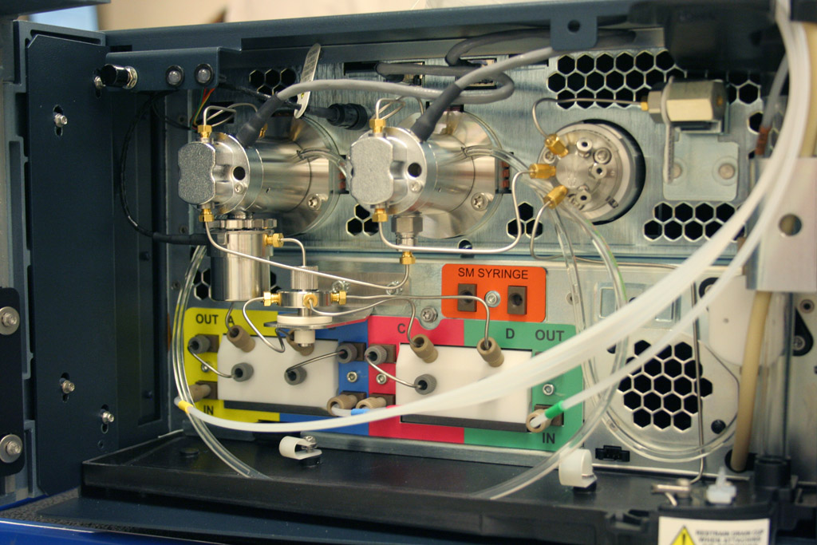
Quaternary Solvent Manager

Slide 6
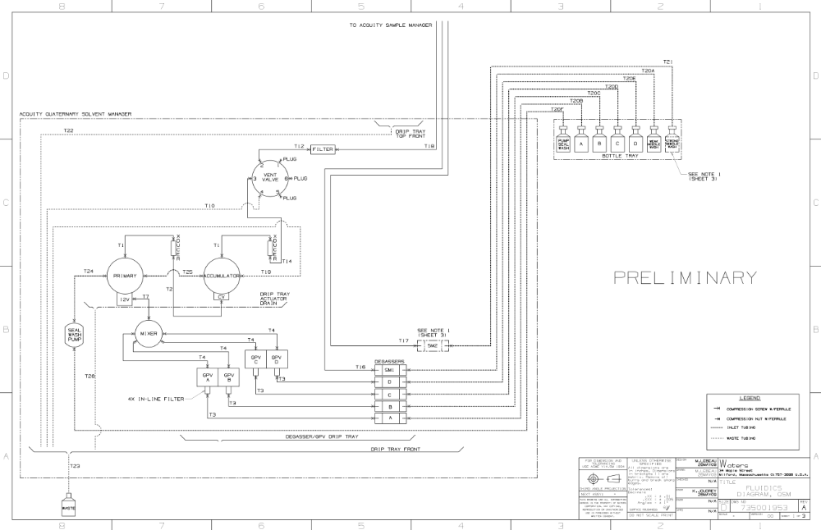
QSM Flow Diagram

Slide 7
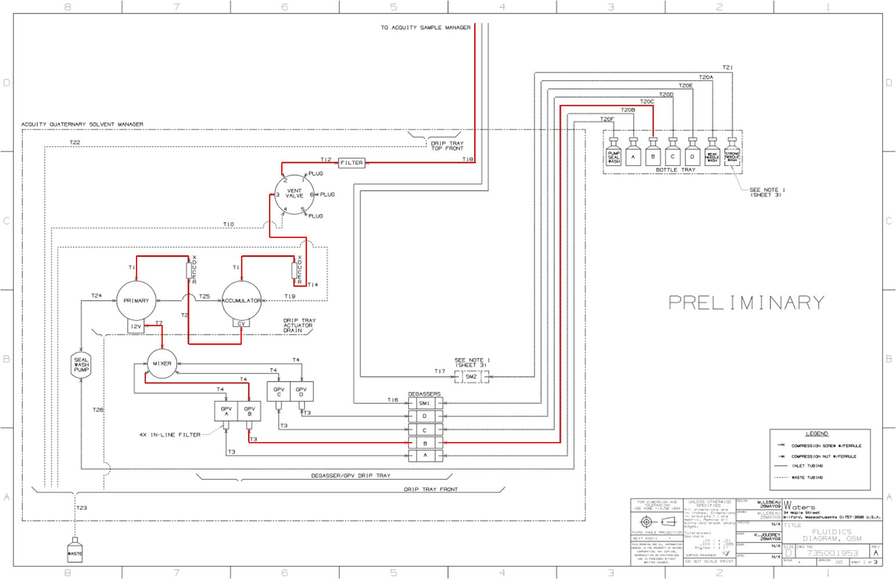
QSM Flow Diagram
The approximate dwell volume of the QSM fluidics will be 345ul to the SMDI Inject valve.

Slide 8
QSM Fluidics-Front View
Primary Head
Accumulator Head
100ul Mixer
Vent Valve
Low Pressure
Manifold
Degasser Chambers
Gradient Proportioning Valve Pairs
Seal Wash Pump

Slide 9
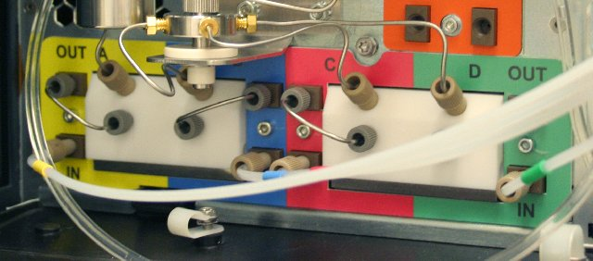
QSM Degasser / GPV Flow Path
3- GPV Outlet to LP Manifold inlet
Sample Manager Purge Solvent Degasser Chamber
2- Degasser Chamber outlet to GPV inlet
1- Solvent Bottle to Degasser Chamber inlet

Slide 10
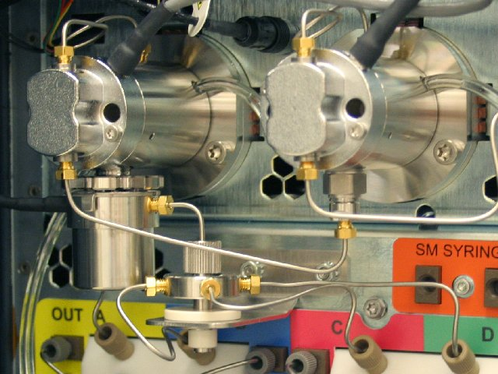
QSM Pump Head Flow Path
3- Primary Head Transducer to
Accumulator Check Valve
4- Accumulator Head Transducer
to Vent Valve
I2V Actuator
2- LP Manifold to Primary I2V
1- GPV Outlet to LP
Mixing Manifold

Slide 11
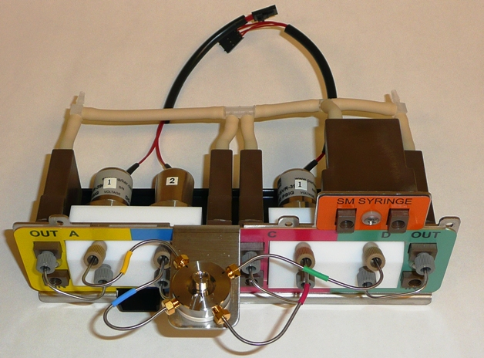
GPV Degasser Assembly

Slide 12
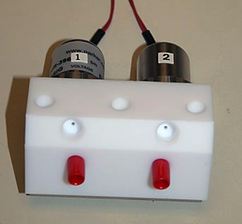
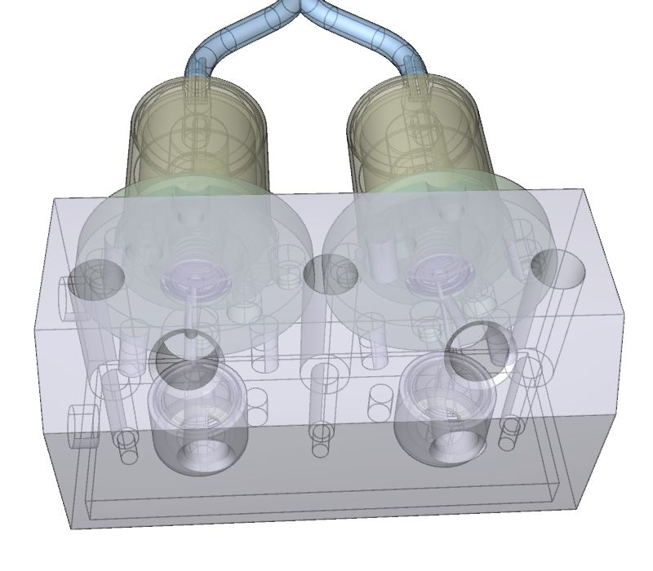
GPV Valve Pair
Same proven Alliance type GPV valve
Located closer to the head to keep dwell volume down
Can be replaced as a pair for lower maintenance costs

Slide 13
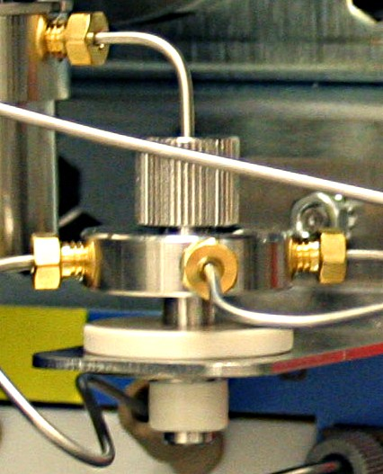
LP Manifold
Knurled Knob SS Fitting
Support Bracket

Slide 14
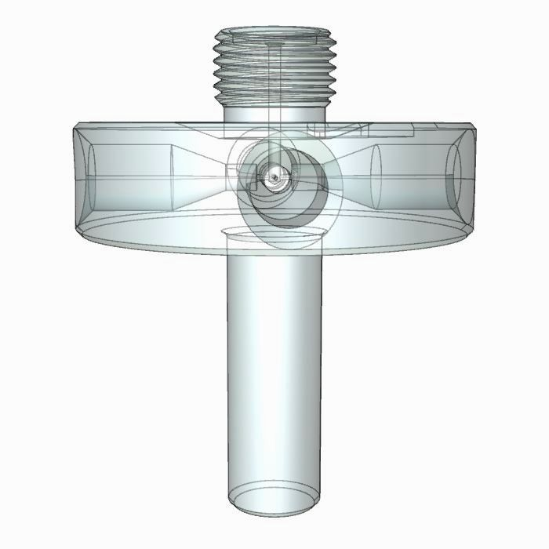
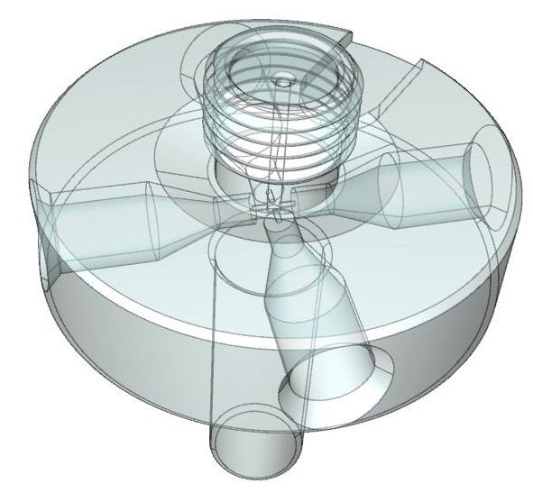
LP Manifold
Side View
Top View

Slide 15
Gradient Proportioning Sequence
0% to 90%B- “ABBA” Sequence
A
B
B
A
A
B
B
A
A
B
B
A
A
B
B
A
A
B
B
A
~10%B
~80%B
Gaps shown are for illustration purposes only. There are no actual gaps in sequence.
90% to 99%B- “BAB” Sequence
B
A
B
B
A
B
B
A
B
B
A
B

Slide 16
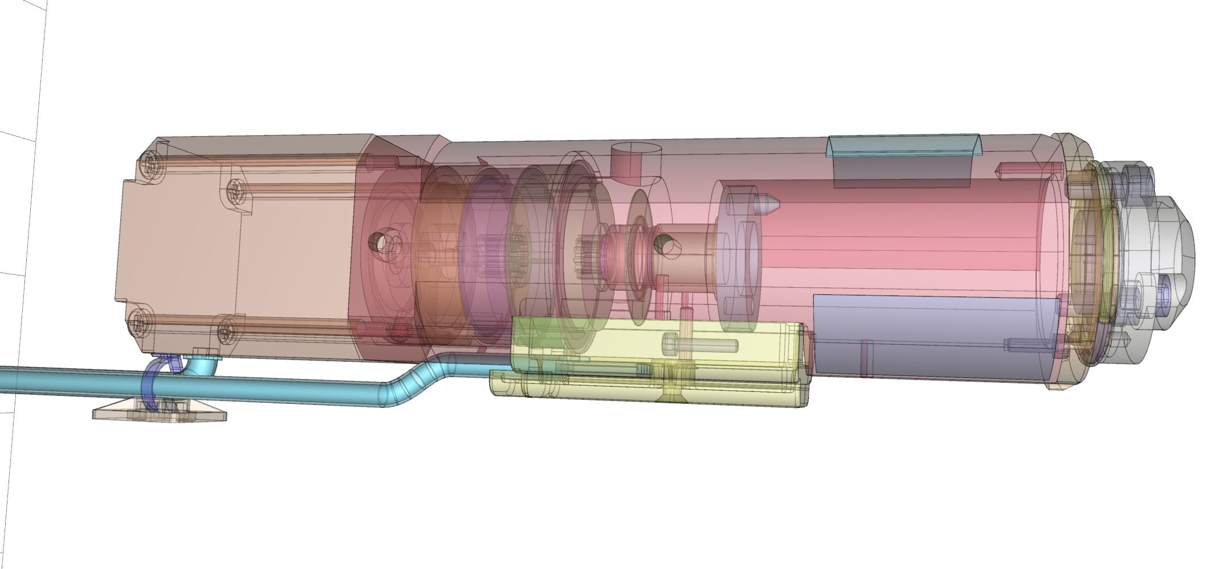
QSM Internal Components

Slide 17
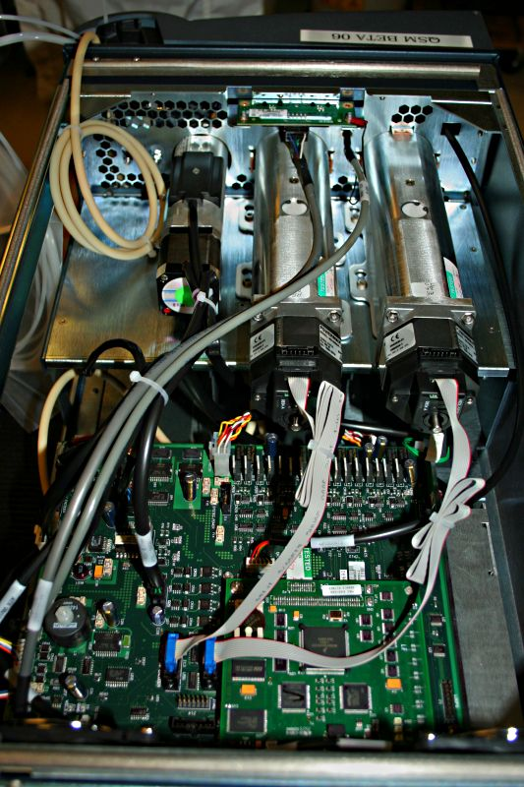
QSM Internal Components- Top View
Primary and Accumulator Actuators
Vent Valve
Power Supply
Personality
Card
CCPU2K3V

Slide 18
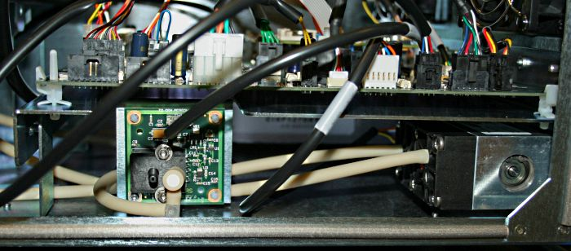
QSM Right Side View
Degasser Gauge PCB
Power Supply
Degasser Pump

Slide 19
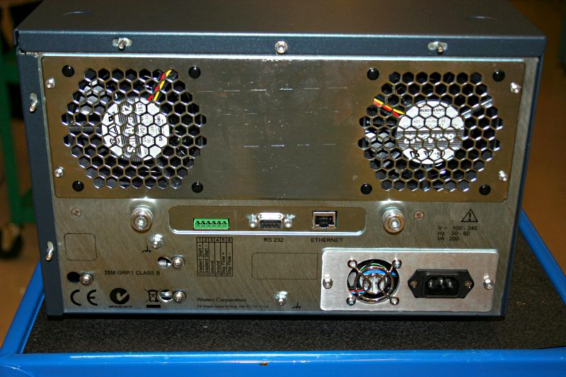
QSM Rear Panel
Vacuum Pump Attachment Screws
ENET and RS232 Connectors
Power Supply

Slide 20
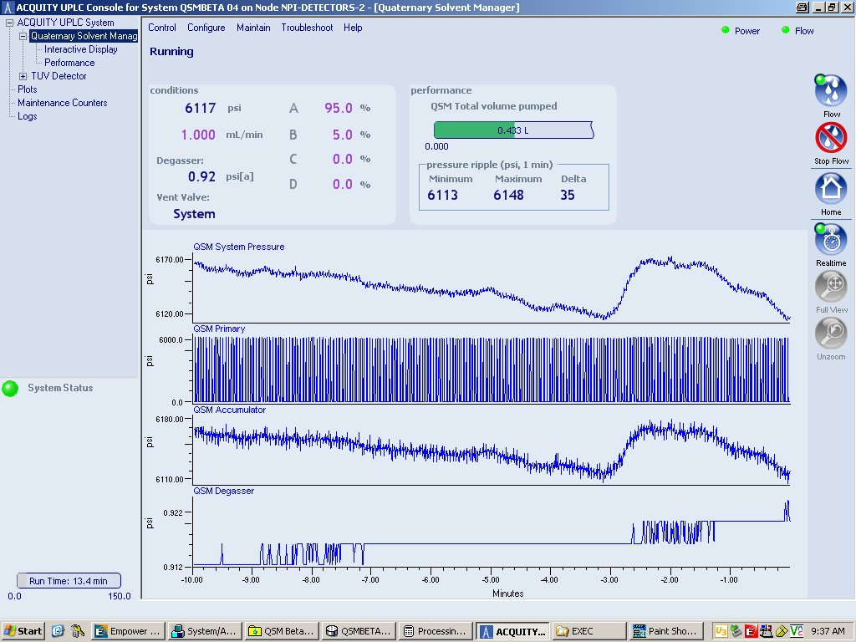
QSM Console Top Level Menu

Slide 21
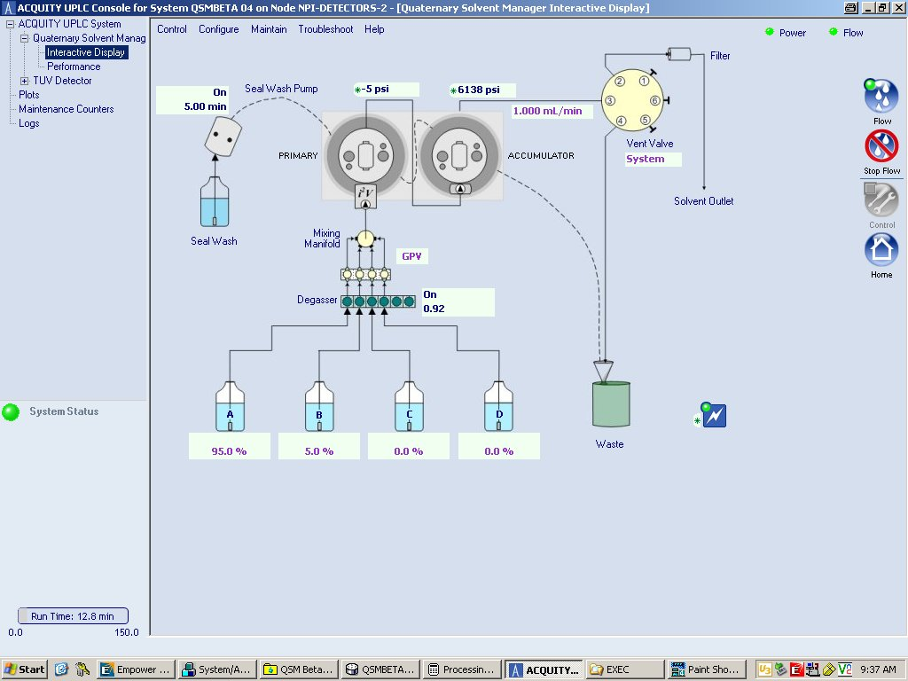
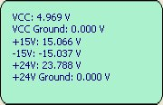
QSM Console Interactive Menu

Slide 22
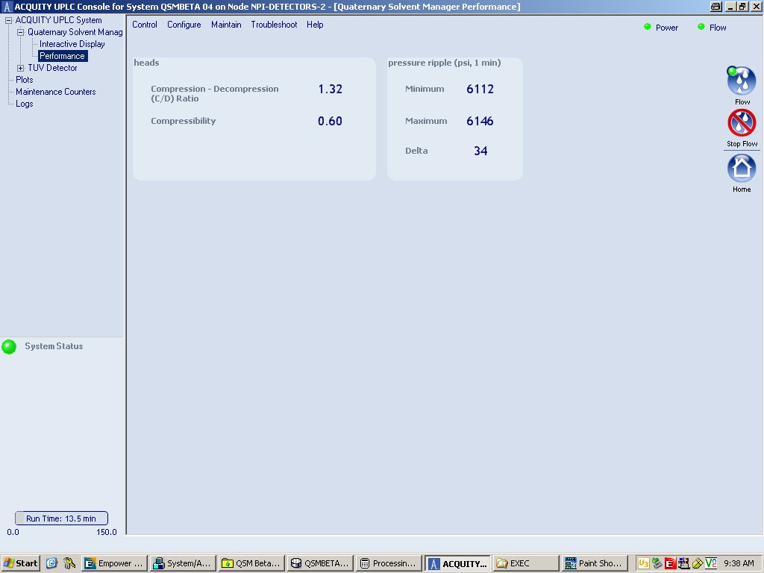
QSM Console Performance Menu

Slide 23
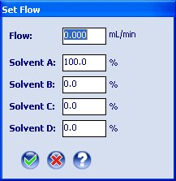
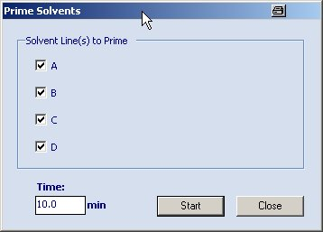
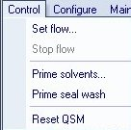
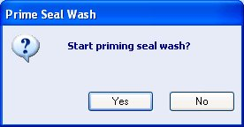
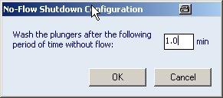
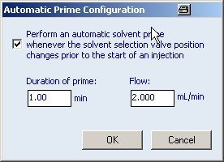
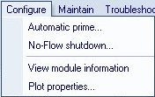
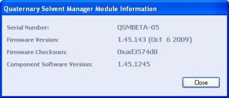
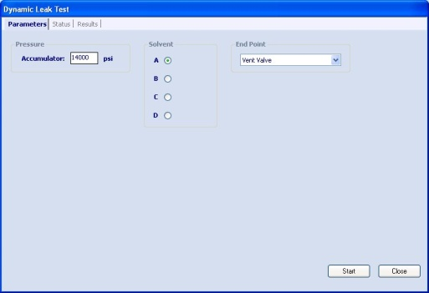
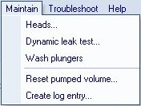
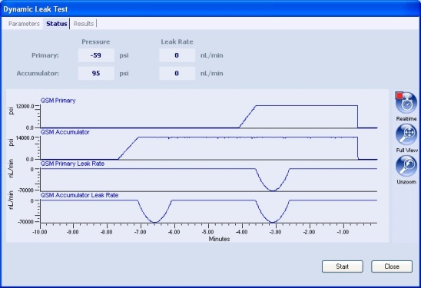
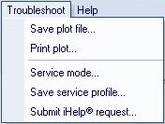
QSM Console- New Pull-Down Menus

Slide 24
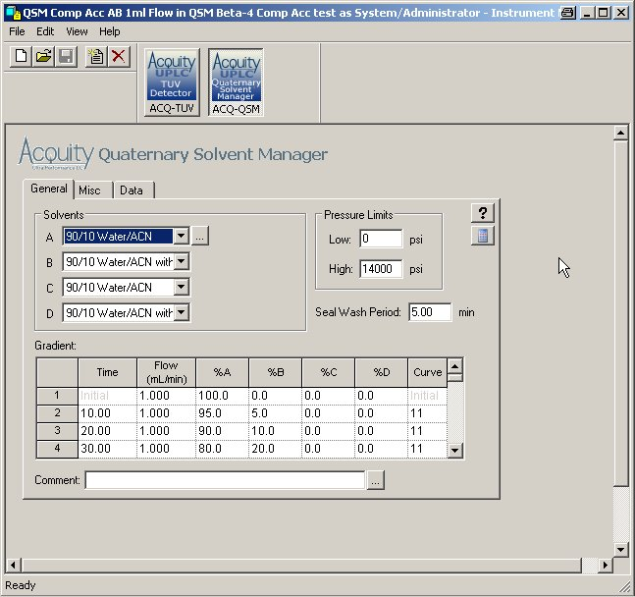
QSM Instrument Method-General Tab
Solvent Descriptions here form the pull-down menus. Descriptions can be added by clicking the edit button.
The ACQUITY Calculator can be accessed by clicking the Calculator button or alternately from the ACQUITY console top-level menu.
Gradients or isocratic conditions are entered in the Gradient Table. Binary to Quaternary gradients may now be specified. Standard Waters gradient Curves apply.

Slide 25
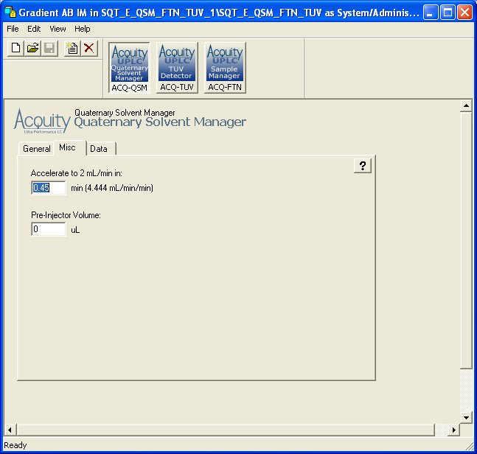
QSM Instrument Method-Misc Tab
A flow acceleration rate can be entered in this field. Once downloaded to the QSM the flow rate will ramp up at the prescribed rate.
The Pre-Injector Volume specifies the volume from the QSM to the SMDI inject valve. When a value other then zero is entered, the injection will be delayed until the QSM has pumped the prescribed volume of the gradient. Approximate volume is 345ul.

Slide 26
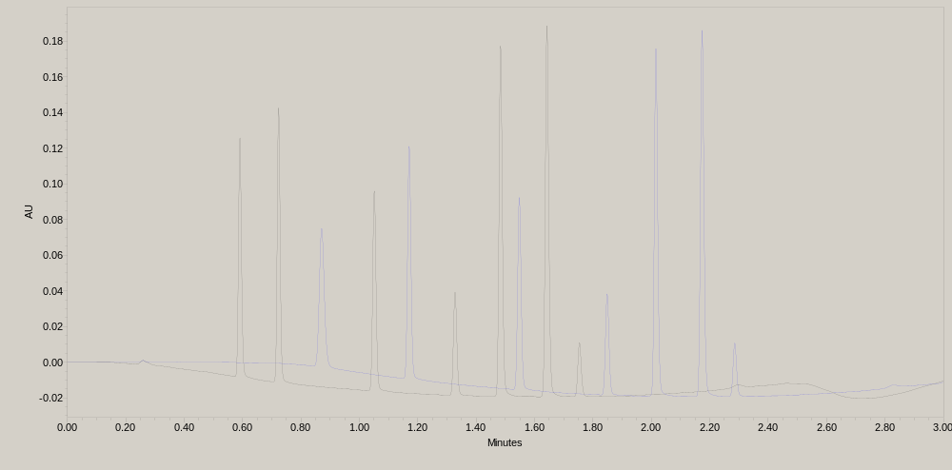
Effect of the Pre-Injector Volume Field
Blue Chromatogram- No PI Delay Black Chromatogram- 300ul PI Delay

Slide 27
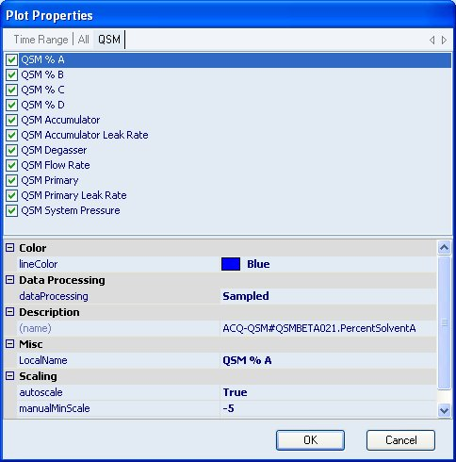
QSM Instrument Method-Data Tab
Select the QSM diagnostic data channels to acquire. These will be saved as independent channels in Empower or MassLynx. Note: some of the above channels are enabled for beta testing only and will not be available in the released product.

Slide 28
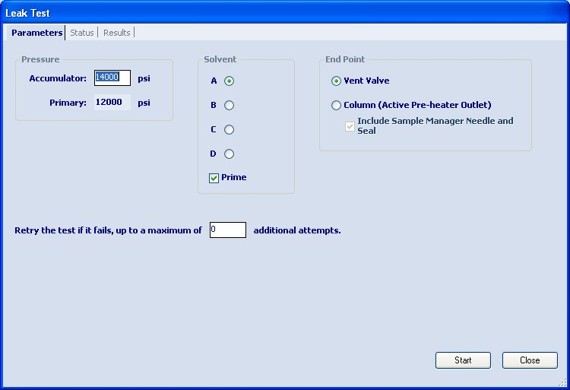
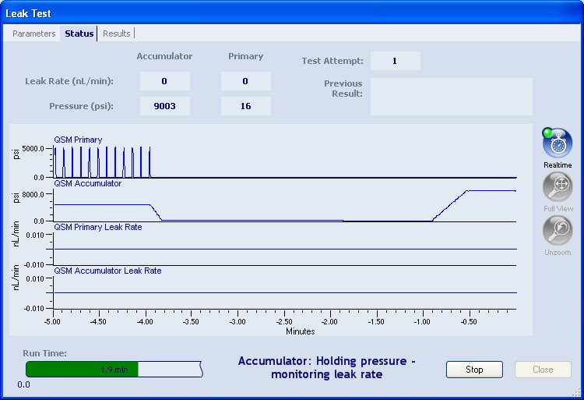
QSM Dynamic Leak Test

Slide 29
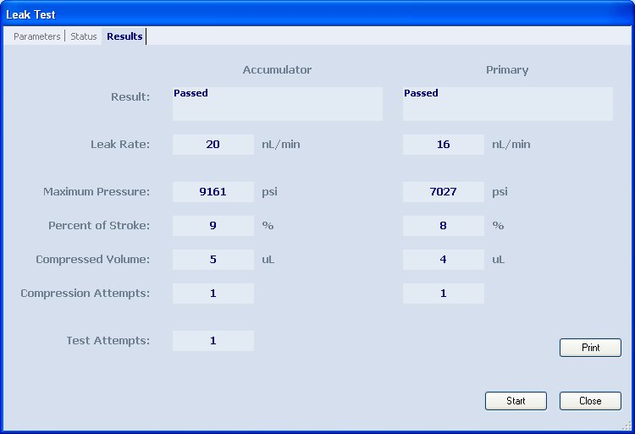
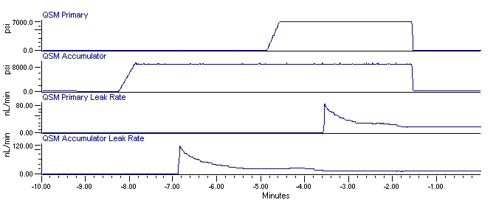
QSM Dynamic Leak Test Results

Slide 30
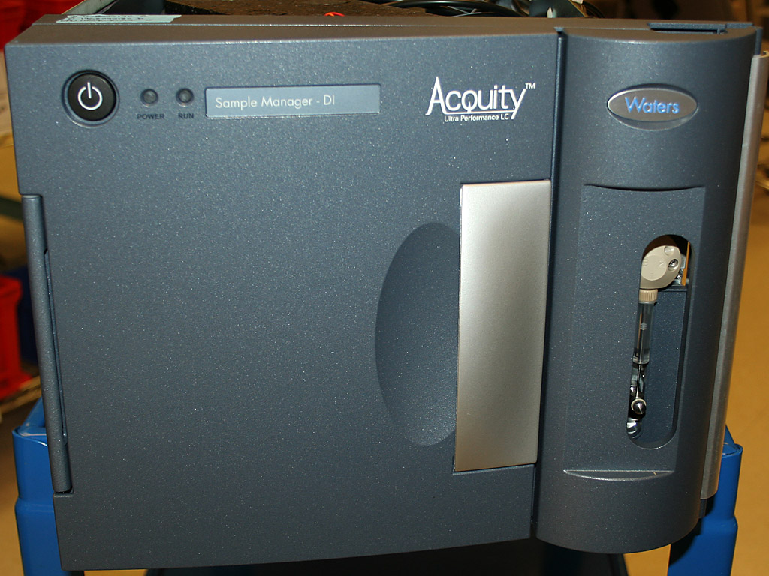

Slide 31
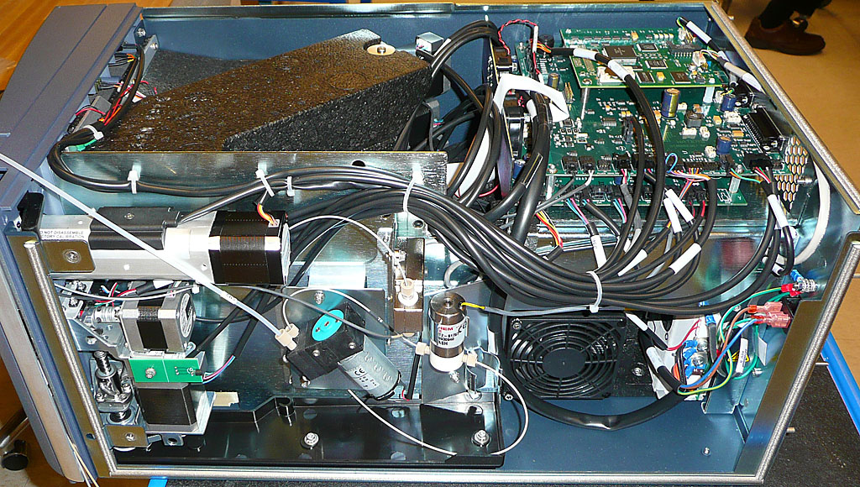
SM-FTN Component Overview
Sample Compartment Insulating Foam
CPU2000, Control and Driver PCB
Internal Fluidic Components
Heater/Cooler
Power Supply

Slide 32
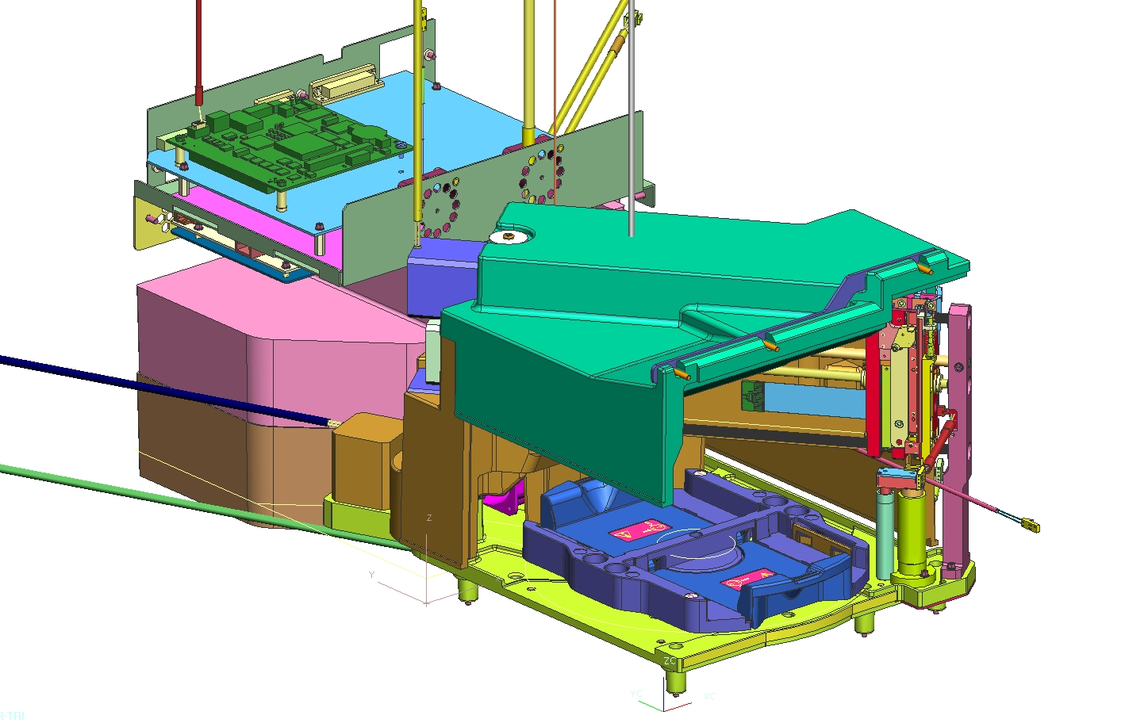
SMDI Component Overview
CPU2000, Control and Driver PCB
Sample Compartment Insulating Foam
Needle Drive Assembly
Rotary Tray and Datum Drive
R-Carriage Drive Assembly
Inject Block
Heater/Cooler Insulating Foam

Slide 33
Major Assemblies
Fluidics
R-Theta Drive Assembly
Sample Heater/Cooler Assembly
Electronics
Software Components

Slide 34
Fluidics

Slide 35
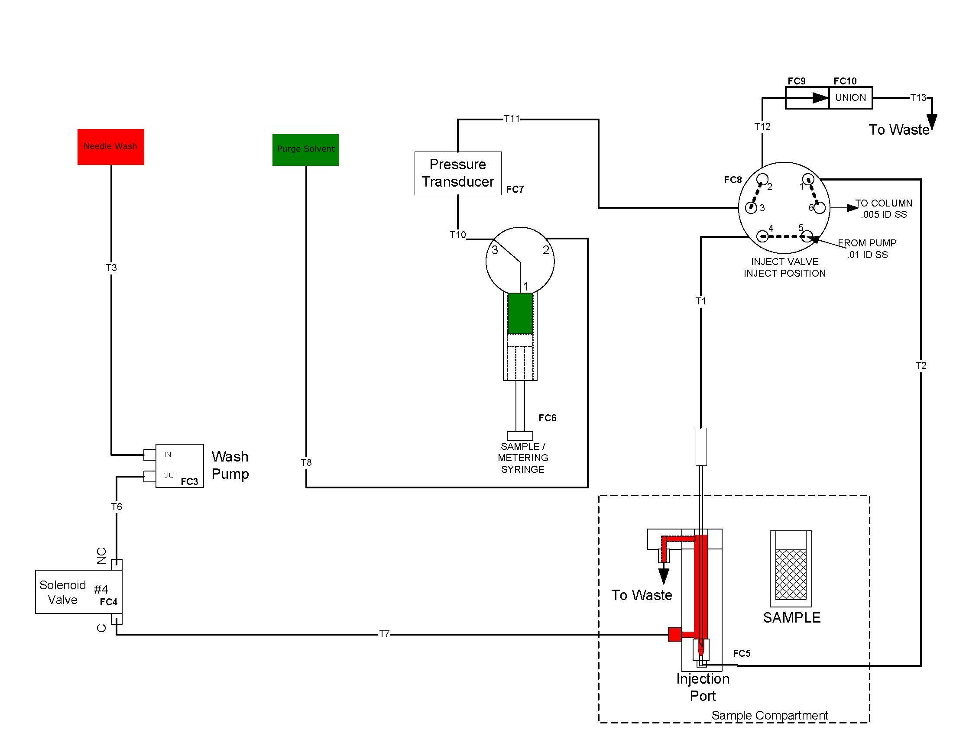
SM-FTN Flow Diagram
Wash
Solvent
Purge
Solvent

Slide 36
SM-FTN Flow Diagram
Wash
Solvent
Purge
Solvent

Slide 37
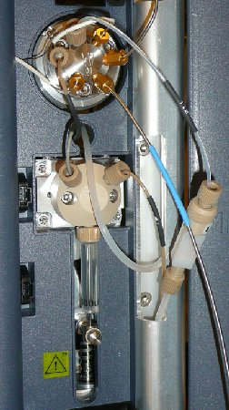
SMDI Front Panel Fluidics
Inject Valve
Metering Syringe Valve
Check Valve and Union
Leak Sensor Connections
Wash Solvent Inlet Line (not degassed)
Sample Metering Syringe

Slide 38
Inject Valve Assembly

Slide 39
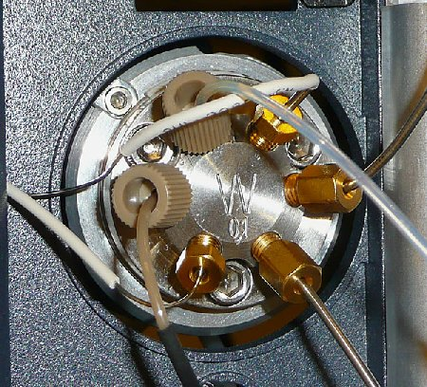
SDMI Inject Valve Connections
To Check Valve
Stationary Side Tube
To CH-A and Column
To Pressure Transducer
From Pump
To Sample Needle

Slide 40
SM-FTN Flow Diagram
Wash
Solvent
Purge
Solvent

Slide 41
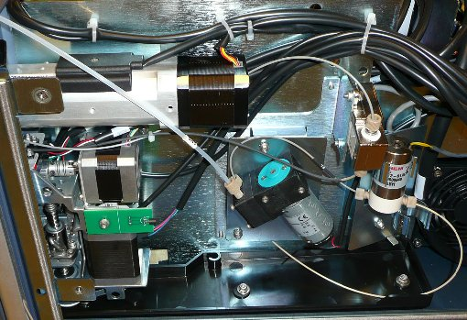
Internal Fluidic Connections
Inject Valve Motor Assembly
To Inject Valve Port 3
Pressure Transducer
Needle Wash Solenoid Valve
Room Temperature Sensor
To Needle Wash Solvent Bottle
Wash Pump
To Metering Syringe Valve Port 3
To Inject Block Wash Solvent Inlet fitting

Slide 42
SM-FTN Flow Diagram
Wash
Solvent
Purge
Solvent

Slide 43
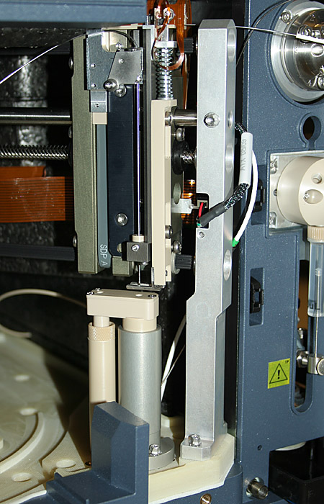
Internal Fluidic Components
Needle Carriage Assembly
Needle Lug Latch
SS Needle
Needle Seal Wash Housing Assembly
R-Carriage End Plate

Slide 44
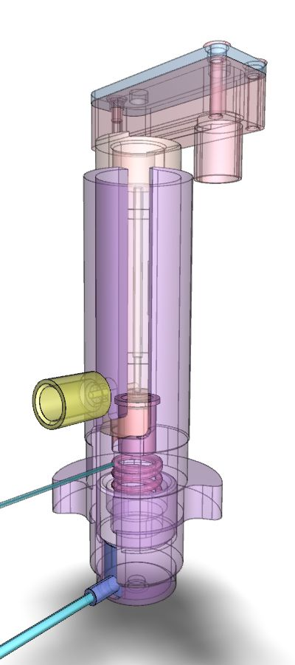

Needle Seal Wash Housing Assembly

Slide 45

NSW Assembly- Needle in Inject Position

Slide 46

NSW Assembly- Cutaway Diagram

Slide 47

NSW Assembly- Transparent View
Wash Solvent Inlet
Needle Wash Segment
Spring
Stationary Side Seal
(Vespel)
Load Cell

Slide 48

Stationary Side Seal Assembly
Stationary Side Cup Assembly
Vespel Seal
Stationary Side Tubing (to inject valve)

Slide 49

Needle Seal Wash Housing Assembly

Slide 50



Needle, Loop and Syringe Options

Slide 51
SM-FTN Injection Sequence

Slide 52


Sample Withdrawal Sequence

Slide 53
Flow Diagram- Sample Withdrawal
Wash
Solvent
Purge
Solvent

Slide 54


Sample Injection Sequence

Slide 55
Flow Diagram- Inject Mode
Wash
Solvent
Purge
Solvent

Slide 56

Injection Sequence Pressure Trace
1. Flow going through needle (in seal)
2. Flow switched to bypass needle (Port 5 to 6)
6. Injection occurs- Flow switched back through needle (Port 5 to 4)
3. Needle moves to vial
4. Sample withdrawal from vial
5. Needle moves back into seal.
7. SM syringe purges line to waste.

Slide 57

Sample Injection Sequence

Slide 58

Injection Sequence Pressure Trace
6. Injection occurs- Flow switched back through needle (Port 5 to 4)
1. Flow through needle (in seal)
2. Flow switched to bypass needle (Port 5 to 6)
4. Sample withdrawal from vial
7. SM syringe purges line to waste.
5. Needle moves back into seal.
3. Needle moves out of seal. Load cell to 0%

Slide 59

Needle Installation- Pre-Production Units

Slide 60

Needle Installation- Pre-Production Units

Slide 61

Needle Installation- Pre-Production Units

Slide 62


Needle Installation- Production Units

Slide 63

Needle Routing- Production Units

Slide 64
SM Performance

Slide 65
Injection Linearity for each configuration
Configuration | Extension Loop | Injection Volume | R² 0.999
15µL needle |  | 0.1 to 10µL | 0.2 to 10µL
30µL needle |  | 0.1 to 25µL | 0.2 to 25µL
Any needle | 50µL | Up to 50µL | 2 to 50µL
Any needle | 100µL | Up to 100µL | 10 to 100µL
Any needle | 250µL | Up to 250µL | 25 to 250µL

Slide 66
Carryover with UV Detection
Excellent carryover performance @ 0.0002% was achieved for chlorhexidine (a basic and difficult-to-remove compound) with the new sample manager flow-through-needle (SM-FTN) design.

Slide 67


3.5 AU Full Scale
Stress Injection @ 2mg/mL
1st Blank Injection
Carryover = 0.0002%

Slide 68
R-Theta Drive Assembly

Slide 69

R-Theta Drive Assembly

Slide 70

R-Theta Coordinated Movement

Slide 71

Sample Compartment
Power and Status LEDs
Plate Selector Switch
Power Switch
Magnetic Door Sensor
Rotary Tray
(Plate Holder)

Slide 72

Removing Sample Plates

Slide 73

Loading Sample Plates

Slide 74

Sample Compartment Top Foam Cover

Slide 75

Sample Compartment Top View

Slide 76

R-Carriage Assembly

Slide 77


Slide 78


Slide 79
Sample Heater/Cooler Assembly

Slide 80
Sample Heater/Cooler Assembly
Heater/Cooler Engine
Sample Compartment Insulation
Sample Compartment Temperature Probe

Slide 81

Heater/Cooler Engine

Slide 82

Heater/Cooler Engine in Foam Support

Slide 83

Sample Compartment Foam Cover

Slide 84

Sample Compartment Temperature Probe
Temperature Probe

Slide 85
Electronics

Slide 86

Electrical Interconnect Diagram

Slide 87

Power Supply
Power Supply

Slide 88

Power Supply

Slide 89

SM-FTN PCB Module Assembly

Slide 90

SM-FTN PCB Module Assembly

Slide 91


Slide 92

Ethernet Switch PCB

Slide 93

Ethernet Switch PCB

Slide 94

SM-FTN Rear Connections
CH-A Connector
Inject Start and Inject Hold
For HyperTerminal Diagnostics

Slide 95

SM-FTN Software Components

Slide 96
Software Components
Instrument Method Menus
ACQUITY Console Diagnostics and Control

Slide 97


SM Instrument Method- General Tab

Slide 98

SM Instrument Method- Dilution Tab

Slide 99

SM Instrument Method- Data Tab

Slide 100

SM Instrument Method- Events Tab

Slide 101

SM-FTN Interactive Display Menu

Slide 102
SM-FTN Interactive Display Menu

Slide 103

SM-FTN Interactive Display Menu

Slide 104


Z-Needle Calibration

Slide 105



Characterize Needle Seal

Slide 106


Needle Seal Readiness Test

Slide 107




Running the System Leak Test

Slide 108



Calibrate Rotary Tray
Tray is moved manually until these holes line up.
Calibration Pin is inserted into the lined up holes to lock the location.

Slide 109

Rotary Tray Calibratation Pin
Calibration Pin is located in SM door foam

Slide 110
High Temperature Column Heater with Active Pre-Heater (CH-A)

Slide 111

CH-A

Slide 112
Why Do We Heat Columns?
Retention depends upon average temperature
Viscosity and backpressure depend upon average temperature
Selectivity depends upon temperature
Reduced viscosity and faster diffusion can improve column efficiency
Peak Shape depends upon uniformity of column temperature
Goals:
  More consistent effective column temperatures
  Better peak shape
  Equivalency between column heater configurations

Slide 113
What Problem is the Active Inlet Pre-heater Attempting to Solve?
Heat Transfer Efficiency varies with configuration in the present passive inlet preheater
Temperature of the fluid entering the column depends upon how well the preheater is placed in its heating element
Inlet Temperature varies within Column Manager and between Column Heaters
Passive Preheater uses 22 inches of 0.005 inch ID tubing
  Longer than required for connection to column
  Length precludes selection of smaller ID
  Device adds pre-column dispersion
    Visible as loss of efficiency for ISOCRATIC separations
    Visible as a loss of efficiency for early peaks in gradient separations

Slide 114

CH-A
Complete Module:
Service can remove module without
disturbing ACQUITY stack.
New Door Latch
(No Magnets)

Slide 115

CH-A
Added Tubing Gasket (top and bottom)
For 3rd party Mass Spec at left side of
ACQUITY Stack.
Allows use of existing
Passive Pre-heater
Improved Door Gasket
No wires to connect
Active Pre-heater

Slide 116

CH-A Module Removed

Slide 117

CH-A Control PCB

Slide 118

CH-A Chasis

Slide 119

Active Pre-Heater and Sleeve (Beta)

Slide 120

Active Pre-Heater in Adaptor Sleeve

Slide 121

Installing the Active Pre-Heater

Slide 122

Switching CH-A for MS Use
New Style CH-A
Removed and switched to external bracket for MS position
Drip Tray added
Old Style CH-A
Rotated to MS position

Slide 123



Checking Active Pre-heater Function
Active Column Pre-heater should read present when in place and CH-A door is closed.
Pre-heater should read ambient temperature and ramp up quickly when a temperature is programmed.

Slide 124

Column Manager (CM-A)
4 - 90°C -> Multi-zone (Independent control of each trough)
Supports up to 2 columns, 2.1 to 4.6 mm, up to 150 mm with filter or guard column
Two 7-port, 6-position switching valves
  Front-mounted for easy access
  Bypass and Waste supported
Stackable (up to 3 CM-A) for support of up to 6 columns
Notes:
We’ll be adding to the H class system over the next few weeks what we would call a Column Manager. It is a device that automatically selects one of two columns. You can have as many as three of these devices on a single H class system for a total of six columns. That gives us the ability to run a sample on a series of columns to find the best selectivity. Each one of these chambers, each one of these paths in the Column Manager has independent temperature control with active pre-heating for each of the individual columns, so we can test the selectivity effects of different mobile phases, different temperatures and different operating conditions on the series of columns to find the best possible separation for a particular sample.

