Slide 1
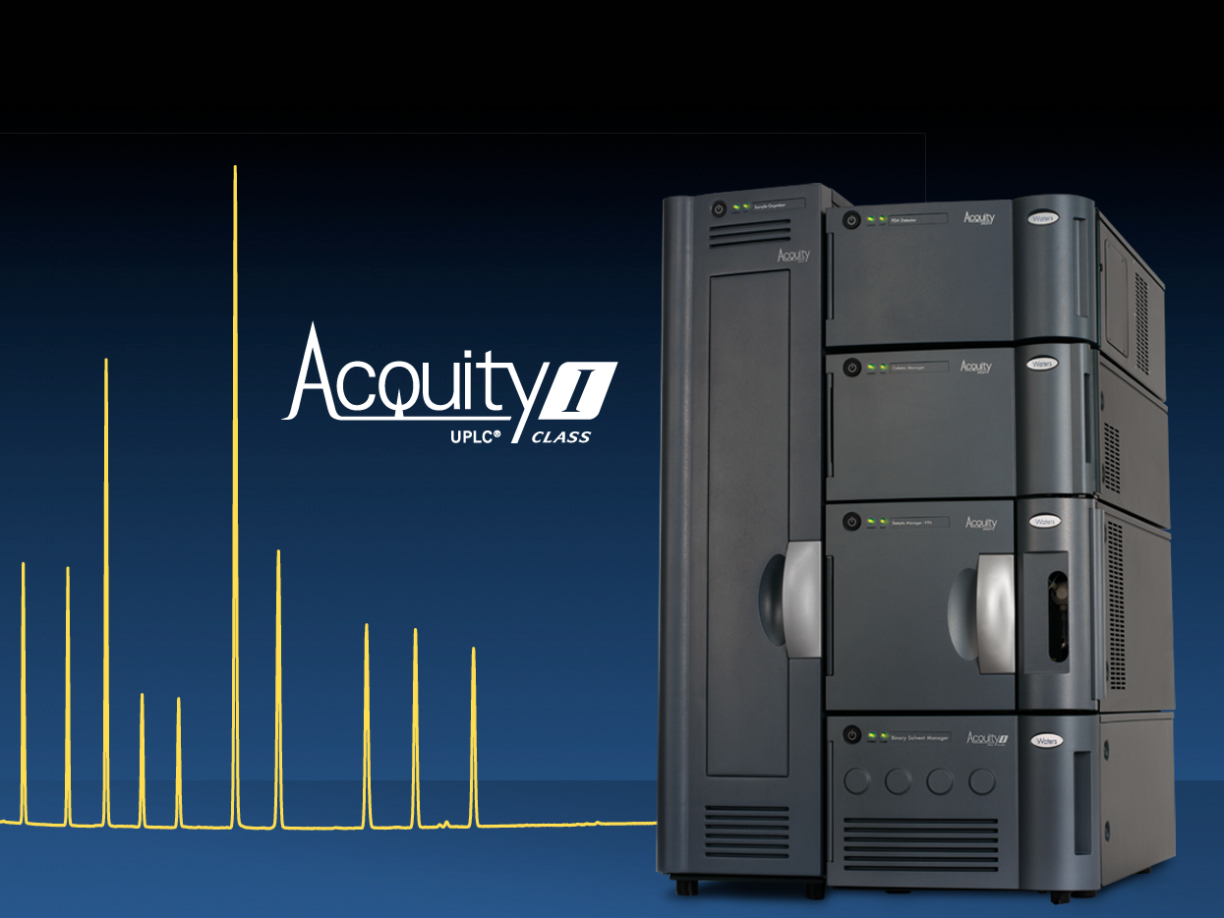
Extending the ACQUITY UPLC Family…

Slide 2

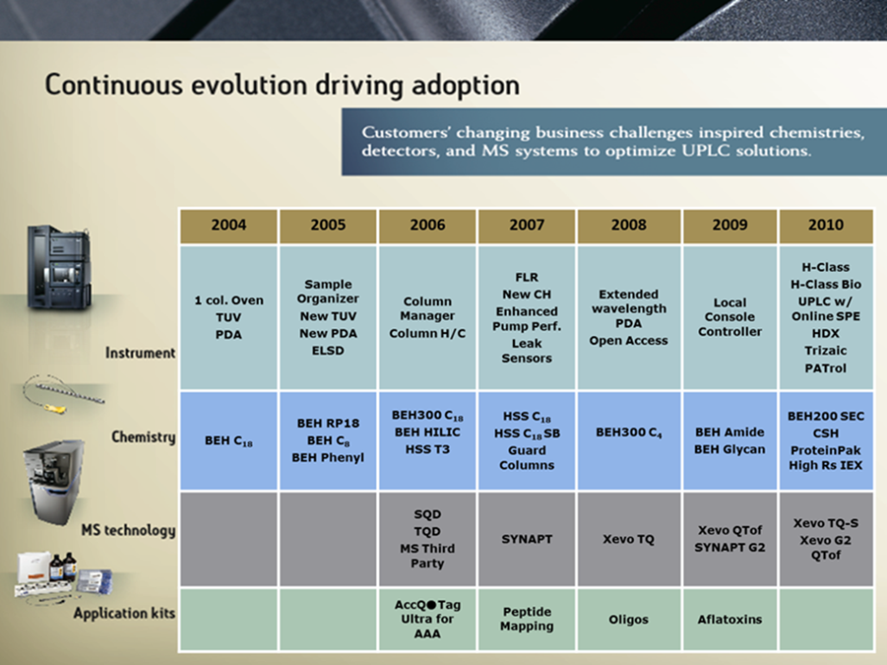
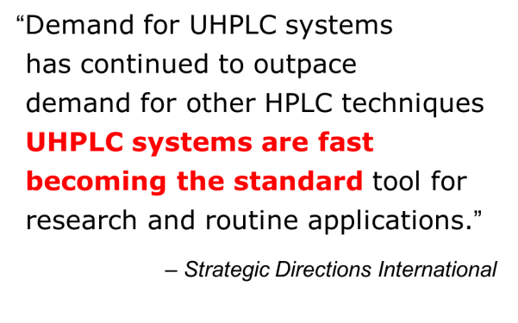
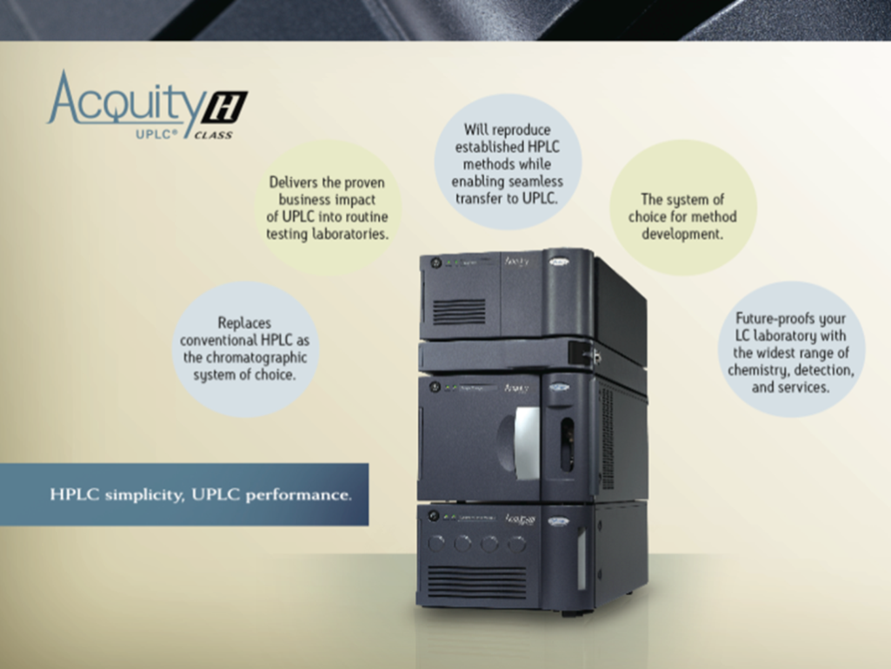
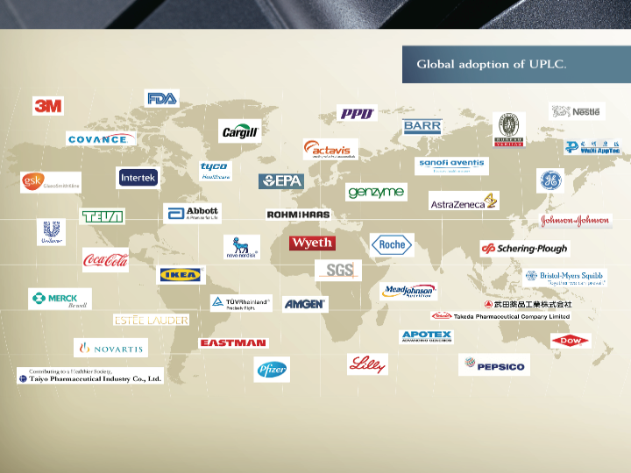
Notes:
This is just a small selection of some of the global organisations that have implemented ACQUITY UPLC and are realising significant business benefits in their laboratories around the World. You will see from the companies listed that UPLC is established in many different types of organisations and we do now have thousands of users Worldwide.

Slide 3
Challenges Continued …
Need Ability to See More
Complex separation challenges which require systems that are designed to maximize the benefits of sub 2 µm particle
Focusing on minimizing dispersion to enhance chromatographic resolution and sensitivity of UV and MS
Lowering carryover complements MS sensitivity and extends MS linear dynamic range
The system’s low dispersion and faster cycle-time allows complex separations to be accelerated without compromising chromatographic performance
Notes:
Why have customers driven us to improve? Customers are facing more complex separation challenges require UPLC systems that are designed to maximize the benefits of sub 2µm particle columns. Although, Regulated Bioanalysis is the example, but there are many examples in other industries where changes in regulations, new sampling techniques and new molecules require new solutions. So many of the issues that are represented below by Regulated Bioanalysis resonate with many other potential users.
ACQUITY UPLC I-Class is the pinnacle of LC performance and now we can review 3 examples are how the performance of I-Class can impact customers, dispersion and sensitivity improvement; CO and why an improvement is critical here and finally how the system can improve cycle time w/o compromising the separation itself.

Slide 4

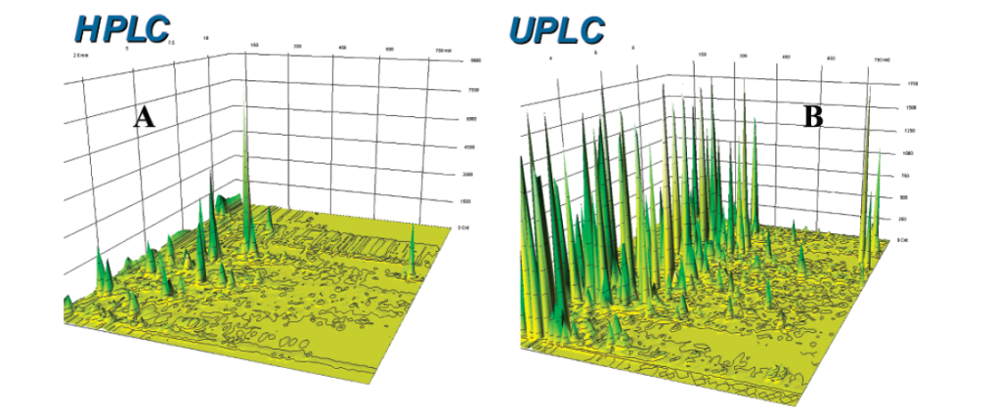
Introducing ACQUITY UPLC I-Class
The ACQUITY UPLC I-Class System represents
The ACQUITY UPLC I-Class System accomplishes
More recent evolution of UPLC
Based on 7 years of engineering innovation
Fueled by customer input
Pinnacle of chromatographic performance
Highest throughput without compromising performance
Maximum Peak Capacity
Enhances the performance of any Mass Spectrometer
Better data quality
Notes:
The ACQUITY UPLC I-Class system achieves this highest level of performance by maximizing peak capacity and includes features that enhance the sensitivity and complement Mass detectors to make the system the best inlet for any Mass spectrometer.
The new ACQUITY UPLC I-Class System represents the next step in the evolution of UPLC technology.
It is simply the best UPLC yet, and attains the pinnacle of separation performance.
The system has been designed using the tools and understanding, developed from 7 years experience of working to meet our customers’ needs.
At Waters, products are developed, using a strategy of innovation which allows Waters to respond rapidly to changes in the market.
And today, customers are demanding even higher standards of performance so that they can meet the evolving requirements of their own industries, and Bioanalysis exemplifies this. Users need to generate the best results ever. And this has led to the development of the ACQUITY UPLC I-Class system.
(The ACQUITY UPLC I-Class system achieves these performance gains by maximizing peak capacity and includes features that enhance the sensitivity of Mass detection, to make the system the best inlet for any Mass spectrometer.)
4

Slide 5
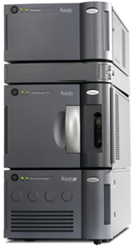
ACQUITY UPLC I-Class System
What is it?
Full range of ACQUITY UPLC Column chemistries
New cells for TUV and PDA
  500 nl/10mm
  250 nl/10 mm (for 1mm ID columns)
Compatible with FLR, ELSD & all MS
Column ovens
  Single or multiple column
  New APH with smaller ID
Sample manager (SM-FTN or SM-FL)
  Less dispersion volume (tubing, valve)
  Improved carry over
Binary solvent manager (BSM)
  1200 bars
  New flow path with smaller ID
Notes:
Overall the entire ACQUITY UPLC I-Class system including tubing length, I.D.’s and internal finish and fittings have been improved to reduce volumes compared to current ACQUITY UPLC (and ACQUITY UPLC H-Class systems) to provide the lowest dispersion characteristics of any analytical UPLC system on the market.
The ACQUITY UPLC I-Class system is based upon a high pressure binary solvent manager that combines high pressure mixing with the lowest dwell or system volume.
The system is offered with a choice of autosampler and users can choose a configuration that includes either the ACQUITY UPLC style, Sample Manager with a Fixed Loop design. Or the customer can choose a re-engineered, optimized version of the Flow-Through-Needle Sample Manager (this is the design used in the popular H-Class system).
There are two column management options either a single column heater module or a column manager module which supports up to two columns. Both column management module designs are based on the successful H-Class system and use active inlet solvent pre-heating. This technology offers very uniform and consistent temperature control and temperatures between each module type and between, individual systems are conserved.
The dual column heater/cooler offers two column selection or with another set of optional valves that can be swapped in and along with a second pump, to offer multi-pump, multi-valve configurations which enable capabilities such as selective peak trapping for removing of interferences or pre-concentration to improve sensitivity for dilute samples.
The system will be offered with the same ACQUITY UPLC absorbance detectors - either of the 2 ACQUITY UPLC PDA detectors or the ACQUITY UPLC TUV. However, the UV detectors will be available with two new flow cells for each detector, Each is optimized for the lowest possible dispersion. Matching peak volume to the flow cell volume is important to prevent dilution and peak distortion has been recognized by Waters. Although this remains an area that many u-HPLC manufactures neglect. Standard HPLC cells diffuse separation in as little as 2 μL (recognize that the Agilent 60 mm pathlength flow cell has a volume of 4 μL).
The first a new flow cell is a lower dispersion/lower bandspreading version of the existing analytical 500 nL/10 mm pathlength flow cell, and the second new flow cell has half the volume, 250 nL with the same 10 mm pathlength which is designed for high resolution chromatography using 1.0 mm I.D. columns.
The full range of ACQUITY UPLC sub 2 micron column chemistry products are supported.

Slide 6
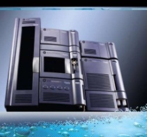
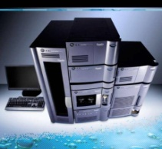
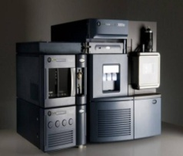
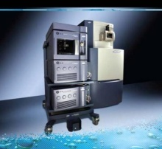
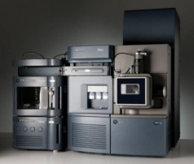
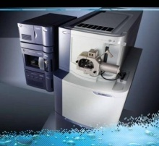
ACQUITY UPLC I-Class
The Pinnacle of Chromatographic Performance
Take full advantage of resolution benefits offered by Sub 2um particles and low dispersion fluidics
Get accelerated complex separations achieved with low system’s dispersion & faster cycle-time
Obtain the best sensitivity with lowest carryover autosampler
ACQUITY® SQD
ACQUITY® TQD
Xevo™ TQ MS
SYNAPT™ G2 MS
Xevo™ QTof MS
SYNAPT™ G2 HDMS

Slide 7
Instrument Contribution to
Bandspread/Extra-Column Effects
Injection
volume
+
injector
band-
spreading
Tubing
between
injector
and
column
Column
volume
+
frits
Tubing
between
column
and
detector
Band-
spreading
inside the
detector
cell
+
tubing
Time-based
Band-
spreading
in the
Detector
(Sampling
Rate; Time
Constant)
Engineering developments have specifically improved dispersion
  Injector design, injector volume, fittings, flow path, sealing surfaces
  Reduced tubing volumes - higher pressure/extended flow rate range
  Improved flow cell dispersion
Notes:
All the key changes in the system have all been made to improve dispersion….the elements of the system affect the column operating efficiency are encompassed by the term “Extra-column effects”.
Once the column separates solubilized components, the efficiency of that separations is affected directly by the system. Therefore for I-Class design, development paid close attention to the tubing, its ID and length has been reduced and hence its volume.
This effect is measured by chromatographers by calculating bandspread (and as you will see I-Class systems specify this value), which measures the volume of a peak at a SPECIFIED peak width for an injected single component when the column is removed.
Also critically, system fittings, all of the UPLC’s flow path and sealing surfaces have been optimized. It is not just volume but the fluidic flow characteristics of the system that affect peak shape.
NOTE interestingly THERE ARE NO FRITS IN THE INJECTOR AND THE DETECTOR in the ACQUITY UPLC I-Class system design.
The existing injector designs have been changed to reduce volume and increase efficiency.
Finally, as just discussed. Waters’ engineers improved the existing analytical UV flow cell dispersion and created a new low volume (250uL)/ 10 mm pathlength. (Used for 1 mm chromatography).

Slide 8
Extra Colum Volume
Contribution Of Tubing ID
Tubing ID | Volume/foot | Volume/100 cm
0.009’’ | 12 µl | 42 µl
0.005’’ | 3.5 µl | 12.5 µl
0.004’’ | 2.5 µl | 8.2 µl
0.003’’ | 1.4 µl | 4.6 µl
How does it translate to chromatographic performances?
  Peak capacity is increased (with decreasing ID)
  Peak shape is improved
  Overal chromatographic performances are strongly impacted
  Pressure drop created with tubings is increased
    ΔP α 1/ID⁴
0.003’’ vs 0.004’’: 50% less volume, 3x more pressure
Higher pressure limit is required, just a tool, a technology enabler
Higher pressure is not a goal

Slide 9
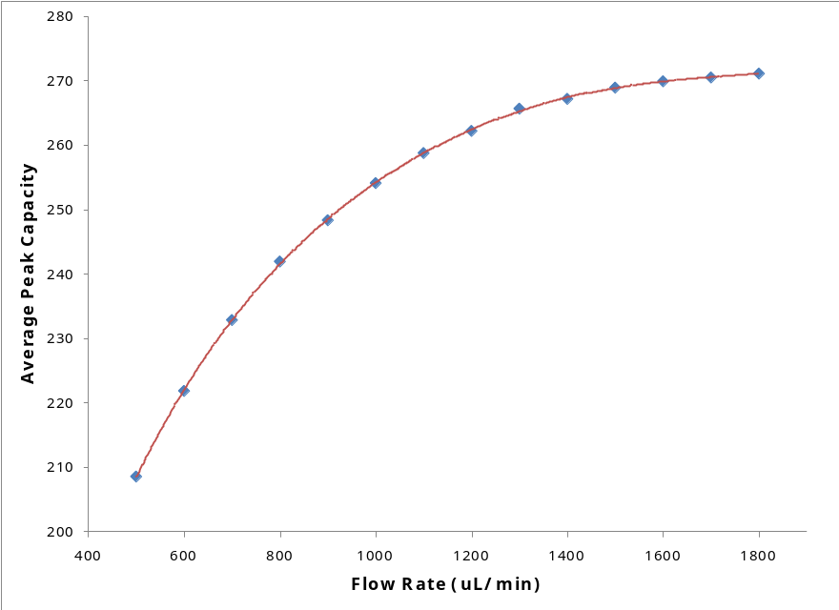
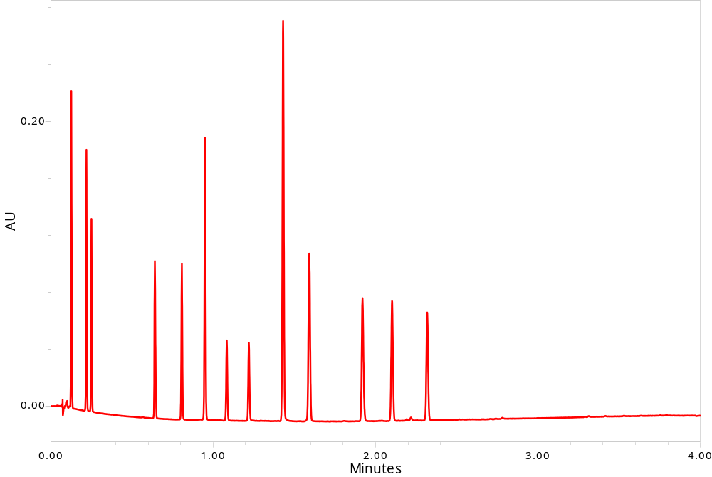
NEW Binary Solvent Manager
ACQUITY UPLC I-Class BSM
Peak Capacity = 271
Flow Rate = 1.8mL/min
High pressure binary mixing
  1200 bars maximum
  0.01 - 2 mL/min
  Four solvents (A1 or A2 and B1 or B2)
New pump head, seals, vent valves & Intelligent Intake Valves (i²V)
New higher pressure mixers
  50 µL default, 100 µL, and 380 µL
Notes:
By definition, the new ACQUITY UPLC I-Class Binary Solvent manager can operate up to 18,000 PSI maximum
The unit has functionality based upon the familiar ACQUITY UPLC BSM and with the same robust performance. Waters remains the only manufacturer PROVIDING electronically controlled check valves which ensure the highest level of performance.
Although the new pump looks similar to the original BSM, it has several key differences. The materials and coatings used for sealing surfaces have been improved andlong with enhancing the surface smoothness and the strength, in order to ensure robust and reliable performance at 18,000 PSI. The 18,000 psi seals have a new design which features multiple sealing surfaces and superior seal lifetime.
The tubing in the pump flow path is now FABRICATED from the MP35N alloy which is used in the ACQUITY H Class Bio system and in the Waters’ Alliance Sample Manager’s injection needle. It ensures a higher level of inertness and enhances the reliability of the solvent manager.
Other changes include: improved fittings and new mixers, all designed for operation at 18,000 psi. The mixer volumes are the same as in the current ACQUITY UPLC, to ensure easy method transfer.

Slide 10
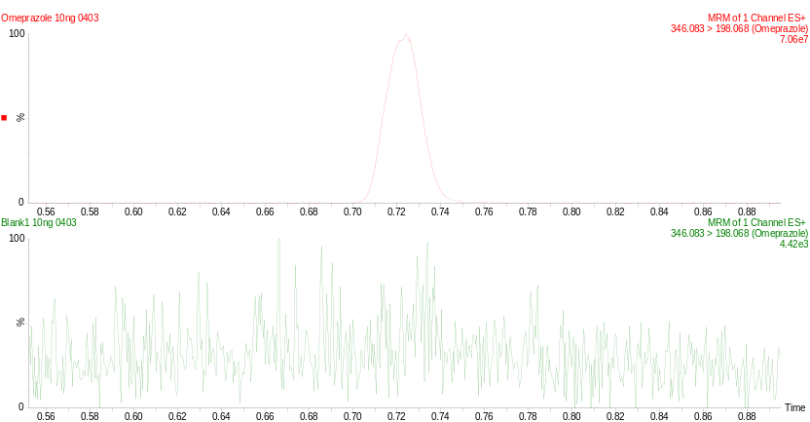
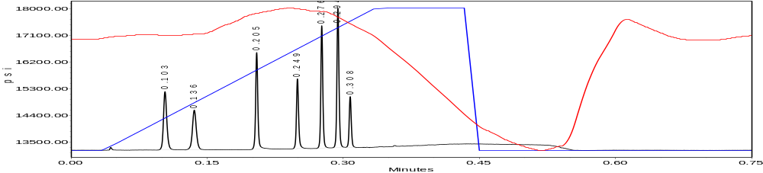
Two NEW Sample Managers
Fixed Loop
Flow Through Needle
New EverFlow inject valve design
to enable higher pressures
ACQUITY UPLC H-Class chassis and robust rotary sample tray/plate mechanism
Compatible with newest Sample Organizer (18 shelves)
New low dispersion fittings, shorter sample path for the FL (10 µL)
Low dispersion 1, 2, 5 & 10-µL loop design
  Conventional 20, 100, and
  250 µL available
System volume <95 µL
New low dispersion fittings, lower dispersion needle seal for the FTN
Optional extension coil
  System volume <100 µL
Notes:
Now let’s discuss the 2 new sample manager options: the Sample Manager – Fixed Loop (SM-FL) and the Sample Manager – Flow-through Needle (SM-FTN).
The SM-FL features a transfer mechanism, drawing the sample and holding it in a sample loop and on injection transferring the entire loop contents to the head of the column. When the smallest loops are used the dispersion is reduced to its lowest possible volume. The range of volume depends upon the size of the loop and ranges from 10% to 75% of the loop volume. The range is changed by changing the loop.
In the SM-FTN design, the sample aliquot and the entire needle are brought online to deliver contents to the head of the column. The injection volume range depends upon the size of the needle and its extension coil and is not limited as is the case in SM-FL design. This design promotes the lowest possible carryover as the entire fluid path of the SM experiences the gradient. This design choice offers the lowest possible dispersion with excellent carryover performance.
The sample managers both take advantage of the circular two holder/tray platform that rotates a full 360 degrees – the “R-theta” mechanism. This design promotes uniform temperature control but more importantly by rotating the sample into position the required length of the sampling needle is reduced along with dispersion.
Both sample managers are compatible with the new H-Class style Sample Organizer to extend total sample capacity.
While the two sample managers look the same and seem closely related to their predecessors, they both feature new components and differ from the ACQUITY UPLC and the H-Class, as dispersion and total volume are reduced.
The injection valves of both and the SM-FTN needle seal support 18,000 PSI operation. The valve surfaces have been completely re-ENGINEERED and represent significant advantages for both robust operation at higher pressure and reduced carryover. The design of these valves and materials is proprietary. Similarly, the needles, loops, tubing, fittings, materials and surfaces have all been improved to reduce dispersion and to control carryover.
The two sample Managers are the modules that confer the difference in dwell volume of the two I-Class configurations - <95 µL for the FL and <100 µL for the FTN. Thus the FL is the lowest dispersion configuration.
To reinforce the differentiation. Here we have a 1.0 mm ID column separation run on the ACQUITY UPLC FL based system to demonstrate speed of analysis with highest peak capacity, and reduced solvent consumption – it is the separation of 7 peaks with a gradient duration of 20 seconds, run on a 1.0 x50 mm column, a total run time of 45 seconds and the Average peak capacity at 5σ of 70. For this analysis truly minimal dispersion is important. However, this is an aggressive example – for occasional users of 1.0 mm columns the FTN is perfectly adequate.
In the second example is a reminder of the FTN’s excellent carryover performance, and that is perfectly suited for the highest sensitivity Mass Spectrometers. Here less than 500 attograms of Omeprazole can be detected in blank following 10 pg injection

Slide 11
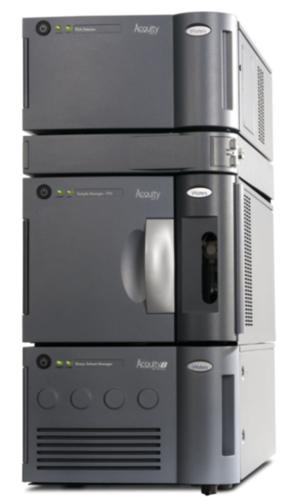

I-Class FTN vs. I-Class FL:
Comparison Summary
 | ACQUITY | I-Class FTN | I-Class FL
Dwell Volume* | 120 µL | 100 µL | 95 µL
Bandspread* | 12 µL | <9 µL | <7 µL
Carryover | 0.005 % | 0.001 % | 0.002 %
Precision | <0.3% Full loop <1.0% PLUNO | <1% 0.2 to 1.9 μL <0.5% 2 to 10 μL | <0.3% Full loop <1.0% PLUNO
Cycle Time | < 15 sec (with load ahead) | <30 sec | < 15 sec (with load ahead)
User Simplicity | 3 injection modes loop changes | Single injection mode | 3 injection modes loop changes
*Measured with a complete system – Measurement on module only doesn’t make sense
Notes:
Here is an overview of the ACQUITY UPLC I-Class and ACQUITY UPLC injectors.
When comparing the performance of the ACQUITY UPLC I-Class injectors, both offer excellent feature improvements over existing products, but each user must decide which configuration would be best for them, based upon their individual applications. To summarize, the ACQUITY UPLC I-Class FL has lower dispersion characteristics, but the I-Class FTN has more flexibility. In many cases there is no difference between the two designs, for example when injection reproducibility alone is considered.
The FL injector confers the lowest system dwell volume and lowest dispersion, because the injector can be configured with the lowest volume loops: 1 or 2 µL and thus the FL injector is best for 1.0 mm ID columns.
In many cases, the FTN will be most suitable for the user’s application, due to its flexibility. The largest differentiator is carryover. When carryover is critical the Sample Manager FTN has the highest performance. Also the FTN is flexible, users can inject from 0.1 through to 10µL (without having to change a loop).
The FTN has a single needle wash solvent, that is usually generic. If the user needs to queue multiple methods the same needle wash can be used, which simplifies operation and applicability to different column/solvent/separation choices.

Slide 12
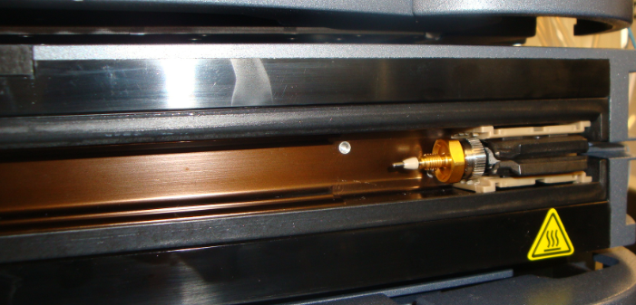
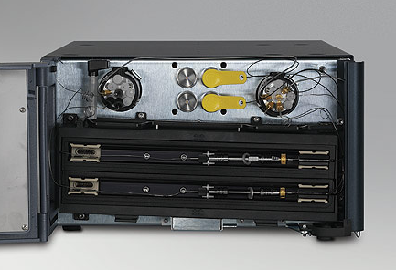
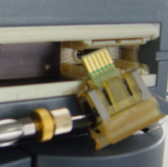
Column Ovens
NEW Column Heater
NEW Column Manager
New 0.003”/0.075 mm I.D. tubing
Robust 18 K psi fitting
Excellent method transfer between ACQUITY UPLC I-Class Systems
CH-30A is compatible where HPLC columns must be supported
Two (2) Columns plumbed right or left only
New 0.003”/0.075 mm I.D. tubing
Robust 18 K psi fitting
For method development or multi-method support
Notes:
Moving on the column management, ACQUITY UPLC I-Class system – like ACQUITY UPLC H-Class exploit the use of the APH technology -- an active preheater shown on the right of this photo. The new I-Class version uses 0.003”/0.075 mm (75 MICRON) ID tubing and features a new easy to attach, robust fitting rated to 18 K psi and designed to confer the lowest possible volume.
The APH technology directly heats the solvent/mobile phase prior to introduction onto the column. The solvent passes through several bends in the tubing in contact with a heater block. The I-Class design reduces the amount of tubing, reducing dispersion and , importantly, allows for very consistent heating profiles when a method is developed and then transferred. WHEN methods are shared between different systems, even those in different locations, they will be perfectly consistent.
The ACQUITY UPLC I-Class is also available with a 2-column Column manager Module.
In a typical laboratory, the Column Manager can be used to select one of two columns will allow for method development, or allow users to run two different analysis types and maximize the usage of the system and maximize Return-On-Investment.
Also, the Column Manager valves are interchangeable and a valve configuration which supports multi-valve, multi-pump or 2D technology can be used for sample cleanup, to reduce matrix effects as in a typical column trapping application or for pre-concentration of dilute samples, for additional flexibility and to enhance detection sensitivity.

Slide 13
ACQUITY UPLC I-Class
The Pinnacle of Chromatographic Performance
Take full advantage of resolution benefits offered by Sub 2um particles and low dispersion fluidics
Get accelerated complex separations achieved with low system’s dispersion & faster cycle-time
Obtain the best sensitivity with lowest carryover autosampler
  Reduced dispersion volume
  Higher peak capacity
  Less matrix effect
  Less ion suppression
  More information from complex samples
  Higher sensitivity with sharper and more concentrated peaks
ACQUITY® SQD
ACQUITY® TQD
Xevo™ TQ MS
SYNAPT™ G2 MS
Xevo™ QTof MS
SYNAPT™ G2 HDMS
Notes:
Cross Talk = Interferences croisees

Slide 14
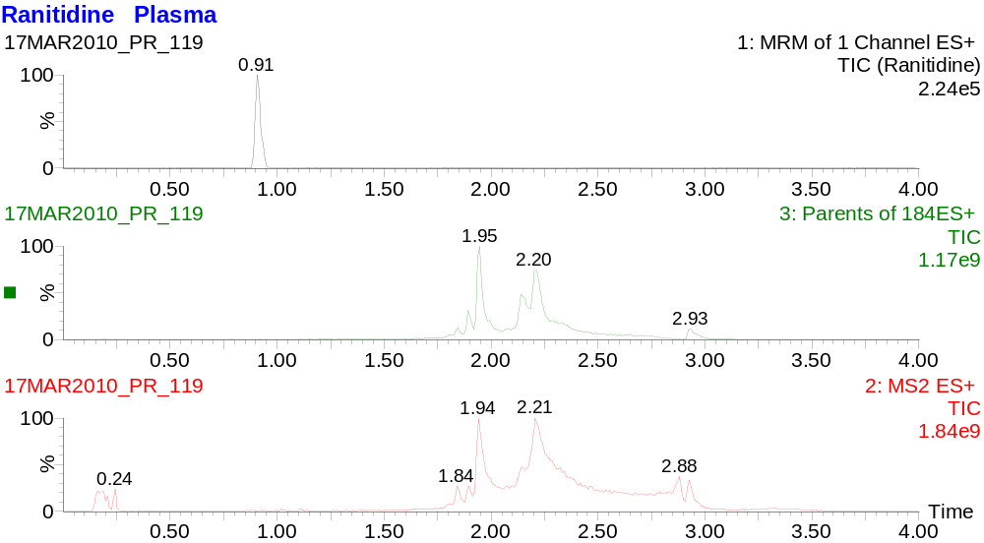
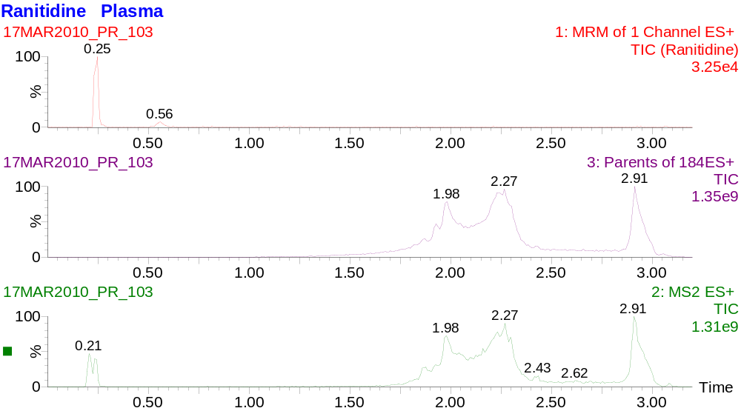
BEH UPLC Technology
Using pH to Increase Resolution
Basic Separation
Greater peak retention
Acidic Separation
Notes:
And here is a specific example of the role that pH can play. Please concentrate on the top traces, the bottom traces show the Matrix response.
The change in method allowed the metabolite to be better retained, getting it away from the void, in ESI + mode
And as I mentioned here, again a Higher response was obtained with the higher pH conditions.
Again, the utility of an UPLC that allows you to swap easily between columns and conditions is critical to optimize the process of method development.

Slide 15
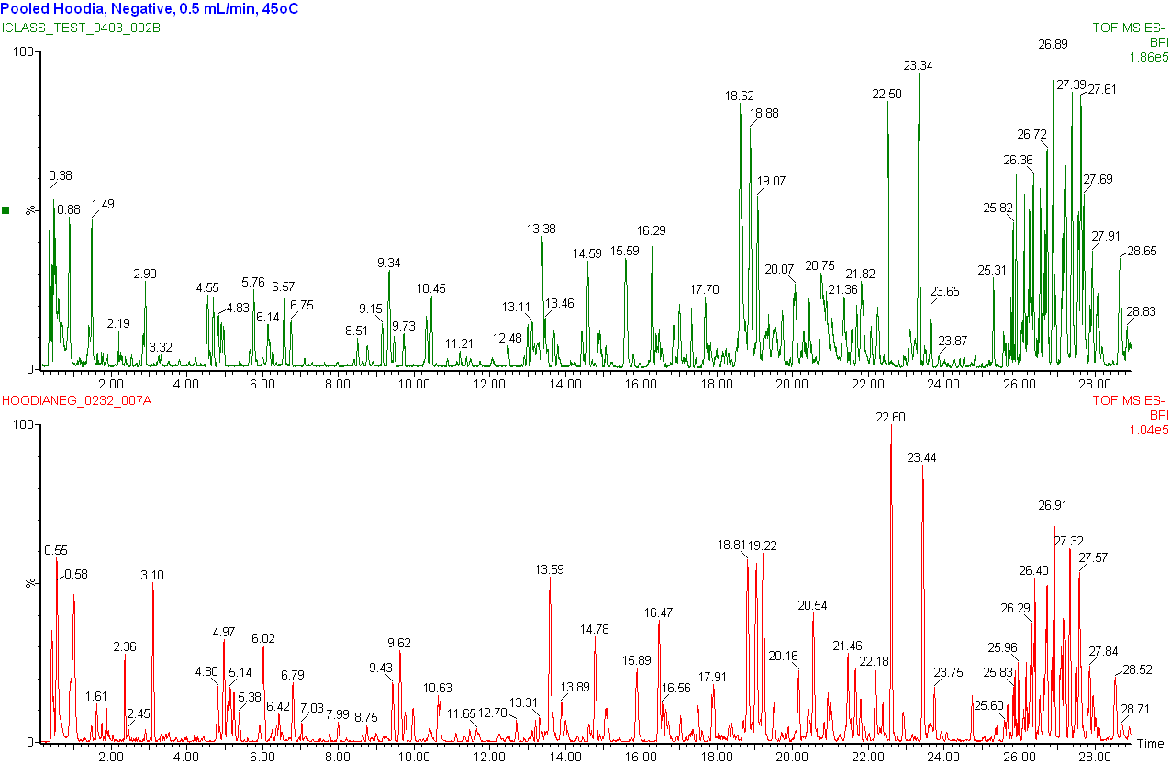
Impact of Low Dispersion:
Increase in Sensitivity
1.87x10⁵
1.04x10⁵
Notes:
To show this specifically for I-Class we have an example of the interrogation of information rich samples, by MS, requires a UPLC system which provides the highest quality information.
Here is an example using a current ACQUITY UPLC system (in red) compared to the ACQUITY UPLC I-Class system (in green).
You can see, that the improved dispersion characteristics of the I-Class system profoundly improved resolution and sensitivity, even for this complex sample, where many peaks are separated.
The method used, was identical on both these ACQUITY UPLC systems and was based upon a gradient separation using an ACQUITY UPLC High Strength Silica T3, 1.8 micron particle column, with a 2.1 ID by 100 mm column length.
The sample is an extract of Hoodia gardonii, a natural product that was analyzed in collaboration with Dr. Khan and Dr. Avula (et al), at the National Center for Natural Products Research, based at the University of Mississippi.
You will notice immediately, the advantage the ACQUITY UPLC I-Class System provides – the increase in sensitivity is almost x2-fold, because the highly resolved, more concentrated peaks created by the ACQUITY UPLC I-Class system ionize more efficiently and hence MS sensitivity is also increased.

Slide 16
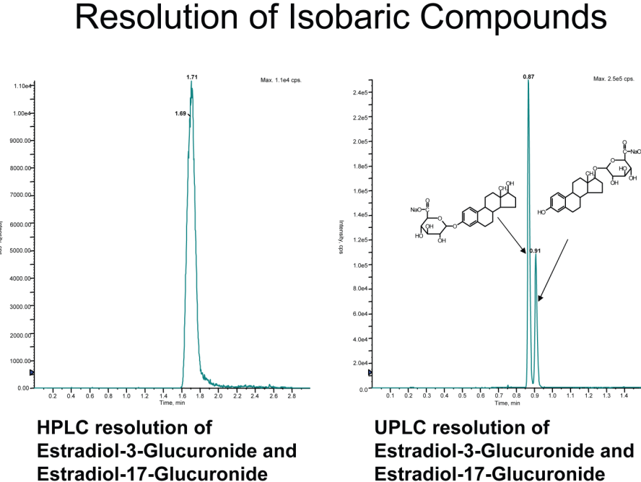
ACQUITY UPLC
Resolution of Metabolites
Separation of metabolite
critical pairs is essential for accurate quantitation and is becoming more important in order to satisfy increasing
Regulatory expectations (MIST)
Ref: Donegan M,BMS, www.cosmoscience.org/archive_2008.htm
Notes:
Just to further illustrate the resolving power of UPLC and how it can be of paramount importance, here is another customer example. Two metabolites - isobaric compounds – that is compounds that have the same molecular weight and thus result in the same transition. This means that a MS MRM method cannot be selective for each metabolite and will result in an overestimation of concentration if they are not fully resolved. Resolution by UPLC will mean that they can be accurately quantitated. Furthermore, although it is not discussed in this presentation, our MS platform of choice, the Xevo TQ can take scan on the fly without compromising sensitivity or accuracy of quantitiation of each of these metabolites for added confirmation and confidence in the final result.
Allowing the assay to demonstrate that these metabolites were not at that level to raise safety concerns.

Slide 17
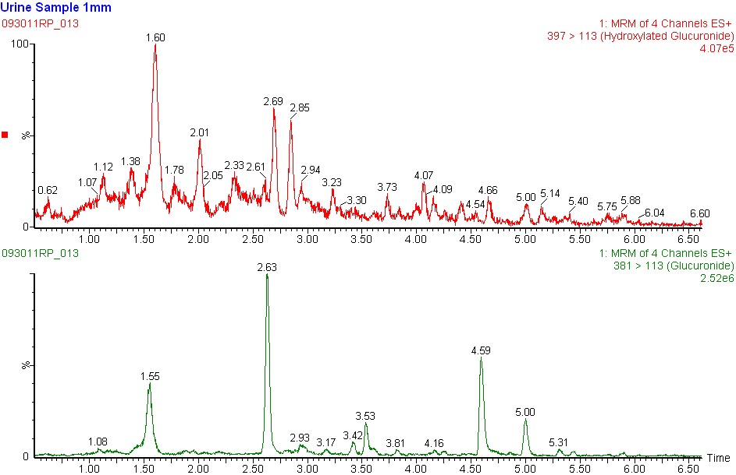
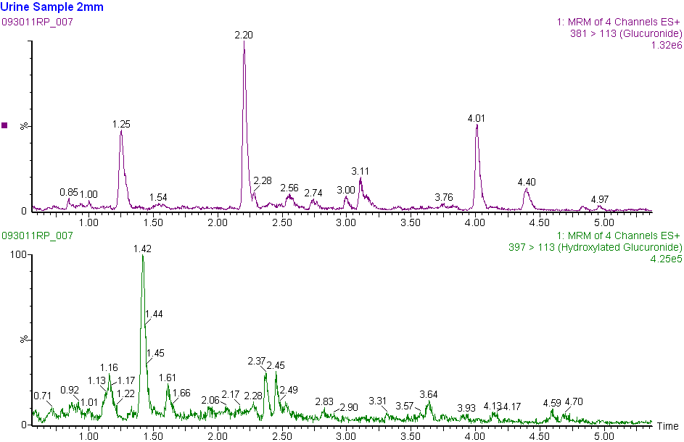
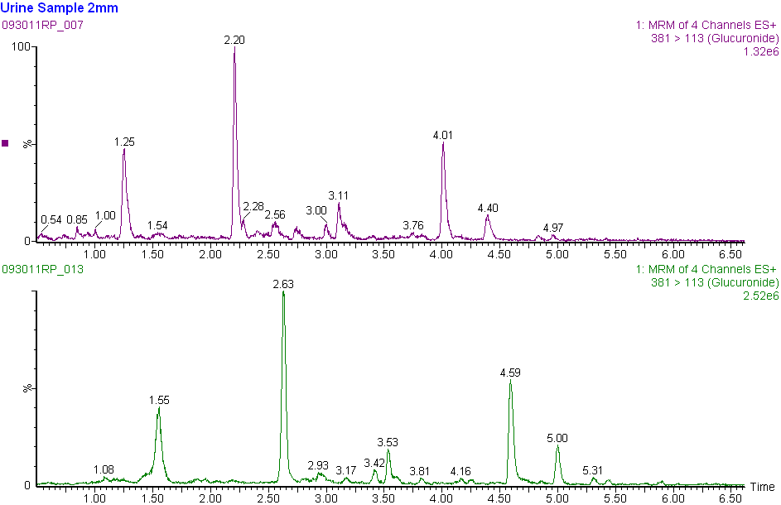
Metabolites of Ibuprofen - Performance Flexibility
2.1 mm ID
1 mm ID chromatography offers additional FLEXIBILITY, when use of costly solvents, higher viscosity solvents or for some sample limited analyses
RT= 2.63
2.1 mm ID
1.32 x 10⁶
RT= 2.20
1.0 mm ID
1.0 mm ID
2.52 x 10⁶
Notes:
1 mm – ACQUITY UPLC I-Class and Xevo TQS
Note RT offset, due to dispersion overhead, 2.1 mmm RT= 2.20 and 1.0 mm = 2.63
1 mm offers flexibility
Ability to use less solvents, such as expensive deuterated solvents.
Accomodates high viscosity solvents such as IPA.
As this is the FTN based ACQUITY UPLC I-Class - can be helpful for sample limited applications
There is indeed an increase in sensitivity, but note, do not attain the predicted four fold increase, further, in most case injecting x4 more on a 2.1 mm might be fine. TRIZAIC and nanoACQUITY UPLC can address these applications routinely.

Slide 18
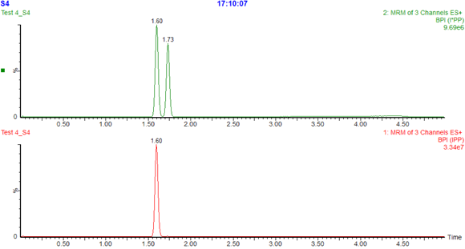
ACQUITY UPLC I-Class
Resolution – Draw the Correct Conclusion
Internal Isoleucine standard not pure - was mixture of its isomers
During the analysis using Xevo TQ-S peptide analysis, the labeled standard was found to be a mixture of both isomers of isoleucine. The performance at high temperature (90◦C)and high linear velocity of I-Class resolved the isomers. Ensuring accurate determination of correct fragment ratios
RT=1.60
RT=1.73
Resolved isomer peaks with identical mass
Same Mass
Transition
Notes:
Quadruple Mass detectors cannot distinguish compound coelutions of the same mass, ultimate UPLC resolution ensures that the correct conclusions are drawn from the data analysis.

Slide 19
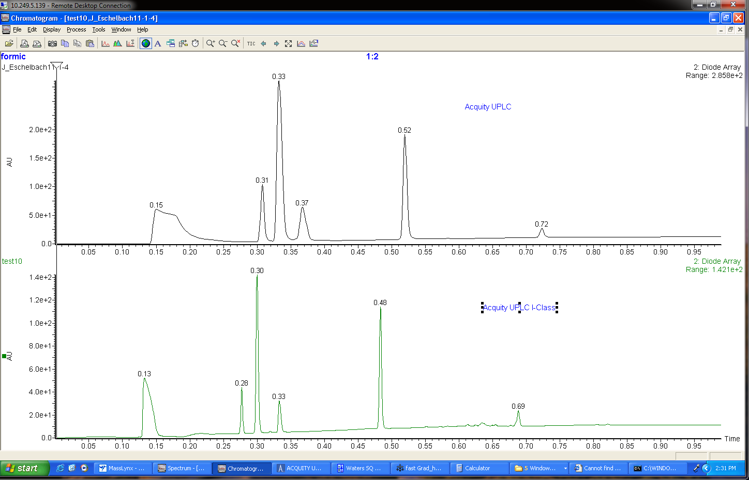
Lower Dispersion Further Enhances ACQUITY UPLC I Class Performance
ACQUITY UPLC
ACQUITY UPLC I-Class

Slide 20
ACQUITY UPLC I-Class
The Pinnacle of Chromatographic Performance
Take full advantage of resolution benefits offered by Sub 2um particles and low dispersion fluidics
Get accelerated complex separations achieved with low system’s dispersion & faster cycle-time
Obtain the best sensitivity with lowest carryover autosampler
  Reduced dispersion volume
  Higher peak capacity
  Less matrix effect
  Less ion suppression
  More information from complex samples
  Higher sensitivity with sharper and more concentrated peaks
Multi-pump design, reduced dwell volume
Increased sample troughput
Fast ballistic gradients
Real 1mm column ID separation
No compromises with chromatographic fidelity
ACQUITY® SQD
ACQUITY® TQD
Xevo™ TQ MS
SYNAPT™ G2 MS
Xevo™ QTof MS
SYNAPT™ G2 HDMS

Slide 21
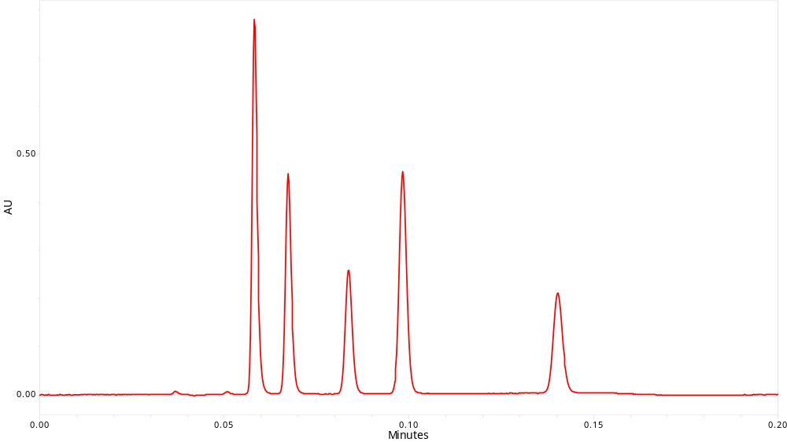
Accelerated analyses
Ballistic Gradients
10 Second Gradient
Peak Capacity = 46
RETENTION TIME SD = 12ms (for 6 replicates)
½ Height Width = 88ms
2 mL/min @ 90°C
Notes:
To illustrate this with an actual chromatogram produced on the ACQUITY UPLC I-Class is this separation, here is ONE OF 6 replicate INJECTIONS OF a 10 second gradient with a peak capacity of 46. The system is running at maximum flow rate, 2mL/min and the separation quality is unaffected, because dispersion is controlled allowing the separation to be accelerated to take fullest advantage of the efficiency of sub 2 µm particles.

Slide 22
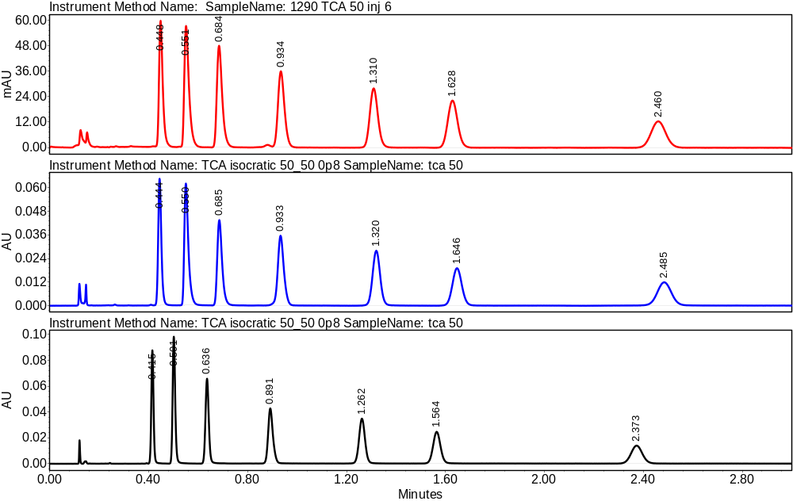
Isocratic Separation Comparison
- 2.1 x 50 mm column
UHPLC low volume configuration;
21 μL measured band spread
Average USP Plates = 6016
ACQUITY UPLC;
12 μL measured band spread
Average USP Plates = 7163
ACQUITY UPLC I-Class;
5 μL band spread
Average USP Plates = 11,356
Notes:
Here is another comparison of efficiency: a current competitive u-HPLC, current ACQUITY UPLC and ACQUITY UPLC I-Class. The separation (of Tricyclic antidepressants) is isocratic, which fully illustrates the effect of dispersion. The same column, samples and mobile phase was used.
NOTE: Improved peak shape for early eluting peaks, increased peak height (100 VS. 60 mAU) and less TAILING.
It is important to understand it is the difference in total system efficiency that enables the ACQUITY UPLC I-Class to perform as it does and how in the second example the I-Class system can increase throughput without compromising chromatographic fidelity.
This slide is meant to link the bandspreading specification of I-Class or the difference in plate count for a user working routinely.

Slide 23
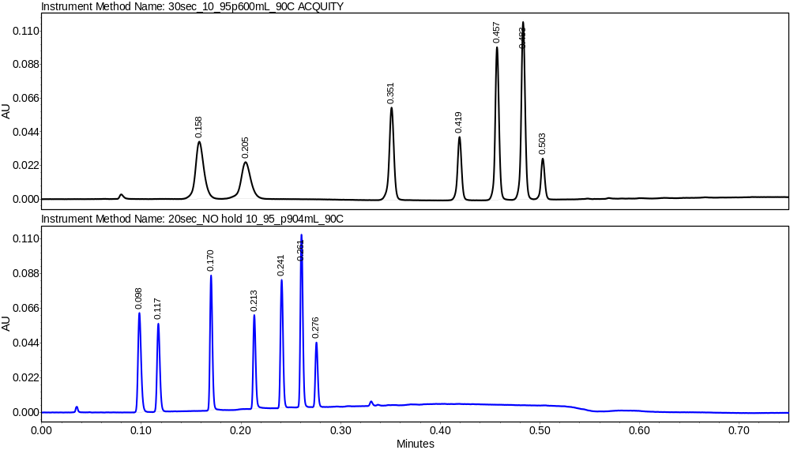
Accelerate Ballistic Separations
ACQUITY UPLC and ACQUITY UPLC I-Class
– 1 mm I.D. column
ACQUITY UPLC
Average peak capacity at 5σ = 57
ACQUITY UPLC I-Class
Average peak capacity at 5σ = 70
Enhanced backpressure limits allows the use of optimum flow rates for 2.1 and 1.0 mm I.D. columns packed with 1.7 μm particles resulting in best speed and resolution.
Notes:
Here the current ACQUITY UPLC is compared to the ACQUITY UPLC I-Class, the same 7 peaks are now separated by a gradient with the same chemistry in smaller 1.0 mm I.D. format. And, even though ACQUITY UPLC retain market leading dispersion and speed of analysis, the I-Class can accelerate this separation even farther, delivering a faster separation with perhaps even a higher quality separation, again note the improvement for early elutors, for reversed phase this is the more polar compounds. Note a flow rate range above 1.0 mL/min is not required to produce a 20 second gradient time, but the control of dispersion is critical to improve throughput. The lower flow rate has the advantage of solvent savings and is suitable for MS detection where less mobile phase assists in ionization efficiency.

Slide 24
The ACQUITY UPLC I-Class System Optimizes
Peak Capacity by Minimizing Dispersion and
Providing the Necessary Pressure Range.
Peak Capacity = 271
Flow Rate = 1.8mL/min
Notes:
Let me explain the significance of this graphic, we you saw earlier - as the flow rate in a gradient separation is increased, peak capacity approaches a theoretical maximum. The ACQUITY UPLC I-Class System allows you to achieve the theoretical peak capacity for your separation by minimizing dispersion and providing the necessary pressure range.
Here you can see 14 different components can be separated in the fastest possible time by choosing a value at maximum flow rate – here 1.8 mL/min flow rate, BUT resolution is not lost. The combination of increased flow rate, high pressure require reduced dispersion characteristics in order to attain the fastest possible separation.

Slide 25
ACQUITY UPLC I-Class
The Pinnacle of Chromatographic Performance
Take full advantage of resolution benefits offered by Sub 2um particles and low dispersion fluidics
Get accelerated complex separations achieved with low system’s dispersion & faster cycle-time
Obtain the best sensitivity with lowest carryover autosampler
  Reduced dispersion volume
  Higher peak capacity
  Less matrix effect
  Less ion suppression
  More information from complex samples
  Higher sensitivity with sharper and more concentrated peaks
Multi-pump design, reduced dwell volume
Increased sample troughput
Fast ballistic gradients
Real 1mm column ID separation
No compromises with chromatographic fidelity
Minimised carry-over
Real benefit of higher sensitivity
Better quantitation
Extended linear range of calibration curves
ACQUITY® SQD
ACQUITY® TQD
Xevo™ TQ MS
SYNAPT™ G2 MS
Xevo™ QTof MS
SYNAPT™ G2 HDMS

Slide 26
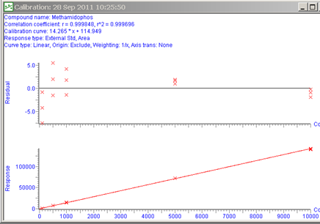
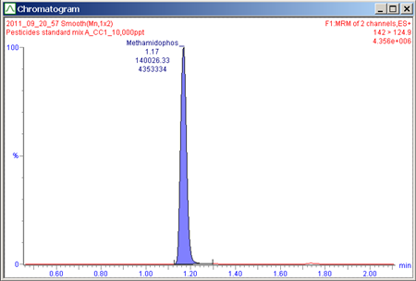

ACQUITY UPLC Sample Manager – Confidence in linearity and Carryover
5 Pesticides: Methamidophos, Atrazine-desethyl, Atraton, Aldicarb sulfone and Prometryn
ACQUITY UPLC I-Class |  | Carryover 1st Blank
Analyte | R² | ND
Methamidophos | 0.9997 | None
Atrazine –desethyl | 0.9999 | None
Atraton | 0.9999 | None
Aldicarb sulfone | 0.9939 | None
Prometryn | 0.9986 | None
ACQUITY UPLC |  | Carryover 1st Blank
Analyte | R² | None
Methamidophos | 0.9995 | None
Atrazine –desethyl | 0.9988 | None
Atraton | 0.9967 | None
Aldicarb sulfone | 0.9991 | None
Prometryn | 0.9900 | None
UPLC
ACQUITY UPLC I-Class substitutes for ACQUITY UPLC, and add even greater confidence in linearity, and in carryover performance. Providing ideal tool for routine screening across all levels
Notes:
I-class : Methamidophos calibration curve
Calibration points: 100 pg/mL, 500 pg/mL, 1000 pg/mL, 5000 pg/mL and 10,000 pg/mL

Slide 27
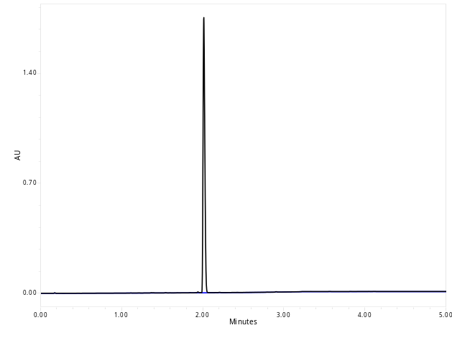
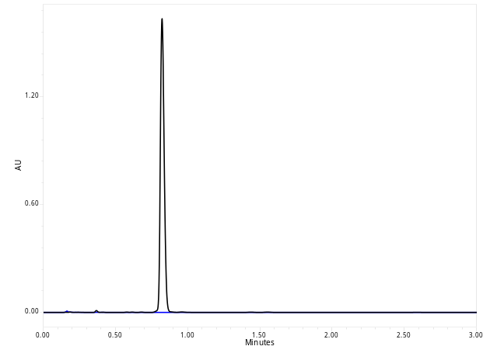
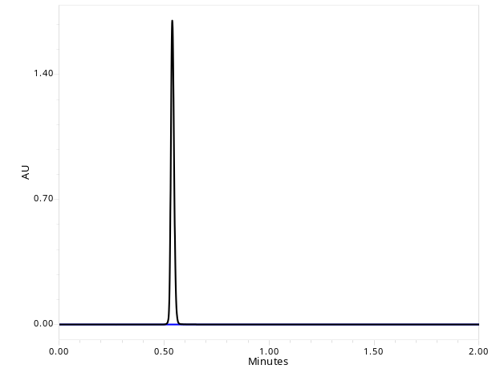
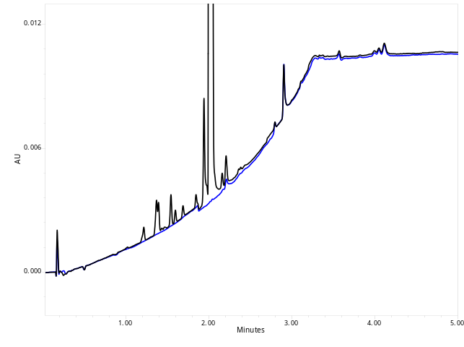
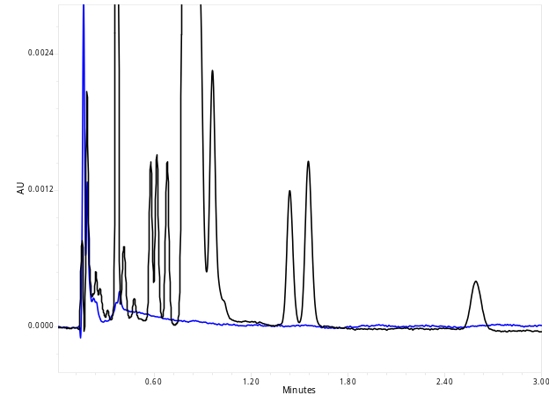
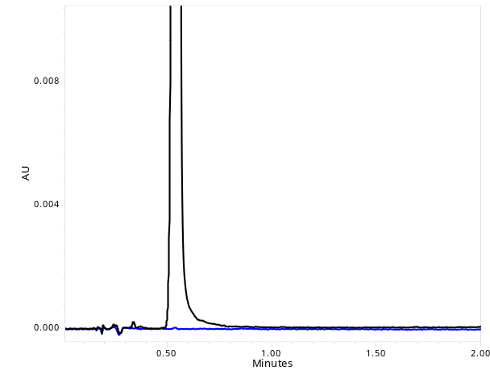
SM-FTN: UV Carryover Performance
Chlorhexidine
Dioctyl Phthalate
Caffeine
Wash Solvent
1% Formic Acid in MeOH
Concentration
0.25mg/mL
Wash Solvent
Acetonitrile
Concentration
0.5mg/mL
Wash Solvent
80/20 Water/MeOH
Concentration
0.25mg/mL
Standard Trace
Blank Trace
Standard Trace
Blank Trace
Standard Trace
Blank Trace
For concentrations within linear range of detector(<2AU): No Quantifiable Carryover
Notes:
Finally, in the next series of examples illustrate improved carryover a key feature of the ACQUITY UPLC I-Class system.
Customers have challenged Waters to improve carryover and this example for UV analyses, demonstrates that the improvement in ACQUITY UPLC I-Class system is significant.
The first analysis uses Chlorohexidine, a compound that is commonly used in the marketplace to illustrate UV carryover in published performance specifications.
The second uses Di-octyl Thalate, which is a very hydrophobic sample, that Waters uses to explore carryover in our systems.
The last separation, is of Caffeine, a polar, low k’ sample, that is used by Waters and many others, as a qualification standard.
For all three separations, where concentrations of each compound was kept within the linear range of the UV detector, (that is below 2 Absorbance Units): no measurable carryover was observed.

Slide 28
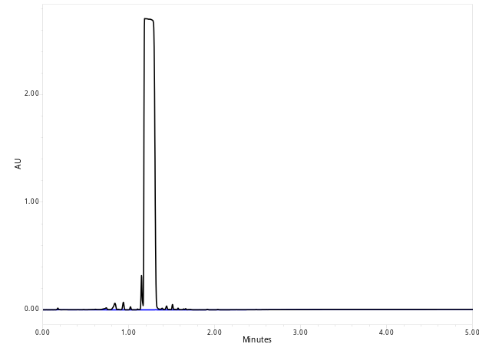
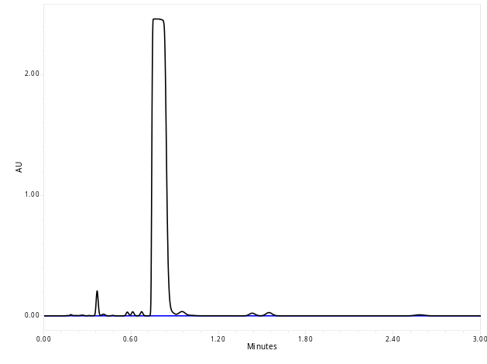
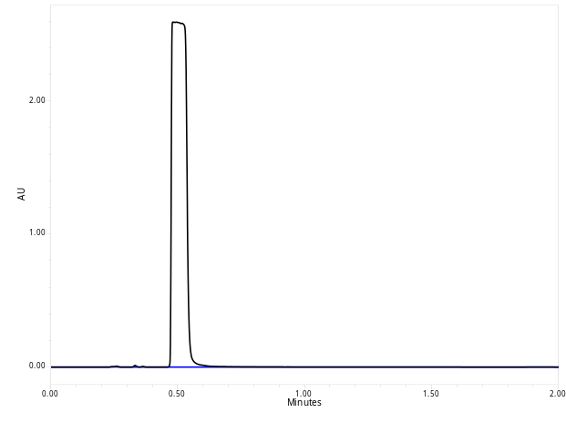
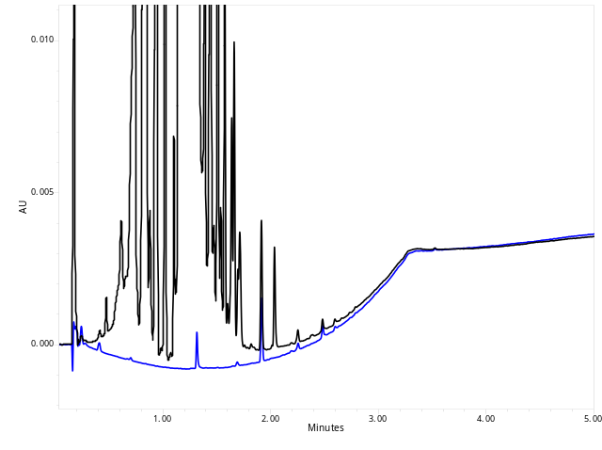
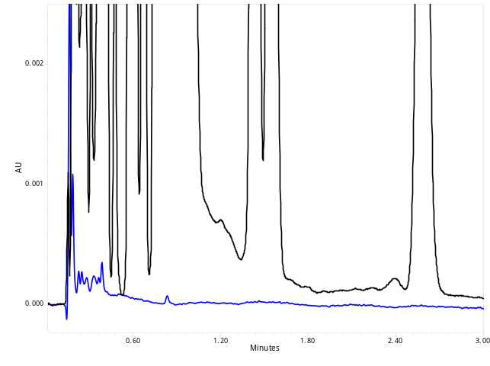
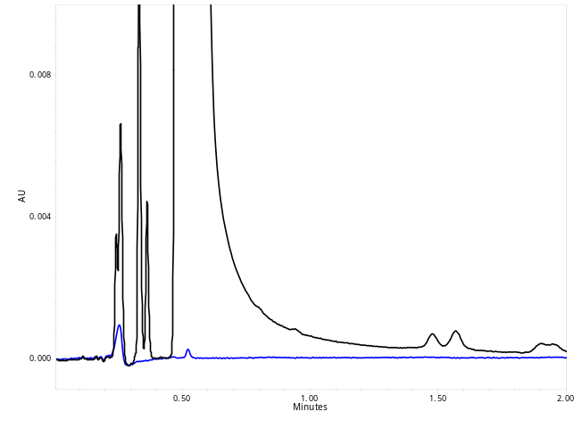
ACQUITY UPLC I-Class
SM-FTN: UV Carryover Performance
Chlorhexidine
Dioctyl Phthalate
Caffeine
Wash Solvent
1% Formic Acid in MeOH
Concentration
10mg/mL
(40x Higher)
Carryover
0.00093%
Wash Solvent
Acetonitrile
Concentration
10mg/mL
(20x Higher)
Carryover
0.00020%
Wash Solvent
80/20 Water/MeOH
Concentration
10mg/mL
(40x Higher)
Carryover
0.00034%
Standard Trace
Blank Trace
Standard Trace
Blank Trace
Standard Trace
Blank Trace
To quantify carryover: High concentrations, above detection linear range, are injected.
Notes:
To explore this further, carryover was then quantified at high concentrations, where the absorbance values were above the linear range of the detector.
Carryover for these compounds is still extraordinarily low. The highest observed was 0.00093%.
In these examples, the ACQUITY UPLC I-Class FTN based system configuration was used.
So what does this mean for MS detection?

Slide 29
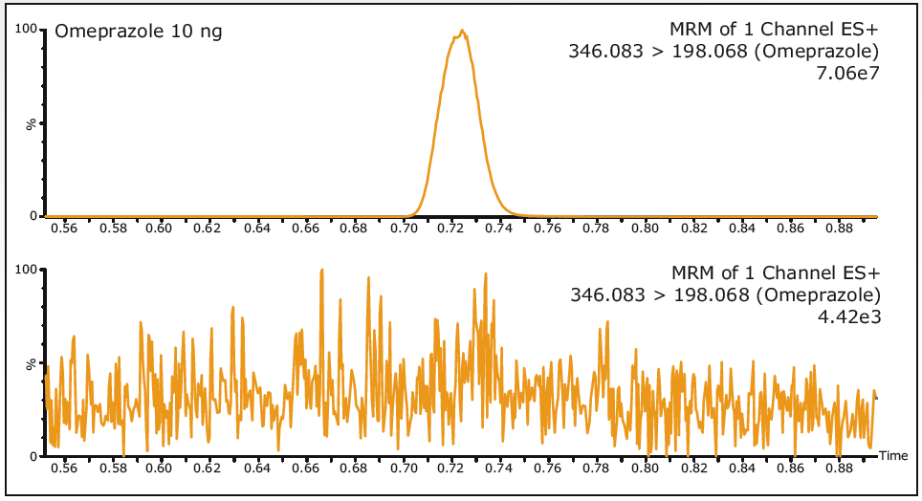
Carryover Performance:
ACQUITY UPLC I-Class with Xevo TQ-S
Omeprazole 10 ng/mL
Blank Injection
Carryover was reduced to <0.0005% of the highest standard (10 ng/mL)
  Regulation is <20% of LOWEST CALIBRANT
  Calibration was achieved from 500 fg/mL to 10 ng/mL
  Linear quantification >4 orders of magnitude
Assurance that the quantitation represents only the presence of analyte, not carryover
Notes:
Now, this reduction in carryover is especially significant for MS and means that methods developed for even the most sensitive MS detectors can be validated and utilized across the full dynamic range of the MS detector without concern that carryover will force the upper limit of quantitation to be reduced. In other words the PRACTICAL and THEORETICAL sensitivity limit of the MS are the same.
The ACQUITY UPLC I-Class system is ideally suited for managing the challenging carryover requirements of the most sensitive LC/MS/MS methods requiring quantification across greater than four orders of magnitude.
In this example, the ACQUITY UPLC I-Class system FTN configuration and the very sensitive Waters’ Xevo TQS detector are combined. The Xevo TQS triple quadruple, has industry leading sensitivity.
During the analysis of omeprazole, carryover was not detected by the Xevo TQ-S and was, therefore, reduced to below 0.0005%. Because sample carryover was minimized, calibration for the method was achieved from an Lower Level of Quantitation, LLOQ of 500 fg/mL to Upper level of Quantitation, ULOQ of 10 ng/mL or 500 ag to 10 pg on column.
29

Slide 30
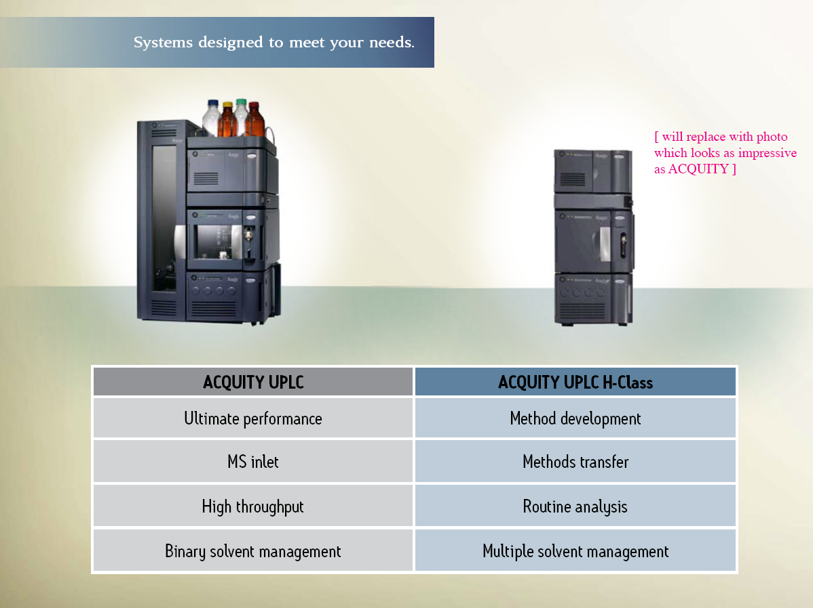
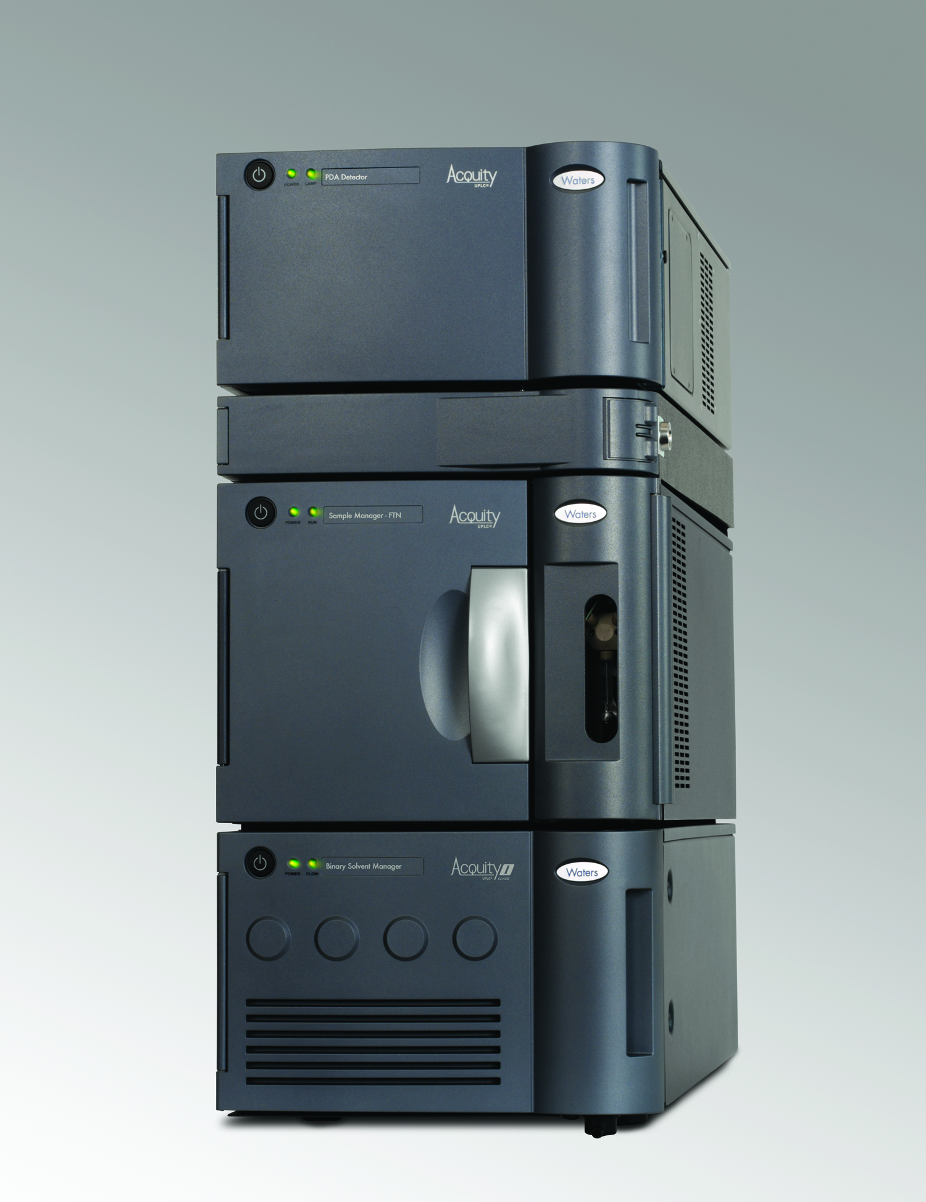

I-Class
Notes:
Although updated, this slide should be familiar, it details the positioning contrasts between ACQUITY UPLC H-Class and ACQUITY UPLC systems. The sales strategy team has been using since the launch. These are the key differentiators between the two systems, one is not better than the other, but either may be best suited to a particular user task.
In general, if the customer requires an MS based system consider positioning the ACQUITY UPLC I-Class initially, but if HPLC compatibility or the primary user task is method development than H-Class should be considered.

Slide 31

The UPLC Family
Notes:
I hope that you can see from the last few minutes that we are not standing still. We are continuously evolving the ACQUITY family based on ever changing customer demands and challenges. We are listening to all of our customers, be they from Pharma (small or large molecules), chemical analysis, chemical materials and clinical. We recognize that ours is a global market and there are different challenges across the World. The ACQUITY Family of products is extensive, the competition is way behind where we are and we will not stop evolving. I wish you great success, an enjoyable few days and as always, if thee is any help that you need then please do not hesitate to ask.

