Slide 1

Acquity I-class TQ-XS Demo sample analysis report
-- Group 2: Sweeteners

Slide 2
Introduction
AVA has provided us with four groups of samples.
Group -1 : Sudan Dyes
Group -2 : Sweeteners
Group -3 :Marine Biotoxins List A
Group -4 :Marine Biotoxins List B
This system must be able to run a variety of applications,
including a sensitive assay for all the group of compounds mentioned in the above samples.
This report demonstrates the potential for the I-Class FTN/
XEVO TQ-S to provide a robust and sensitive results for the above mentioned compounds.

Slide 3
Objectives
To detect composition of the sweetener standard solution
To show linearity of the calibration curves in both food matrix and neat solvent
Sample Blank – Z(Blank)
Spiked Extract 1 – Z(S1)
Spiked Extract 2 – Z(S2)
Sweetener standard standards – 100 ppb (Std Z) Solvent: 30% Acetonitrile in water

Slide 4
Executive Summary
Five sweeteners were successfully identified, they were Advantame, Acesulfame K, Saccharin, Aspartame, and Sucralose (Table 1)
The SRM-derived quantitation plots for all the detected sweeteners were linear (R2 > 0.99) in both matrix matched and neat solution standard curve (Table 2 & Table 3)
Based on the matrix matched standard curves, the respective LLOQs for all the detected sweeteners except for Sucralose were 10 ppt
The calculated instrument lower detection limits (LLOD) of all the detected sweeteners were in the range of 2 to 25 ppt in food matrix

Slide 5
Executive Summary (Continued)
The fast polarity switching in Xevo® TQ-XS mass spectrometer allowed multi-analyte analysis based on very short UPLC gradient (8 min) without sacrificing MS duty cycle and data sampling points to achieve accurate quantification
The ACQUITY UPLC system with small particle (sub-2 µm) column packing generated extremely narrow peaks (FWHM < 3 s), which allowed the MS system to generate enough data points (> 15) for accurate quantification
MassLynx software provided integrated solution from method editing, data acquisition, to data processing and report generation

Slide 6
Results

Slide 7
Identification & Quantification of Sweeteners in Spiked Extract 1 & 2
Table 1. The calculated concentration of detected sweeteners using matrix matched calibration curve
Sweetener | RT (min) | S1 (ppb) | S2 (ppb)
Advantame | 1.54 | 1.04 | 0.49
Acesulfame K | 1.03 | 0.93 | 0.43
Saccharin | 1.09 | 1.18 | 0.46
Aspartame | 1.15 | 1.00 | 0.45
Sucralose | 1.21 | 9.37 | 5.29

Slide 8
Linearity of Calibration Curve & LLOQ / LLOD in Matrix
Table 2. The linearity of calibration curve for the detected sweeteners using matrix blank as diluent
Sweetener | Linearity (R²)¹ | LLOQ(ppb) | S/N at LLOQ | Cal. LLOD (ppb)²
Advantame | 0.999 | 0.01 | 24 | 0.002
Acesulfame K | 0.999 | 0.01 | 13.9 | 0.003
Saccharin | 0.999 | 0.01 | 6.0 | 0.005
Aspartame | 0.998 | 0.01 | 1.9 | 0.01
Sucralose* | 0.999 | 0.5 | 63.5 | 0.025
Note: ¹ The calibration curve was ranging from 0.01 ppb to 10 ppb except for Sucralose, the calibration points were, 0.01, 0.05, 0.1, 0.5, 1, 5 and 10 ppb
² Calculated LLOD based on the Peak signal-to-noise of LLOQ
* The calibration curve for Sucralose was ranging from 0.5 ppb to 10 ppb

Slide 9
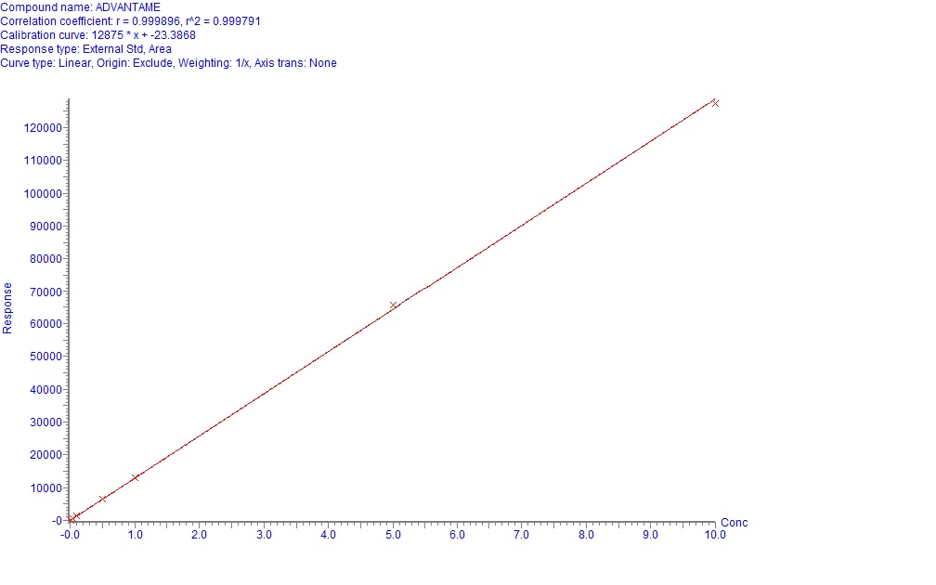
Matrix Matched Standard Curve of Advantame
R² = 0.999
LLOQ: 10 ppt
S/N at LLOQ: 24
Calculated LLOD: 2 ppt

Slide 10
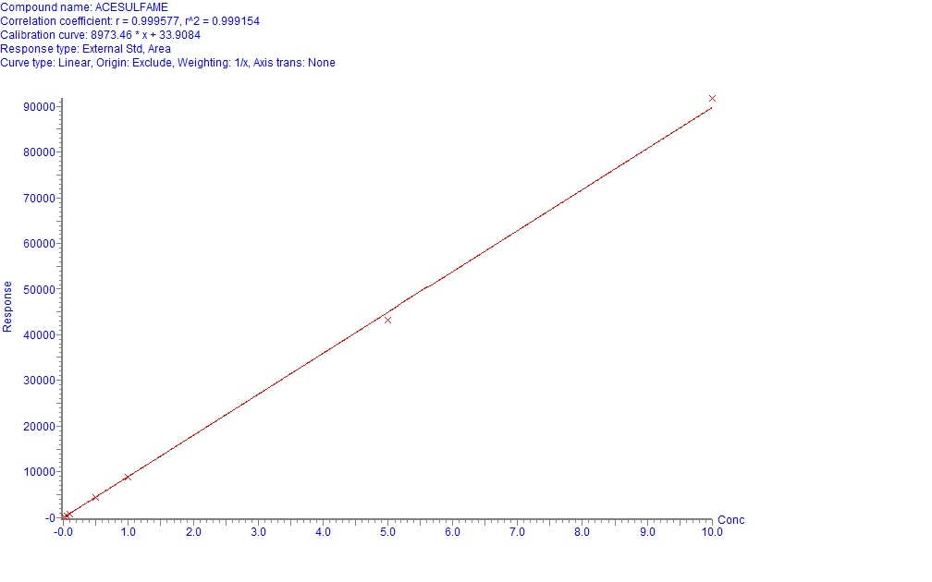
Matrix Matched Standard Curve of Acesulfame K
R² = 0.999
LLOQ: 10 ppt
S/N at LLOQ: 13.9
Calculated LLOD: 2.5 ppt

Slide 11
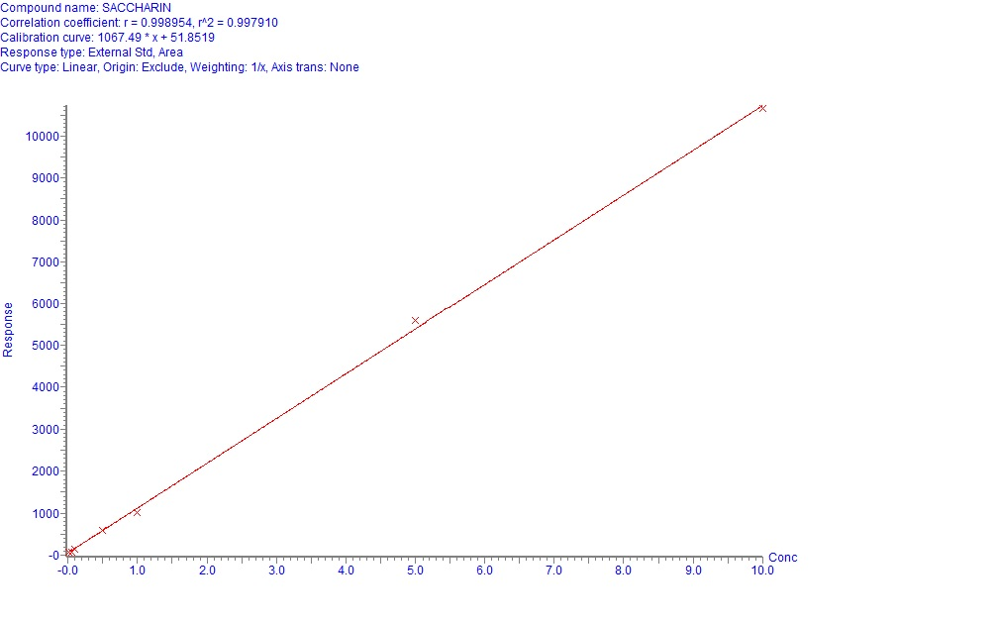
Matrix Matched Standard Curve of Saccharin
R² = 0.999
LLOQ: 10 ppt
S/N at LLOQ: 6
Calculated LLOD: 5 ppt

Slide 12
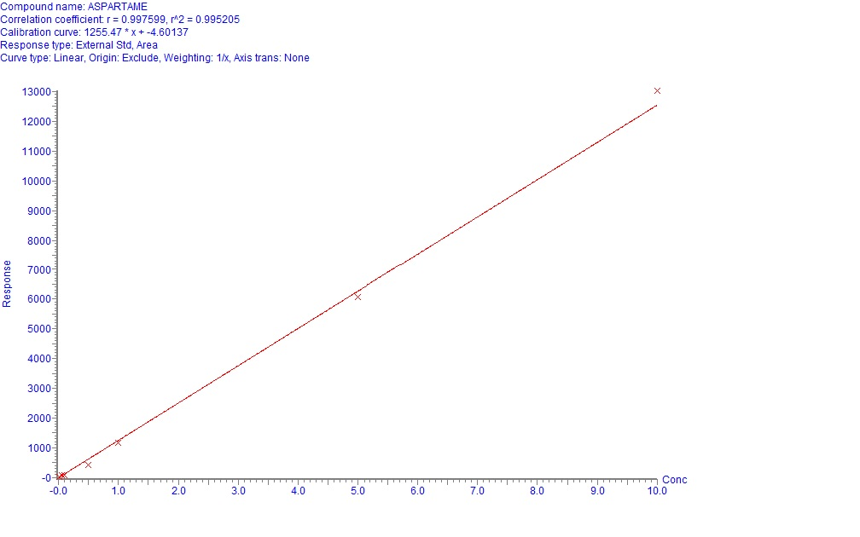
Matrix Matched Standard Curve of Aspartame
R² = 0.998
LLOQ: 10 ppt
S/N at LLOQ: 1.9
Calculated LLOD: 10 ppt

Slide 13
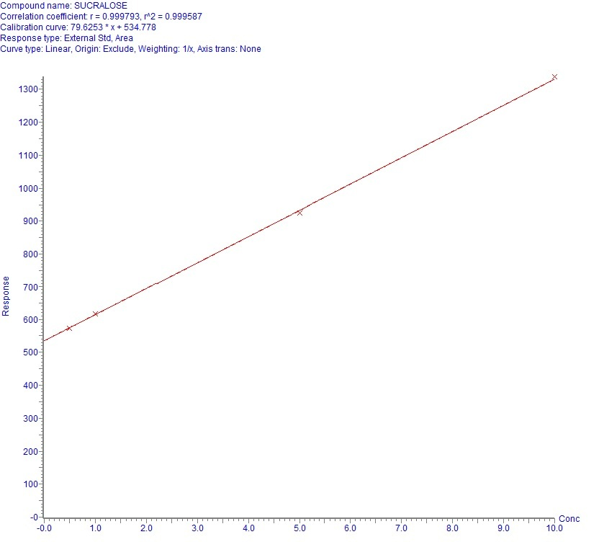
Matrix Matched Standard Curve of Sucralose
R² = 0.999
LLOQ: 50 ppt
S/N at LLOQ: 63.5
Calculated LLOD: 2.5 ppt

Slide 14
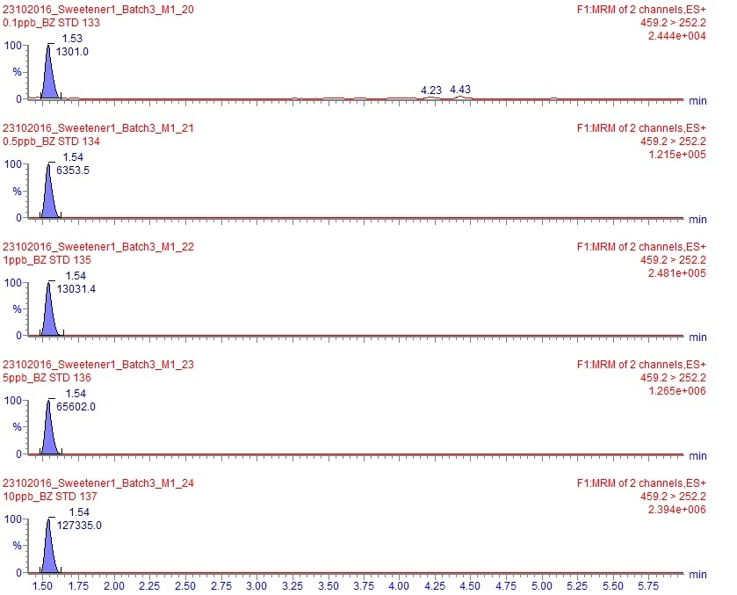
Chromatogram of Advantame in Matrix
0.1 ppb
0.5 ppb
1 ppb
5 ppb
10 ppb
The retention time (RT) and peak response area are shown on peak top of the chromatogram

Slide 15
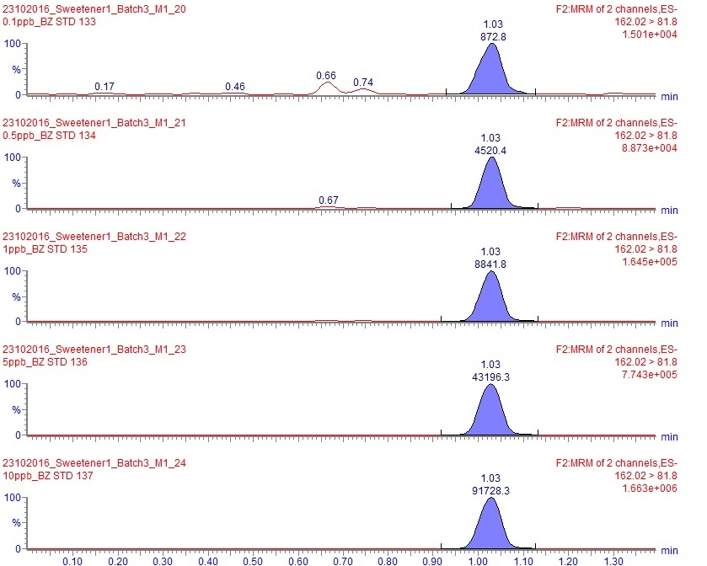
Chromatogram of Acesulfame K in Matrix
0.1 ppb
0.5 ppb
1 ppb
5 ppb
10 ppb
The retention time (RT) and peak response area are shown on peak top of the chromatogram

Slide 16
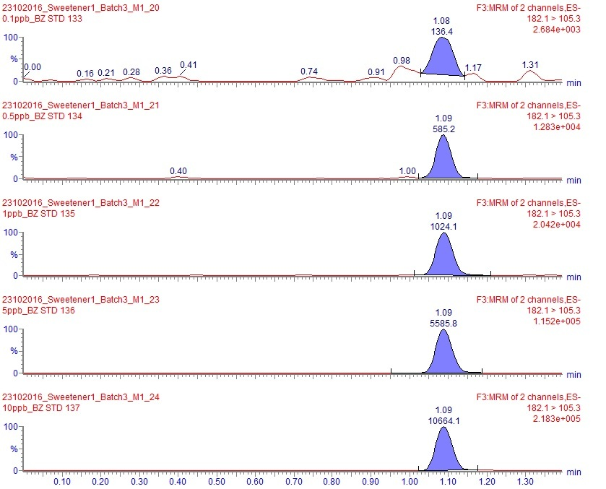
Chromatogram of Saccharin in Matrix
0.1 ppb
0.5 ppb
1 ppb
5 ppb
10 ppb
The retention time (RT) and peak response area are shown on peak top of the chromatogram

Slide 17
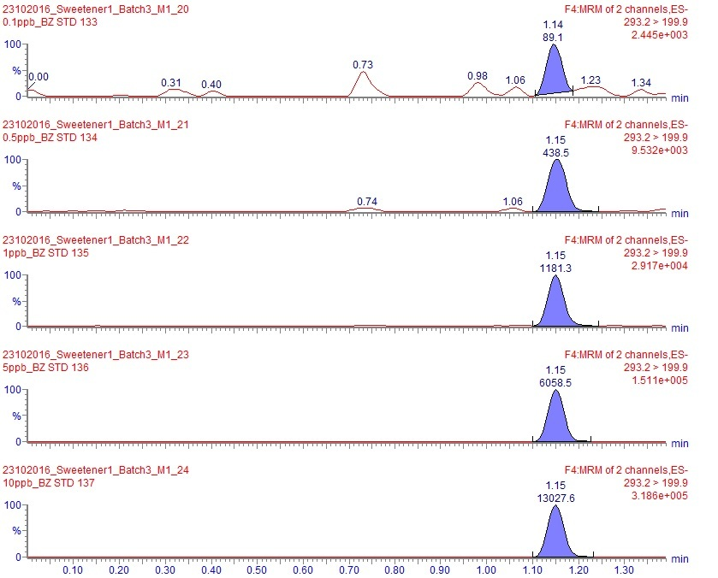
Chromatogram of Aspartame in Matrix
0.1 ppb
0.5 ppb
1 ppb
5 ppb
10 ppb
The retention time (RT) and peak response area are shown on peak top of the chromatogram

Slide 18
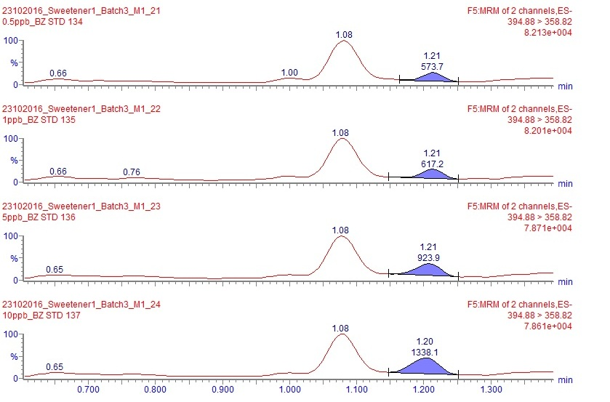
Chromatogram of Sucralose in Matrix
0.5 ppb
1 ppb
5 ppb
10 ppb
The retention time (RT) and peak response area are shown on peak top of the chromatogram

Slide 19
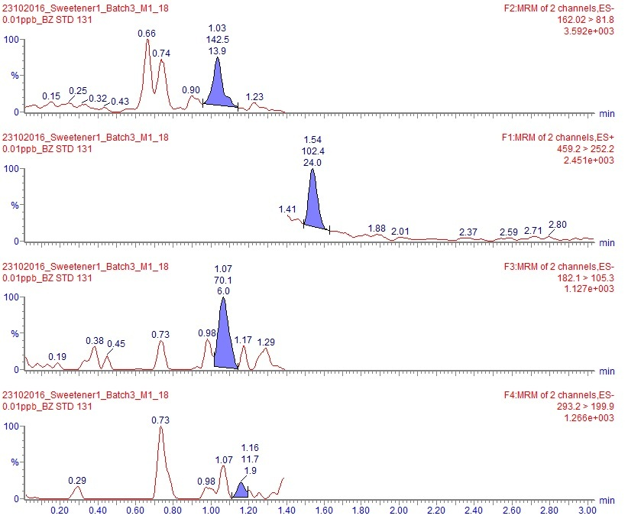
Peak Signal-to-Noise of Detected Sweeteners at LOQ Level (0.01 ppb)
Acesulfame K
Advantame
Saccharin
Aspartame
The retention time (RT), peak response area and peak signal-to-noise (S/N) are shown on peak top of the chromatogram

Slide 20
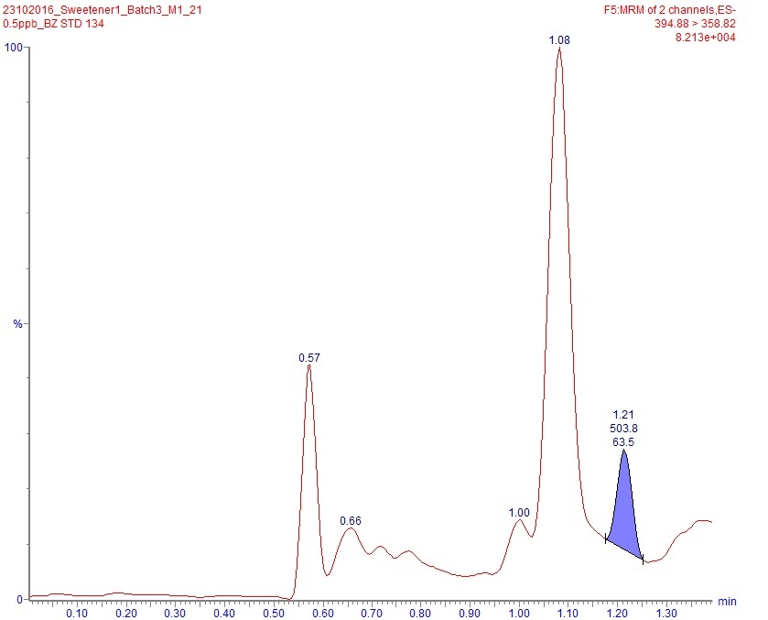
Peak Signal-to-Noise of Sucralose at LOQ Level (0.5 ppb)
Sucralose
The retention time (RT), peak response area and peak signal-to-noise (S/N) are shown on peak top of the chromatogram

Slide 21
Linearity of Calibration Curve and S/N at 0.01 ppb of Detected Sweeteners in 30% Acetonitrile
Table 3. The linearity of calibration curve for the detected sweeteners using solvent blank as diluent
Sweetener | Linearity (R²) | S/N at 0.01 ppb
Advantame | 0.999 | 4.1
Acesulfame K | 0.999 | 10.3
Saccharin | 0.998 | 15.5
Aspartame | 0.999 | 9.7
Sucralose | 0.996 | 4.4

Slide 22
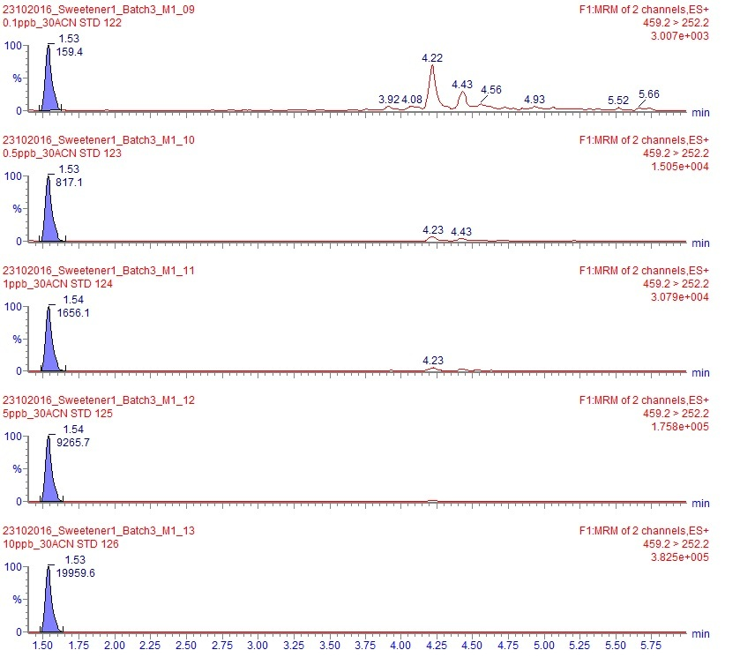
Chromatogram of Advantame in 30% Acetonitrile
0.1 ppb
0.5 ppb
1 ppb
5 ppb
10 ppb
The retention time (RT) and peak response area are shown on peak top of the chromatogram

Slide 23
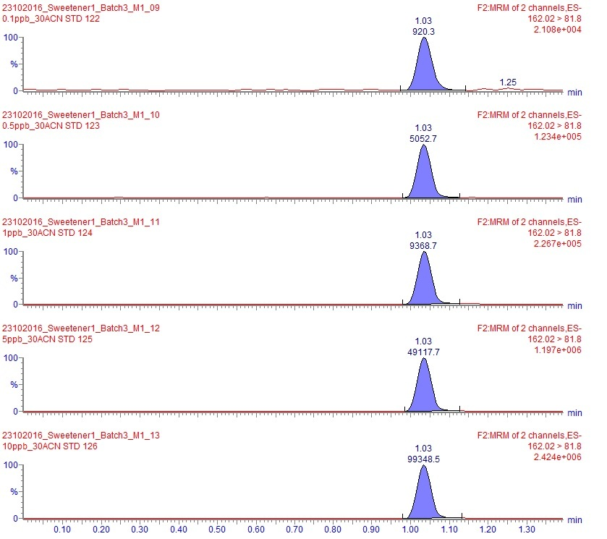
Chromatogram of Acesulfame K in 30% Acetonitrile
0.1 ppb
0.5 ppb
1 ppb
5 ppb
10 ppb
The retention time (RT) and peak response area are shown on peak top of the chromatogram

Slide 24
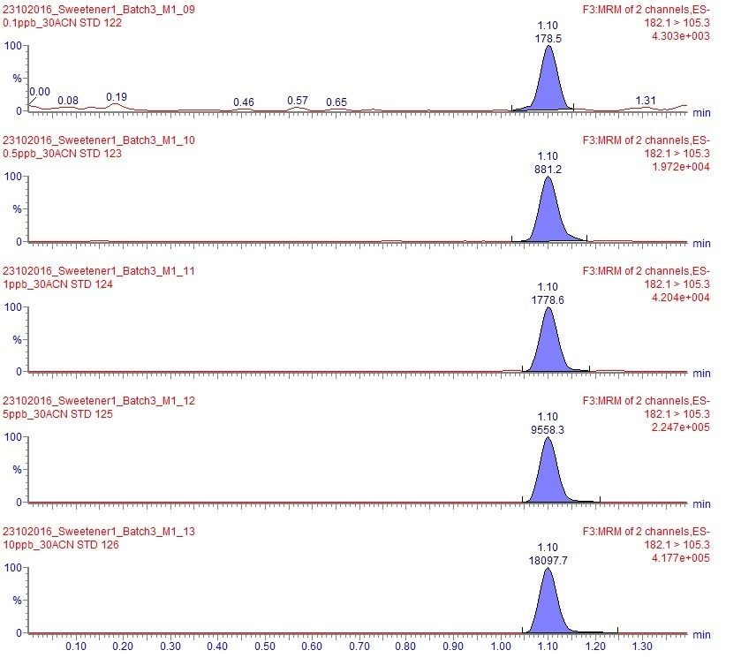
Chromatogram of Saccharin in 30% Acetonitrile
0.1 ppb
0.5 ppb
1 ppb
5 ppb
10 ppb
The retention time (RT) and peak response area are shown on peak top of the chromatogram

Slide 25
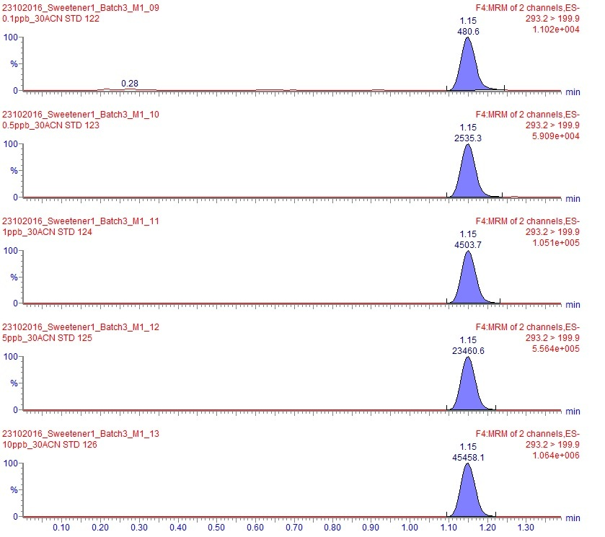
Chromatogram of Aspartame in 30% Acetonitrile
0.1 ppb
0.5 ppb
1 ppb
5 ppb
10 ppb
The retention time (RT) and peak response area are shown on peak top of the chromatogram

Slide 26
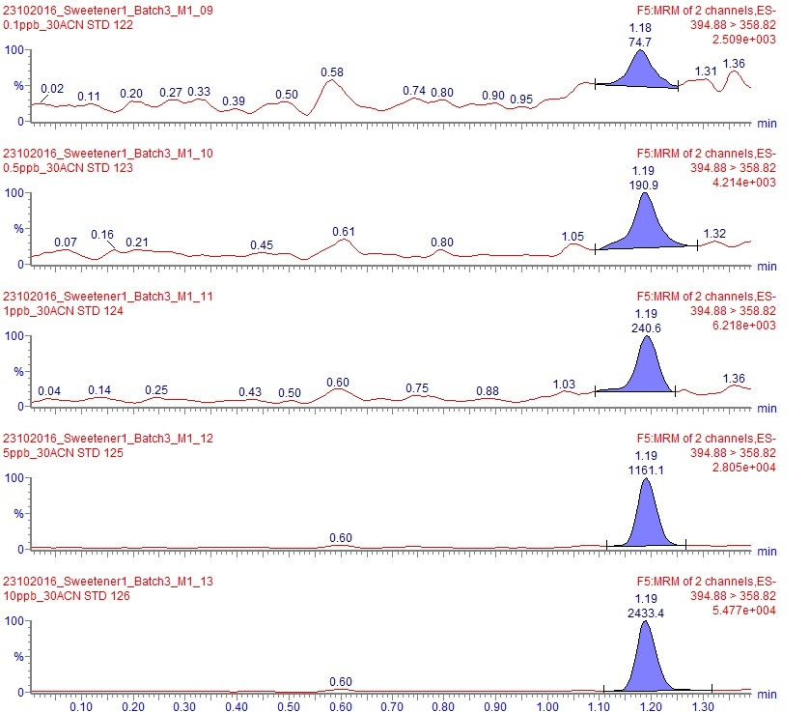
Chromatogram of Sucralose in 30% Acetonitrile
0.1 ppb
0.5 ppb
1 ppb
5 ppb
10 ppb
The retention time (RT) and peak response area are shown on peak top of the chromatogram

Slide 27
Conclusion
The SRM quantification for sweeteners in food matrix was based on the most intense product ion for each analyte
The demonstrated timed-SRM technique based on the ACQUITY UPLC coupled to Xevo TQ-XS showed excellent LLOQ/LLOD in food matrix
The ease of use and flexibility for the MassLynx software allows the customer to focus on the research rather than method development, optimization, and report customization

Slide 28
Method

Slide 29

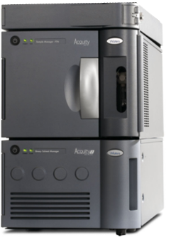
UPLC Conditions: I-Class
System | ACQUITY UPLC™ I-Class
Column | ACQUITY HSS T3 100 mm x 2.1 mm, 1.8 µm
Column temperature | 40ºC
Flow | 0.4 mL/min
Mobile phase | Water with 0.1% Formic Acid
 | (B) Acetonitrile with 0.1% Formic Acid
Injection Vol (FTN) | 10 µl
Time (min) | % A | % B
0.00 | 95 | 5
1.60 | 60 | 40
3.50 | 5 | 95
5.00 | 5 | 95
5.10 | 95 | 5
8.10 | 95 | 5
Notes:
The advantages of UPLC I-Class include: the capability of maximizing the peak capacity, and low dispersion.

Slide 30
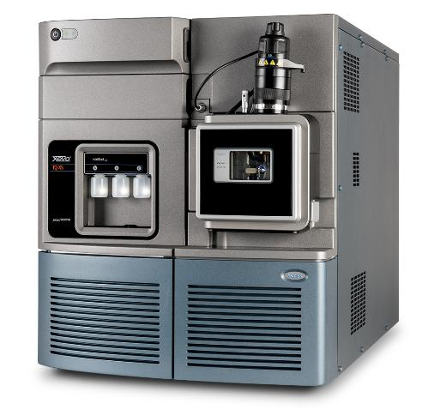
MS Conditions: Xevo TQ-XS
Ionization Mode | ESI+, ESI_
Capillary voltage | 1.5 kV (ESI+) & 1.0 kV (ESI-)
Source Temperature | 150 ˚C
Desolvation Temperature | 600 ˚C
Desolvation Gas Flow (L/Hr) | 6 V
Xevo TQ-XS

Slide 31
MRM Transitions
Analyte | Parent (m/z) | Daughter (m/z) | Dwell (s) | Cone Voltage (V) | Collision energy (eV) | Mode of Ionization
Acesulfame K | 162.02 | 77.8 | 0.01 | 10 | 24 | ES-
Acesulfame K | 162.02 | 81.8 | 0.01 | 10 | 14 | ES-
Advantame | 459.2 | 102.1 | 0.01 | 10 | 20 | ES-
Advantame | 459.2 | 252.2 | 0.01 | 10 | 12 | ES-
Aspartame | 293.2 | 199.9 | 0.01 | 10 | 14 | ES-
Aspartame | 293.2 | 261 | 0.01 | 10 | 12 | ES-
Neotame | 379.0 | 172.2 | 0.01 | 10 | 15 | ES+
Neotame | 379.0 | 85.2 | 0.01 | 10 | 24 | ES+
Saccharin | 182.1 | 105.3 | 0.01 | 10 | 20 | ES-
Saccharin | 182.1 | 41.0 | 0.01 | 10 | 20 | ES-

Slide 32
MRM Transitions (Continued)
Analyte | Parent (m/z) | Daughter (m/z) | Dwell (s) | Cone Voltage (V) | Collision energy (eV) | Mode of Ionization
Sodium Cyclamate | 178.1 | 79.8 | 0.01 | 50 | 20 | ES-
Sodium Cyclamate | 178.1 | 95.0 | 0.01 | 50 | 17 | ES-
Sucralose | 394.9 | 358.8 | 0.01 | 15 | 12 | ES-
Sucralose | 396.9 | 360.9 | 0.01 | 15 | 12 | ES-
Alitame | 330.1 | 311.9 | 0.01 | 10 | 12 | ES-
Alitame | 330.1 | 294.8 | 0.01 | 10 | 12 | ES-
Stevioside | 803.3 | 641.3 | 0.01 | 10 | 15 | ES-
Stevioside | 803.3 | 317.2 | 0.01 | 10 | 20 | ES-
Rebaudioside A | 965.4 | 803.4 | 0.01 | 20 | 20 | ES-
Rebaudioside A | 965.4 | 726.3 | 0.01 | 20 | 22 | ES-

Slide 33
References for the MRM Transitions of
Sweeteners
Romina Shah, Samantha Farris, Lowri S. De Jager & Timothy H. Begley (2014): A novel method for the simultaneous determination of 14 sweeteners of regulatory interest using UHPLC-MS/MS, Food Additives & Contaminants: Part A, DOI: 10.1080/19440049.2014.994111
Chui-Shiang Chang, Tai Sheng Yeh (2014) Detection of 10 sweeteners in various foods by liquid chromatography/tandem mass spectrometry, Journal of Food and Drug Analysis, 22(3): 318–328
Paweł Kubica & Jacek Namieśnik & Andrzej Wasik (2015) Determination of eight artificial sweeteners and common Stevia rebaudiana glycosides in non-alcoholic and alcoholic beverages by reversed-phase liquid chromatography coupled with tandem mass spectrometry, Anal Bioanal Chem, 407:1505–1512
http://www.mn-net.com/tabid/12671/default.aspx

Slide 34
THANK YOU
For further details, please contact Han_Wang@waters.com

Slide 35


