Slide 1


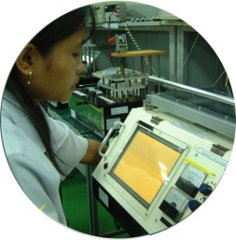






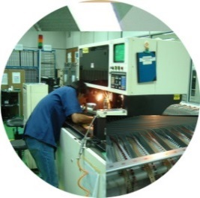
High Mix Low Volume Printed Circuit Board Assembly, Box Build and Equipment Manufacturing
IS014001:2015
AS9100:2009
Electronics AC7120
IS09001:2015
ISO13485:2016

Slide 2
New Production Introduction, NPI
DFM / DFT Analysis
  Analyze manufacturability in line with CEI processes
    SMT process
    AOI / MI process
    Wave soldering process
    Mechanical assembly process
  Testability analysis for ICT and FCT
    Test accessibility and coverage
    Other test for enhance reliability – Burn-in
Prototype Run
  Complete prototype build within 20 working days from material sourcing to production run and delivery of finish good
CEI Limited Co-Confidential
Slide No. 1

Slide 3
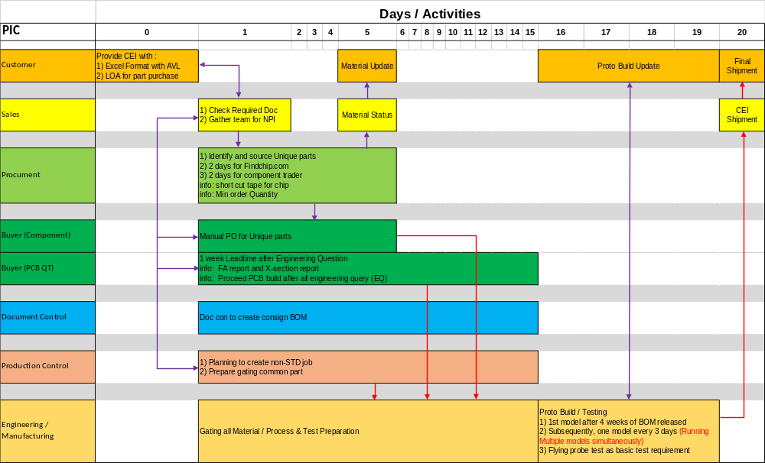

Slide 4
Test Engineering Capabilities
In-Circuit test (ICT)
  Testability and coverage analysis for ICT
  ICT test platform
    Genrad 228x
    Agilent 3070
    Medalist i1000
    Takaya Flying Probe tester
  Co-ordinate ICT fixture and program development with ICT vendors
  Test program & fixture migration - in view of possible obsoletion of Genrad test system

Slide 5
Test Engineering Capabilities
Functional Test
  Test development platform capable:
    NI Lab View
    Embedded System Test
    Boundary Scan Test
    Other standalone test for low complexity assembly
  Migrating test from Racal to GTS platform due to Racal tester obsoletion.
  Functional test development shall required close collaboration with customer test engineering / design team.
  Detail understanding of UUT functional and specification requirement.

