Slide 1
Efforts at Waters to Resolve “High Blanks” and Carryove Issues
June 28, 2018

Slide 2
Three Current Activities
  Attempts to rationalize the output from various tests that describe seal pack geometry
    This will be discussed elsewhere
  Remote experiments conducted by Waters personnel on QA system at Flextronix
  Experiments, on systems in Milford, to reproduce carryover behavior in Singapore

Slide 3
Remote Experiments
Baseline exercise of replicate carryover sequences with 2998 PDA
Zero volume post blank injections
Sample syringe draw rate experiment to alter injection sequence timing
Carryover sequences without needle wash fluid

Slide 4
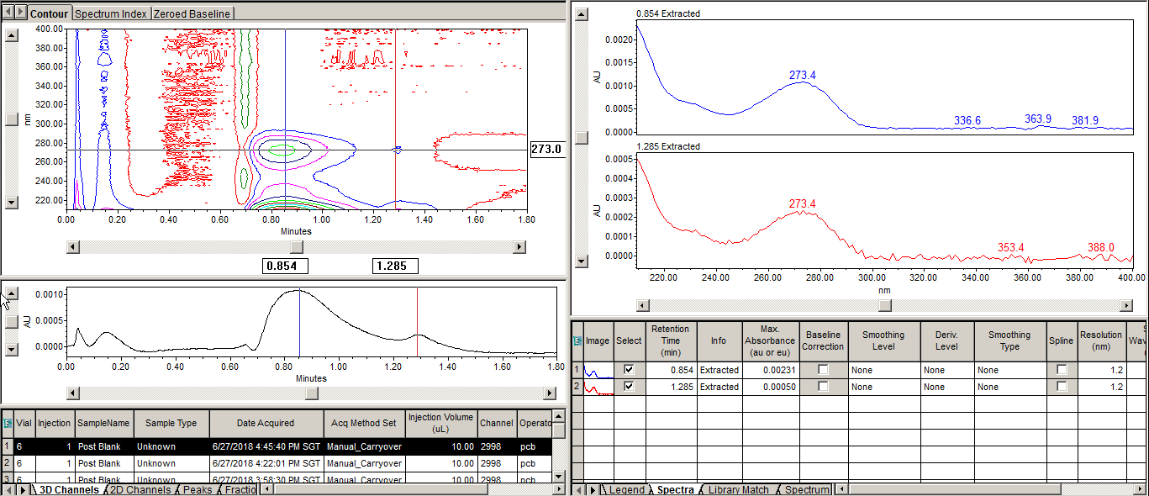
Carryover with 2998 PDA
Six replicate carryover sequences
UV spectrum of caffeine retention and large “hump” consistent with caffeine
High blank should be considered as carryover

Slide 5
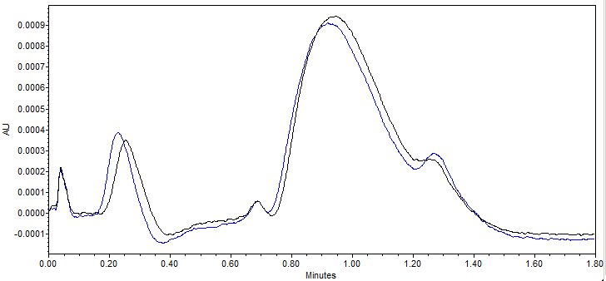
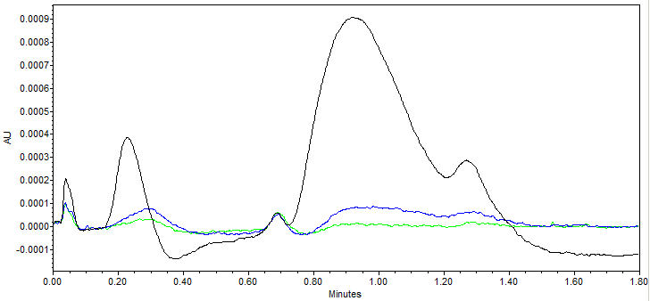
Zero Volume Injections of Post Blank
Carryover sequences run as normal except the injection volume for post blank programmed as 0.0 µL
Even without blank fluid being injected, high blank profile is observed (left)
This suggests that it is the act of injection that creates high blank rather than injected fluid
It also suggests an “external” mechanism for the high blanks (i.e. not inside needle)
Additional zero volume post blank injections result in a rapid decrease in high blank profile (right)
1st injection - Black
2nd injection - Blue
3rd injection - Green

Slide 6
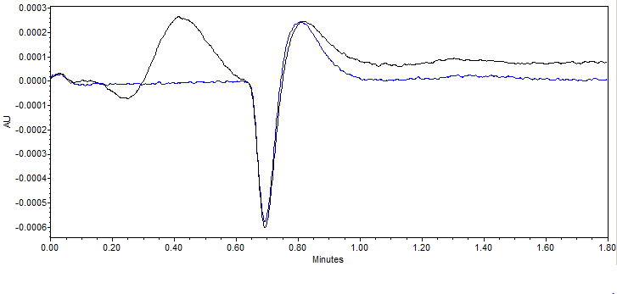
Zero Volume Post Blank Injections (contd.)
Making 10 µL injections from the zero volume post blank vials confirms that there is very little caffeine in the vials. This suggests that the high blank behavior is generated in the seal pack.

Slide 7
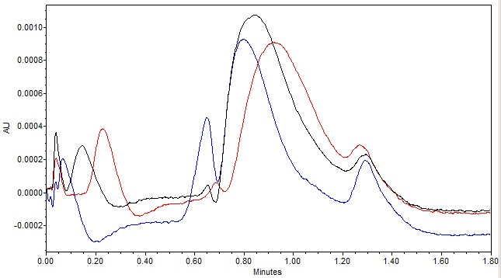
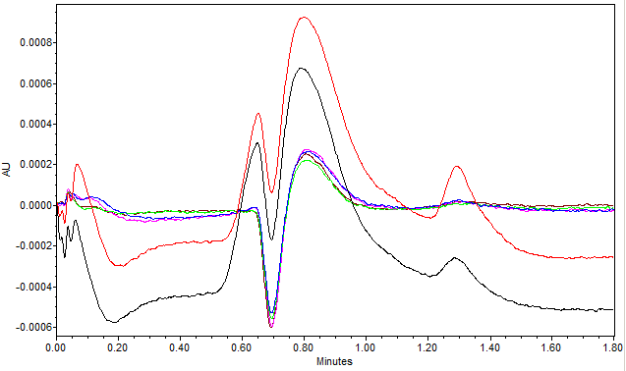
Slow Draw Rate Experiment
Normal carryover sequences except that sample syringe draw rate programmed slow
This cased the high blank profile to elute 12 seconds earlier (left)
This indicates that the injection took place 12 seconds later from the high blank event
This indicates that the event which produces the high blank take place before, or during, sample aspiration.
Split in high blank profile caused by void volume disturbance (left)
Normal draw rate - Black
Slow draw rate - Blue
Zero volume (no time) - Red

Slide 8
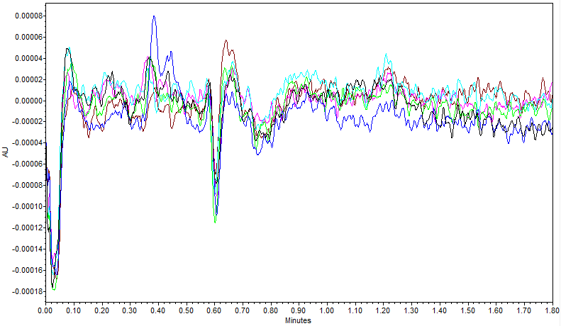
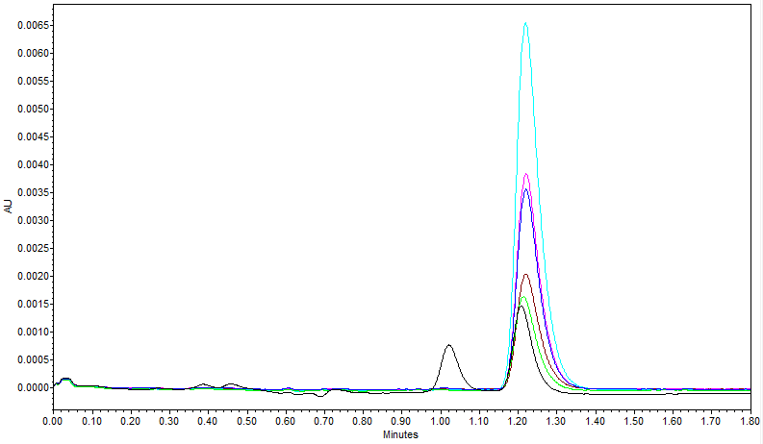
Baseline Carryover on Milford Systems
Milford systems equipped with two injectors supplied by Flextronix
Serial numbers of injectors end in 058 and 090
The 058 injector and seal pack almost never exhibits carryover in post blanks (left)
The 090 injector always demonstrates high carryover. (right)

Slide 9
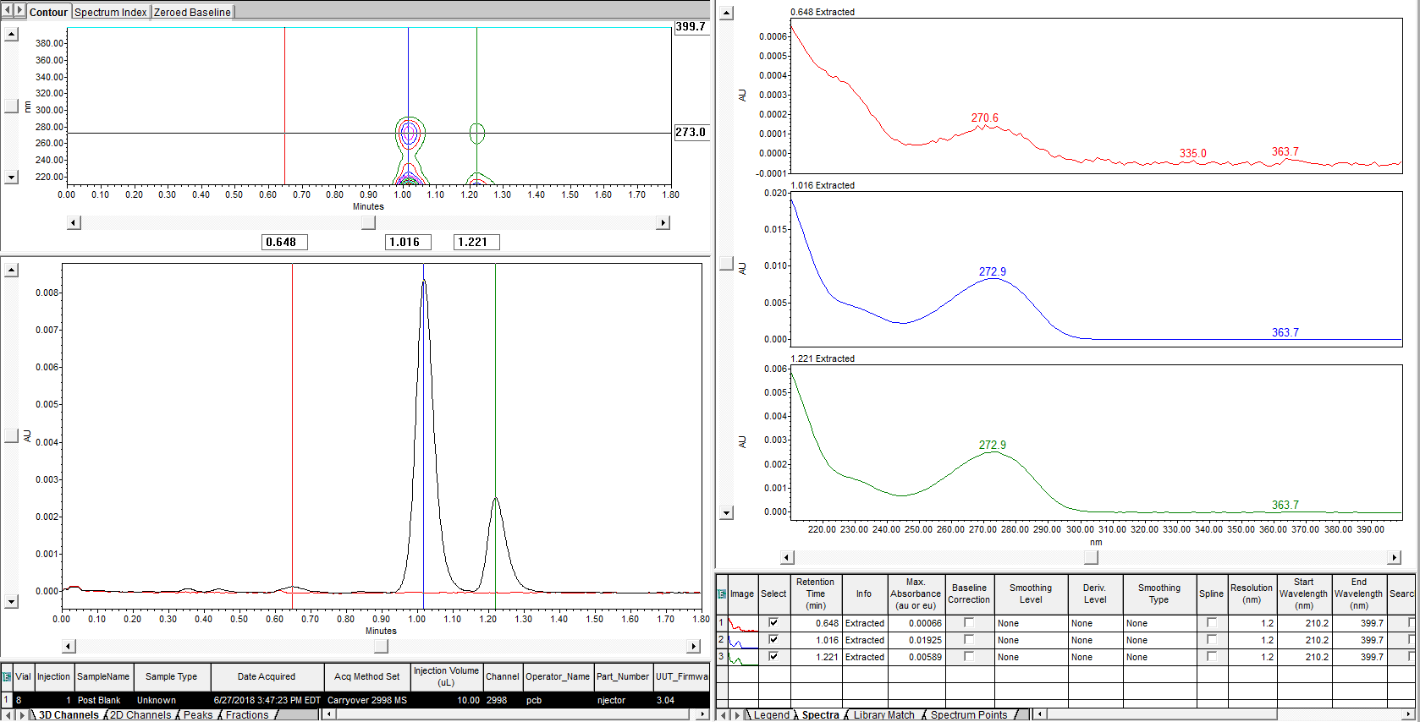
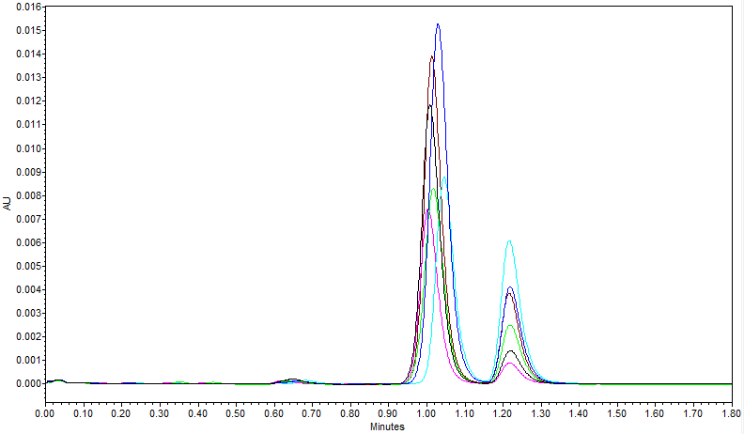
Dry Needle Wash Experiment
Milford team was curious how severe carryover could become with no needle was fluid
Needle wash system “primed” with air
Carryover behavior similar to high blank behavior with large caffeine peak preceding caffeine retention time
There is also a third caffeine contamination even earlier than high blank (left)
All three visible peaks are caffeine (right)

Slide 10
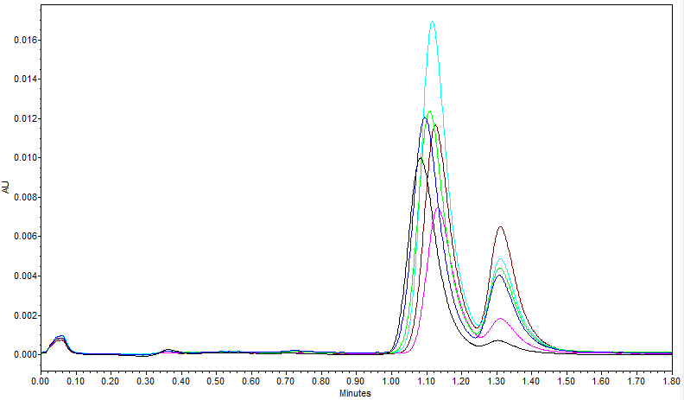
Attempt to Simulate High Blank Profile
Added dispersion on Milford systems begins to resemble high blank profile with dry needle wash
Overlay of 6 post blanks with dry needle wash and added dispersion

