Slide 1


Needle Seal Force –
4M analysis

Slide 2
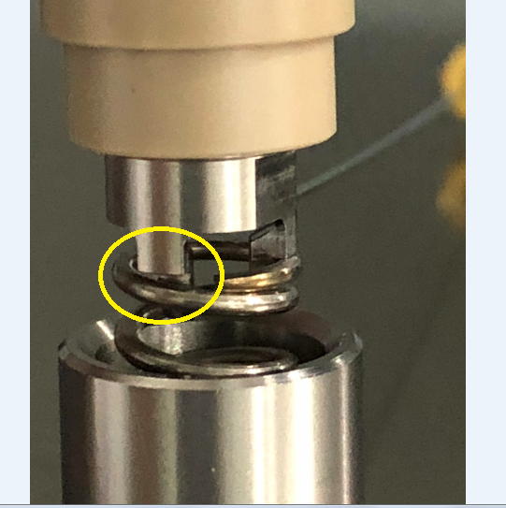
Needle Seal Force – 4M study
Man
No new operator trained and change for load cell assembly.
Method
Assembly process of seal wash assembly followed as per ASP.
Observed that all legs of “port locking nut” may not be
fully seated on the spring as picture.

Slide 3
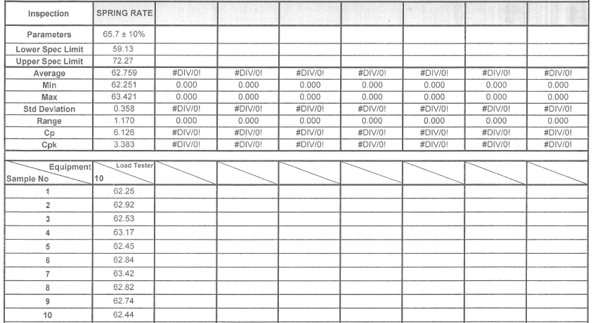
Needle Seal Force – 4M study
Material
Spring rate of 10 pieces of spring P/N:410001746 have been tested. All are within the spec at lower tolerance side as below.

Slide 4
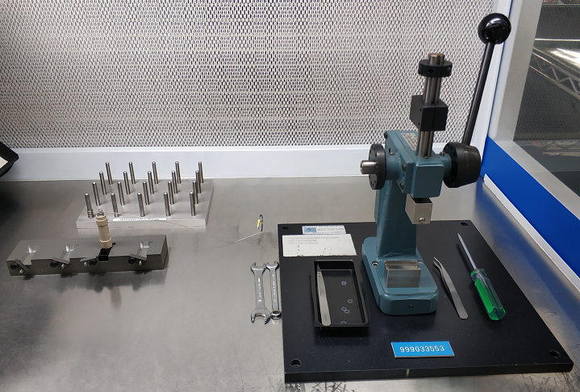
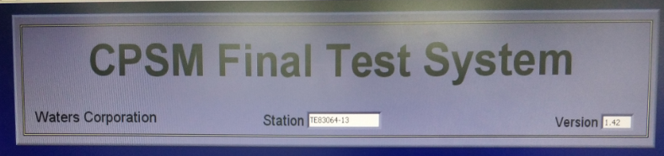
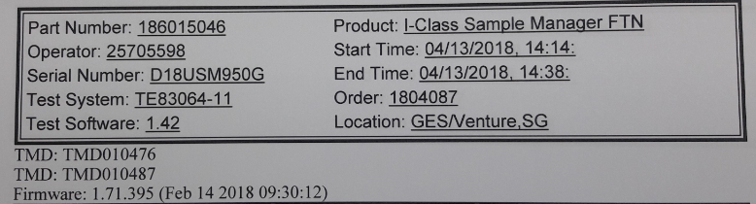
Needle Seal Force – 4M study
Machine
There is no tool and fixture change of seal wash housing assembly.
Testing software change to version 1.42 and firmware change to 1.71.395 at the end of April-2018.

Slide 5
Needle Seal Force –
actions taken on failure

Slide 6
Actions taken for Needle Seal Force failure
Month | FTN models total unit tested | No. of Needle Seal Force failure
Jan-18 | 271 | 3
Feb-18 | 208 | 1
Mar-18 | 238 | 4
Apr-18 | 259 | 9
May-18 | 202 | 23
Jun-18 | 368 | 67
Jul-18 | 221 | 32

Slide 7
Needle Seal Force –
Study on position of nut port locking vs spring

Slide 8
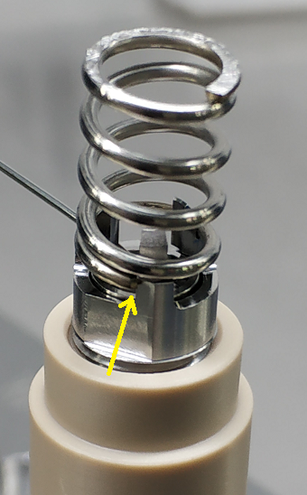
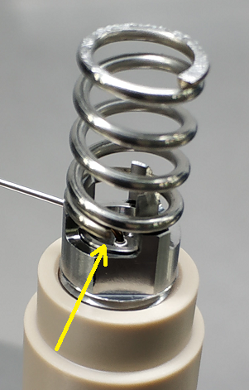
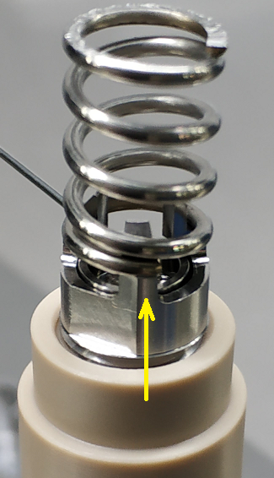
Evaluation Plan
To perform needle seal force test with 3 position of spring edge contact to port locking nut.
To maintain contact position between the spring and the pork locking nut, double side tape is applied to the legs of
port locking nut.
  First position → spring edge position is very close, touching to one of the fork of port locking nut.
  Second position → spring edge’s position is between two forks of port locking nut.
  Third position → spring edge’s position is on the one of the forks of port locking nut.
First position
Second position
Third position

Slide 9
Study the Outcomes
performed x10 times of each position for 3 different positions of spring edge contact to port locking nut.
compared and analyzed test results.
 | 1st position | 2nd position | 3rd Position
Attempt | Test reading (lb/inch)
1 | 49.45 | 54.53 | 50.72
2 | 50.97 | 50.97 | 51.14
3 | 50.88 | 50.97 | 51.22
4 | 50.97 | 51.05 | 51.39
5 | 49.95 | 51.14 | 51.31
6 | 50.72 | 51.22 | 51.22
7 | 50.12 | 51.14 | 51.22
8 | 50.04 | 51.22 | 51.31
9 | 50.21 | 51.31 | 51.31
10 | 50.46 | 51.22 | 51.22
Average reading | 50.3 | 51.47 | 51.2
Based on the average test readings among three different position, there is about 1lb/inch different between first position and (second & third position).
With this study, it could be concluded that there is no significant test result among the different positions of spring edge contact to port locking nut.

Slide 10
Needle Seal Force –
Study on position of Spring related to the Spring Cup

Slide 11
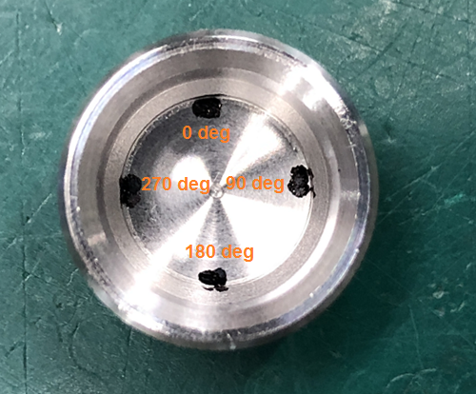
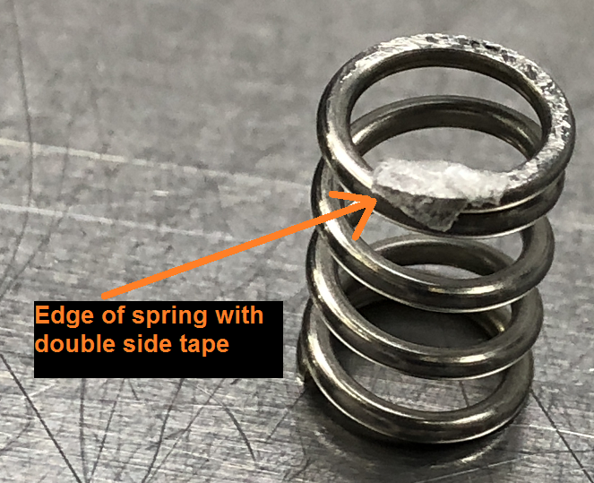
Test Positions of Spring and Spring Cap
Performed needle seal force tests with 4 positions of spring edge contact to spring cap.
Spring was positioned at 90 deg intervals on spring cap.
To maintain contact position between the spring and spring cap, double side tape was applied to edge of the spring as shown below.
Edge of spring has been placed at 0 deg, 90 deg, 180 deg and 270 deg respectively and needle seal force tests were performed.

Slide 12
Test readings
performed x10 times of each position for 4 positions of 90 deg intervals.
test readings are as below.
 | 0°position | 90°position | 180°position | 270°position
Attempt | Test reading (lb/inch)
1 | 48.60 | 48.26 | 49.61 | 50.29
2 | 49.28 | 48.85 | 49.61 | 50.80
3 | 49.19 | 49.36 | 49.45 | 50.63
4 | 48.60 | 49.19 | 49.61 | 50.55
5 | 48.60 | 49.11 | 49.11 | 50.72
6 | 49.28 | 49.28 | 49.61 | 50.72
7 | 48.60 | 49.36 | 49.61 | 50.72
8 | 48.60 | 49.28 | 49.61 | 50.72
9 | 49.28 | 50.12 | 49.28 | 50.80
10 | 48.68 | 49.28 | 49.45 | 50.72
Average reading | 48.87 | 49.20 | 49.5 | 50.67
range of average test readings are between 48.87~50.67 lb/inch.
minimum test reading - 48.6 lb/inch at 0 deg position
maximum test reading - 50.80 lb/inch at 270 deg position

