Slide 1

Engineering Change Request Pilot Training

Slide 2
Background
To align and harmonize the process across the sites. Develop a solution that is efficient, simple and delivers results.
Project objectives & business benefits include the following:
  Harmonized process
  Notification to impacted stakeholders
  Allow impacted stakeholders to have input
  Review signature strategies and approval matrices
  Drive collaboration
  Scalable
  Improve effectiveness

Slide 3
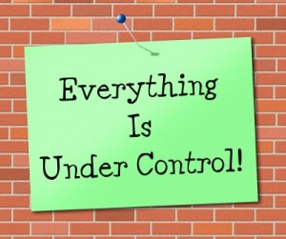
Why are we doing this?
Documented changes to be coordinated across all relevant departments throughout the entire change process.
Create consistency with how ECRs are created and reviewed.
Provide guidance on proper change documentation for ECRs.
Notification to all impacted functions.

Slide 4
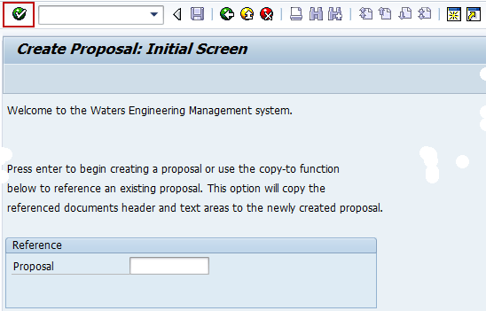
Generating a Proposal
First step in the proposal process

Slide 5
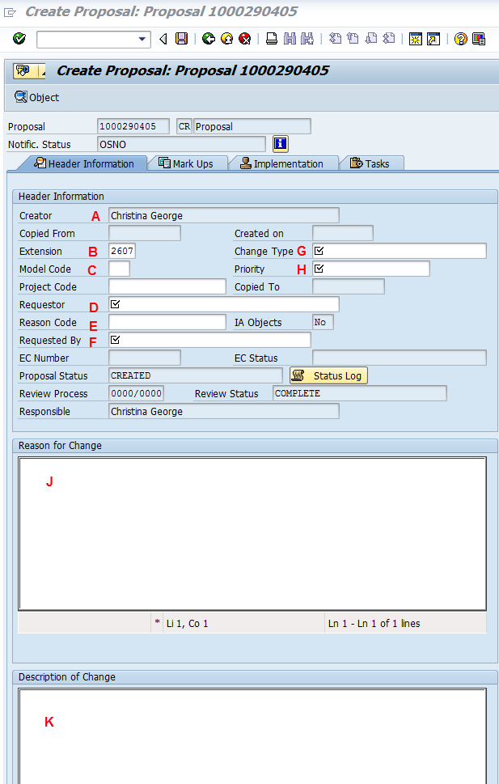
Generating a Proposal
Name of Creator: initiator name
Your Extension number: Add phone extension
Model Code/Project Code (For Development ECRs only): Is it Mechanical, Electrical, etc.?
  Covered in next slide
Requestor: Name of the person
Reason Code: Pull down menu
Request By: Functional department
Change Type: Drop Down List ex: Mechanical/Electrical/etc.
Priority: Class I, II, III
(J) Reason for Change: provide details
(K) Description of Change: What is changing to and from

Slide 6
Generating a Proposal
[CLICK] Change Type: (G) Select one of the following only from Drop Down
    Mechanical – Changes to mechanical related non-chemical parts and product specification, quality control plans for material part numbers and/or assemblies MEI’s.
    Electrical – Changes supporting product specification, electrical components, power supplies, raw cables, cable assemblies, PCB assemblies or firmware.
    Assembly Procedures – Changes in assembly procedures and quality control plans for material part numbers and/or assemblies.
    Change Master – Changes to release or change parts at EN status.
    Software – Releases of software
    Marketing Promotion Literature – Change to release or Clinical/Nonclinical documentation.
    System End Items – Change to release or change system end items.

Slide 7
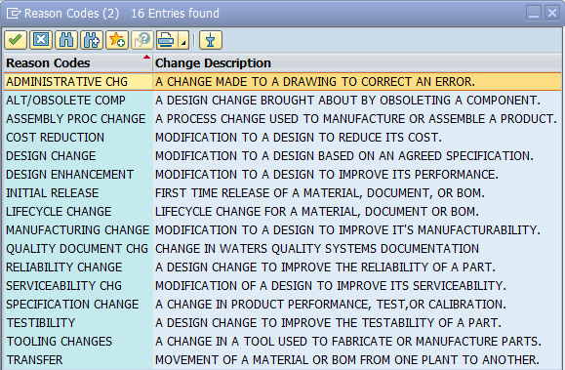
Generating a Proposal
(C) Model Code provided by the Requestor
Project Code: Add project code
(E) Reason code that best describes why the change is being requested (Drop Down)

Slide 8
Generating a Proposal
Reason & Description of Change
  Should be clear and understandable
  Reasons: (The why…)
    Customer complaint
    Reduce assembly time of components
  Descriptions: (The what…)
    Removed the 1.125” feature in print location C3 as it was unnecessary
    Added an edge break to the leading edge of door

Slide 9
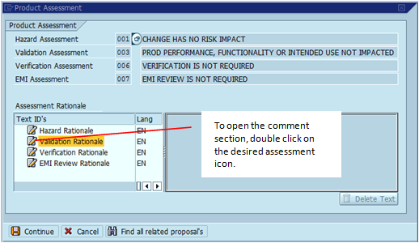
Generating a Proposal
For each Product Assessment which is required, please reference the Impact Assessment Tool to document the action being assigned.
You must provide a response in SAP.
If Product Assessment indicates “Change Has No Risk Impact or Is NOT Required or Intended Use Not Impacted”, no further action is required.

Slide 10
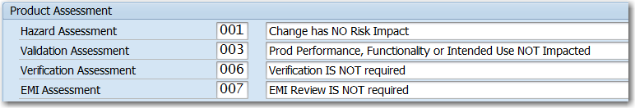
Generating a Proposal
ZCHANGE:
  Do not change the text fields on the right of this area, but do provide justification or evidence
  Select continue to save your text fields.
  Change Plan can capture additional language/specifics.
  Click save and your proposal will be created!

Slide 11
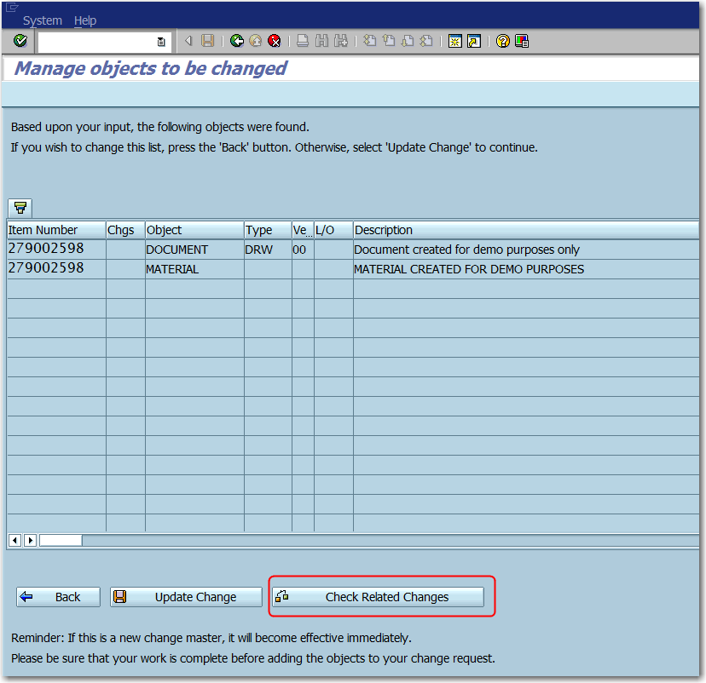
Proposal
Option you may add objects at this point or wait until ECR.
‘Check Related Changes’ for the objects being modified.
This will look for other pending changes on the same items!!!
If there are other changes contact the other originator to agree on path forward!!!

Slide 12
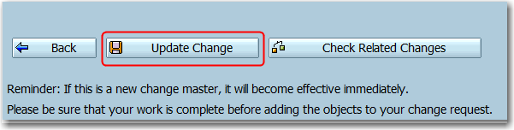
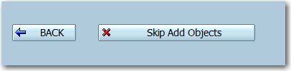
Generating a Proposal
Click ‘Update Change’ to proceed.
If any errors occur, must address each issue before proceeding.
If adding objects: Once all items are corrected, click the ‘BACK’ button or “Skip Add Objects”.

Slide 13
Initiate ECR
Impacted Stakeholders will complete the “Specific Actions.”
Update ECR with references to records i.e. Engineering Drawings.
Any modifications to change plan will require notifications to impacted stakeholders.
Document Implementation Plan (Impact Assessment Tool 730006237, SOP 730006236).
Design Authority evaluates if the deliverables meets the plan objectives and resolves issue.

Slide 14
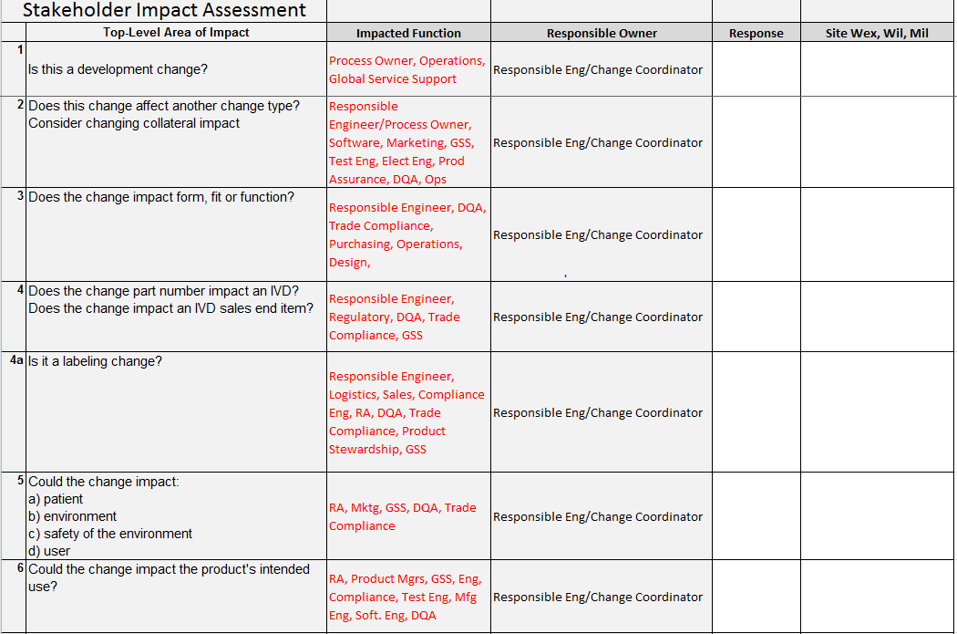
Initial Impact Assessment
Process Owner/Design Authority reviews proposal, assigns priority & Responsible Engineer.
Responsible Engineer documents proposed solution.
Responsible Engineer & Change Coordinator reviews Assessment Tab by:
  Selecting from the Response Column either “Yes / No.”
  The Impacted Stakeholder completes the Change Plan (730006237):
    Answering all questions.
    For Development Changes, only answer specified questions!
Change Coordinator ensures Impact Assessment Tool is attached, and responses documented.
  Escalate if no response is received.

Slide 15


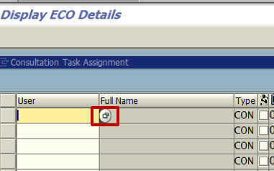
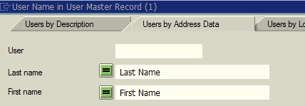

Consultation Task
From the Display ECR screen, click “Consult. Asgn.”
Enter the User ID by selecting from the dropdown menu
  Users will automatically populate
  Click save icon

Slide 16

Manage Objects to be Changed
A - Item Number: Enter part number/DIR/BOM to be changed.
B – CAD Indicator: If releasing or modifying Unigraphics documents select the ‘CAD’ indicator, otherwise leave blank.
  If releasing or modifying a material select the ‘Material’ indicator, otherwise leave blank.
  If releasing or modifying a BOM select the ‘BOM’ indicator, otherwise leave blank.
C – Doc. Type: Select from drop- down menu document type to be released/changed.
D – Action: Select from the drop-down menu.
E – To Status: Select from the drop-down menu appropriate status.
F – Src Plnt: Select the source/development plant, on where the material/BOM has been created, from the drop-down menu.
G – To Plant: Select the production plant from the drop-down menu (the plant on where the material/BOM is being released to).
H – BOM Usage: Select ‘1’ for Production BOMs or ‘5’ for Sales End Items and variant configurations.
I – NewCmpPlnt: This field is only required if an existing CAD assembly is being revised and new components are being added to the existing Part List/ UG BOM.
J - Disposition Code – List the disposition code (This field is required for material added as an object. See Appendix A for more detail)

Slide 17
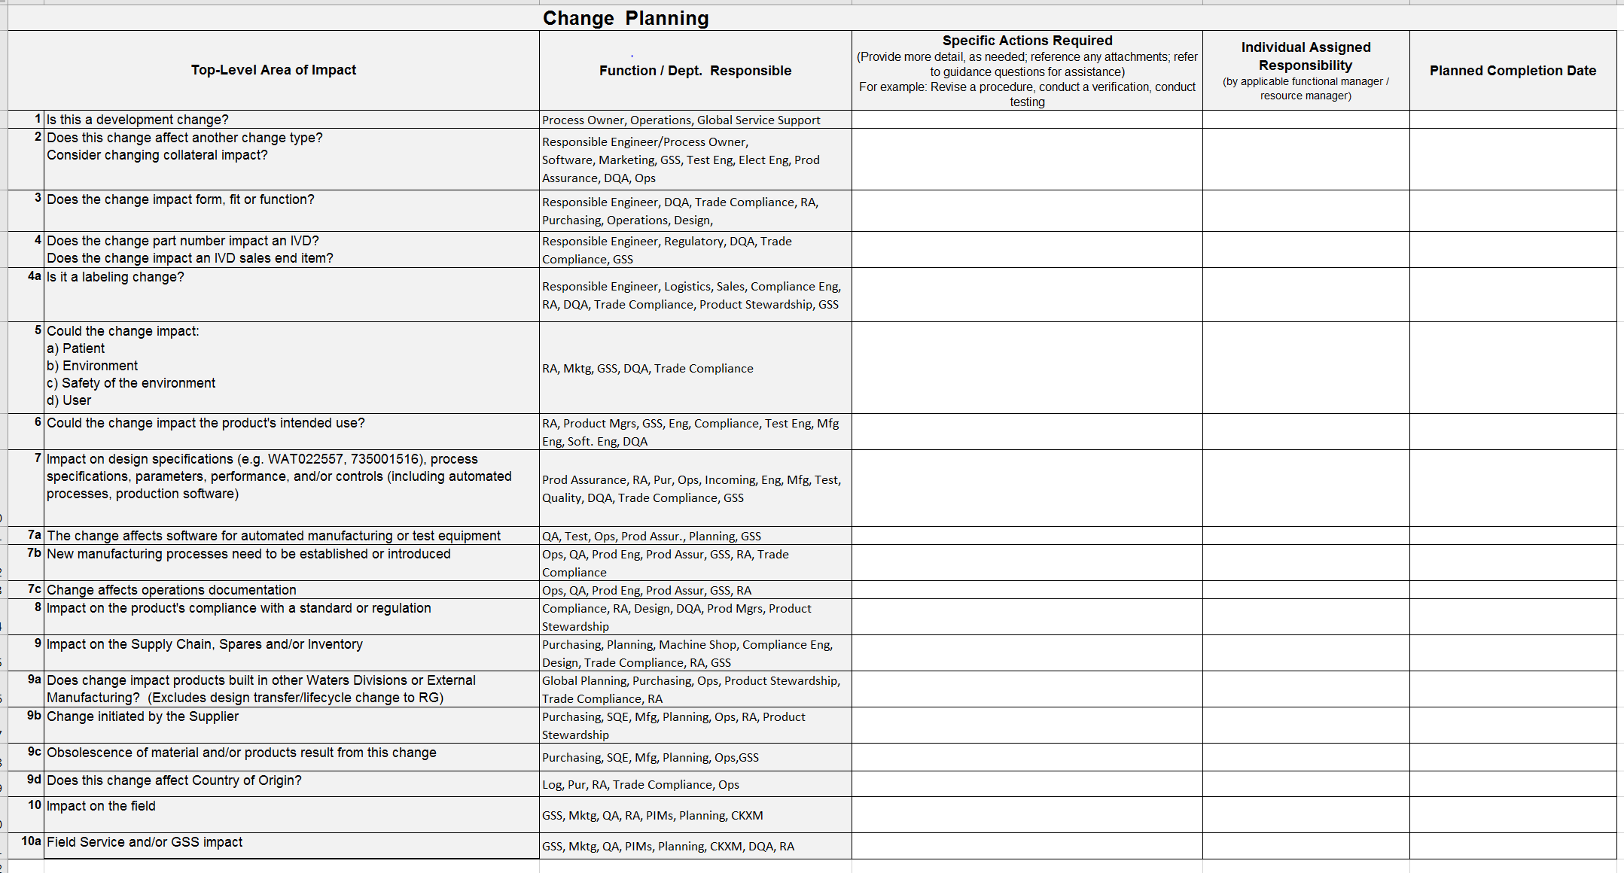
Impacted Stakeholder
  Impacted Stakeholder opens the Impacted Assessment Tool (Supporting Docs in SAP).
Select the “Change Plan Tab.”
Document “Specific Action Required” for all “Yes” responses.
Document “Individual Assigned Responsibility” & the “Planned Completion Date” for each action.

Slide 18
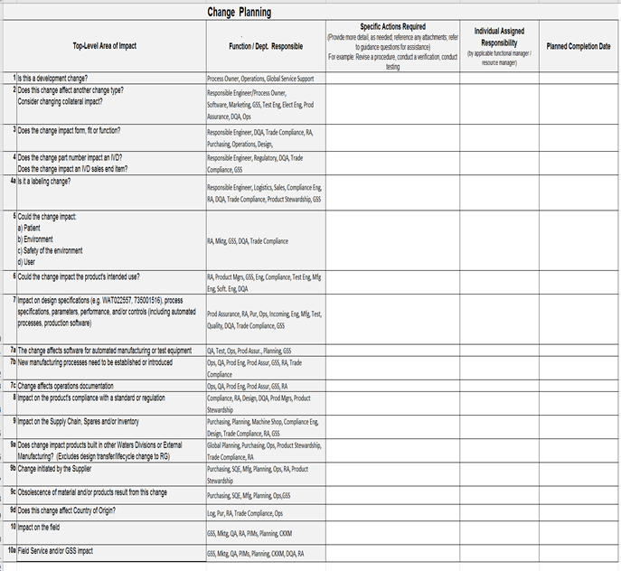
Review Change Plan
Change Coordinator confirms change has been classified.
Confirms impacted stakeholders have responded.
Process Owner/Design Authority approves / rejects the plan.

Slide 19
Preparing the ECR for QC review
Before submitting the ECR for QC review:
Confirm classification of change
Confirm correct model and or project code selected
Review ECR content
Ensure the change is technically feasible and meets product specifications
Delegate change to responsible engineer / subject matter expert or return change to originator for additional information or termination

Slide 20
Submit ECR for Initial Review / Directly to QC Inbox
From the Display ECO Details screen:
Select the Submit button:
Once submitted, depending on the Change Type selected, the status of the ECR will be changed to Initial Review or Checker, once ready Submitted to QC.
Mechanical, Electrical, and Mechanical Chemical Device change types will be submitted to an Initial Reviewer.
All other ECRs will go directly to Quality Inbox.

Slide 21
Change Implementation Plan
Impacted Stakeholder verifies the change plan.
Provides input on the change implementation plan.
Change Coordinator:
  Coordinates cross-functional input
  Updates implementation plan, as necessary
  Ensures implementation plan is ready for execution
  Submits change for review and approval

Slide 22
Submit ECR for QC Review
From the Display ECO Details screen:
Click Submit
For Development ECR will route to the NPI for review.
For Production ECR will route to Submitted to QC.

Slide 23
QC Review
QC Reviewer assigned to the ECR upon receiving the change request.
The QC Reviewer will verify:
Ensure the required fields have been completed and contain the appropriate material links
Follow up on site impact if warranted
Assign signature strategy
Convert ECR to ECO
Process ECO
Close the ECO
Note: The QC Reviewer will work with the ECR originator if there are any discrepancies.

Slide 24
Change Approver & QC Reviewer
Change Approver:
  Reviews the change implementation plan execution
  Approves the ECR
QC Reviewer:
  Converts ECR to ECO!
  Execute the change!
  Notifies all impacted stakeholders!
QS Analyst closes the ECO and notifies all impacted stakeholders.

Slide 25
Summary
Pilot to be conducted
Impact Assessment Tool included in pilot
Deviation (TMD010647) used to allow use of DRAFT SOP & Tool
Responsible engineer along with coordinator collaborate to process the change
Impacted stakeholders provide input to Change Plan & Implementation Plan
Consultation phase used to notify impacted stakeholders

