Slide 1
2020 FPY Improvement Activities ( Flex)

Slide 2
Goal and Objective
To achieve FPY for Alliance, BSM, QSM, TUV, PDA and Pumps equal and greater 90%
The approach is to optimize the test coverage through process , consumables and test enhancements. It is a conjunction efforts to work between Milford, WPPL and Flex.
3. Flex is to plot out the Pareto Charts for Alliance, BSM, QSM, TUV, PDA and Pumps across all the failures reported in Year 2019. Flex is to fill up all the actions taken and efforts in the past 1 year and so the upcoming as well as on going activities for yield improvement.
4. Milford and WPPL team are to provide more technical advice and actions in term of test software and specification, test and pre-inspection methods as well as the control of test samples / consumables to ensure test coverage are fully optimized and enhanced.

Slide 3
FPY Improvement Summary
Model | Target 2020 | Q1 2020 | Q2 2020 | Q3 2020 | Q4 2020 | Item | Progress
Pumps | 100% | 100%
TUV Detectors |  |  |  |  |  | Dual Noise
PDA Detectors |  |  |  |  |  | Loss Communication | Open, pending EVALS20015
BSM |  |  |  |  |  | Dynamic leak
QSM |  |  |  |  |  | Test Prime A,B,C,D with MeOH | Open, pending Evaluation
Alliance

Slide 4
Pareto Chart for BSM

Slide 5
BSM – 1. Dynamic Leak Test failure summary
Failure Modes | 186015001
Re-prime & Re-test (due to BSM seal wear & tear) | 5.11%
Test tubing fitting | 3.12%
Materials | 2.31%
System failed to pressurize | 2.48%
Communication | 1.86%
Column Error | 1.08%
System Overpressure | 0.93%
Total failure % contributed | 16.89%

Slide 6
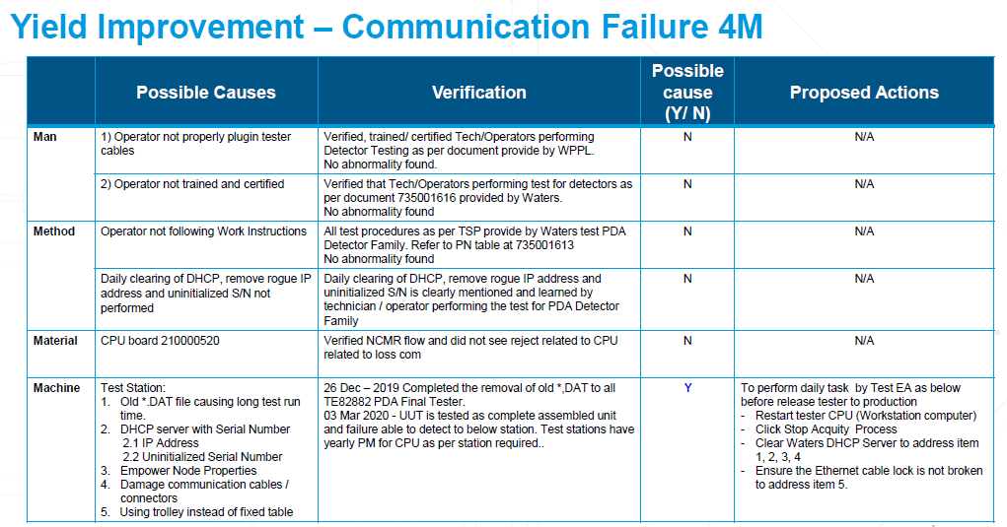
Yield Improvement - 4M

Slide 7
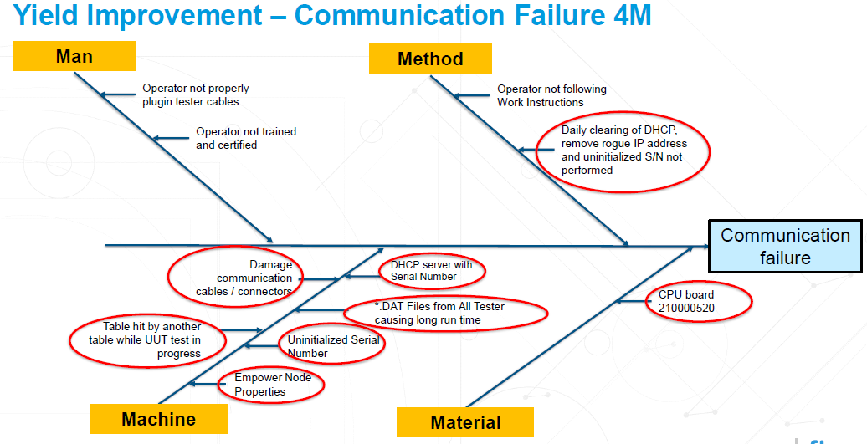
Yield Improvement - 4M

Slide 8
BSM – 2020 FPY Improvement Plans
No | Failure | % Fail 2019 | % Improve 2020 | Actions & Results
 |  |  |  | Flex | PIC / Date
1 | Dynamic Leak Test Re-prime & Re-test 5.11% During test, failed with comment abc Retested and Passed. Test tubing fitting 3.12%, During test, failed with comment “System failed to pressurize. Look for severe leak” or “system failed to pressurize”. No physical leak found. Re tighten, Retested and Passed. | 186015001 16.89% | To be monitoring and refer to next slide for monthly update | ID:TE:XXXXX-XX to TEXXXXX-XX RE-Prime & Re-Test Prime BSM before functional test. No improvement Not implement Test tubing fitting Check frequency of tubing wear No improvement Not implement | Joel June 2019 Joel June 2019

Slide 9
Monitoring in 2020 – Re-prime & Re-test and Test tubing fitting
BSM - 5001
Month | Total Unit Tested | Re-prime & Re-test (failure%) | Test tubing fitting (failure %)
 |  | 2019 Ref rate 5.11 % | 2019 Ref rate 3.12%
Jan -2020 | 109 | 6.58% (Refer to slide 7) | 3.67% (Refer to slide 8)
Feb -2020 | 174 | 0% | 0%
Mar-2020 | 174 | 0.57% | 2.29%

Slide 10
BSM - Re-prime & Re-test
Mar 2020 | BSM 2019 Ref failure rate – X.XX% Achieved – 10.5% | Improvement |  | Financial / Productivity Gain Details (e.g. FPY % improvement, cycle time reduction, etc)
PIC
Purpose
Why are we doing this project? Failure observed: eg. System failed to pressurize during Dynamic Leak test (x4). Resolution actions : eg. Retest can pass and no other action was required. There was no physical leakage found Root Cause: eg. As no physical leakage and the BSM pump was working fine, unable to identify the root cause
Progress |  | Project Status
Key activities achieved |  | Q1 | Q2 | Q3 | Q4
 |  |  |  |  | Target closure
Next Steps |  | Risks & Issues
what are the activities to achieve target |  | Roadblocks, assistance required

