Slide 1
QSM – Test Improvement
Apr 2021

Slide 2
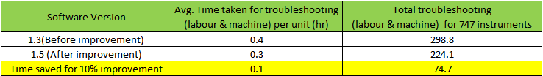
Data Comparison
6 months data in between test software version 1.3 & 1.5
FPY Improvement over 6 months - ~10%
Time saved based on 10% yield improvement over 6 mths and 6 units per day - 0.1hr per unit
Methanol saved – 116mL or USD 1.624 per unit

