Slide 1

<FPY improvement on FTN testing in Venture>
Owner | Luo HuaZhen/Victor Montero | ROI |  |  | Needle seal force test failure drop from 11% to 0%; Cost saving 376.6 USD/year
Date | 05 Apr 2021
Purpose
This project is to improve FTN sample manager test First Pass Yield by reducing the Needle Seal Force test failure rate from 11% to 0% through tightening spring rate spec.
Progress |  | Project Status
Q4 2019, Needle seal force is identified as area to improve. Q1- Q2 2020, an evaluation with high side of spring rate was conducted in Venture. The result shows positive. Q3-Q4 2020, Milford sustaining engineering team conducted evaluation in Milford after getting positive evaluation result from Venture. Q1 2021, evaluation result shows positive in Milford, but team wants optimize the spec for spring rate as observed some batch differences although results shows almost 0 fallout. |  | Q1 | Q2 | Q3 | Q3 | Q4
 |  |  |  | Target to complete | Target to complete
Next Steps |  | Risks & Issues
Q2 2021, Milford will review extended evaluation result and release updated spring rate drawing to finalize this improvement. |  | Evaluation progress was affected by Covid-19
Notes:
Look at having different colour schemes for different pillars

Slide 2
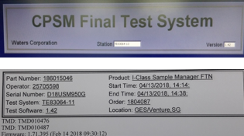
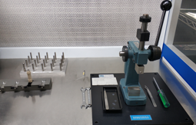
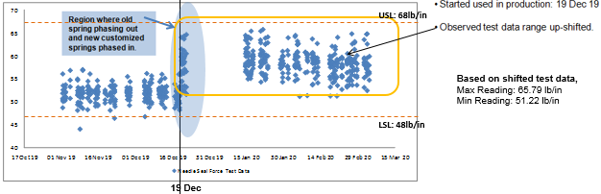
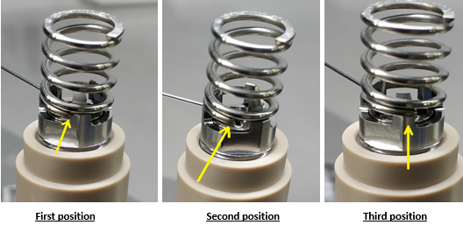
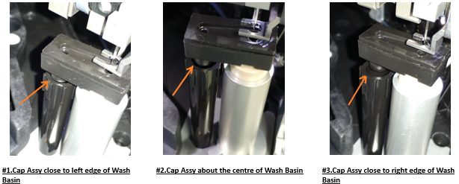
Needle Seal Force Test – Force Stack up Analysis
Spring occupy 60.7% of Test Acceptance specification (< 20 lb/in).
Raw springs are measured from 3rd party, the compression force is at low side (62 lb/in, spec : 59 ~ 72 lb/in).
Proposed : To use spring at high side tolerance – 65.5 ~ 72 lb/in, to raise up seal force 5~10 lb/in.
Operator
No new trainee
Test Software (Needle travelling distance )(X lb/in)
Parts | Force Ib/in | % of 20 lb/in
Spring Tolerance | 12.14 | 60.70
Port Seating | 1.17 | 5.85
Wash cup position | 2.60 | 13.0
Fixture | X | 20.45
Test Software | X
Load Cell | X
Control PCBA | X
Total |  | 100
Area to improve
Discipline
As per WI
Fixture (Wash Cup misalignment)(X lb/in)
Man
Needle Seal Force
< 20 lb/in
Machine
Material
Method
Spring Tolerance (12.14lb/in)
Control PCBA ( X lb/in)
Load Cell (X lb/in)
Seating Port Locking Nut on spring (1.17lb/in)
Position Wash Cup (2.6lb/in)
Note : X – To be studied / defined

Slide 3
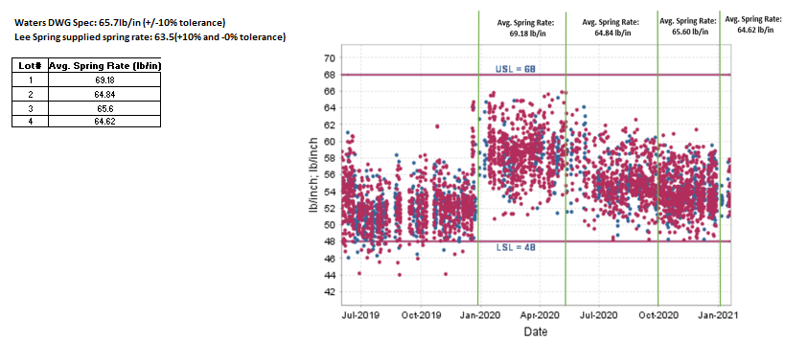
Evaluation result shows positive reading with high side of spring rate
Needle seal force test failure rate dropped from 11% to 0 since started evaluation in Q1 2020.
Spring force reading variance from different batches was observed during evaluation. Although all test data shows it’s within the spring rate spec (< USL 68 lb/in and > LSL 48 lb/in).
An extended evaluation is conducting in Milford to optimize the spring rate spec before releasing new spring drawing with tighten spec.

