Slide 1

<FPY improvement on FTN testing in Venture>
Owner | Luo HuaZhen | ROI |  |  | Needle seal force test failure drop from 11% to 0%; Cost saving 376.6 USD/year
Date | 05 May 2020
Purpose
This project is to improve FTN sample manager test First Pass Yield by reducing the Needle Seal Force test failure from 11% to 0% by tightening spring rate spec from 65.7lb/in (+/- 10%) to 63.5lb/inch+10%/-0%.
Progress |  | Project Status
Q4 2019, Needle seal force failure was identified as area to improve Q1 2020, provided positive evaluation data to Milford Sustaining Engineering Q2 2020, Milford is working on Spring rate spec update |  | Q1 | Q2 | Q3 | Q3 | Q4
 |  |  |  | Target to complete | Target to complete
Next Steps |  | Risks & Issues
Q3 2020, implementation of new spring rate spec |  | To update parts spec, have to go through a cycle of evaluation and across function to get it done Evaluation progress was affected by Covid-19
Notes:
Look at having different colour schemes for different pillars

Slide 2
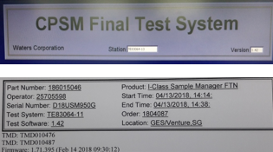
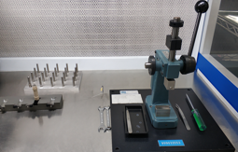
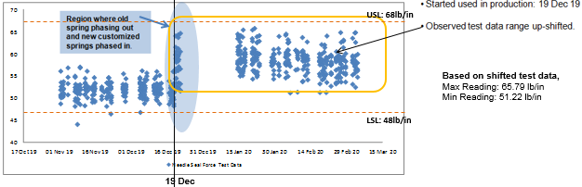
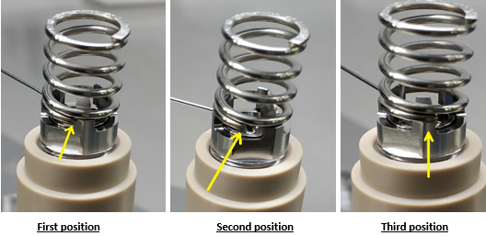
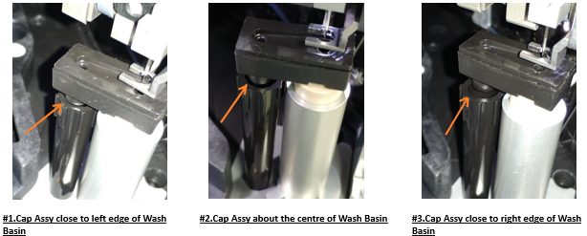
Needle Seal Force Test – Force Stack up Analysis
Spring occupy 60.7% of Test Acceptance specification (< 20 lb/in).
Raw springs are measured from 3rd party, the compression force is at low side (62 lb/in, spec : 59 ~ 72 lb/in).
Proposed : To use spring at high side tolerance – 65.5 ~ 72 lb/in, to raise up seal force 5~10 lb/in.
Operator
No new trainee
Test Software (Needle travelling distance )(X lb/in)
Parts | Force Ib/in | % of 20 lb/in
Spring Tolerance | 12.14 | 60.70
Port Seating | 1.17 | 5.85
Wash cup position | 2.60 | 13.0
Fixture | X | 20.45
Test Software | X
Load Cell | X
Control PCBA | X
Total |  | 100
Discipline
As per WI
Fixture (Wash Cup misalignment)(X lb/in)
Man
Needle Seal Force
< 20 lb/in
Machine
Material
Method
Spring Tolerance (12.14lb/in)
Control PCBA ( X lb/in)
Load Cell (X lb/in)
Seating Port Locking Nut on spring (1.17lb/in)
Position Wash Cup (2.6lb/in)
Note : X – To be studied / defined

Slide 3
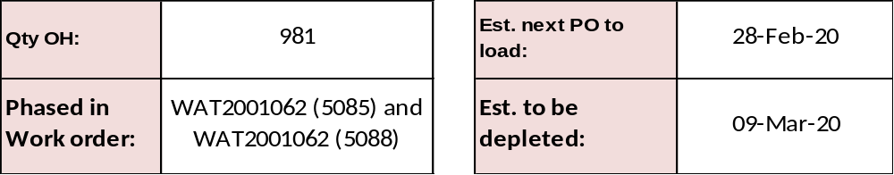
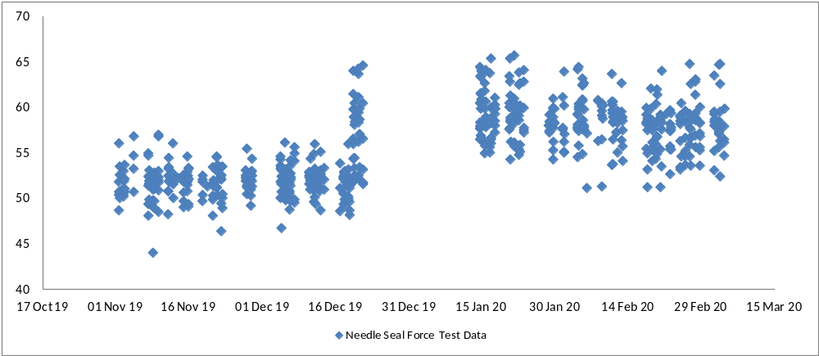


Needle Seal Force Test – Spring 63.5lb/inch (+10% and -0)
USL: 68lb/in
Based on shifted test data,
Max Reading: 65.79 lb/in
Min Reading: 51.22 lb/in
LSL: 48lb/in
19 Dec

