Slide 1

<FPY improvement on PDA Testing in Flex>
Owner | Luo HuaZhen | ROI |  | Reducing lost comm failure rate from 9.68% to 5%
Date | 05 May 2020
Purpose
Flex PDA production First Pass Yield was affected by intermittent lost communication between tester and Unit Under Test during final test in many years. This project is to reduce this lost comm soft failure from 9.68 % to 5%.
Progress |  | Project Status
Q1 2020, this lost communication issue was identified as an area to improve. Team did some evaluation on testers set up/test software configuration Q2 2020, an evaluation plan was implemented to collect 100 units test yield on each testers from total 6 testers and monitor loading port performance (4 loading port each tester) Q3 2020, Completed total 600 data points on 29 Jul 20 and it shows Tester TE82882-8,-11 and -13 has higher failure rate than other station. Milford team was informed and made change on 3x stations above and advise to monitor these 3 stations FPY. |  | Q1 | Q2 | Q3 | Q3 | Q4
Next Steps |  | Risks & Issues
Complete 10 units on each port data collection on station TE82882-8,-10 and -13 |  | The data collection process will take longer than expecting with low loading volume
Notes:
Look at having different colour schemes for different pillars

Slide 2
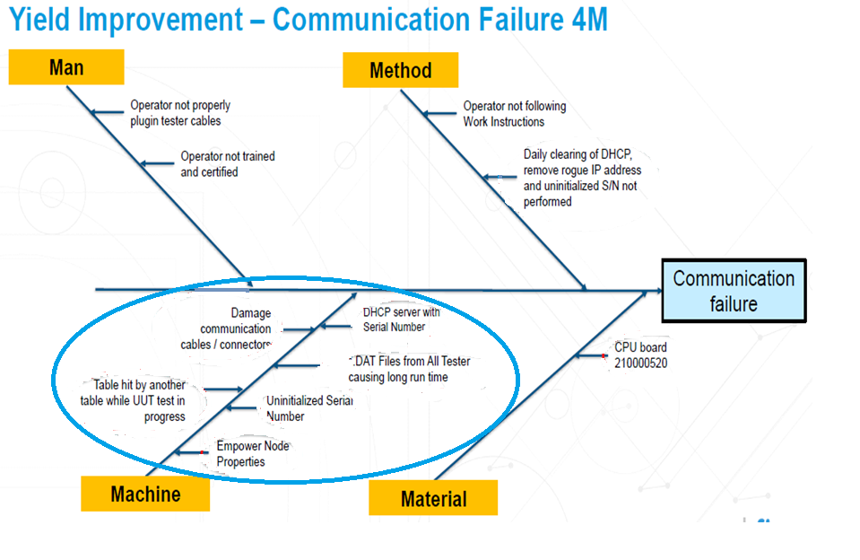
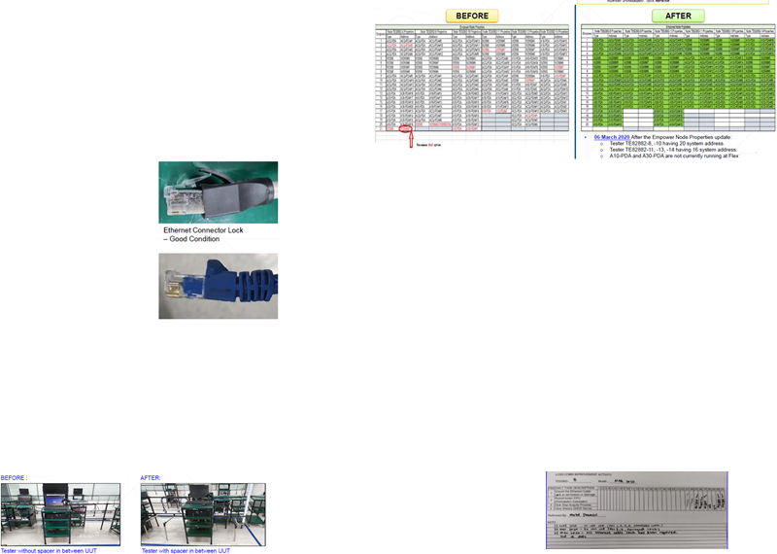

Slide 3
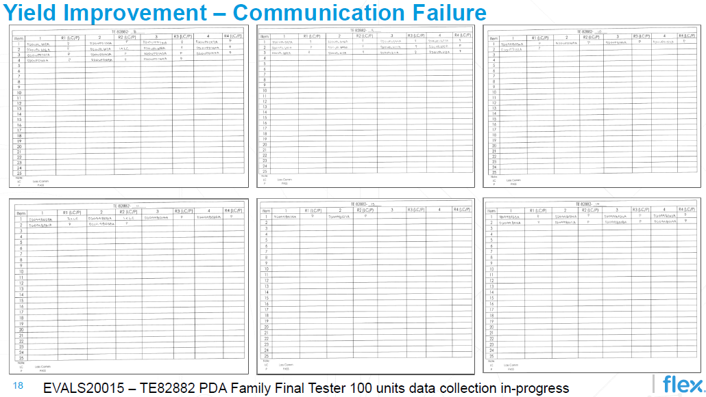
Data collection for testers in progress

Slide 4
<FPY improvement on TUV Testing in Flex>
Owner | Luo HuaZhen | ROI |  | Reducing Dual Noise failure rate from 9.68% to 5%
Date | 05 May 2020
Purpose
To improve Dual Noise failure rate by 50%
Progress |  | Project Status
 |  | Q1 | Q2 | Q3 | Q3 | Q4
 |  |  |  |  |  | Complete data collection
Next Steps |  | Risks & Issues
Notes:
Look at having different colour schemes for different pillars

Slide 5

<FPY improvement on Interfacing Tubing in Flex>
Owner | Luo HuaZhen | ROI |  | Reducing lost comm failure rate from 10.67% to 5%
Date | 29 May 2020
Purpose
To improve soft failure rate by 53% ➢ To gather 100 data points per station for 8 Tester (total of 800 data) ➢ To publish status on weekly Engineering Meeting
Progress |  | Project Status
 |  | Q1 | Q2 | Q3 | Q3 | Q4
 |  |  |  |  |  | Complete data collection
Next Steps |  | Risks & Issues
Notes:
Look at having different colour schemes for different pillars

