Slide 1

<FPY improvement on PDA Testing in Flex>
Owner | Luo HuaZhen | ROI |  | Reducing lost comm failure rate from 10.26% to 5%
Date | 05 May 2020
Purpose
Flex PDA production First Pass Yield was affected by intermittent lost communication between tester and Unit Under Test during final test in many years. This project is to reduce this lost comm soft failure from 10.26 % to 5%.
Progress |  | Project Status
Q1 2020, this lost communication issue was identified as an area to improve. Team did some evaluation on testers set up/test software configuration Q2 2020, an evaluation plan was implemented to collect 100 units test yield on each testers from total 6 testers and monitor loading port performance (4 loading port each tester) Q3 2020, Completed total 600 data points (100each station) on 29 Jul 20 and it shows Tester TE82882-8,-11 and -13 has higher failure rate than other station. Result was shared with Milford team. These 3x high lost comm stations were checked by Eric Turner and testers database was adjusted. Team was advised to monitor performance on tester TE82882-8,-11 and -13. Q4 2020, Root cause of high failure rate on TE82882-8,-11 and -13 was identified and a recommended solution is in place. Will see the yield improvement from Nov and onwards data. |  | Q1 | Q2 | Q3 | Q3 | Q4
 |  |  |  |  |  | Target to complete
Next Steps |  | Risks & Issues
Complete min. 10 units on each port data collection on station TE82882-8,-10 and -13. Compile and review lost comm failure rate on these 3 testers and share it with Milford team. Target to improve from ave. FPY 56.7% to 80% on tester TE82882-8,-11,-13 Working total yield improvement once data collection is completed |  | NA
Notes:
Look at having different colour schemes for different pillars

Slide 2
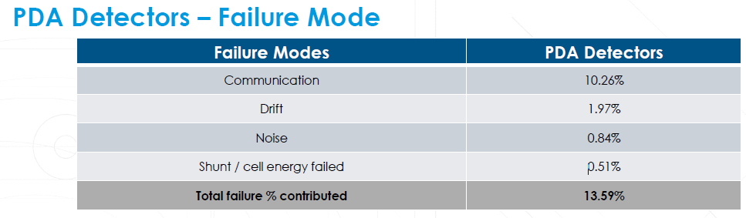
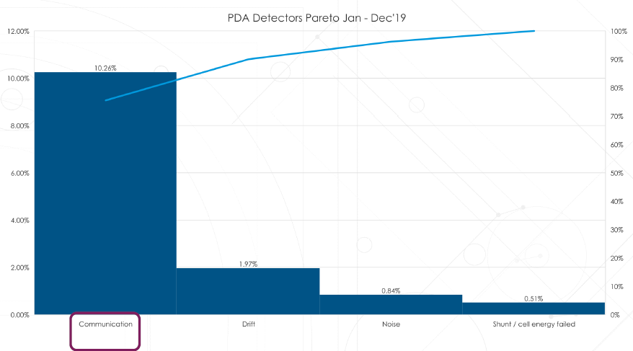
1. Loss Comm (10.26 %) was identified as area to improve

Slide 3
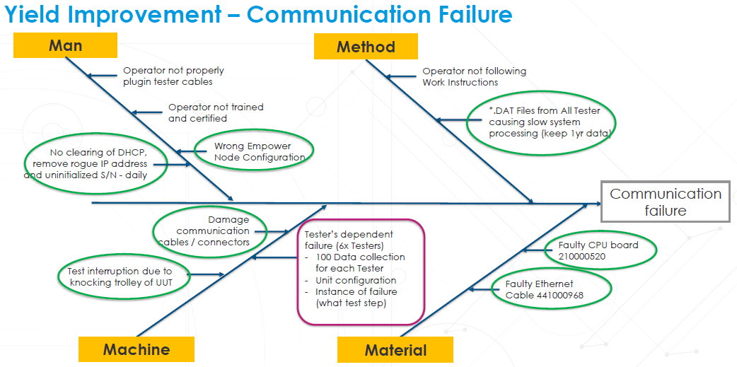
2. Machine (Testers) was identified as area to improve for loss comm issue

Slide 4
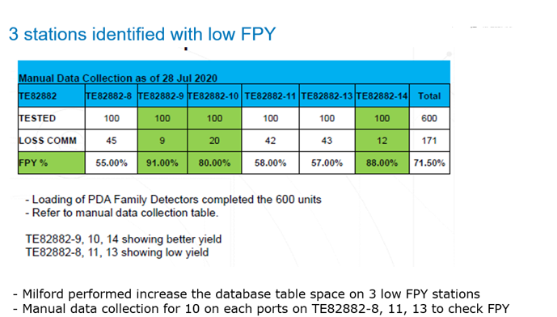
3. An evaluation to check individual port/tester across all 6 testers carried out and it show 3 testers have low FPY

Slide 5
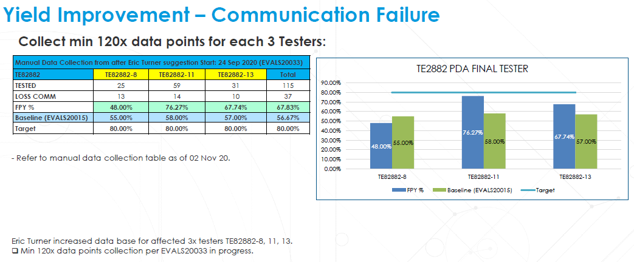
4. Improvement from 3 low FPY Testers after test software database adjustment

Slide 6
5. Still low FPY observed on TE82882-8 and TE82882-13 after database adjustment
Root cause of low FPY on TE82882-8 was identified
1. The relay bank cannot be closed as per test program instruction; Suspect it’s a faulty relay bank, Eric is shipping out a new relay bank and will monitor the FPY on new relay bank once received.
2. Direct LAN cable is used as alternate solution for testing now, and it shows very good FPY (9/10 passed without failure). Data collection is ongoing.
Root cause of low FPY on TE82882-13 was identified
1. Port 3 LAN cable is opened. Replaced LAN cable and data collection is ongoing.
Tester TE82882-11 shows FPY improved after database adjustment.

Slide 7
6. Conclusion/Plan
FPY improvement will be reflected from Nov 2020 data and onwards since we have narrowed down the root cause of low FPY on TE82882-8, -13 and -11 which are giving the high failure rate on loss comm issue
The data collection is still ongoing after made adjustment to address the root causes on 3 low FPY testers at end of Oct 2020. Will update this yield improvement with test data for Nov & Dec again
Will review and close this project once the overall FPY improved for this PDA final test.

