Slide 1

<FPY improvement on PDA Testing in Flex>
Owner | Luo HuaZhen | ROI |  | Reducing lost comm failure rate from 10.26% to 5%
Date | 05 May 2020
Purpose
Flex PDA production First Pass Yield was affected by intermittent lost communication between tester and Unit Under Test during final test in many years. This project is to reduce this lost comm soft failure from 10.26 % to 5%.
Progress |  | Project Status
Q1 2020, this lost communication issue was identified as an area to improve. Team did some evaluation on testers set up/test software configuration Q2 2020, an evaluation plan was implemented to collect 100 units test yield on each testers from total 6 testers and monitor loading port performance (4 loading port each tester) Q3 2020, Completed total 600 data points (100each station) on 29 Jul 20 and it shows Tester TE82882-8,-11 and -13 has higher failure rate than other station. Result was shared with Milford team. These 3x high lost comm stations were checked by Eric Turner and testers database was adjusted. Team was advised to monitor performance on tester TE82882-8,-11 and -13. Q4 2020, Root cause of high failure rate on TE82882-8,-11 and -13 was identified and a recommended solution is in place. Will see the yield improvement from Nov and onwards data. |  | Q1 | Q2 | Q3 | Q3 | Q4
 |  |  |  |  |  | Target to complete
Next Steps |  | Risks & Issues
Complete min. 10 units on each port data collection on station TE82882-8,-10 and -13. Compile and review lost comm failure rate on these 3 testers and share it with Milford team. Target to improve from ave. FPY 56.7% to 80% on tester TE82882-8,-11,-13 Working total yield improvement once data collection is completed |  | NA
Notes:
Look at having different colour schemes for different pillars

Slide 2
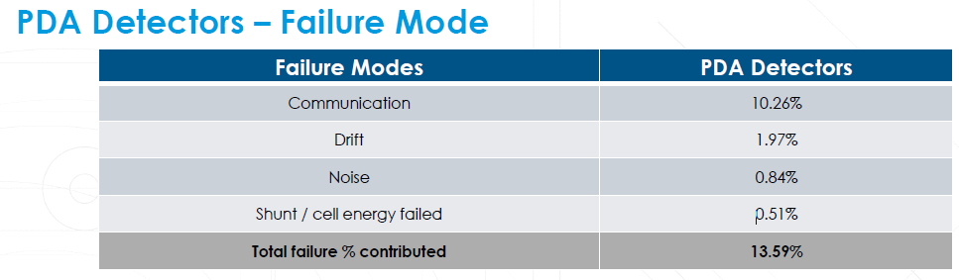
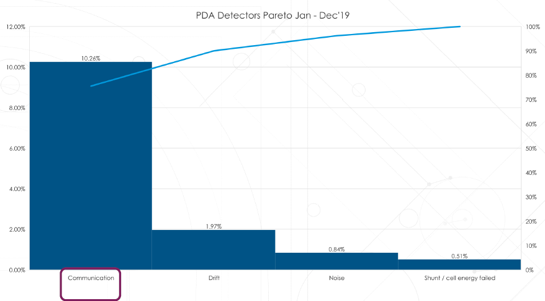
1. Loss Comm (10.26 %) was identified as area to improve

Slide 3
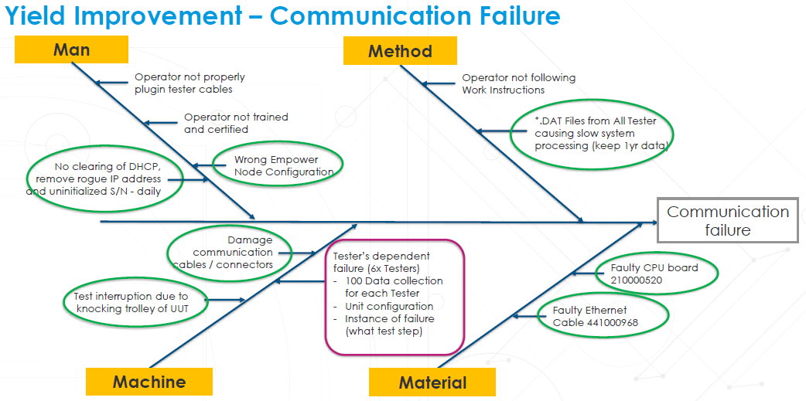
2. Machine (Testers) was identified as area to improve for loss comm issue

Slide 4
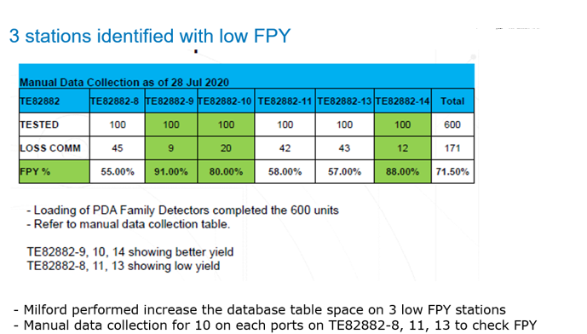
3. 3 testers was identified with low FPY across 6 testers

Slide 5
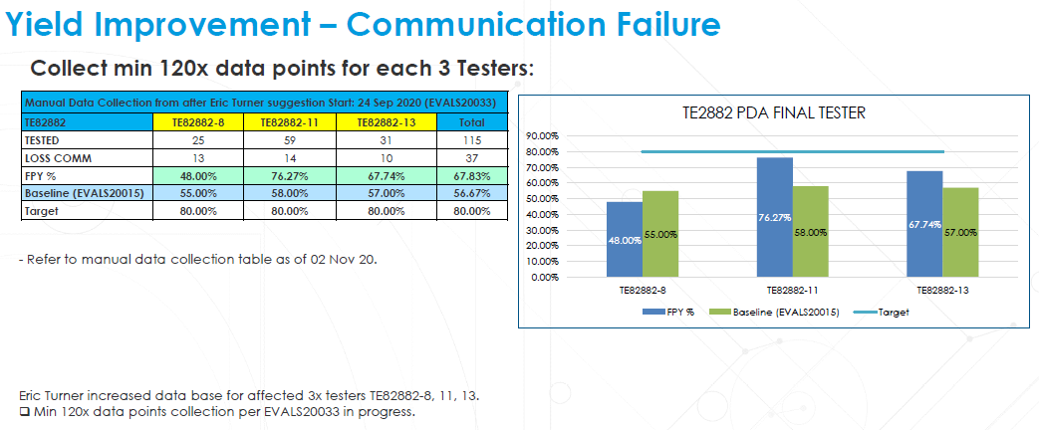
4. Target to improve 3 low FPY testers to 80% FPY.
Data collection in progress since Eric adjusted database

Slide 6
5. Actions to improve FPY to 80% on 3 low FPY testers
TE82882-8
1. The relay box is giving issue on high loss comm; Milford is shipping out a new relay box for replacement.
2. While waiting for relay box replacement, this tester can use direct LAN cable to continue test.
TE82882-11
1. FPY improved from 58% to 76% after database adjustment by Eric.
2. Team is checking on relay box and cables to see if can improve further for this testers.
TE82882-13
1. Port 3 LAN cable is opened that’s caused high failure rate. The problem is fixed by replacing LAN cable.
2. Data collection is in progress.

Slide 7
6. Conclusion/Plan
The loss comm issue is a soft failure and happening intermittently throughout the years for PDA testing. The UUT can pass the test with rerunning the test but affecting the FPY. It’s difficult to capture the root cause.
Through this project we manage to identified the root cause of high failure rate down to component level on each tester and working to address the issue. Hence improving overall FPY for PDA testing.
The latest FPY improvement actions on 3 low FPY testers will be reflected in Nov-Dec test data.
Team will review the latest FPY data in Nov-Dec to conclude this project.

