Slide 1

<FPY improvement on PDA Testing in Flex>
Owner | Luo HuaZhen | ROI |  | Reducing lost comm failure rate from 10.26% to 5%
Date | 05 May 2020
Purpose
Flex PDA production First Pass Yield was affected by intermittent lost communication between tester and Unit Under Test during final test in many years. This project is to reduce this lost comm soft failure from 10.26 % to 5%.
Progress |  | Project Status
Q1 2020, this lost communication issue was identified as an area to improve. Team did some evaluation on testers set up/test software configuration Q2 2020, an evaluation plan was implemented to collect 100 units test yield on each testers from total 6 testers and monitor loading port performance (4 loading port each tester) Q3 2020, Completed total 600 data points (100each station) on 29 Jul 20 and it shows Tester TE82882-8,-11 and -13 has higher failure rate than other station. Result was shared with Milford team. These 3x high lost comm stations were checked by Eric Turner and testers database was adjusted. Team was advised to monitor performance on tester TE82882-8,-11 and -13. Q4 2020, The average yield improved from 56% to 84% in Nov & Dec on 3 Low FPY stations. Overall yield improved to 93.7% in Nov and 92% in Dec for loss comm. |  | Q1 | Q2 | Q3 | Q3 | Q4
Next Steps |  | Risks & Issues
Projected closed but improvement is continuing |  | NA
Notes:
Look at having different colour schemes for different pillars

Slide 2
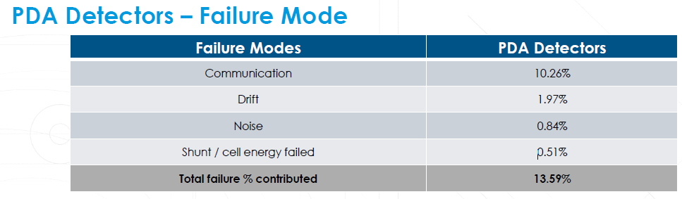
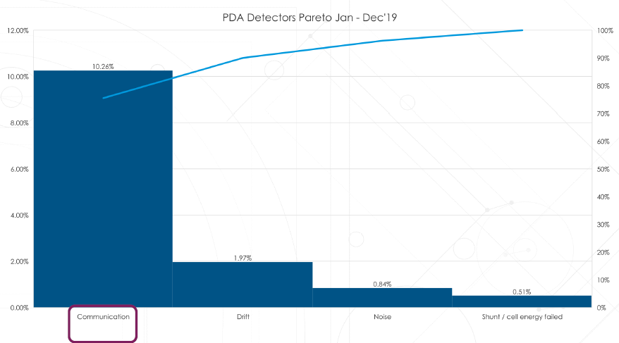
1. Loss Comm (10.26 %) was identified as area to improve

Slide 3
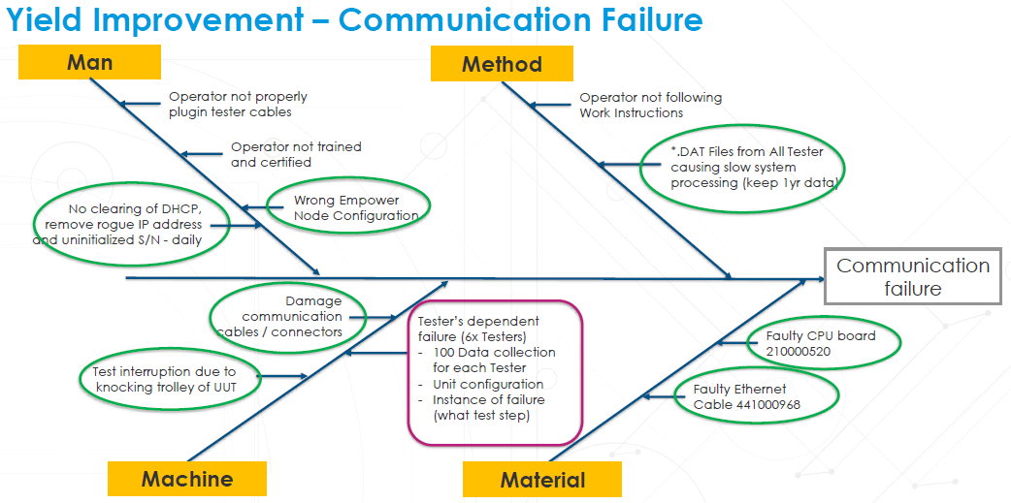
2. Machine (Testers) was identified as area to improve for loss comm issue

Slide 4
Yield Improvement – Communication Failure
Collect min 120x data points for 3 Testers:
Manual Data Collection from after Eric Turner suggestion Start: 13 Oct 2020 (EVALS20033)
TE82882 | TE82882-8 | TE82882-11 | TE82882-13 | Total
TESTED | 55 | 128 | 76 | 259
LOSS COMM | 14 | 13 | 18 | 45
FPY % | 74.55% | 89.84% | 76.32% | 84.39%
Baseline (EVALS20015) | 55.00% | 58.00% | 57.00% | 56.67%
Target | 80.00% | 80.00% | 80.00% | 80.00%
- Refer to manual data collection table as of 27 Nov 20.
Eric Turner increased data base for affected 3x testers TE82882-8, 11, 13.
Min120x data points collection per EVALS20033 in progress.
EVALS20033 To collect min.10x data points per port per tester to TE82882-8, TE82882-11, TE82882-13
TE82882-8
  Relay box caused high loss comm; Going to replace relay box
  Tester can use direct LAN cable to continue test
TE82882-11
  FPY improved from 58% to 76% after database adjustment.
  Checking on relay box and cables to see if can improve further for this testers.
TE2882-13
  Port 3 LAN cable caused high loss comm. Fixed by replacing LAN cable.
  Data collection is in progress
TE82882-8 Implementing of direct ethernet
TE82882-11 Increased database table size
TE82882-13 replaced ethernet head at POS3

Slide 5
PDA Detectors – Yield Improvement
Monitoring in 2020 – Communication Failure
The latest improvement actions for 3 low FPY testers were done at end of Oct’ 20
Yield improved to 93.70% in Nov and 92.00% in Dec
Project Closed but yield improvement is continue
Model – PDA Detectors Family
Month | Total Unit Tested | w/o Communication failure%
 |  | 2019 FPY Ref rate 89.74 %
Jan -2020 | 347 | 87.32 %
Feb -2020 | 379 | 85.22 %
Mar -2020 | 305 | 87.37 %
Apr -2020 | 187 | 80.75 %
May -2020 | 199 | 82.91 %
Jun -2020 | 178 | 88.76%
Jul -2020 | 248 | 70.97 %
Aug -2020 | 254 | 90.16 %
Sep -2020 | 305 | 77.05 %
Oct -2020 | 489 | 81.19 %
Nov - 2020 | 492 | 93.70 %
Dec-2020 | 463 | 92.00 %

