Slide 1

<FPY improvement on PDA Testing in Flex>
Owner | Luo HuaZhen | ROI |  | Reducing lost comm failure rate from 10.26% to 5%
Date | 05 May 2020
Purpose
Flex PDA production First Pass Yield was affected by intermittent lost communication between tester and Unit Under Test during final test in many years. This project is to reduce this lost comm soft failure from 10.26 % to 5%.
Progress |  | Project Status
Q1 2020, this lost communication issue was identified as an area to improve. Team did some evaluation on testers set up/test software configuration Q2 2020, an evaluation plan was implemented to collect 100 units test yield on each testers from total 6 testers and monitor loading port performance (4 loading port each tester) Q3 2020, Completed total 600 data points (100each station) on 29 Jul 20 and it shows Tester TE82882-8,-11 and -13 has higher failure rate than other station. Result was shared with Milford team. These 3x high lost comm stations were checked by Eric Turner and testers database was adjusted. Team was advised to monitor performance on tester TE82882-8,-11 and -13. Q4 2020, FPY improved from |  | Q1 | Q2 | Q3 | Q3 | Q4
Next Steps |  | Risks & Issues
Complete min. 10 units on each port data collection on station TE82882-8,-10 and -13. Compile and review lost comm failure rate on these 3 testers and share it with Milford team. Target to improve from ave. FPY 56.7% to 80% on tester TE82882-8,-11,-13 Working total yield improvement once data collection is completed |  | NA
FPY
Notes:
Look at having different colour schemes for different pillars

Slide 2
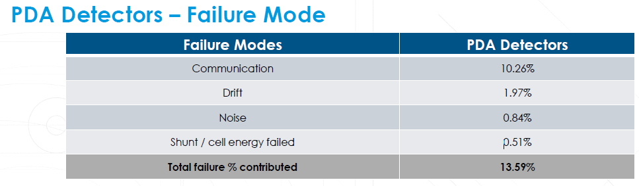
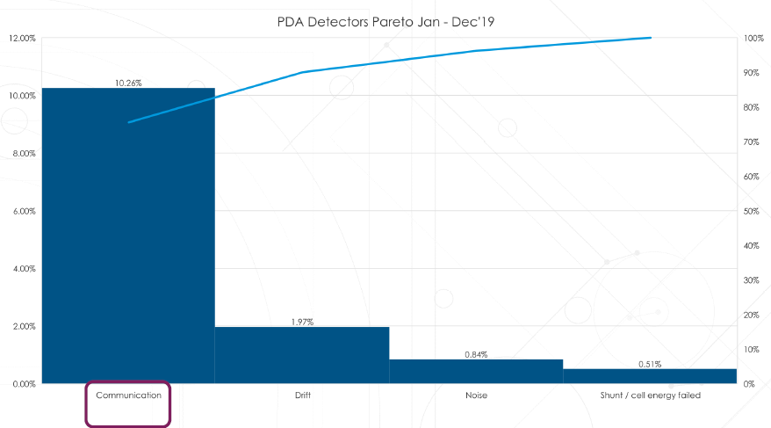
1. Loss Comm (10.26 %) was identified as area to improve

Slide 3
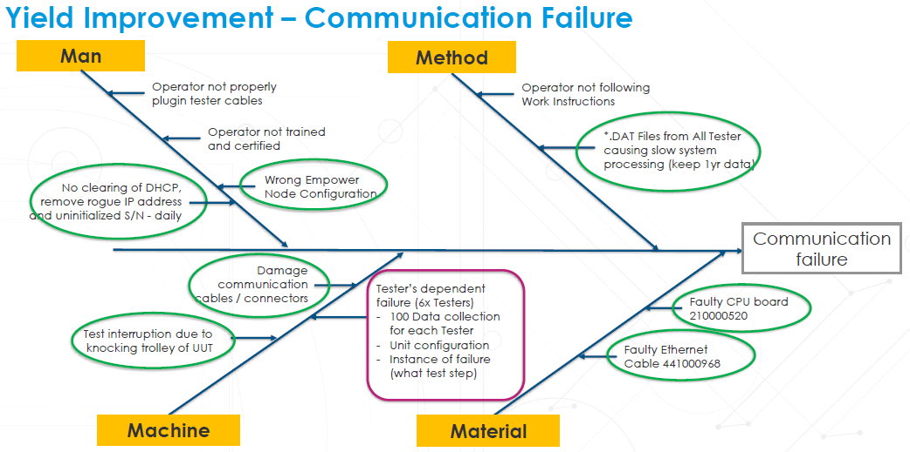
2. Machine (Testers) was identified as area to improve for loss comm issue

Slide 4
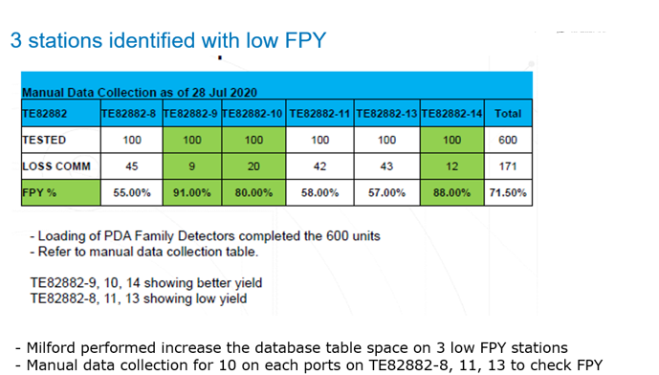
3. 3 testers was identified with low FPY across 6 testers

Slide 5
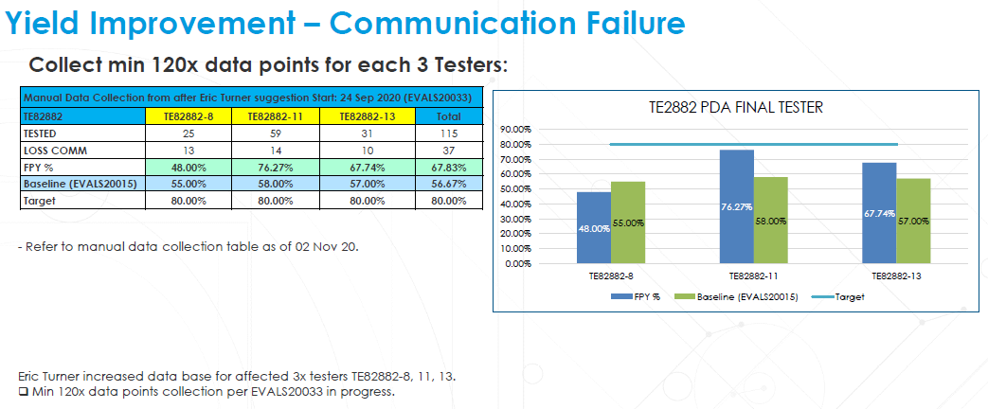
4. Data collection in progress after database adjustment on 3 low FPY testers
Insert latest data to close evaluation.

Slide 6
5. Actions to improve FPY to 80% on 3 low FPY testers
TE82882-8
1. Relay box caused high loss comm; Going to replace relay box.
2. Tester can use direct LAN cable to continue test.
TE82882-11
1. FPY improved from 58% to 76% after database adjustment.
2. Checking on test software errors to see if it’s related to hardware.
TE82882-13
1. Port 3 LAN cable caused high loss comm. Fixed by replacing LAN cable.

Slide 7
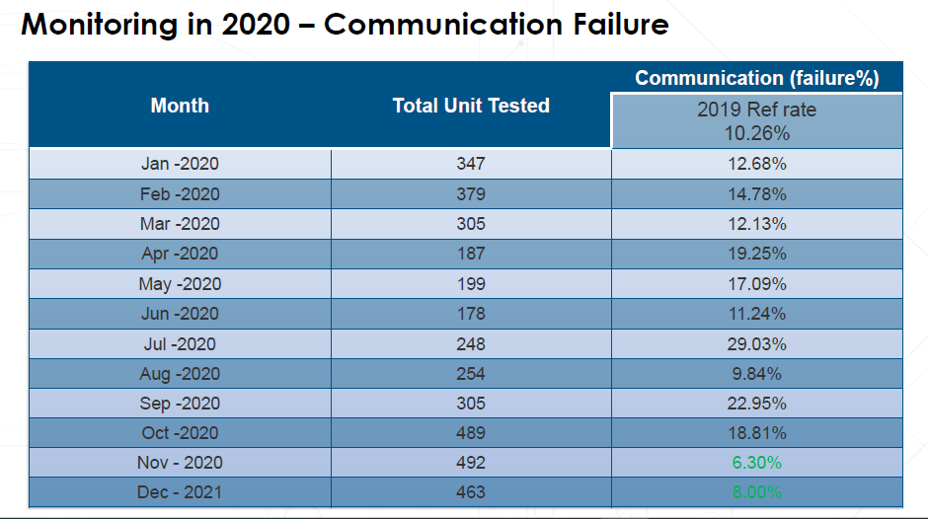
6. Effectiveness check in Dec’20
The latest improvement actions for 3 low FPY testers were done at end of Oct’ 20
Will update and review FPY to check effectiveness of actions in Nov’20 onwards
Project Closed but yield improvement is continue
FPY

Slide 8
Project Closed but yield improvement is continue

