Slide 1

<FPY improvement on PDA Testing in Flex>
Owner | Luo HuaZhen | ROI |  | Reducing lost comm failure rate from 9.68% to 5%
Date | 05 May 2020
Purpose
Flex PDA production First Pass Yield was affected by intermittent lost communication between tester and Unit Under Test during final test in many years. This project is to reduce this lost comm soft failure from 9.68 % to 5%.
Progress |  | Project Status
Q1 2020, this lost communication issue was identified as an area to improve. Team did some evaluation on testers set up/test software configuration Q2 2020, an evaluation plan was implemented to collect 100 units test yield on each testers from total 6 testers and monitor loading port performance (4 loading port each tester) Q3 2020, Completed total 600 data points on 29 Jul 20 and it shows Tester TE82882-8,-11 and -13 has higher failure rate than other station. Result was shared with Milford team. These 3x high lost comm stations were checked by Eric Turner and testers database was adjusted. Team was advised to monitor performance on tester TE82882-8,-11 and -13. Q4 2020, Root cause of high failure rate on TE-8,-11 and -13 was identified and a recommended solution is in place. Will see the significant yield improvement from Nov and onwards data. |  | Q1 | Q2 | Q3 | Q3 | Q4
 |  |  |  |  |  | Target to complete
Next Steps |  | Risks & Issues
Complete min. 10 units on each port data collection on station TE82882-8,-10 and -13. Compile and review lost comm failure rate on these 3 testers and share it with Milford team. Target to improve from ave. FPY 56.7% to 80% on tester TE82882-8,-11,-13 Working total yield improvement once data collection is completed |  | NA
Notes:
Look at having different colour schemes for different pillars

Slide 2
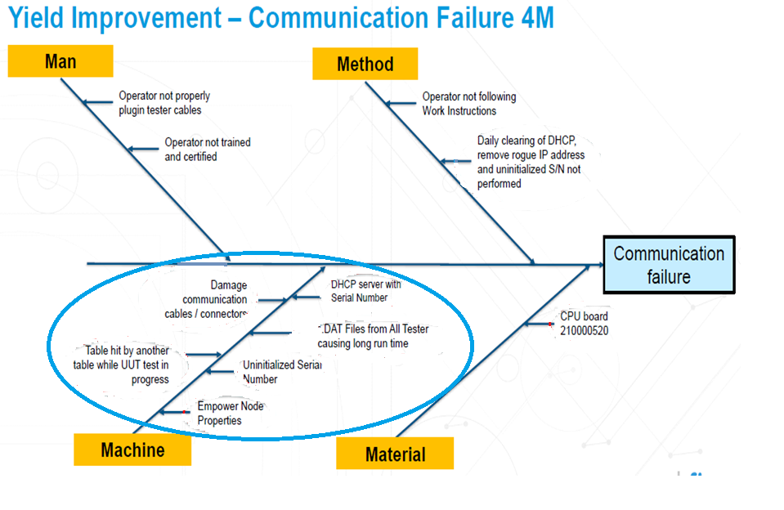
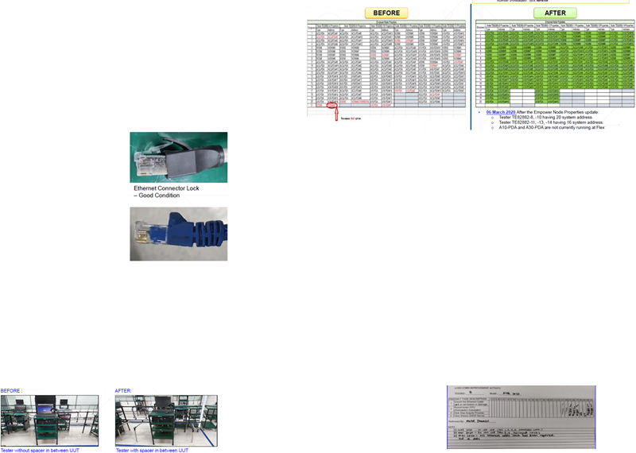

Slide 3
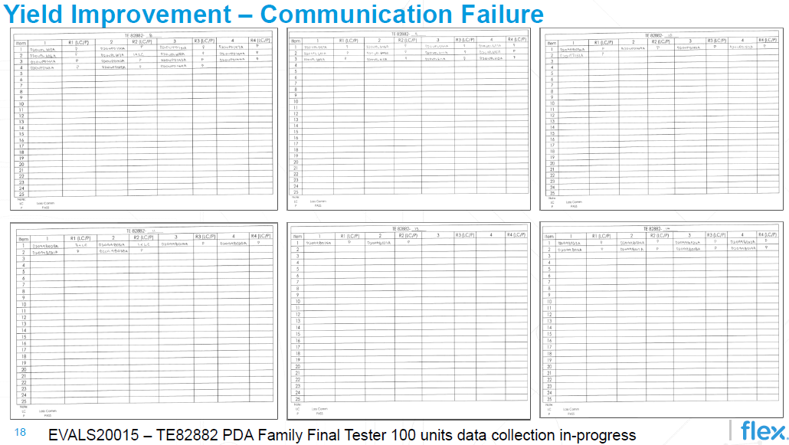
Data collection for testers in progress

Slide 4
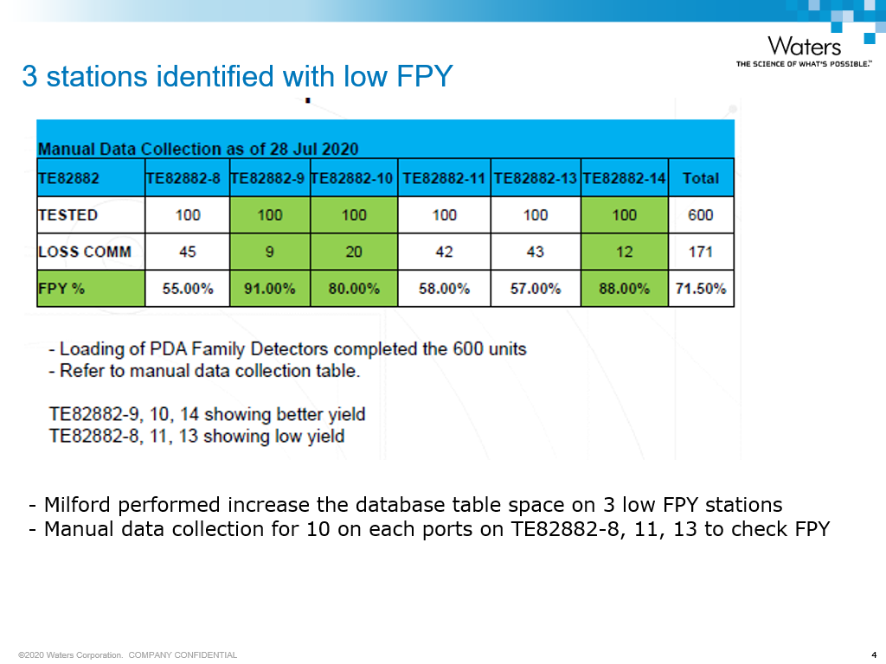

Slide 5
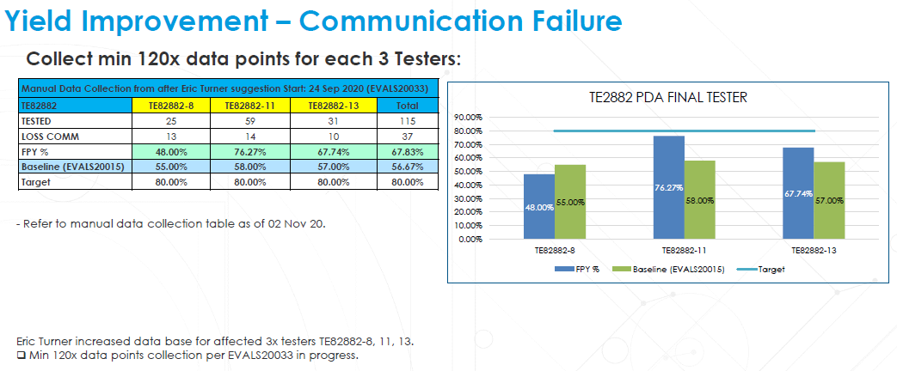
Improvement from 3 low FPY stations

