Slide 1
Electrical Safety Testing
Test Procedure WAT046538

Slide 2
UPDATES to the procedure
TSP WAT046538, GENERIC Electrical SafetyTest PROC. Is being updated to Revision 12
This update adds instruction to implement daily testing of each electrical safety tester before use each day

Slide 3
WHY are we doing this
Electrical safety testers are calibrated yearly to assure performance.
    Assures proper calibration of the tester, but it does not verify programming.
    Tester calibration only checked once yearly leaving potential product risk if calibration drifts.
Testing the set-points daily ensures properly operation daily.
    Verifies program set points.
    Limits risk to one day of production if calibration were to drift.

Slide 4
WHAT are we doing
This revision implements a daily check (and log) of all electrical safety testers prior
to use each day.
A custom S14-03 test box will be available at each electrical safety tester to perform the daily testing. A hang tag will be installed at each tester to log this testing daily and provide operators notification that testing has been completed on any given day.
The testing will take approximately a minute per day to complete. Actual test time is about 15 seconds, plus connection time etc.

Slide 5
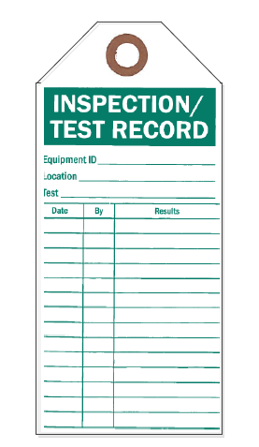
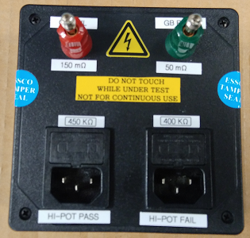
S14-03 Load Box Example Tag

Slide 6
HOW is the test performed
Using a custom calibrated S14-03 Load Box from Chroma, the current manufacturer of the electrical safety testers that Waters uses, the standard programmed electrical safety test is executed 3 times:
Execution | Ground Bond | Hi-Pot | Test Time
1 | Pass | Pass | 8 Seconds
2 | Pass | Fail | 5 Seconds
3 | Fail | Not executed | <1 Second

Slide 7

Execution 1

Slide 8
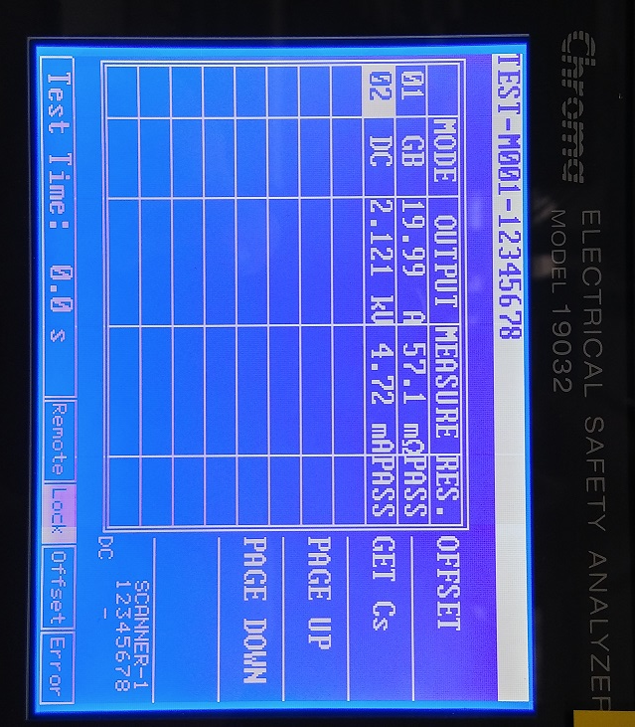
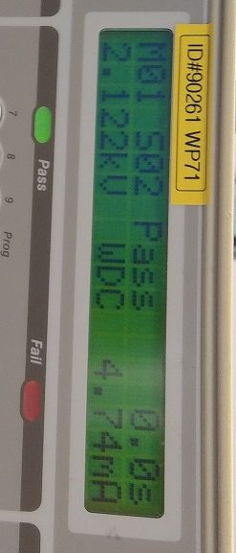
Execution 1

Slide 9
Execution 2

Slide 10
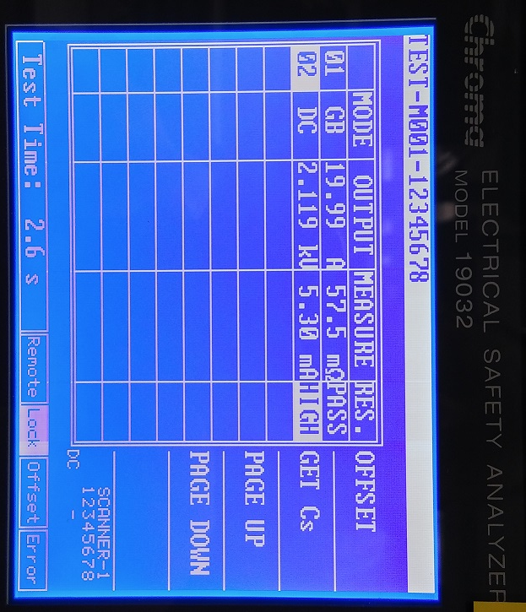
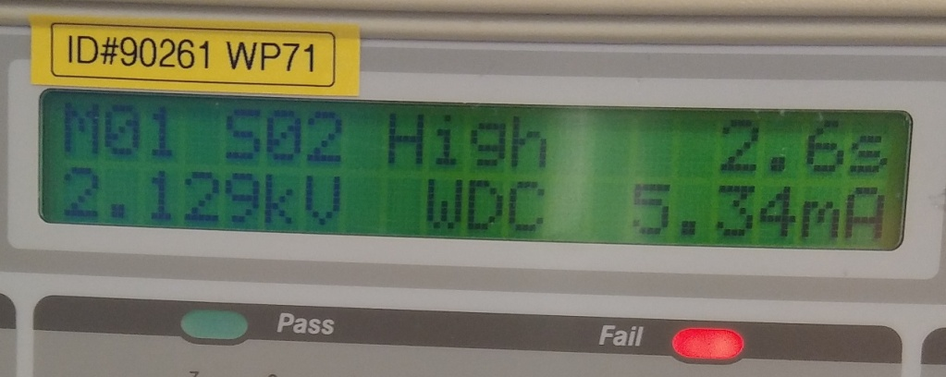
Execution 2

Slide 11
Execution 3

Slide 12
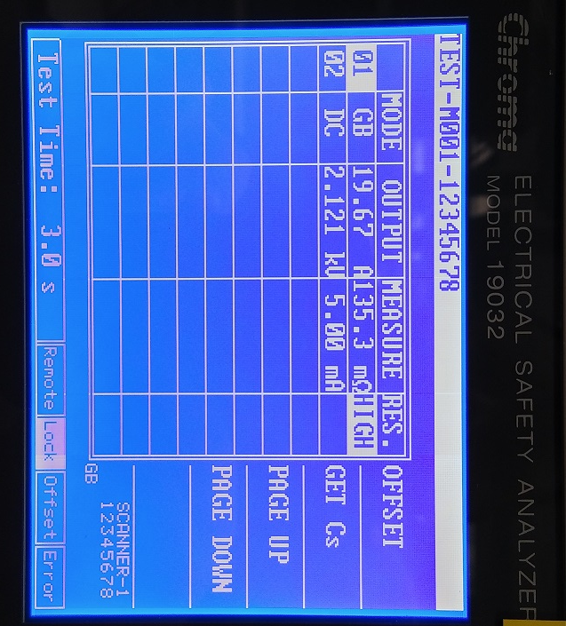
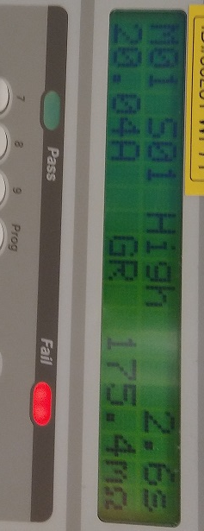
Execution 3

