Slide 1
11 Mar 2021
Ergonomic Improvement for Testers

Slide 2
Project Charter
Project Title: Ergonomic Improvement for Testers
Champion:
CI project leader:
Problem Statement : Some testers were built and commissioned years ago. Noticed the few testers set up is not user friendly or optimized. This project is to re-organize the tester accessories or re-locate the testers to give the best operation experiences to operators and improve productivities by reducing movement required during testing.
What: 1.Re-organize the tester component / accessories in 5S way;
2.Re-locate the testers educing operators movement during testing.
Why: The entire process and the work station are not optimised hence improving it through this project
Impact: 1. Making testers organized and user friendly to operators; 2. Reducing movement timing during testing;
Goal Statement :
Complete improvement by re-organize/re-locate testes within the specific timeframe.
Critical Success Factors/Assumptions :
Assumption: Achieve goal by optimising the process.
Assumptions made to achieve the goal statement
CSF: Remove non-value added activity in the process and
optimise the placement of ingredients and tools at the work
station
Critical factors that determines the success or failure of the
project.
Project Scope : To improve operators user experience; Reducing operators movement during testing;
Process: TBU
Business Benefit and Metrics
Primary Metric: Timing for order completion
Identify the metric that dictates the key success criteria for the project.
Benefit: Lowered cycle time by 50%
Type of benefit: hard/soft savings
Hard savings refers to tangible cash savings
Soft savings refers to intangibles savings
Project Est. Duration: 2 months
Project Resources: ME respective from CM

Slide 3
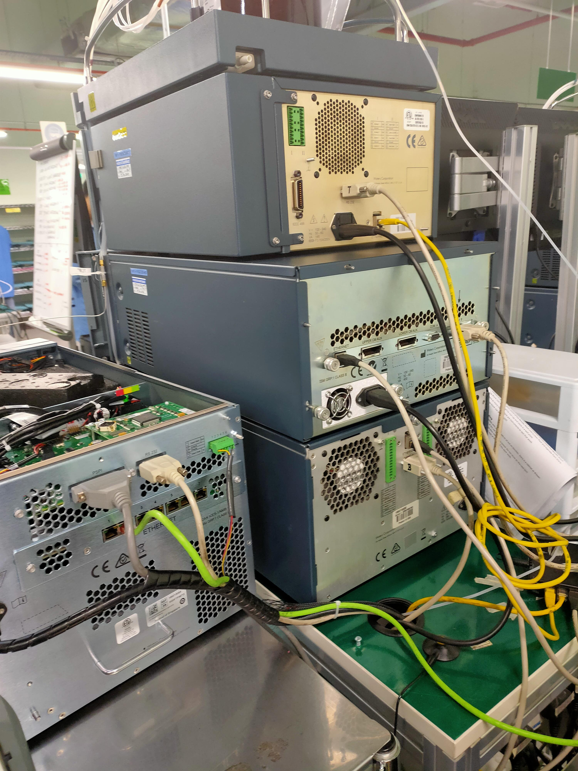
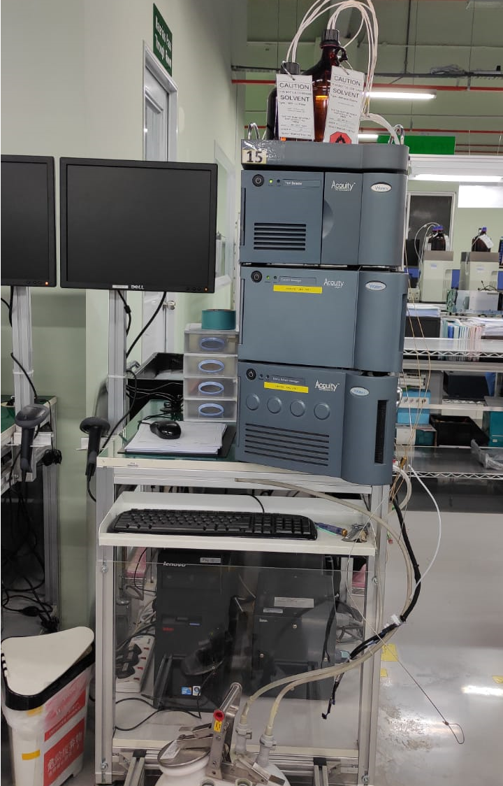
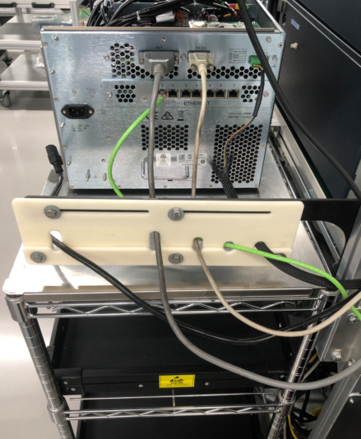
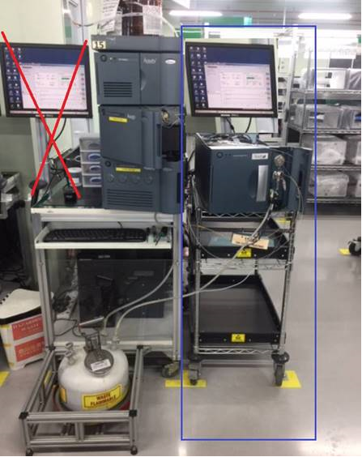
Example of Ergonomic Improvement
Before
After

