Slide 1
ICT Fixture# 9406-11 Y1 frequency test issue
(For model 210000562)
Prepared by : Alex Wong & SJ Sua

Slide 2
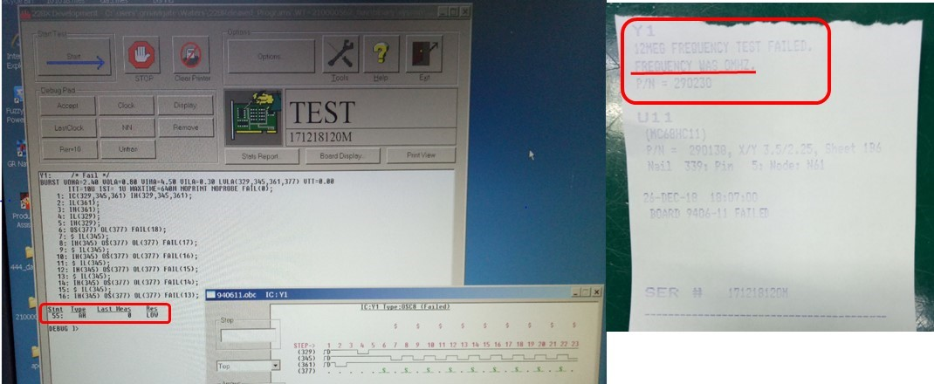
Problem Summary
Detected ICT test for model WATH-WT210000562 failed Y1 frequency testing.
ICT fixture ID# 9406-11
Expected value : 12MHz
Test measurement : 0 MHz

Slide 3
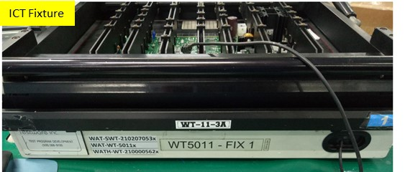
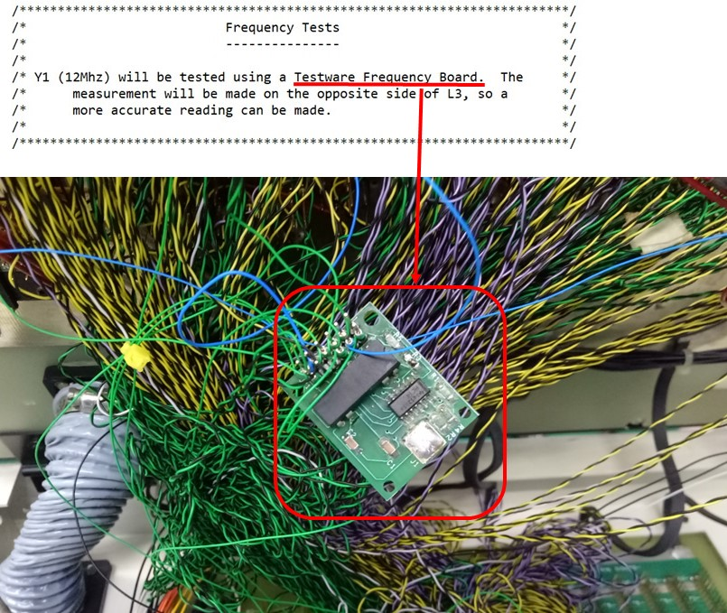
Finding - 1
Troubleshooting done found out it was caused from the fixture internal hardware (Testware Frequency Board) faulty.

Slide 4

Action
Unable to obtain the Testware Frequency Board for replacement.
To fix the issue, some changes make as described in below;
1, Hardware change.
Rewired nail number 34 (L3 pin2) direct to fixture interface BON (bypass the Testware Frequency board).
2, Software change.
Revised existing test script (.tpg) by direct frequency test using the GenRad ICT system AFTM card.
The refer to next page for the detail of changes.

Slide 5
Action – Software changes
Current Y1 Frequency test script
Revised Y1 Frequency test script
/*** OLD Frequency Test
SET PIO(1) RLY(CLOSE 3); /* FREQUENCY TO MEASUREMENT BD */
DELAY 200M;
LET FVAL=0;
Y1: BURST ITT=10U NOPRINT NOPROBE FAIL(); /* (OSC) */
IC(CLEAR , COUNT , SHIFT) IH(CLEAR , COUNT , SHIFT);
IL(CLEAR); /* CLEAR COUNTER */
IH(CLEAR); /* RELEASE CLEAR */
IL(COUNT); /* START COUNT */
IH(COUNT); /* END COUNT */
IH(SHIFT) OS(OUT) FAIL(18); /* MSB Q8 OF OUTPUT */
$ IL(SHIFT);
IH(SHIFT) OS(OUT) FAIL(17); /* Q7 OF OUTPUT */
$ IL(SHIFT);
IH(SHIFT) OS(OUT) FAIL(16); /* Q6 OF OUTPUT */
$ IL(SHIFT);
IH(SHIFT) OS(OUT) FAIL(15); /* Q5 OF OUTPUT */
$ IL(SHIFT);
IH(SHIFT) OS(OUT) FAIL(14); /* Q4 OF OUTPUT */
$ IL(SHIFT);
IH(SHIFT) OS(OUT) FAIL(13); /* Q3 OF OUTPUT */
$ IL(SHIFT);
IH(SHIFT) OS(OUT) FAIL(12); /* Q2 OF OUTPUT */
$ IL(SHIFT);
IH(SHIFT) OS(OUT) FAIL(11); /* Q1 OF OUTPUT */
$ IL(SHIFT);
IH(SHIFT) OS(OUT) FAIL(10); /* Q0 OF OUTPUT */
$ IL(SHIFT);
$ ID(#) OI(#);
END BURST; /* U13 */
IF FAIL(10) THEN [LET FVAL = FVAL + 1;BITCLR(FAIL,10);];
IF FAIL(11) THEN [LET FVAL = FVAL + 2;BITCLR(FAIL,11);];
IF FAIL(12) THEN [LET FVAL = FVAL + 4;BITCLR(FAIL,12);];
IF FAIL(13) THEN [LET FVAL = FVAL + 8;BITCLR(FAIL,13);];
IF FAIL(14) THEN [LET FVAL = FVAL + 16;BITCLR(FAIL,14);];
IF FAIL(15) THEN [LET FVAL = FVAL + 32;BITCLR(FAIL,15);];
IF FAIL(16) THEN [LET FVAL = FVAL + 64;BITCLR(FAIL,16);];
IF FAIL(17) THEN [LET FVAL = FVAL + 128;BITCLR(FAIL,17);];
IF FAIL(18) THEN [LET FVAL = FVAL + 256;BITCLR(FAIL,18);];
IF FVAL > 0 THEN [/* CALCULATE FREQUENCY */
/* DIVISOR MUST = ITT */
LET FVAL=(FVAL)/10;];
TEST ARITH FVAL VAL=12 TOL=20 FAIL(1) [
WRITE ID=MESFILE'%NL% %NL%';
WRITE ID=MESFILE'%037%Y1%NL%%036%12MEG FREQUENCY TEST FAILED.%NL%';
WRITE ID=MESFILE 'FREQUENCY WAS %F%MHZ. %NL%'FVAL;
WRITE ID=MESFILE 'P/N = 290230%NL% %035%%NL%';];
OPEN:SET PIO(1) RLY(OPEN 3); /* FREQUENCY FROM MEASUREMENT BD */
/* TURN OF CRYSTAL */
SET PIO(1) RLY(CLOSE 5);
***/
Y1: /* WATCH DOG FREQUENCY TEST ***/
{ DECLARE FLOAT VVAL1;
CLEAR FTM;
CLEAR LGC;
CLEAR MUX;
CLEAR SCAN;
CLEAR HFSCAN;
/*** TEST OSCILLATOR (triggered by test language) *****/
Y1_HFSCAN:
/* OSC1 IS CONNECTED TO STANDARD SCANNER INPUT */
SET SCAN AT(CHB=34); /** Test at L3 pin2 **/
SET HFSCAN AT(FTMA=CHB);
Y1_MEAS1:
MEAS FTM FREQUENCY MAX=12MEG
AACC
AHYST=0 ATHRSH=350M
INTO VVAL1 VAL=12MEG TOL=10
GATE=0.1 TIMEOUT=155M [
WRITE ID=MESFILE '%037%%S%: (%S%)%NL%%035% %S%%NL% %S%%NL%'
'Y1','WATCH DOG FREQUENCY TEST','12MHZ'
,'Failed Frequency.';
WRITE ID=MESFILE ' Expected = 12MHZ %NL%';
WRITE ID=MESFILE ' ACTUAL = %G%%NL%%NL%' VVAL1;
];
Y1_DONE:
CLEAR FTM;
CLEAR LGC;
CLEAR MUX;
CLEAR SCAN;
CLEAR HFSCAN;
} ; /* end of Y1 */

Slide 6
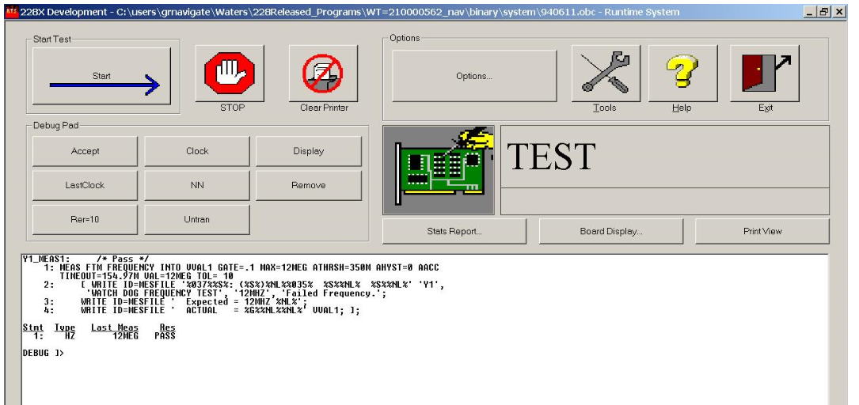
Action - Test Scrip verification (PASS Sample)
Verified with the good sample. Y1 measured 12 Mhz and PASS ICT test

Slide 7
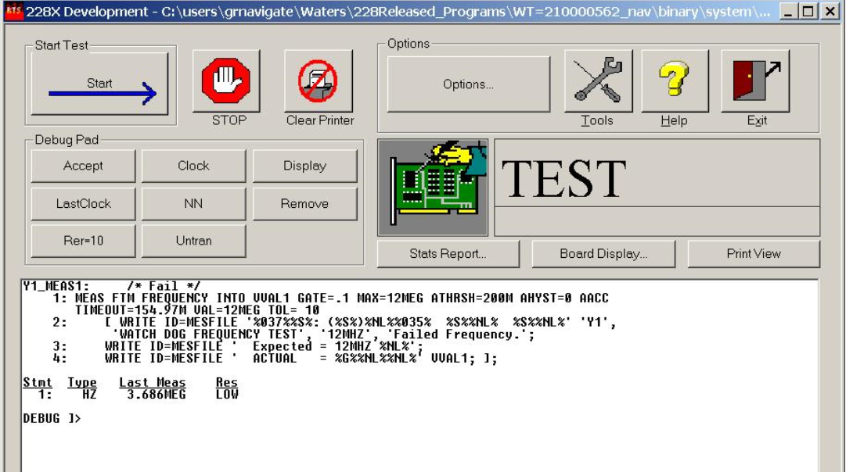
Action - Test Scrip verification (fail sample)
Replace Y1 with wrong part (3.6864MHz). Y1 measured 3.686Mhz and ICT test fail at this Y1.

Slide 8
Thank You

