Slide 1
TE0084016 Design Review
Rev2
2690 Front Panel PCBA [210000384]
Functional Test on GTS
Prepared by: John McCarthy

Slide 2
TE0084016 Design Review
Project Description
  Re-implement the functional test [FCT] of the
  TE0084016 2690 Front Panel[210000384] on the TE82988 Global Functional Test System[GTS]
  Currently this test is implemented on the TE82510 Alliance Universal Test Station
  This is one of a group of active legacy PCBA’s that are current tested on the RACAL and the TE82510 Alliance Universal Test Station.
  These two test platforms are approaching end of life.

Slide 3
TE0084016 Design Review
Sources of information for this project
  2690 Front Panel PCBA 210000384 Schematic [710000384]
    710000384_SCH.pdf
  2690 Front Panel PCBA 210000384 Performance Spec [810000384]
    810000384_PerfSpec.pdf
  2690 Front Panel PCBA 210000384[Gerber Files]
  Consultation Edward Jackson - Principal Test Engineer
  Consultation Bryan Deguire - Sr. Electrical Engineer

Slide 4
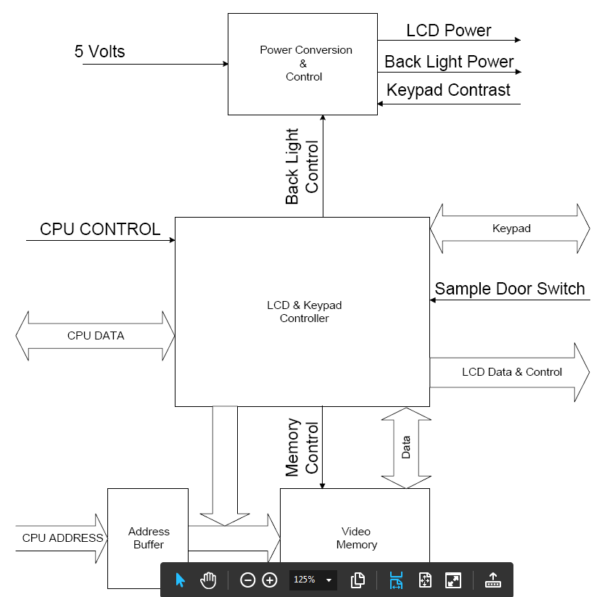
TE0084016 Design Review
UUT Block Diagram

Slide 5
TE0084016 Design Review
Functional Test ITA Hardware Components
  16” x 20” VPC G-12 Vacuum Fixture Kit
    ITA Enclosure with GTS interface connections
  TE82840-1 Waters TE Fixture ID&Down Board
    Used for Fixture ID and Fixture Down Detection

Slide 6
TE0084016 Design Review
Functional Test Software Components
  Test Sequence Development
    NI TestStand 4.2.1
    SP3SequentialModel.seq
  Operator GUI
    Waters GTS UI.exe
  Test Code
    NI LabVIEW 2009 Version 9.0f3 [32-bit]
  TestStand sequence file
    C:\GTS Files\Sequences\210000384\210000384.seq
  Test Data collection
    SigmaQuest’s – SigmaProbe

Slide 7
TE0084016 Design Review
Project Strategy - Hardware
  Use GTS digital I/O to emulate CPU PCB
  Use GTS low current relays to emulate Keypad
  Use GTS digital I/O to capture LCD driver image data
  Create libraries to make future projects more productive
  Create schematics that are useful for build and debug
  Create layouts that are useful for build and debug
  Use Waters TE standard PCB’s for common functions

Slide 8
TE0084016 Design Review
  Project Strategy - Software
  GTS TestStand Sequence
    Use File Globals for hardware/software associations
    Create Test Steps that use File Globals when possible
  LabVIEW VI’s
    Use configuration by File Globals when practical
    Reusable in future projects when practical
    Self documenting when feasible. Comment for clarity.
    Develop VI’s to emulate the CPU, Keypad and LCD Display

Slide 9
TE0084016 Design Review
ITA Documentation
  Schematic TE0084016SCH
    TE0084016SCH Front Panel PCB 210000384_WAT270022 ITA_rH
  Layout TE0084016LAY
    TE0084016LAY Front Panel PCB 210000384_WAT270022 ITA_rC
  Parts List TE0084016BOM
    TE0084016BOM Front Panel PCB 210000384_WAT270022 ITA_rA
  Fixture Order Form TE0084016
    ElectroFix Fixture Order Form TE0084016

Slide 10
TE0084016 Design Review
UUT Input Port Interface
  +5V: GTS-PS1 0-36V 0-12.5A Genesys Power Supply
  Door Open Switch: GTS-2A SPDT Relay
  Keypad Emulation: GTS-2A SPDT Relay
UUT CPU Emulation
  Address Bus: DAQ2 P0.16..31
  Bi-directional Data Bus: DAQ2 P0.8..15
  R_W, CS, IRQ: DAQ2 P0.5..7
  DTACK: DAQ1 P0.8
LCD Data Capture
  LCD Data Bus: DAQ1 P0.0..2, P0.0..5
  CL1,CL2,FLM Lines: DAQ1 P0.13..15

Slide 11
TE0084016 Design Review
  UUT Output Port Interface
      LED Back Light
        Chroma DC Loads CH1: set to 32Ω for Bright, 50Ω for Dim
      LCD Display Contrast
        Chroma DC Loads CH2: set to 620Ω
      Onboard power supplies
        3.3V @C18
        Measured with GTS-DMM via GTS 8x1 Mux
      ITA Signals
        Fixture Down: DAQ2 P0.0
        Fixture ID: DAQ2 P2.0..7
        Vacuum Control via GTS- 12A Relay

Slide 12
TE0084016 Design Review
    CPU Bus Emulation
      Bi-Direction Data Bus
        One challenge was the configuring the bi-directional data port to change modes quickly and not conflict with the UUT data port.
        This was done by pre-configuring both write and read configurations and using the Control Task VI to Reserve\Unreserve the two configurations on demand
        The use of the DO.Tristate property prevented double driving the data lines.
      Timing DTACK[Data Acknowledge Line]
        Because of the LCD display this board uses a DTACK handshaking line to control the timing of write/read operations. The GTS Dig I/O doesn’t have that built in, so I needed to get creative to get this to work.

Slide 13
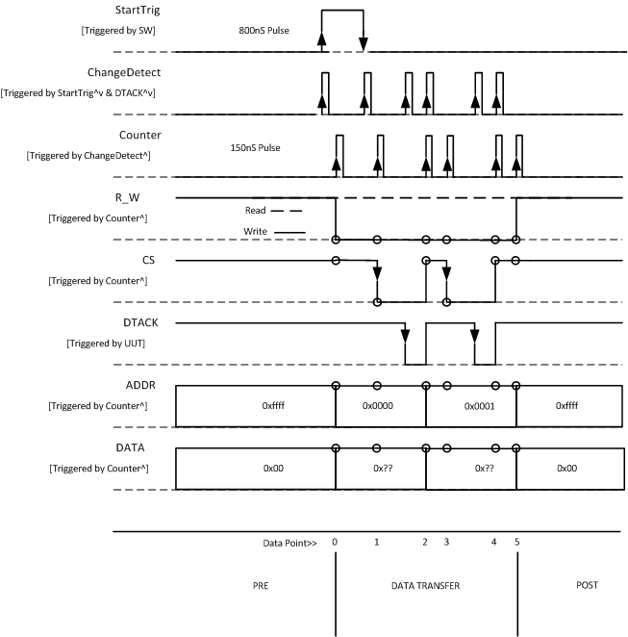
TE0084016 Design Review
    CPU Bus Emulation Timing
This required using the ChangeDetect of the UUT DTACK line to trigger each counter pulse used for the write/read operations.
A StartTrig pulse that also triggers the ChangeDetect was used to get it started.
For VRAM data this was 9600 transfers.

Slide 14
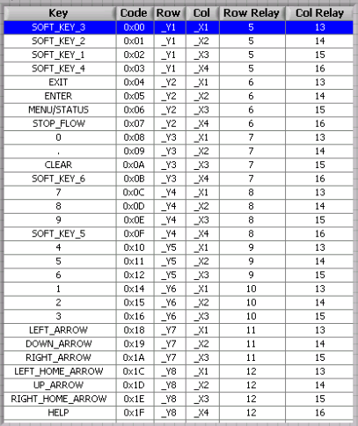
TE0084016 Design Review
    Keypad Emulation
This required the use of 8 Column relays and 4 Row relays to emulate the 29 keys.
Relays are closed and opened as pairs.

Slide 15
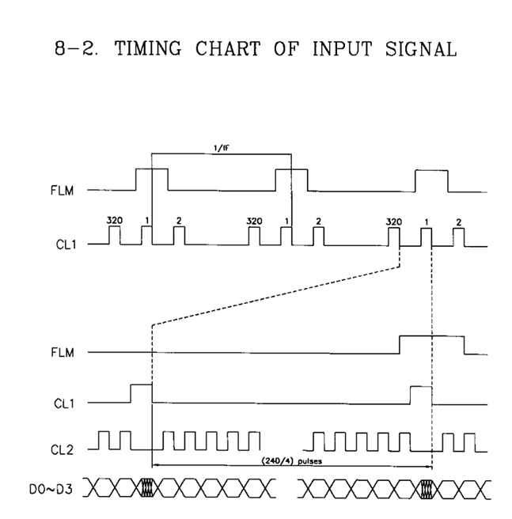
TE0084016 Design Review
    LCD Data Capture
The output from the LCD driver port is captured using ChangeDetect of the CL1, CL2 for acquisition timing.
The image data is extracted and compared to the data written to the specified VRAM page.

Slide 16
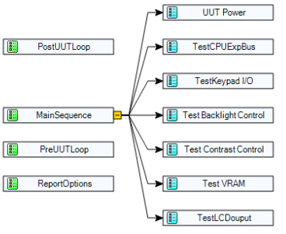
TE0084016 Design Review
Test Sequence Structure

Slide 17
TE0084016 Design Review
PreUUTLoop
  Initialize GTS and ITS Hardware
  Verify FixtureID
  Display Current Software: Version TE0084016 Ver:x.x
Main Sequence [Setup]
  Serial Number Prompt is displayed
    Verify scan is not part number or empty
  Add Current Software Version to Report: TE0084016 Ver:x.x
    It is structured as a test so SigmaSure will capture it
  Initialize ITA
    Enable ITA Power
    Verify FixtureID
    Enable Vacuum
    Verify Fixture is pulled down

Slide 18
TE0084016 Design Review
UUT Power
  Turn On UUT power supply
  Verify Power Supply Status is okay
  Verify +5V current is within expected limits
  3.3V Onboard supply
    Measure voltage with DMM
    Verify Voltages are within expected limits

Slide 19
TE0084016 Design Review
Test CPU Bus
  Verify Write/Read operation to ADDR 0x0
  Verify Read data matches Write data
  Simulate Door Open/Close @J2-1, J2-2 with Relay Contacts
    Verify IRQReg [DoorPositionChange] is set
    Verify KeypadDataReg [DoorOpen] matches open state
    Verify KeypadDataReg [DoorClose] matches close state
Test Keypad I/O
  Simulate Keypad @J5 with Relay Contacts
  Simulate Press/Release for Full Key set[29 Keys]
    Verify IRQReg [KeyUp] is set after Press
    Verify IRQReg [KeyDwn] is set after Release
    Verify KeypadDataReg [KEY0..4] matched key operated

Slide 20
TE0084016 Design Review
Test Back Light Control
  Bright
    Set Backlight LED output load to 32Ω
    Write Bright Code to Back Light Control Register
    Measure Back Light output @J7 and test to limits
  Dim
    Set Backlight LED output load to 50Ω
    Write Dim Code to Back Light Control Register
    Measure Back Light output @J7 and Test to limits
Test Contrast Control
  The contrast control will store the last level obtained and power-up at that level. So the test could start at any level. So it needed to detect the min and max levels and change directions as required until all of the steps have fulfilled.

Slide 21
TE0084016 Design Review
Test Contrast Control(Continued)
  Simulate Contrast Up/Down Keys @J5 with Relay Contacts
    Simulate Contrast Up/Down Single Step with 2mS Momentary Closure
    Measure Contrast DC Level @J4
    Perform Up/Down Sweep of Contrast Levels for 64 Up and Down steps.
    Assemble Up and Down level waveform from measured data
  Extract the following parameters from the waveform and test to limits
    Contrast Steps
    Max Contrast Level
    Min Contrast Level
    Up Linearity
    Down Linearity

Slide 22
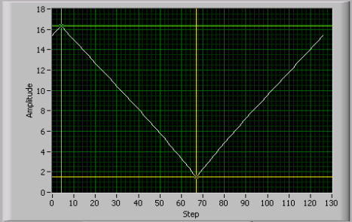
TE0084016 Design Review
Test Contrast Control [Continued]
    Contrast Level Waveform
  Test Auto Step
    Determine direction Increment or Decrement to do first.
      If above mid level Auto-Decrement
      If below mid level Auto-Increment
    Simulate Contrast Up/Down Auto-Step with 1Sec Momentary Closure
    Measure Contrast DC Level @J4 before and after Auto-Step
    Calculate Up/Down Auto-Step Change and test to limits

Slide 23
TE0084016 Design Review
Test Contrast Control [Continued]
  Set Final Contrast Level
    This will set the contrast level to one that will assure that the display is clearly visible when installed in the instrument.
    This was not in place originally.
    It was brought up as a requirement by Matt Brule [Thank You]
  The Process
    Calculate Volts/Step
    Calculate Steps and direction to the target level
    Perform Steps to obtain the target level
    Measure the level and test against limits.

Slide 24
TE0084016 Design Review
  Test VRAM
    Write video image data to VRAM Pages 1..3
    Read video image data from VRAM Pages 1..3
    Compare read image data to written image data
      Read data must match written VRAM data
  Test LCD Output
    Set Video Page Register to Pages 1..3
    Capture LCD driver output @J4 for Pages1..3
    Measure Clock Frequency for Pages 1..3
    Extract image data from captured data for Pages 1..3
    Compare LCD image data to image written to VRAM Pages 1..3
      Read data must match written VRAM data

Slide 25

TE0084016 Design Review
    LCD Emulation
      Test Image
        Video Page 1 & 3 use a checkerboard pattern
        Video Page 2 use an inverted checkerboard pattern

Slide 26
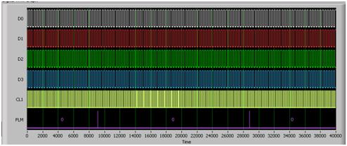
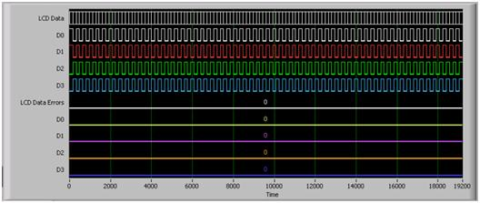
TE0084016 Design Review
    LCD Output Capture
      Captured Waveforms
      Clocked by change detection of
      the CL1, CL2 lines the LCD output
      is captured.
      Extracted Data
      By locating the FLM pulse
      a full frame is extracted. Then the
      240 scans are extracted and
      compared to the video data loaded
      into the selected VRAM page. Any
      differences show as LCD Data Errors

Slide 27

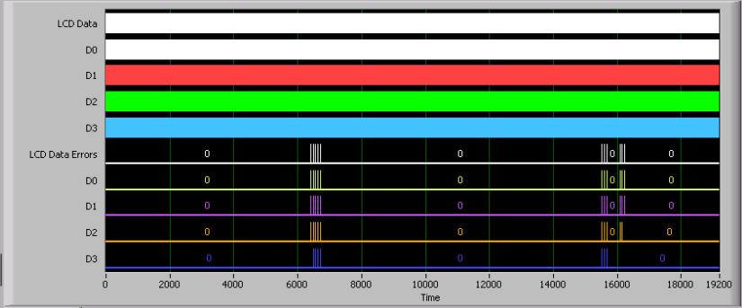
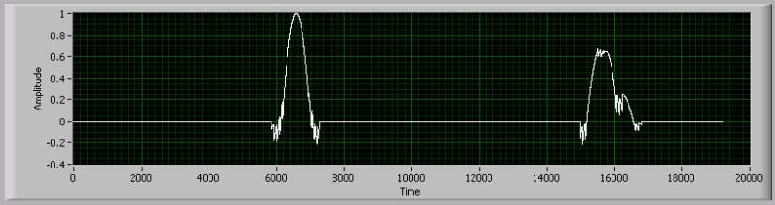
TE0084016 Design Review
    LCD Emulation
      Test Image and LCD Data Waveforms [Issues]
        Some images cause problems
The UUT doesn’t react well to images that have rapid changes on the left edge.
Errors are always at about at 200Hz spacing

Slide 28
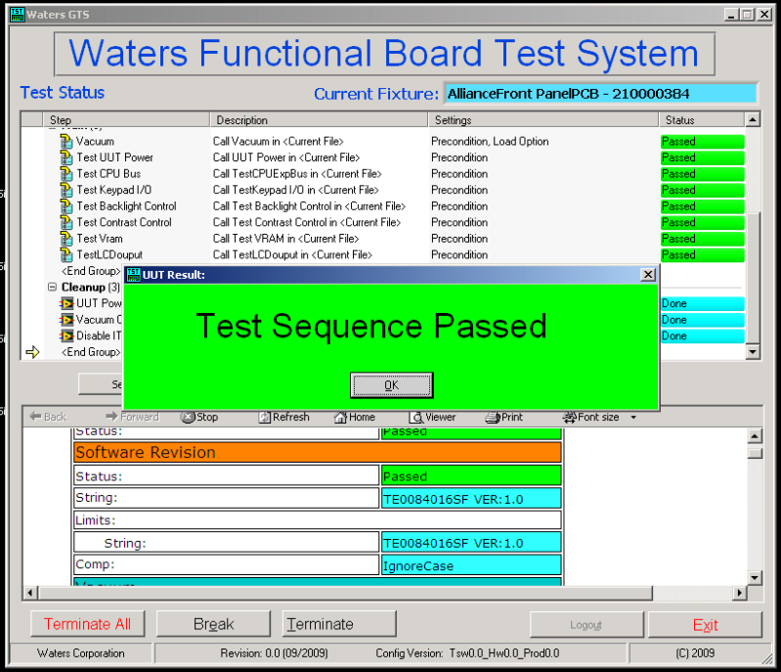
TE0084016 Design Review
Watch TE0084016 Test

Slide 29
TE0084016 Design Review
T0084016 Status
  Hardware Documentation Complete
  Software Documentation in process
  Two ITA’s built and function verified
  Validation TEV submitted for approval
  Design Review in process
Questions ?

Slide 30
TE0084016 Design Review
T0084016 Design Review Checklist
  Fit/Ergonomics
  Graphical User Interface
  Serviceability
  Safety
  Environment
  Cooling
  Electrical
  Sensors/Gauges/Data Acquisition
  Plumbing (N/A)
  Communication
  Sustainability
  Mechanical Enclosure (Good Design Practice)

