Slide 1
MTR Field Data
February 2020
PIM Team
March 2020 Report
18 March 2020

Slide 2
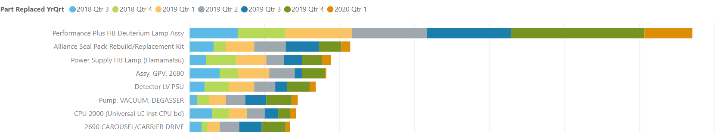
Flextronics – Parts usage 0-90 days, Mfd Jan 2016 – Dec 2019
Milford Part
Waters Investigation
CMO Investigation
Requested
Part Usage Noted
Large jump - PMTR investigation of P+ Deuterium lamp is underway
  Unable to obtain present status due to coronavirus restrictions
Monitoring Hamamatsu PS, Detector LV PS and vac degasser pump

Slide 3
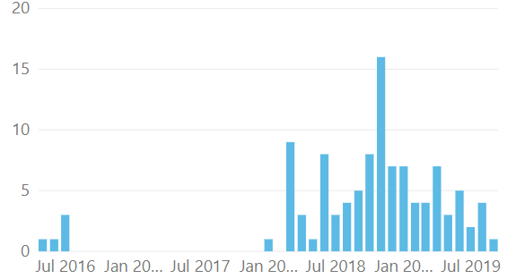
P+ Seal pack replacement kit – Unplanned use vs. instrument DOM
700011784 (no lower level) – P+ SP Repl’t kit
700002791 (no lower level) – SP spare (old)
No Action required – monitor
Q1 2020 usage (6 u) Mostly related to carryover issues
Monitor for < 1 year usage
November 2018 – virtually all replacements in China
Seal pack leaking (related to drops on vials)

Slide 4
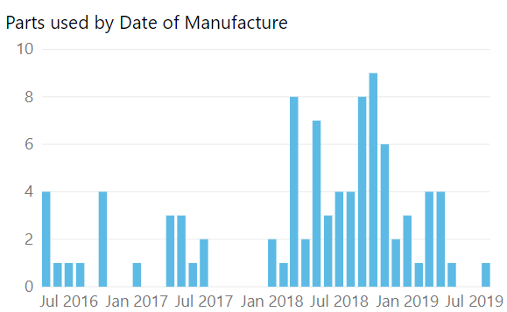
Alliance GPV – Unplanned use vs. instrument DOM
WAT270927 (WAT270524) – Alliance GPV
No Action required – monitor
Feb – Nov 2018 – GPV vendor issues
GPV usage in 2019-manufactured units appears continues to return to baseline usage again this month

