Slide 1
PIM Investigation Review Meeting
Solvent Managers & Alliance
Bill Wildman
22 April 2020

Slide 2
Meeting Agenda
Review Current Investigations
  Alliance CHC PS and cable (Chris P.)
  Glowing resistor on Alliance pump driver board
  270W Power Supply – Acquity, Arc, UPC2
  Alliance needle pitting reported (China)
  Alliance V3.05 (dripping on vials) update
Review Action Items
Review current and new issues - updates and latest
Present RA’d product failure analysis results

Slide 3
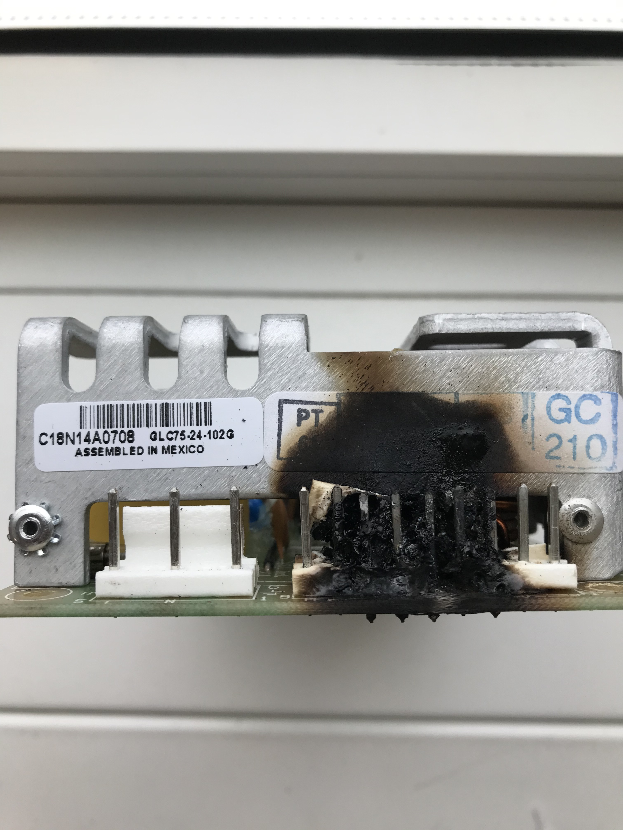
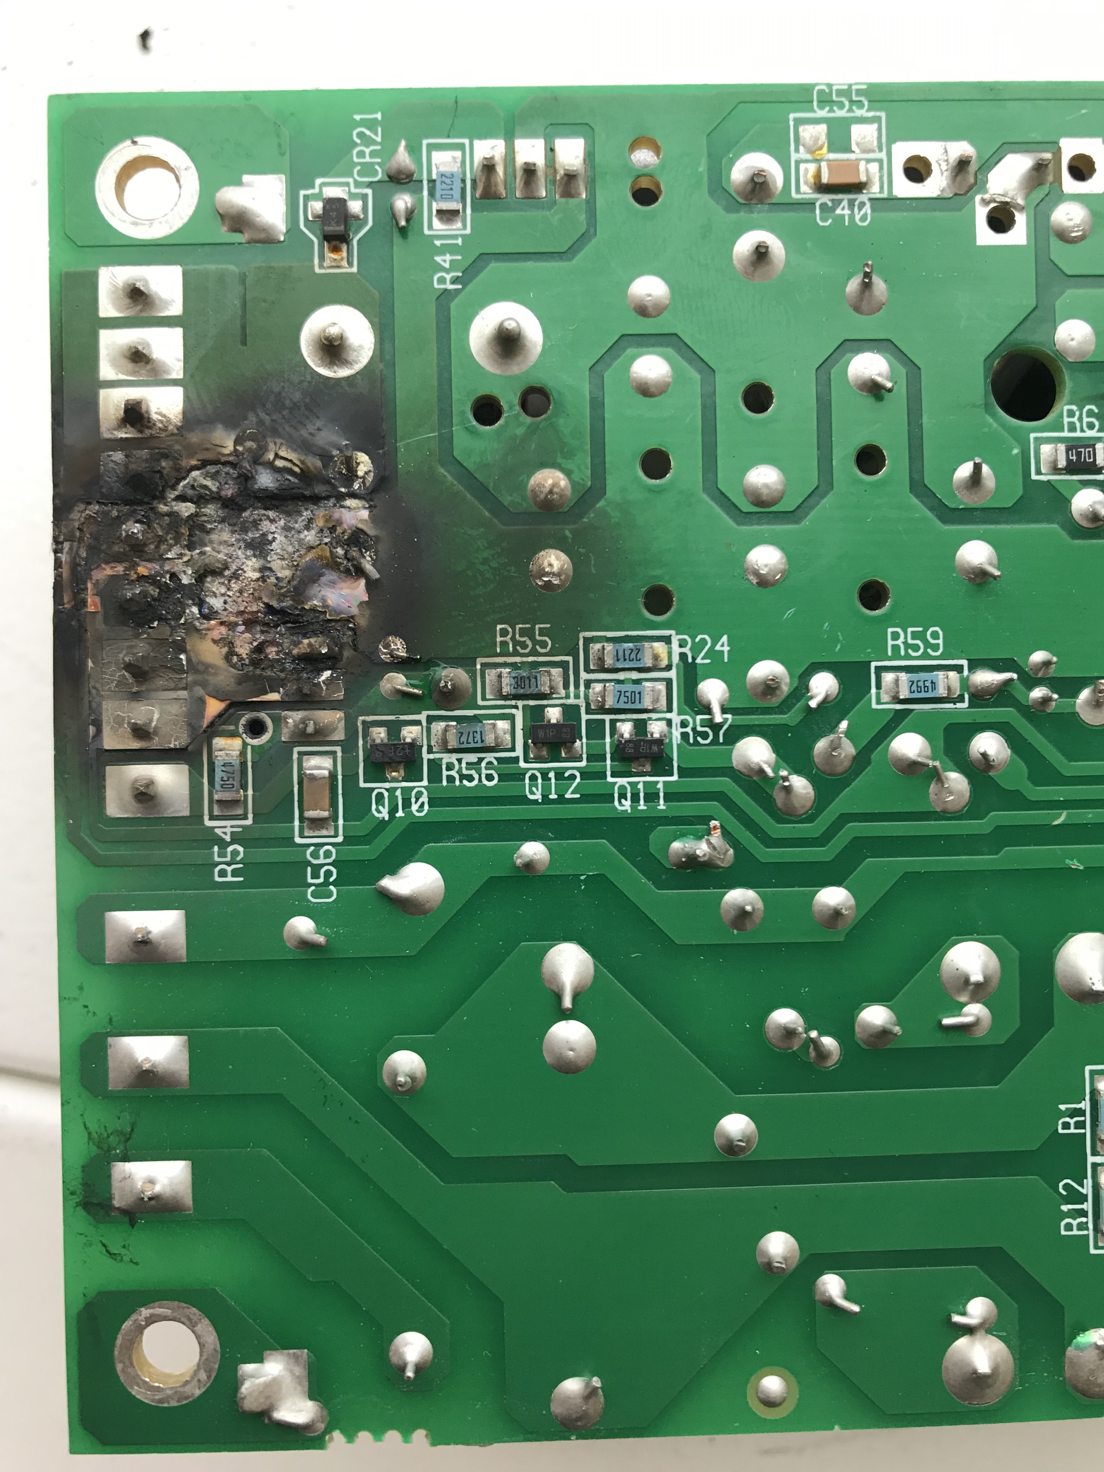
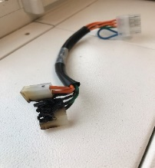
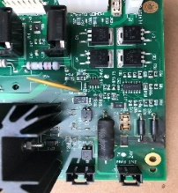
Alliance CHC (186179100). Burnt PSU, PCB and Cable
Origin | Field (BEONBKMGH601/ BEIEBJ6DK633) |  | EQMS Ref | 2433900
Brief Description | Burn damage to PSU (700002138), PCB (700005748), and Cable (441000416) |  | PRA Level | MODERATE
Investigation Details
Alliance CHC (Blue) – B19SMC246G Column Temp HW Fault (7) errors and reported smell of burning. Evidence of overheating/burning to PSU, PCB and connecting cable. Unit repaired by replacement of PSU, PCB, Cable and HC engine. Failed parts currently in transit to Milford to allow evaluation. PIA performed. Failed parts have been lost by courier en-route to Milford. SL Power believe the most likely issue relates to C48 Cap. EE looking at possible change of C48 to a SMT cap with Open Mode (OMD) fault tolerance. SL Power will change C48 to an SMT cap with flexible terminals and designed to fail in an open mode (fail safe) which will avoid this overheating situations. Additionally the flexible terminals aid in the tolerance of bending of the pcb. PN’s 279000138 and 279000520
Current Status | Complete

Slide 4
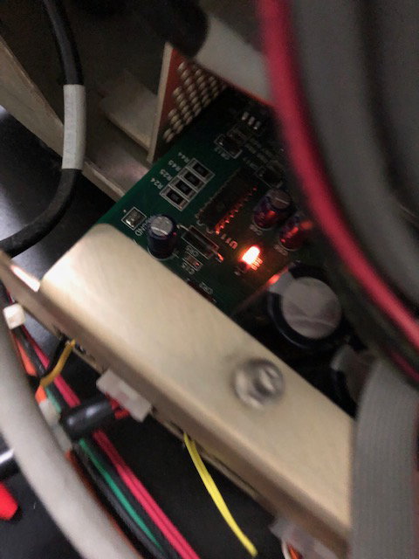
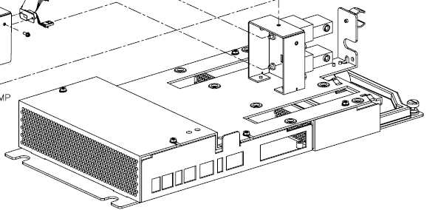
Glowing resistor R69 on Plunger Driver Board
QR 2474861 – PIA complete (awaiting SA number before upload)
After changing a GPV and replacing the pdb fuse, R69 on the board glowed red
  Board seen partially removed from pump tray
Analysis of returned pdb and GPV conducted by Continuing Engineering

Slide 5
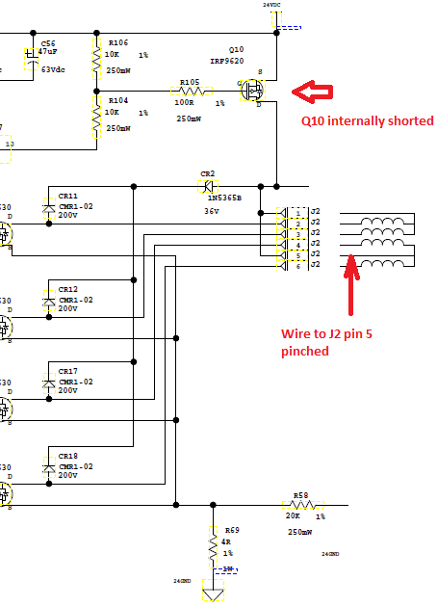
Glowing resistor R69 on Plunger Driver Board
Analyzed failure mode
  Transistor Q10 internally shorted when GPV wire (connected to J2 pin 5) shorted to ground (pinched) also blowing fuse
    Q10 shorted closed in this case
  When GPV and fuse replaced (and Q10 shorted closed) the R69 current sense resistor glowed red.
This is a multi-fault condition
Care to properly dress GPV wires must be taken.
Service communication recommended
  Service Alert request submitted and final draft in process

Slide 6
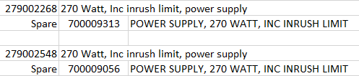
270 W Power Supply
Investigation of warranty use of 270 W PS due to doubled usage in Q1 20 to 11 compared to previous quarters
Reported symptoms
  Power remains on when when power switch turned off
  Sometimes pump does not turn on 3x
  QSP not initially turn on. Power cord reseated and powered on. This occurred multiple times
  Turned QSM off after testing. Would not turn back on without unplugging the power cord first
Unit E19QSP213A returned from field
  Multiple power cycles with/without cord removal unsuccessful
  After >1 week able to reproduce the failure after leaving unit plugged in
  Also able to reproduce issue on returned spare PS
Issue is with 5V circuit within PS that is needed to provide instrument power on
SL Power investigating and is prepared to do FA on 2 failed units

Slide 7
270 W Power Supply
SL Power investigating and is prepared to do FA on 2 failed units
  At this point SL is suggesting adding a bypass cap and changing another cap value to be larger in capacitance to filter out the external noises coupled into the circuit.
    This is neither confirmed, nor supported at this point in time
  Failure analysis occurred, but SQE requiring more info to support root cause

Slide 8
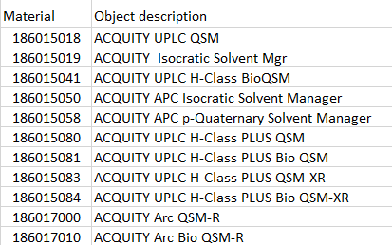
270 W Power Supply
279002268 – Where used
279002548 – Where used

Slide 9
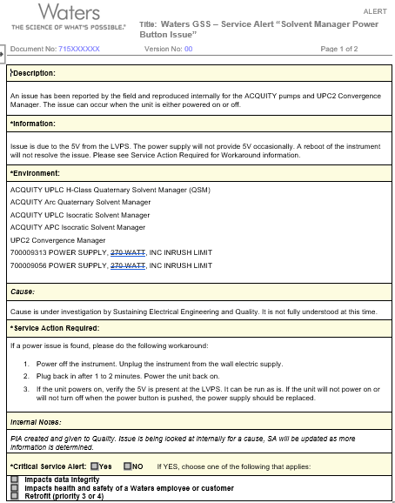
270 W Power Supply

Slide 10
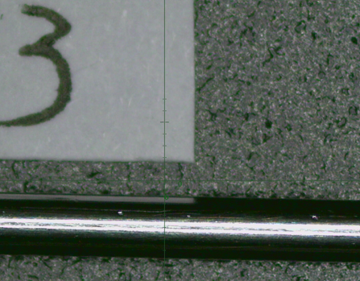
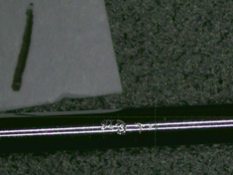
Alliance needle 405001338
One of the final steps in needle manufacture is electropolishing the surface, which is then examined for imperfections (OD inspect).
Imperfections are not allowed in the first 102 mm (as measured from the needle point)
China has noted failures of needles within PM kit (WAT270944)
  Leaking a few days after PM (needles #1 and #2)
  Examined needles in unopened PM kits and found pitting within 102 mm
    Needle #3 date; 20 Sep 2019, PM kit date; 30 Sep 2019
    Needle #4 date; 28 Oct 2019, PM kit date; 01 Nov 2019
Machine shop investigation initiated 21 April
Further actions dependent upon Machine Shop investigation outcome

Slide 11
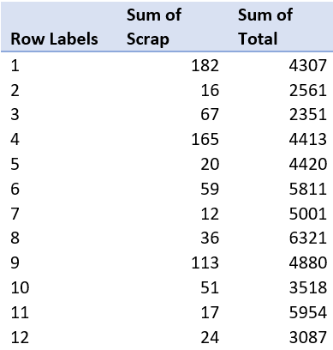
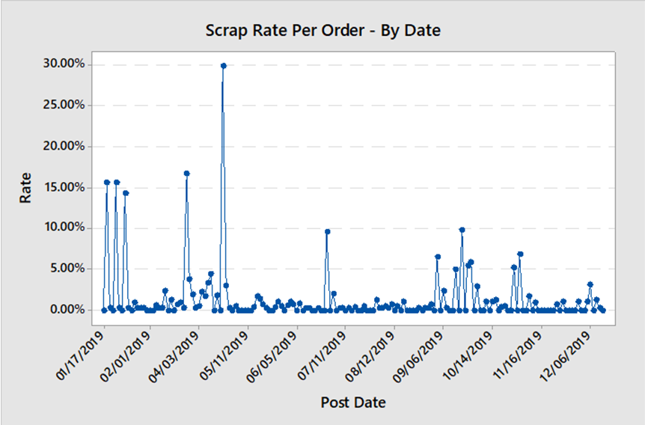
Alliance needle 405001338
Scrap rate at “OD inspect” step for September is somewhat higher, which may account for Chinese teams observations, but this is t.b.d.
The scrap rate by order/date does show somewhat more noise in September

Slide 12
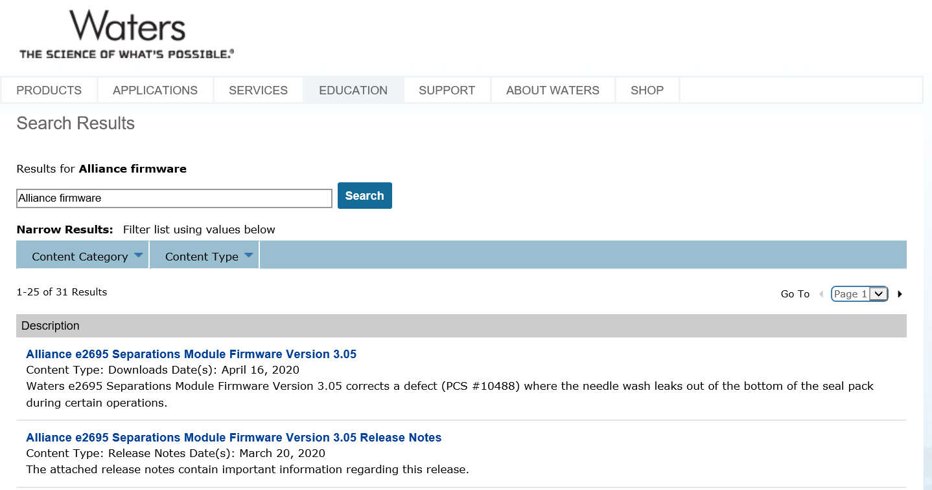
Alliance V3.05 Update
Newly manufactured instrument production has begun
  186269506 (SM4) w/SHC
  Leading SN = D20SM4050A
  186269505 (SM7) w/o SHC
  Pending next build
Customer available on Waters’ website

Slide 13
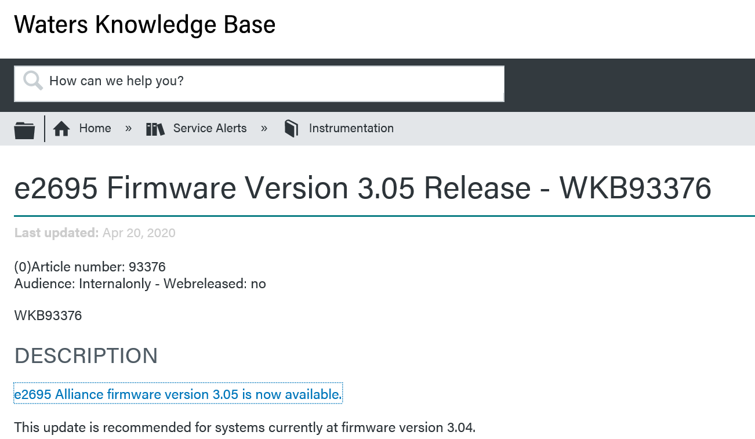
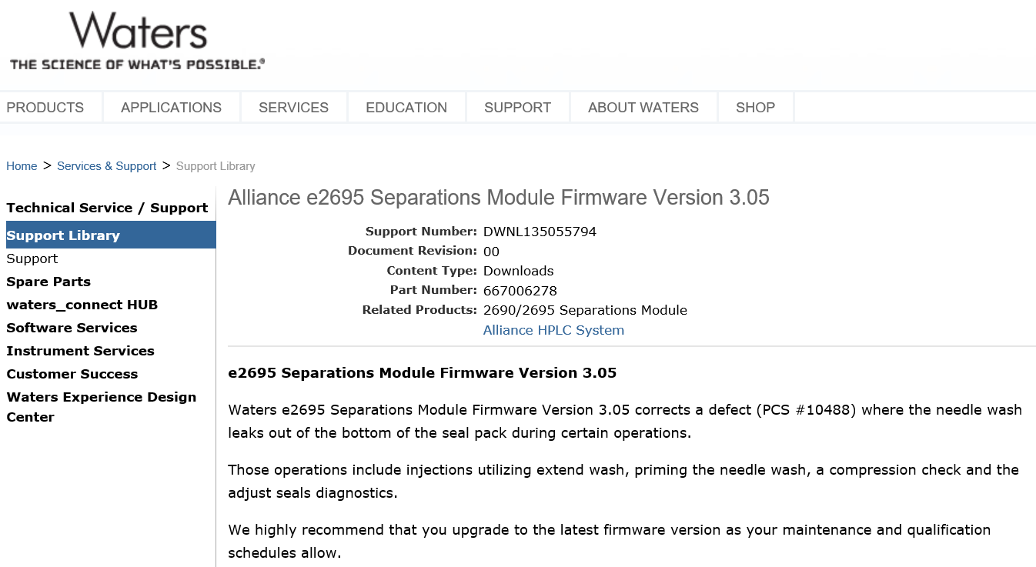
Alliance V3.05 Update
Service Alert info

Slide 14
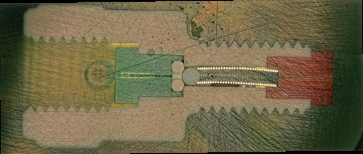
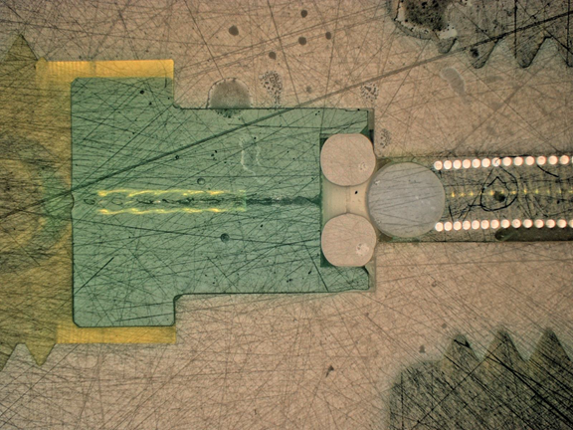
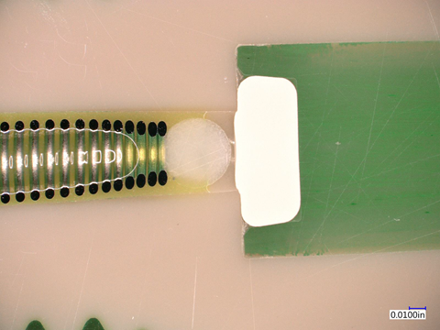
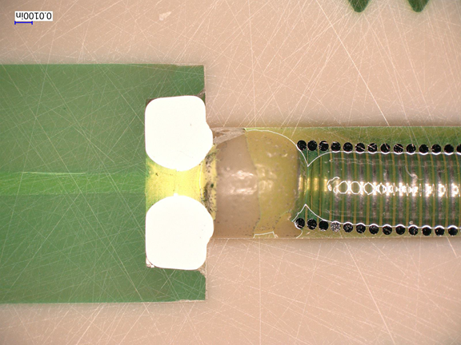
New Issues Reported - Field and Manufacturing
November 2019
Field report of failure of 410003180 – Inline waste valve of FTN
Rottendorf Pharma, Germany
CIT# GEOGBGBEKG20
  Failures occur after about 5-6 months
    Appears to be related to a specific application
  Initial examination of usage data does not suggest an underlying quality issue.
  May be related to needle wash solution used (t.b.d.)
  Material received 16 Dec and given to Cont’g Eng for analysis
    Customer and unused sectioned
      Attempting to get solvent compatibility info from vendor
  Customer testing use of APC equivalent
    410004788 (700009513)
    Successful so far
New (unused)
Customer

Slide 15
ACTION Items-Updates
Ongoing action items –
  Investigating Novo Nordisk issues new seal pack vs. old.
    Awaiting seal pack/injector returns for analysis
    Analysis
      Nothing unusual found about hardware returned
      Expected variation of PTFE insert ID found
        Most likely explanation of NW consumption variation seen, but within expected limits.
      One seal pack sectioned (suspected PTFE not bottomed out)
        Potential gap/dead volume
        Found correctly inserted and bottomed out
    Suspected differences in new vs old seal pack is somehow applications related.
    Excellent analysis and time frame put together by Chris P. for presentation
      Awaiting field feedback of customer meeting
        Actions to be determined, but presently delayed due to coronavirus

Slide 16
Milford Returned Instrument Evaluations

Slide 17
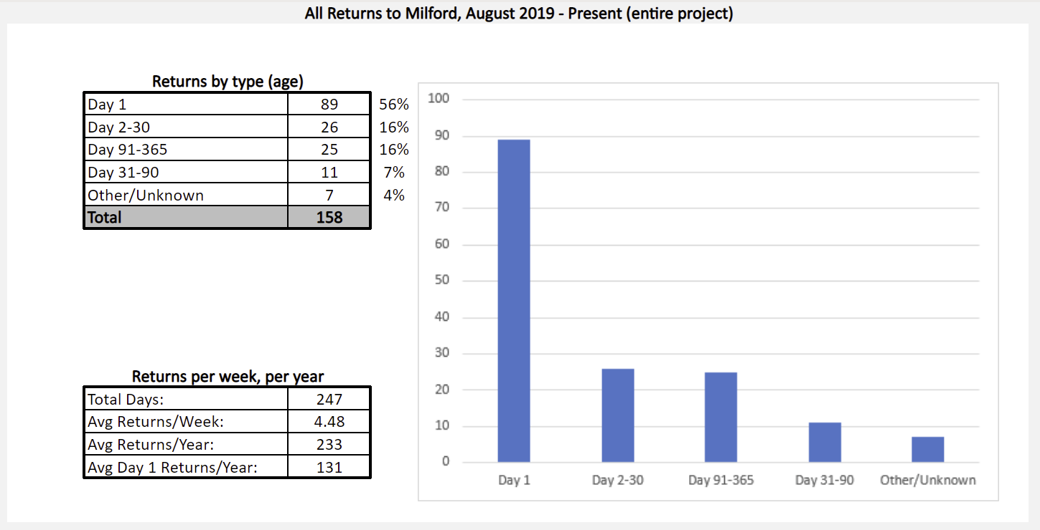
Milford Instrument Returns Project
Run by the System Readiness Group in Milford, with the following goals:
Document and understand returns and perform evaluations, based on requests
Standardize evaluation handling, using data to improve the customer experience

Slide 18
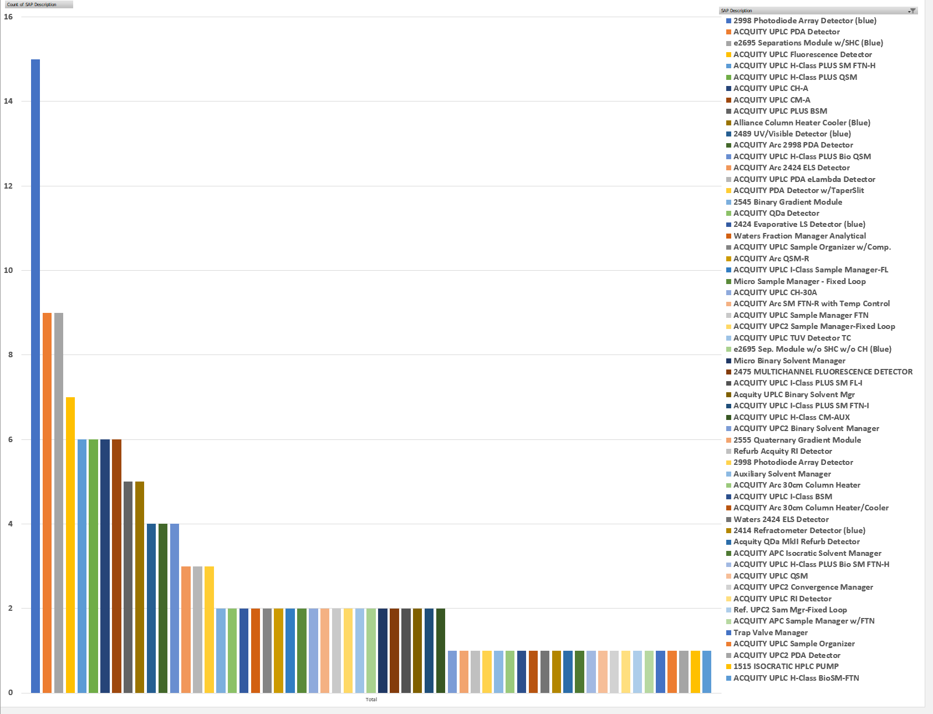
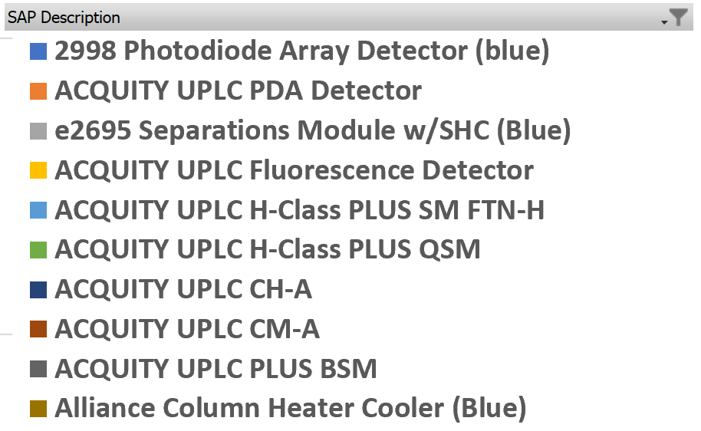
Returns, Sorted by Quantity (August-Present)

Slide 19
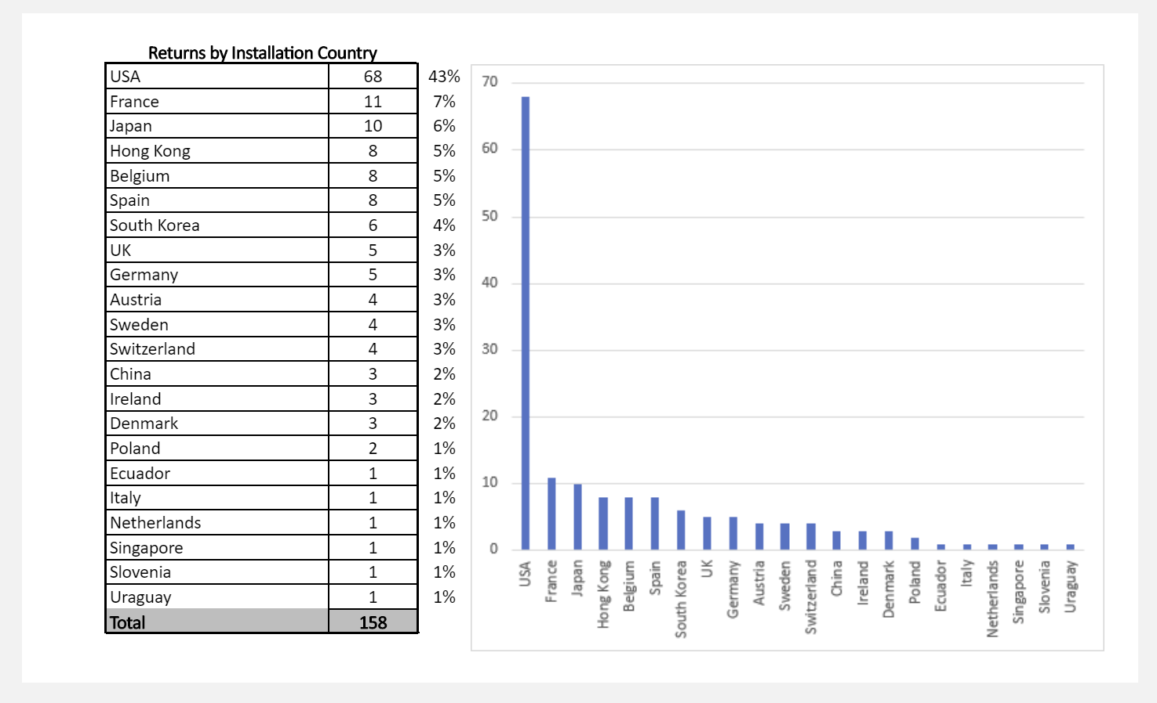
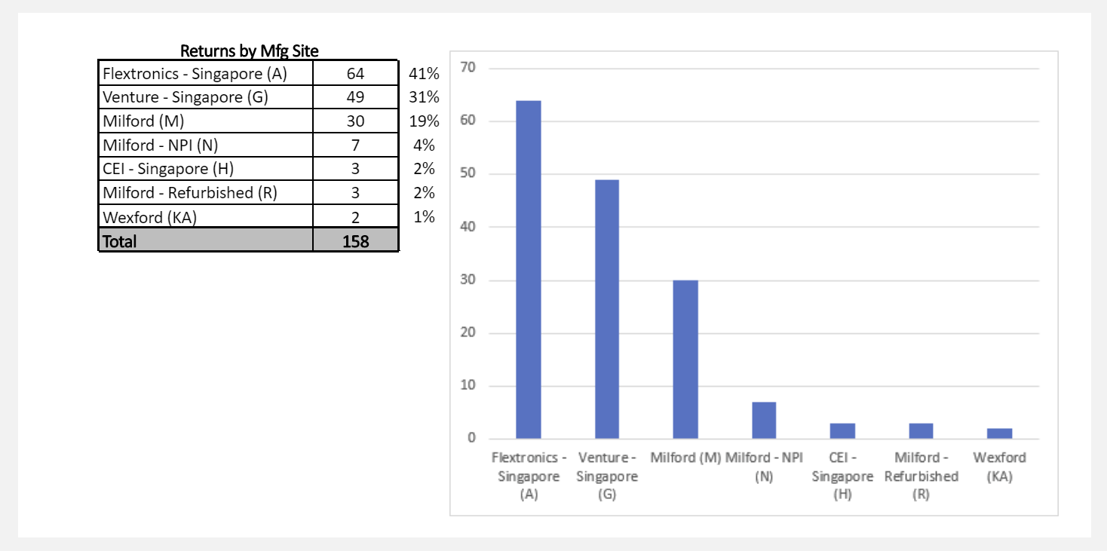
LC Instrument Returns Project (new data this month)
(includes all returns since August)
Returns by Installation Country
Returns by Manufacturing Site

Slide 20
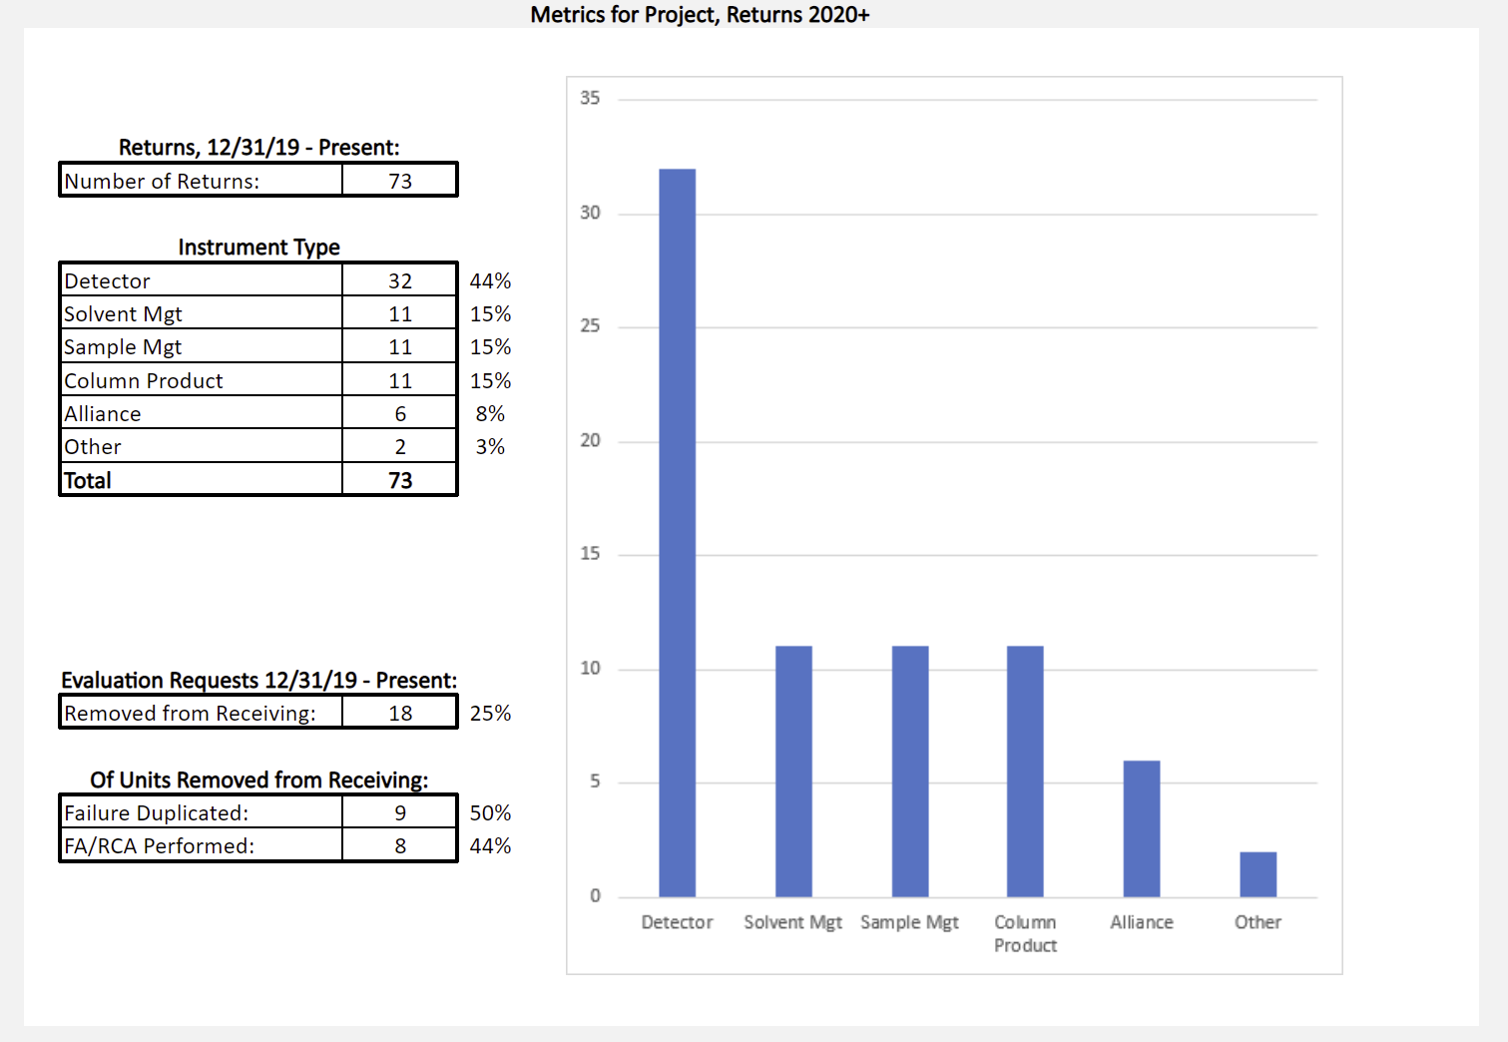
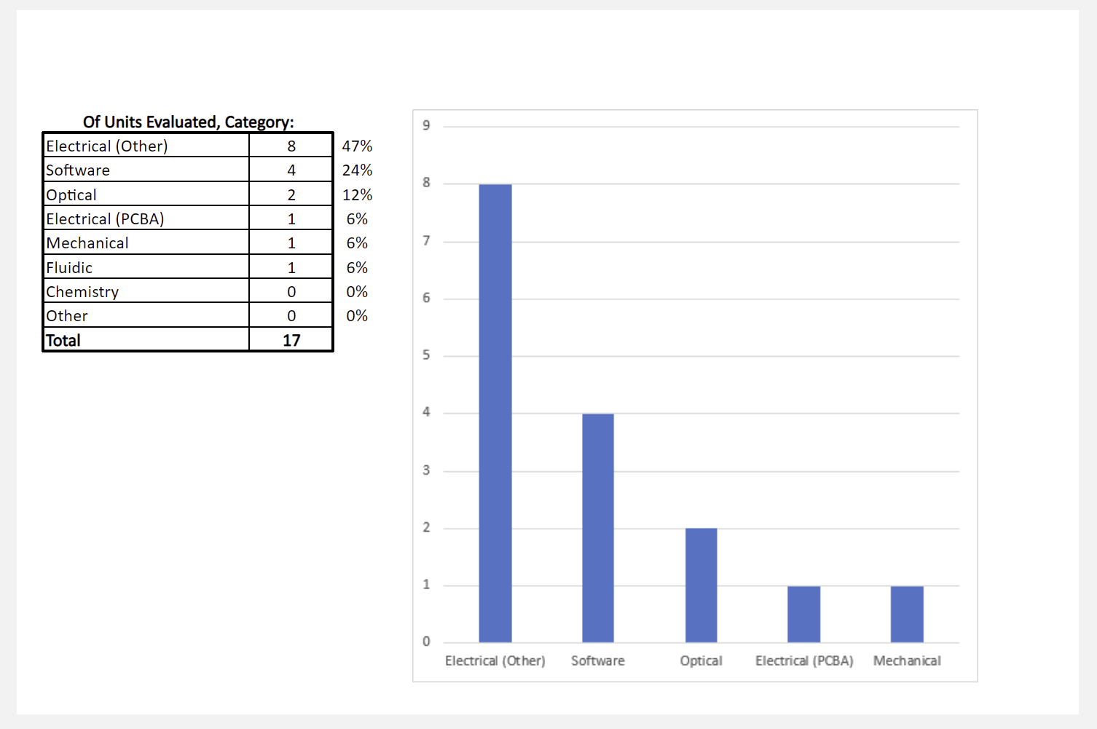
LC Instrument Return Metrics, 2020
Returns by Instrument Type
(and Evaluation Stats)
Root Cause by Category

Slide 21
Recent Evaluations
(Alliance & Pump Products):
No recent Alliance or pump product evaluations
(with System Readiness off-site, little failure analysis has been conducted lately)
The following have been removed from receiving (for anticipated request)
2695 Separations Module, – pressure drops during run, Day 91-365 Failure
Recently Released Reports:
721019810 - QSM, H Class Plus QSM, power supply issue, Supplier Quality Engineering investigating
721019484 - 2695 Pump Driver Board PCBA workmanship, Supplier Quality Engineering investigating​
721019663 - 2695 high ripple with default stroke volume, KCS article updated
721019662 - 2695 Z Axis Malfunction, no fault found (CCD was replaced in field)​
721019483 – 2695 Injector movement error, no fault found (crimp was repaired in field)

Slide 22
Current Stop Ship Status
Stop Ships-LC
None at present
Current LC Retrofits:
Arc Path 1 & 2 mixers – Implemented. GSS tracking
AOB?
Next meeting for Alliance and Pumps
  Regularly scheduled day/time
  Wednesday, 20 May, 2020 @ 9:00

Slide 23
Questions?

