Slide 1
MTR Field Data February 2020
PIM Team
March 2020

Slide 2
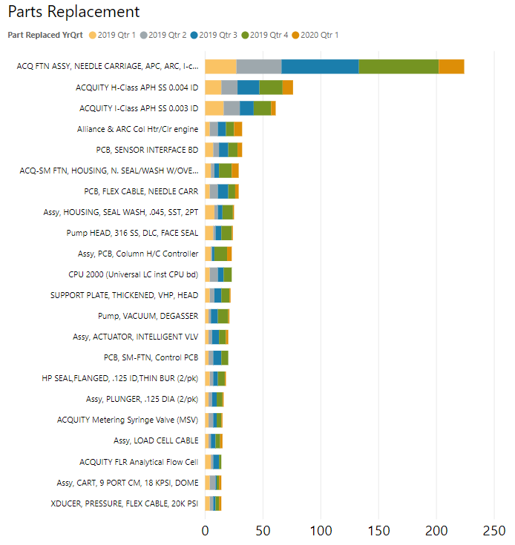
Venture – Parts usage 0-90 days
High Impact Parts
DOM Jan 2016 – Jan 2020
Milford Part
Issues understood
Waters Investigation
Ongoing investigations continuing thru 2020
CMO Investigation
Requested
None requested
at this time
Noted usage, possible investigation

Slide 3
Comments
Due to current global Coronavirus situation, there is a significant drop in field service activity.
Needle carriages
  On-going high usage due to drive belt material issues. Updated material implemented in August 2019, but usage is expected to remain high for a prolonged period as all units produced from mid 2017 – Aug 2019 have potential to be affected.
  Sensor Interface PCB being replaced with needle carriage in Japan
  Load cell cable being replaced as part of needle carriage related investigations.
Needle carriage flex cable
  Usage highlighted through PMTR data. Field reacts to the new coated flex cable to address the failures caused by condensation
Support plate
  On-going engineering work to reduce galling issues. Target to implement updated material is July 2020. Plan to implement in I-Class BSM and evaluate effectivity before rolling out to other pumps.
APH
  Work continues into issues with particulates in tubing, which has been observed to affect APH.
  New APH with extended board and forcing latch tabs on top will be implemented in Q1 2020
Metering Syringe Valve (MSV)
  Increased use also noted at start-ups, mainly in Japan. Failure mode is sample syringe leak test failure. Localized to Japan (~60% of reports). Currently no evidence of systemic issue. Monitoring. No further concerns raised in Feb.

Slide 4
ASSY, PCB, COLUMN H/C CONTROLLER (210000400/700005748)
Origin | MTR 0-90 Day Part Usage | EQMS Ref | TBD
Brief Description | Failure of Column HC Controller PCB (700005748/210000400) | PRA Level | TBD
Investigation Details
Review of 0-90 Day failures of this PCB indicated a common failure mode for a number of PCB – CH/CHC not detected and identified on Alliance 2695 front screen. One instrument, J19SMH041G, returned for this failure mode. This was evaluated by electrical engineers in Milford. Failed motor driver chip on PCB 210000400 Rev E. This motor is used to control optional column select valve. We are waiting for return of three failed PCB (for same failure mode) from failures in China (E19SMH130G, G19SMH711G, J18SMH463G). These additional failed PCB have not yet been received to allow evaluation. Part added to hot parts list and any returns will be evaluated to better understand any failure of this PCB. Aim to establish if any consistent failure mode exists.
Current Status | In Progress

Slide 5
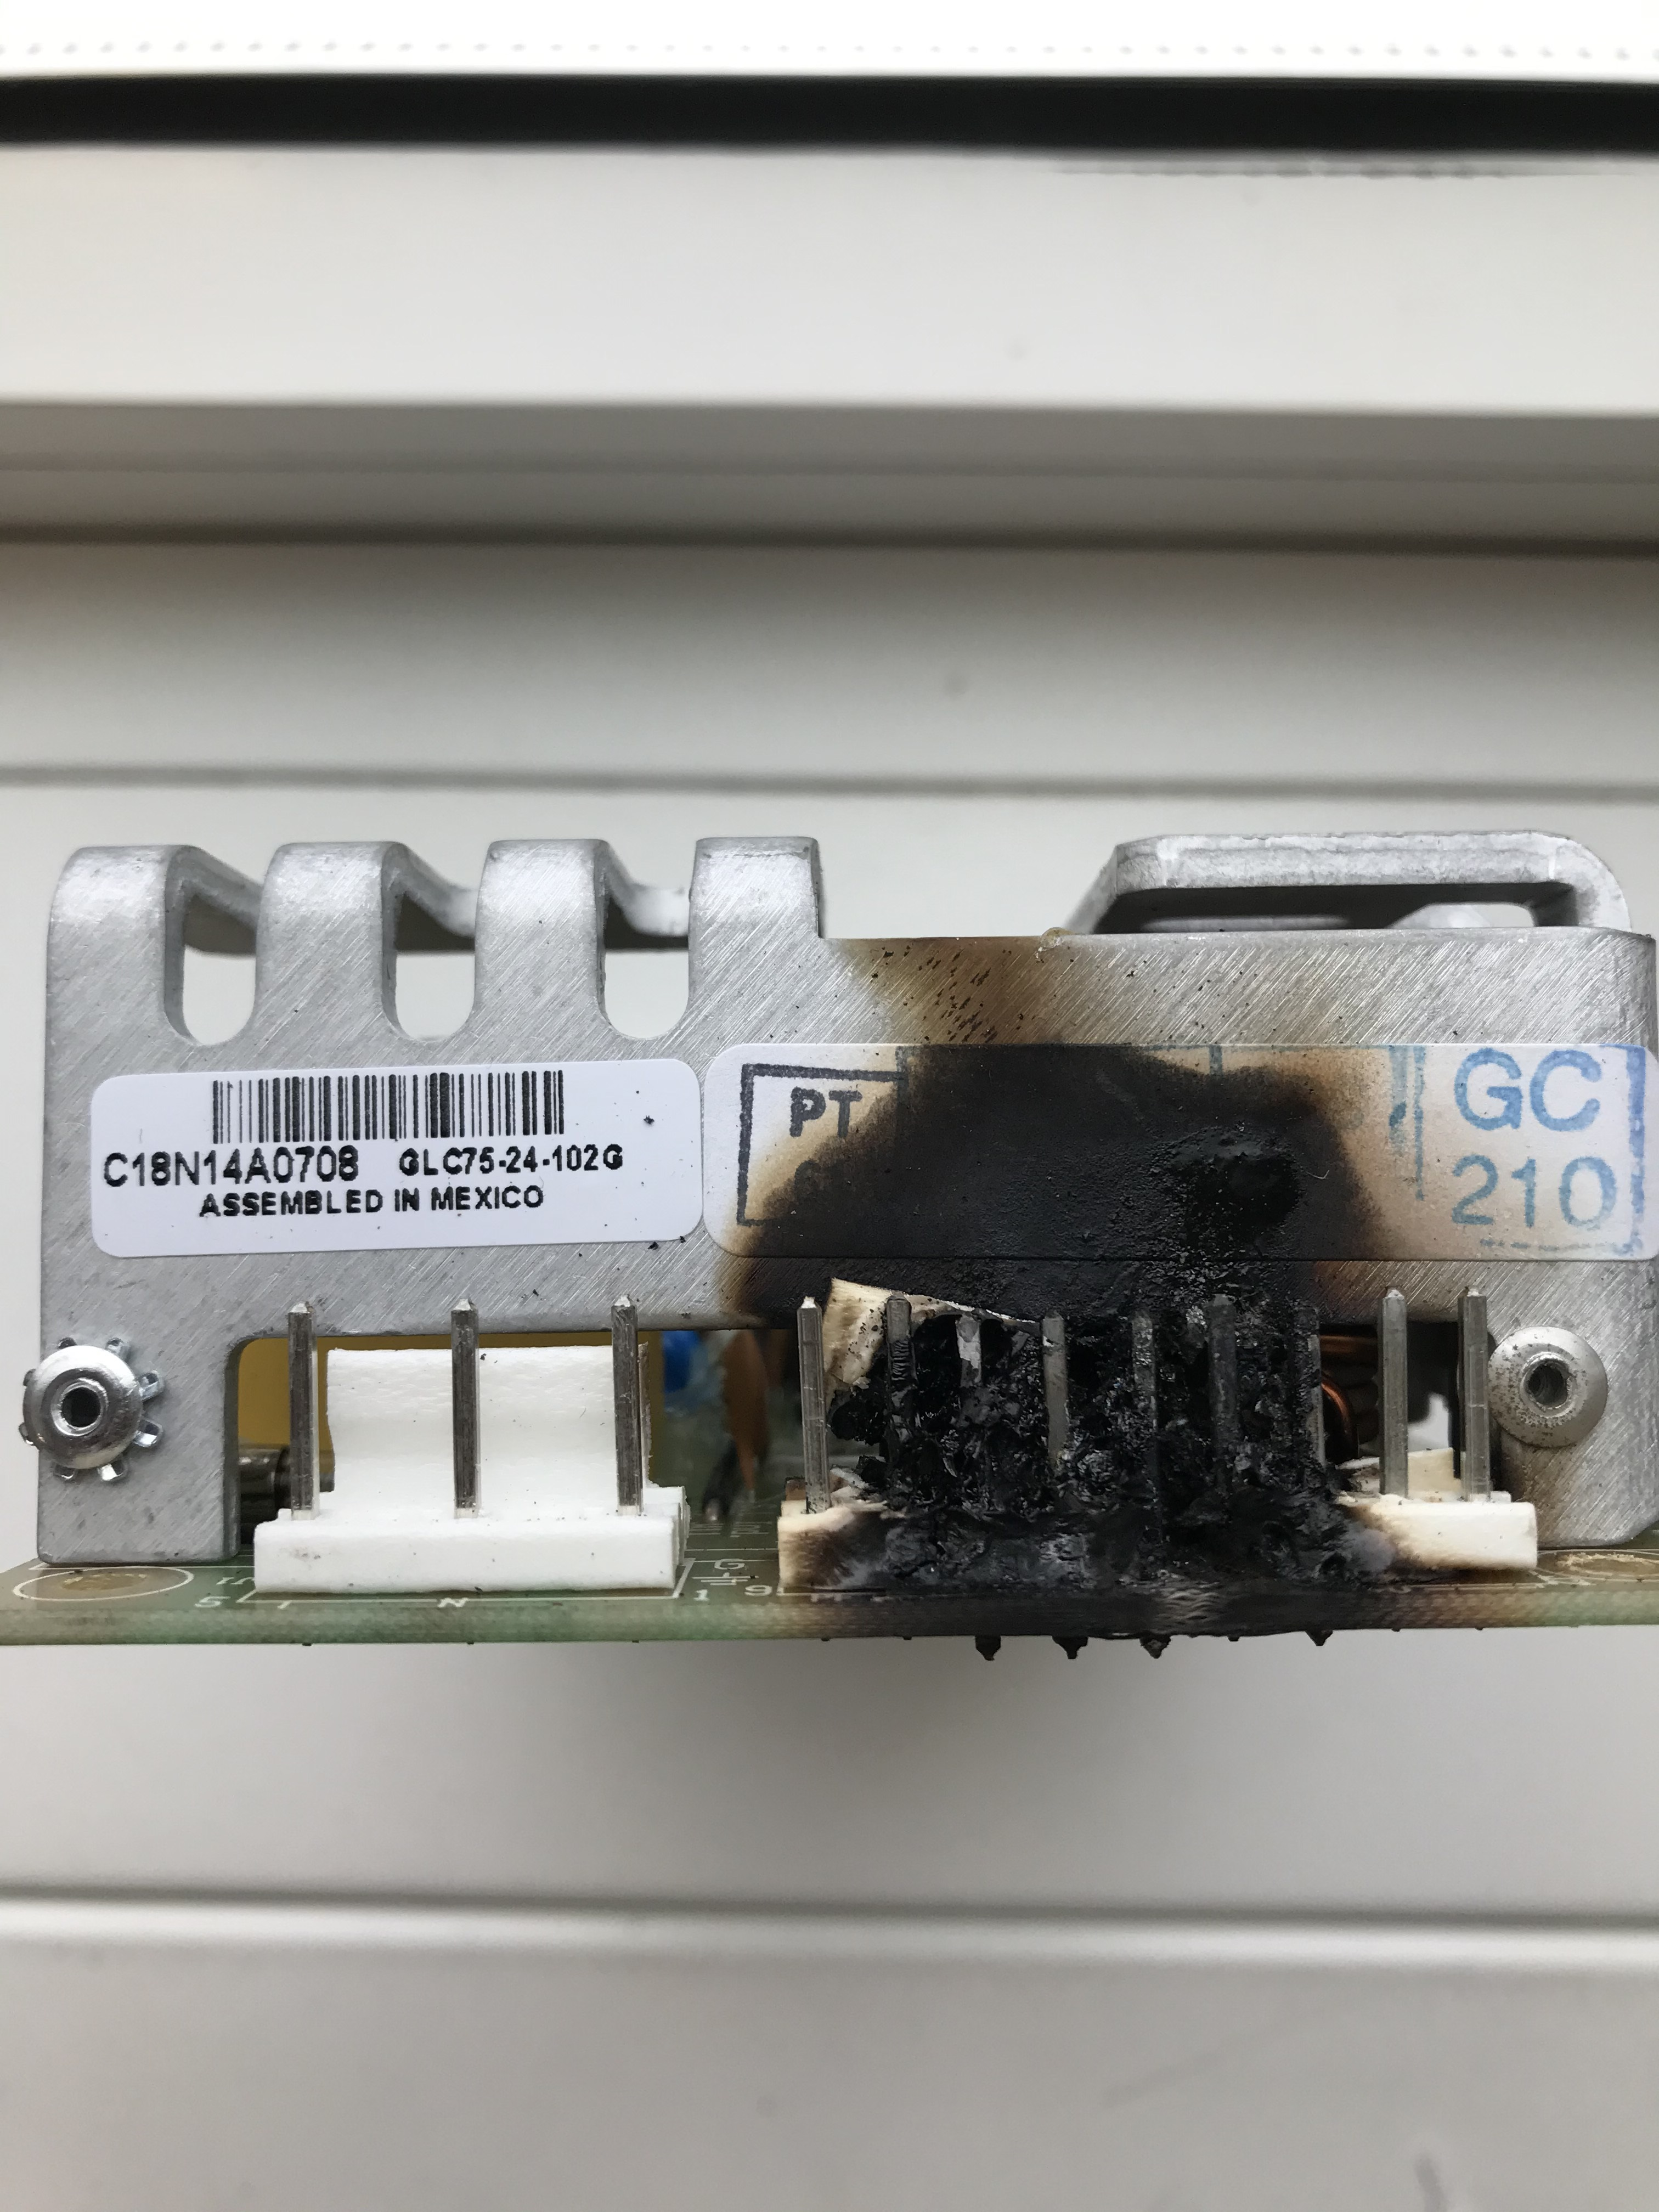
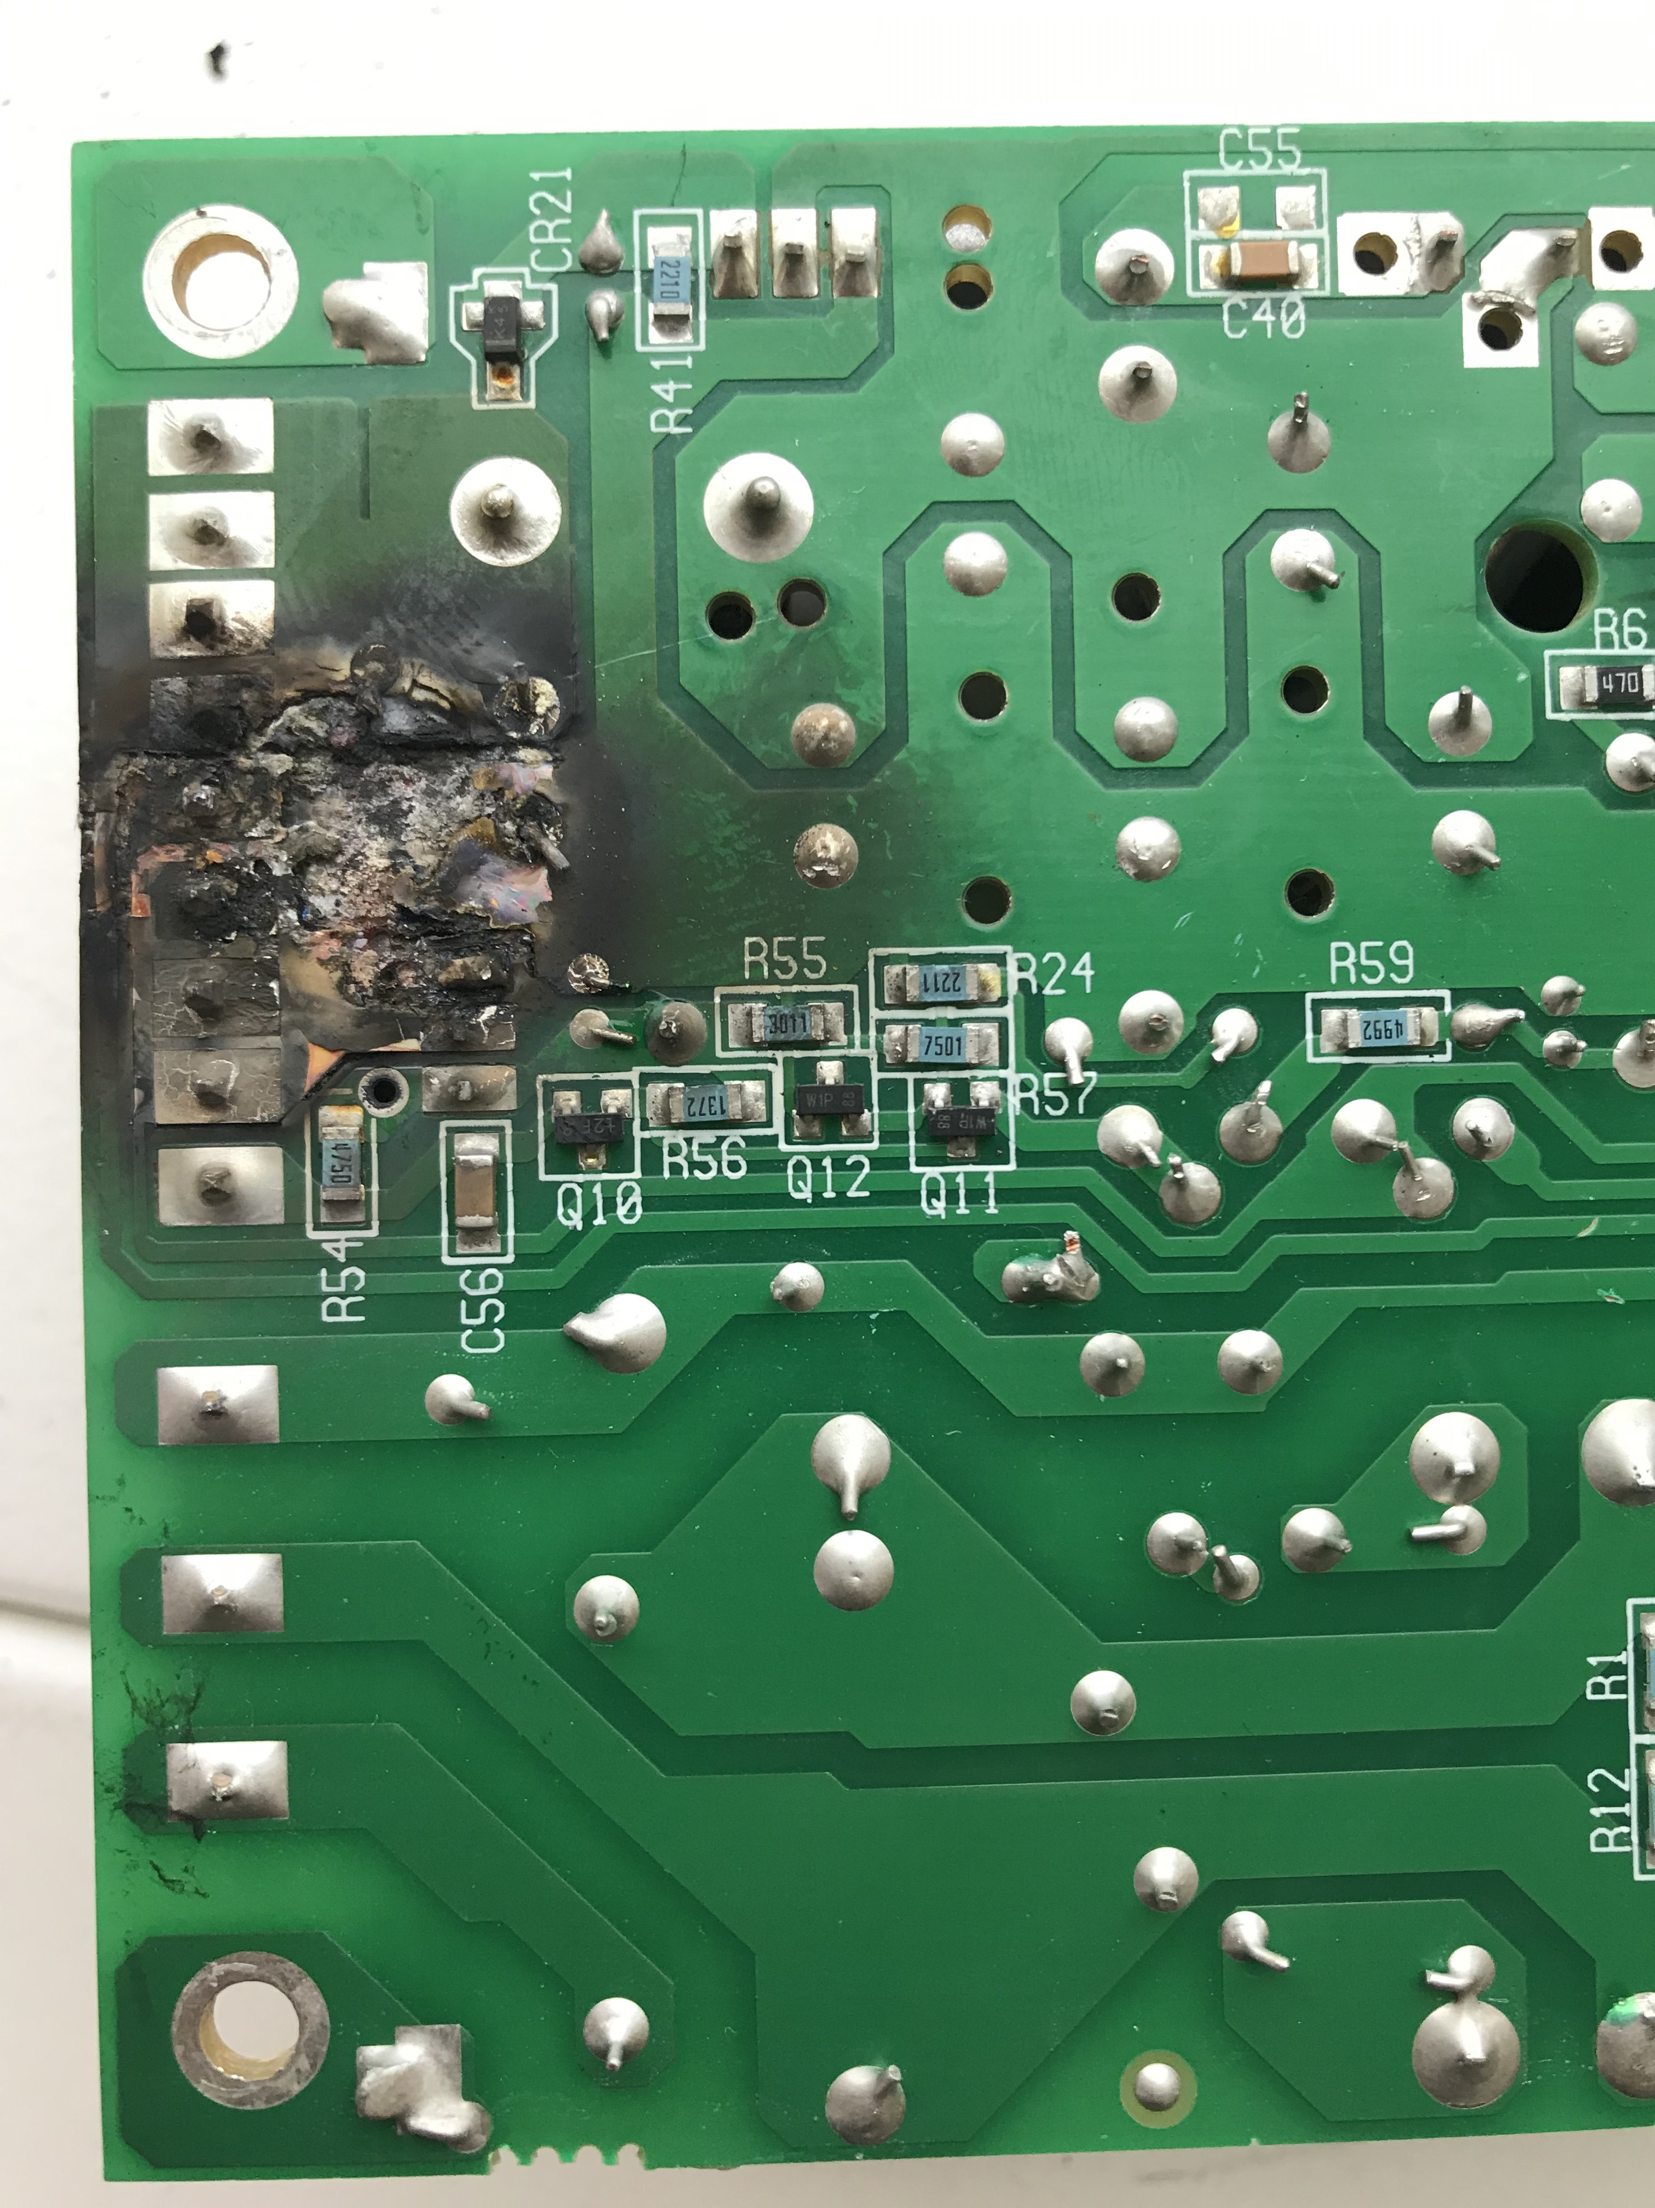
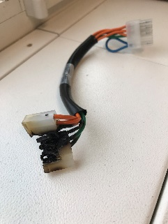
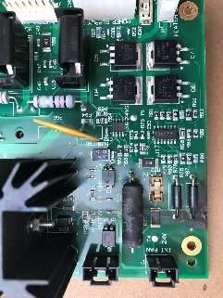
Alliance CHC (186179100). Burnt PSU, PCB and Cable
Origin | Field (BEONBKMGH601/ BEIEBJ6DK633) |  | EQMS Ref | 2433900
Brief Description | Burn damage to PSU (700002138), PCB (700005748), and Cable (441000416) |  | PRA Level | MODERATE
Investigation Details
Alliance CHC (Blue) – B19SMC246G Column Temp HW Fault (7) errors and reported smell of burning. Evidence of overheating/burning to PSU, PCB and connecting cable. Unit repaired by replacement of PSU, PCB, Cable and HC engine. Failed parts currently in transit to Milford to allow evaluation. PIA performed. Failed parts have been lost by courier en-route to Milford. PN 700002138 / 279000520 (Power Supply) SL Power believe the most likely issue relates to C48 Cap. EE looking at possible change of C48 to a SMT cap with Open Mode (OMD) fault tolerance.
Current Status | In Progress

Slide 6
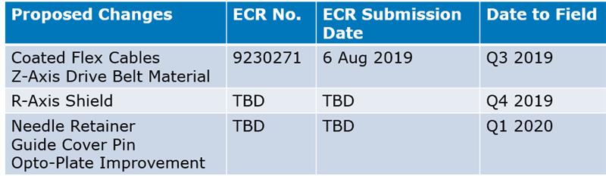
Sample Manager Improvement Project
No new updates for the upcoming changes
TBD
Implementation dates for remaining improvements are not known.
Engineering resource focused on Pathfinder project at this time.

Slide 7
QDA Returned Instrument RCA
KBD5209
  Returned from South Korea due to a ‘noisy’ turbo pump
  RCA performed in Wilmslow
  Fault not reproduced and QDA found to be fully functional
  No Fault Found

