Slide 1
Luo HuaZhen
Quarter Review: Q2 Recap
Senior Test Engineer

Slide 2

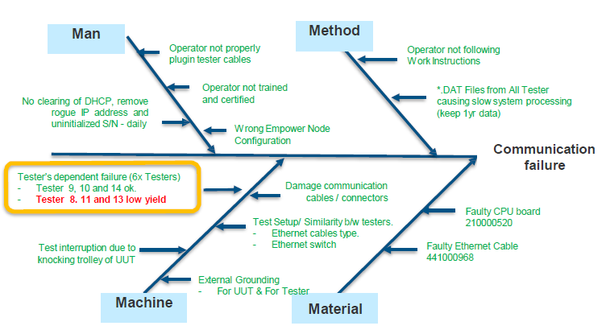

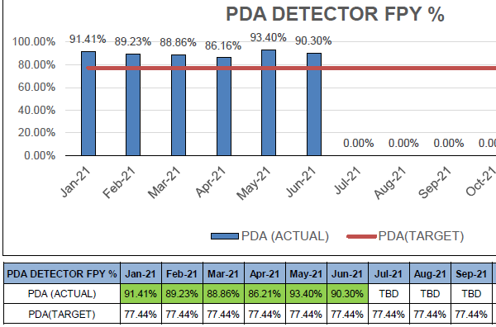
PDA FPY improvement @Flex
Problem |  | To achieve FPY for PDA family equal and greater than 77.44% target FPY. |  |  |  | Issue Background |  |  | PDA Detector family FPY is affected by loss communication. This project focus on how to reduce this loss comm issue and improve overall FPY for PDA.
Signal Identified |  |  |  | Short Term Solution |  |  |  | Long Term Solution
3x Testers show low FPY among of 8 Testers. The overall FPY of PDA is pulled down by these 3 low FPY stations |  |  |  | Team target to improve these 3x low FPY testers, therefore archiving FPY equal and greater than 77.44% target. TE82882-8, no IP was assigned successfully when failing loss comm. The issue is resolved by using direct LAN cable for testing TE82882-11, Tester PC time may intermittently reset to 12 Oct 2012 when failing loss comm. The issue rectified by setting time to local present time. TE82882-13, Test program may crash when inserting another unit while there’s a unit test in progress. Load UUTs all together and test may complete without error. |  |  |  | Long term solution is implemented on each of low FPY testers: TE82882-8, re-installed/update driver for relay box. The issue is resolved with a good FPY. TE82882-11, disabled internet time zone auto-sync. Since then, a good FPY is observed. TE82882-13, reconnected a grounding wire on position 2. FPY was improved to 80% since then.
 | Project Team |  |  |  |  | Gains | Gains
Singapore Edwin Koh Desmond Ann Luo HuaZhen Flex |  |  | Milford Eric Turner |  | 3x low FPY testers yield improved from avg 56.67% to 86.86% in June. Overall PDA FPY (89.95%) achieved greater than 77.44% target FPY in Q2 2021. | 48K pcs Scrap avoidance in ferrules & post staked tubes

Slide 3
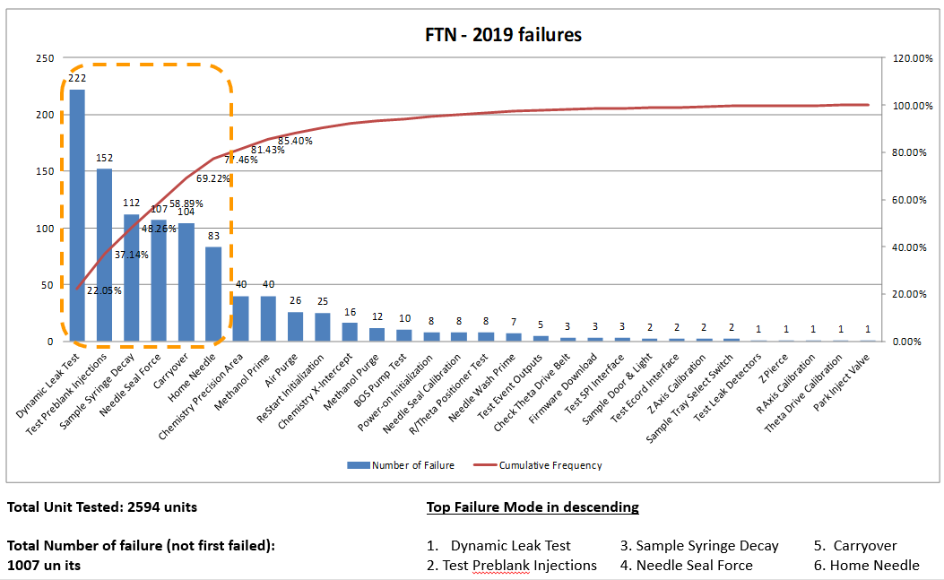
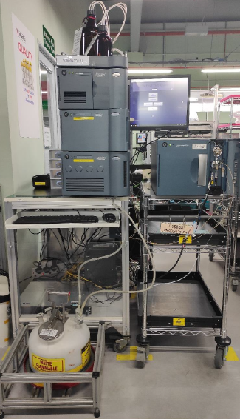
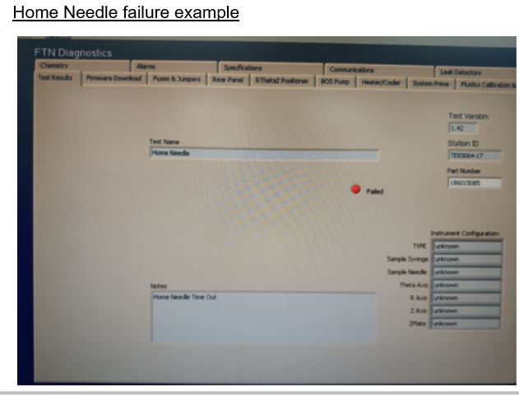
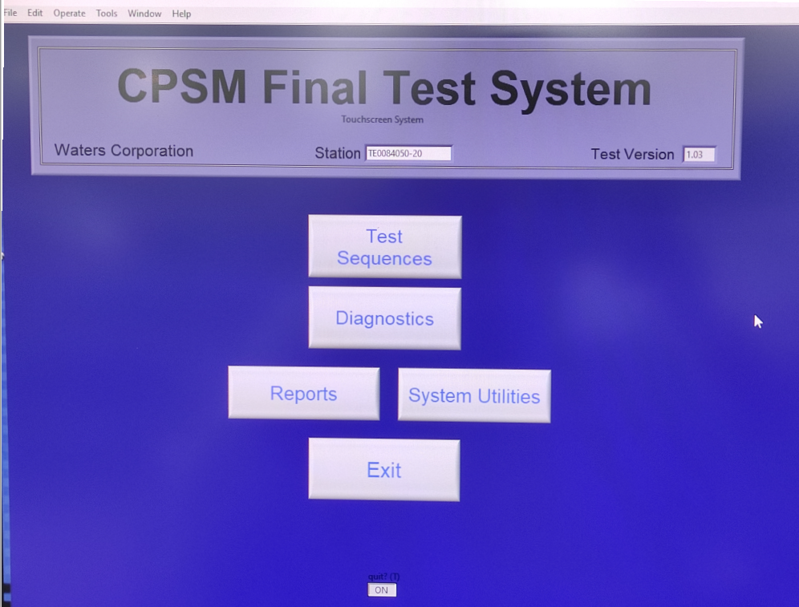
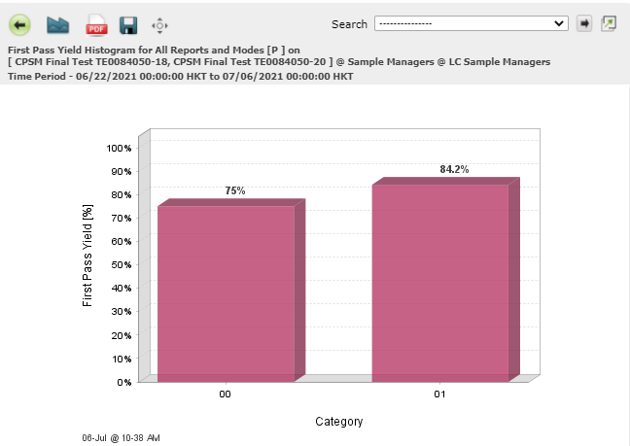
CPSM Testers Upgrade @Venture
Problem |  | CPSM Testers at Venture upgrade from old TE83064 to new generation of testers TE0084050 to improve tester reliability, FPY and test time |  |  |  | Issue Background |  |  | Multiple intermit errors were observed on old generation of testers TE83064. This new generation of testers TE0084050 enhanced to cover most of these reported errors.
Signal Identified |  |  |  | Short Term Solution |  |  |  | Long Term Solution
Multiple failures related to tester or its PC. |  |  |  | Venture practiced to rebooting PC and testers to avoid some of communication errors/test software errors such as below, |  |  |  | Upgraded old tester TE83064 to new generation of tester TE0084050.
 | Project Team |  |  |  |  | Gains | Gains
Singapore Edwin Koh Luo HuaZhen Venture |  |  | Milford Eric Turner Christopher Oski Adam Townsend Bill Bates |  | Completed 2x testers upgrade in Q2. The upgrading is still on-going. The failures observed from new testers TE0084050 is reduced. The tester reliability is improved. | 48K pcs Scrap avoidance in ferrules & post staked tubes

Slide 4
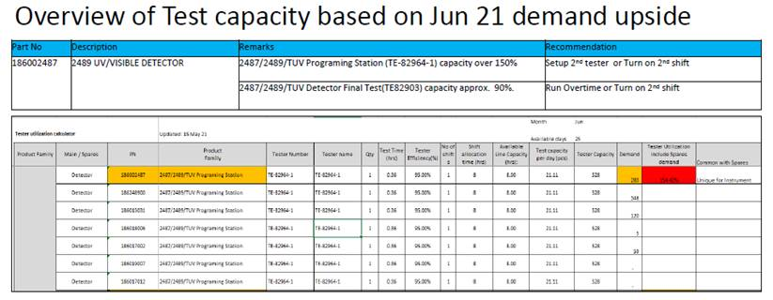

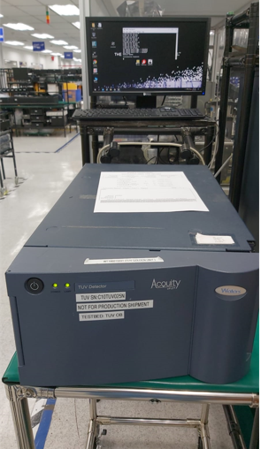
Additional TUV programming station TE82964-2 @Flex
Problem |  | High production demand of TUV detector caused insufficient test capacity on TUV programming station |  |  |  | Issue Background |  |  | Surge to TUV demand in Q2 shows insufficient of TUV programming station and Flex required to have run 2nd shift to fulfil orders.
Signal Identified |  |  |  | Short Term Solution |  |  |  | Long Term Solution
Test capacity calculation shows 1x TUV programming station cannot complete all orders without 2nd shift |  |  |  | After evaluated situation, a short term solution is implemented by turning on 2nd shift at Flex. |  |  |  | Adding TE82964-2 by using latest tester PC image (Windows 10) in Flex and configured for TUV programming.
 | Project Team |  |  |  |  | Gains | Gains
Singapore Edwin Koh Desmond Ann Luo HuaZhen Ernest Chua Flex |  |  | Milford Bill Bates Matt Brule Eric Turner |  | Adding Additional Test capacity to Flex TUV production line. 2x TUV programming station may back up each other | 48K pcs Scrap avoidance in ferrules & post staked tubes

