Slide 1


TEMPLATE [TEXT]
Problem |  | [TEXT] |  |  |  | Issue Background |  |  | [TEXT]
Signal Identified |  |  |  | Short Term Solution |  |  |  | Long Term Solution
[TEXT] [GRAPH/TABLE/PICTURE] |  |  |  | [TEXT] [GRAPH/TABLE/PICTURE] |  |  |  | [TEXT] [GRAPH/TABLE/PICTURE]
 | Project Team |  |  |  |  | Gains | Gains
Singapore |  |  | [OVERSEA SITE] |  | [TEXT] | 48K pcs Scrap avoidance in ferrules & post staked tubes

Slide 2
Kwan Hong Min
Quarter Review: Q2 Recap
Tooling & Manufacturing Engineer

Slide 3
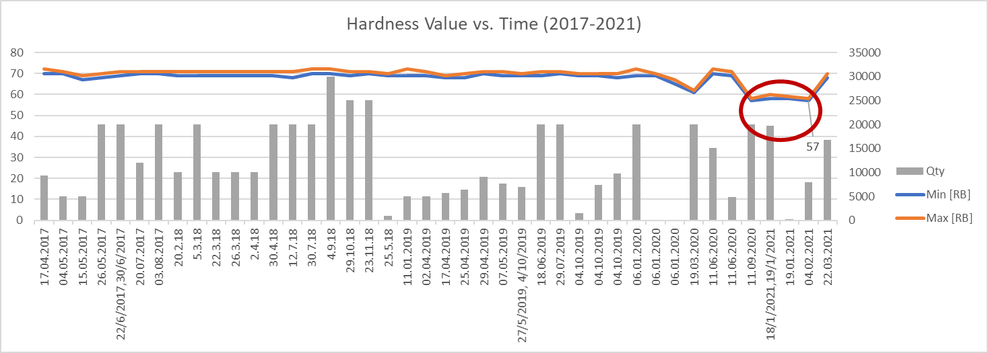
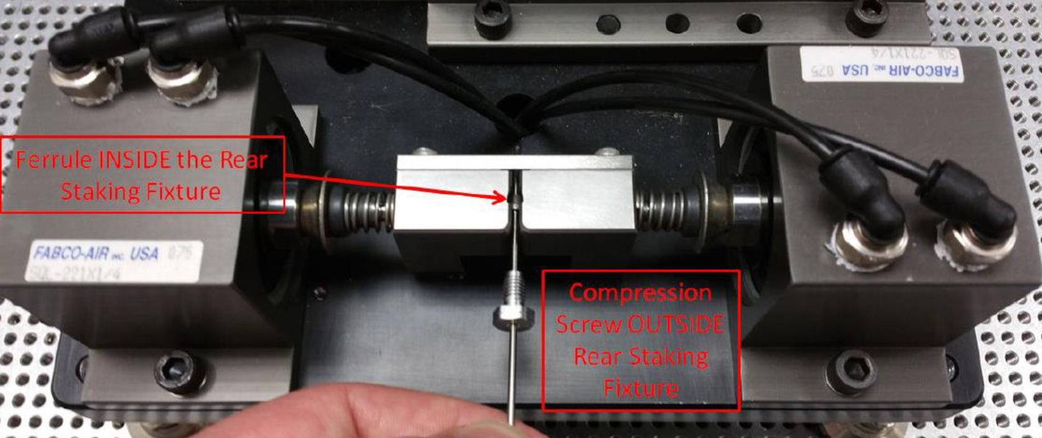
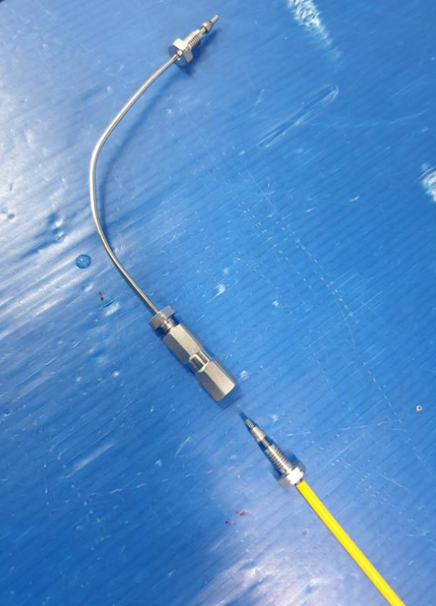
WAT022330 Staked Ferrules @ Keypoint
Problem |  | Multiple pump tray leak test failures 78% of 192 Testing at flex Staked ferrules from Keypoint Staked ferrule stuck ⇨ Unable to form a seal during installation |  |  |  | Issue Background |  |  | Recurring issue since ??? Hardness spec > 90RB (316L SST) Supplier unable to increase hardness in annealing process
Signal Identified |  |  |  | Short Term Solution |  |  |  | Long Term Solution
Abrupt drop in ferrule hardness, soft 70 RB ⇨ 57-60 RB, 48K pcs ⇩ Staking pressure should reduce biting force on tube |  |  |  | Revised staking pressure range used Rollout TMD as trial, effectiveness verified: 100% FPY recovered @ flex, 2.7K pcs Staking pressure used @ Keypoint, new staking pressure Cross check completed with new ferrule shipment Increased hardness (before plunge) |  |  |  | Revise current staking procedures Process 7.4 in WI 910000478 ECO 9242214 ⇧ Robustness: Wider range of ferrule hardness
 | Project Team |  |  |  |  | Gains | Gains
Singapore Kwan Hong Min Tony Shieh Shaynee Lim Keypoint |  |  | Milford Peter Kirby Anthony D’Angelo |  | 48K pcs Scrap avoidance in ferrules & post staked tubes | 48K pcs Scrap avoidance in ferrules & post staked tubes |  |  | 78% yield ⇧ Pump tray leak test Line down scenario avoided

Slide 4


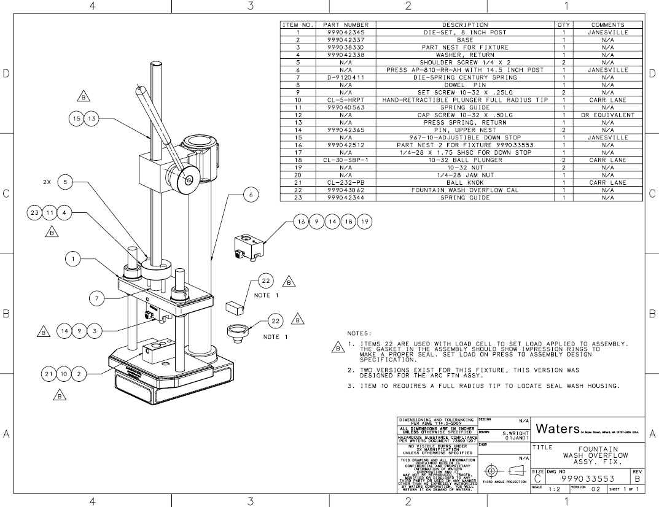
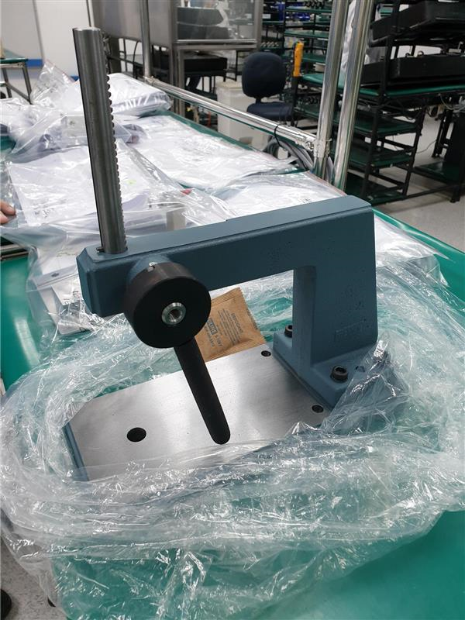
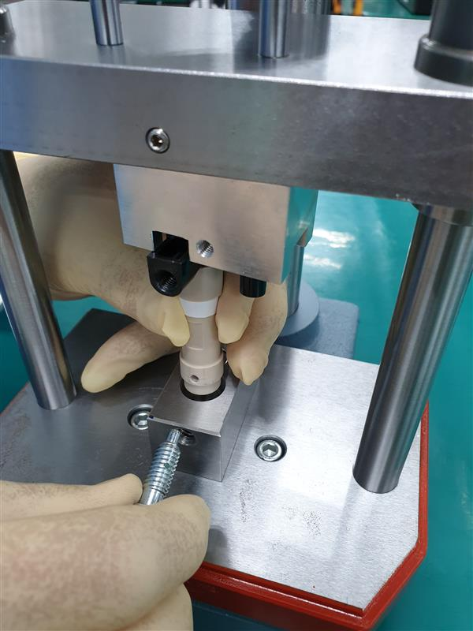
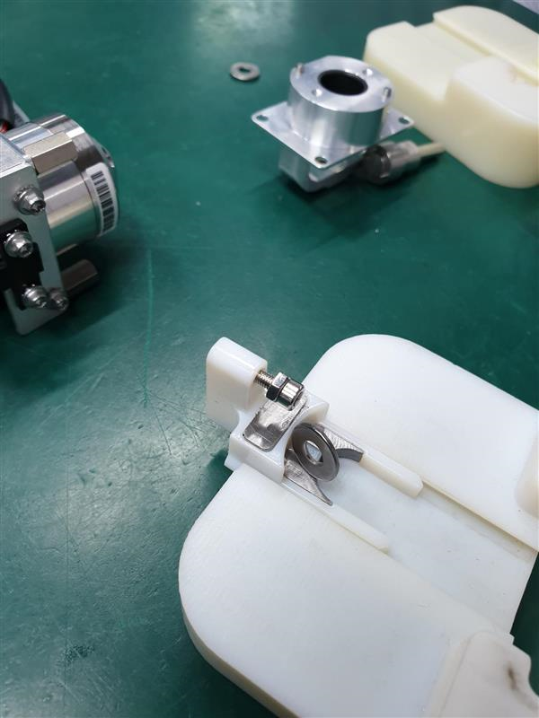
Arc FTN Tooling @ flex
Project Goals |  | In support of 2021’s transfer of Arc FTN instruments into flex |  |  |  | Project Scope |  |  | 46 Localized Toolings 42 Customized 4 Off-the-shelf, unique
Implementation Plan |  |  |  | Actions Taken |  |  |  | Completion
Identification of local fabrication house (JEG) Precision machining & fabrication Quick turnaround |  |  |  | Paper to actual dimension comparison Cross site evaluation Tool improvement from training build feedback Local calibration |  |  |  | Completion on schedule Usage during training build Verified toolings
 | Project Team |  |  |  |  | Gains | Gains
Singapore Kwan Hong Min Desmond Ann Gary Lai (flex) |  |  | Milford Stephen Wright |  | $15K USD Savings from local fabrication | 48K pcs Scrap avoidance in ferrules & post staked tubes |  |  |  | Local Capability Independent fabrication & future modification
 |  |  |  |  | Shipping Costs Savings |  |  |  |  | Lead Time Savings

