Slide 1
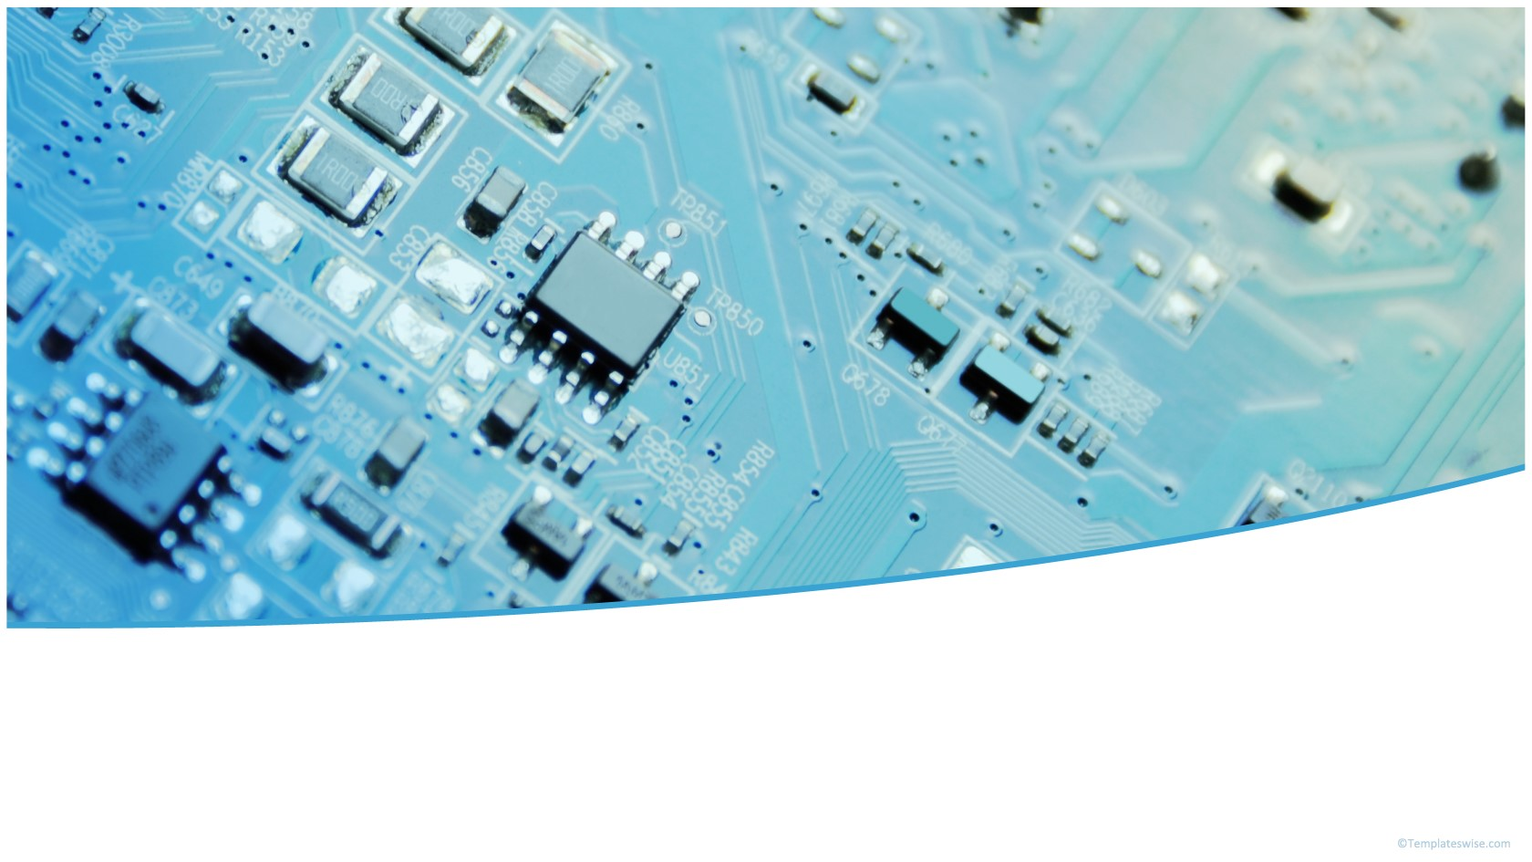








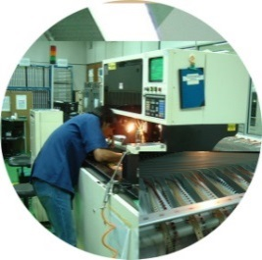

High Mix Low Volume Printed Circuit Board Assembly
Cable Harness
Box Build and Equipment Manufacturing
Waters QBR – Q1 2020 (26 May 20)
ISO9001:2015
ISO14001:2015
AS9100D
ISO13485:2016

Slide 2
Overall
Business Overview
PCBA \ EQM
  Overview of PCBA Sales
  On-time Delivery Performance
  Inventory Analysis
  New Models \New Business Opportunity
  Quality Performance
  Continuous Improvement
3. AOB

Slide 3
Overall Waters Sales (,000K USD)
Percentage %
Sales (,000K USD)
Division / Year | 2016 | 2017 | 2018 | 2019 | 2020 (Projection)
PCBA | 14.4 | 15.27 | 16.7 | 17.07 | 11.01
EQM | 4.41 | 3.99 | 4.31 | 4.44 | 3.42
Cable | 0.37 | 0.57 | 0.58 | 0.88 | 0.56
Total | 19.18 | 19.83 | 21.59 | 22.39 | 14.99
Year to Year Comparison (%) | NA | 3.39% | 8.88% | 3.71% | -33.05%

Slide 4
PCBA

Slide 5
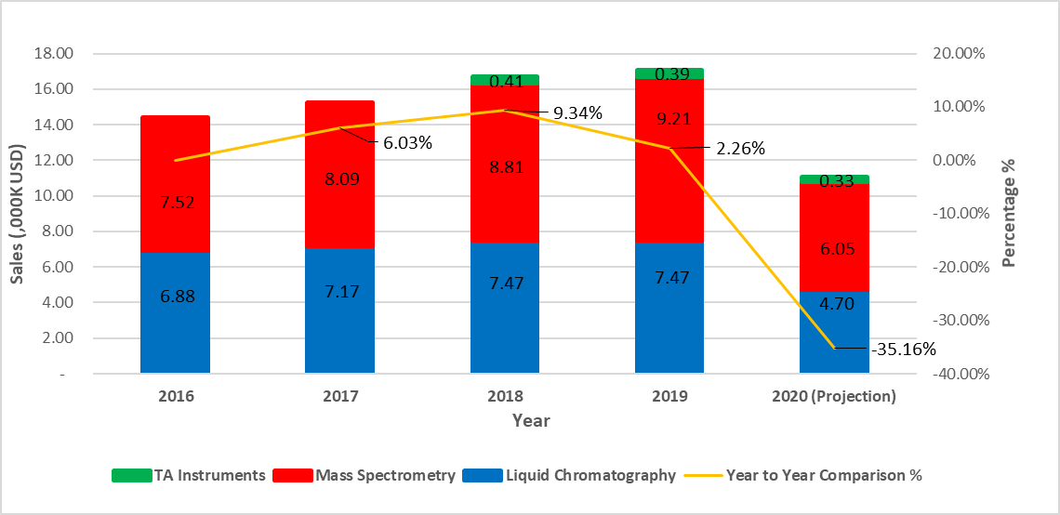
Waters & TA PCBA Sales Revenues (,000K USD)
Site / Year | 2016 | 2017 | 2018 | 2019 | 2020 (Projection)
Liquid Chromatography | 6.88 | 7.17 | 7.47 | 7.47 | 4.70
Mass Spectrometry | 7.52 | 8.09 | 8.81 | 9.21 | 6.05
TA Instruments | - | - | 0.41 | 0.39 | 0.33
Total | 14.40 | 15.27 | 16.70 | 17.07 | 11.07
Year to Year Comparison % |  | 6.03% | 9.34% | 2.26% | -35.16%

Slide 6
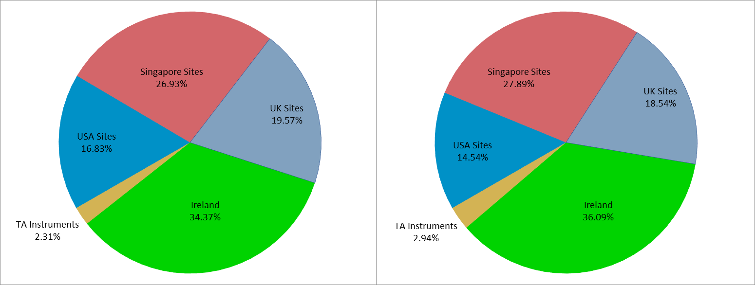
Waters & TA PCBA Sales Revenues By Site (,000K USD)
Year 2019
Year 2020
Year | USA Sites | Singapore Sites | UK Sites | Ireland | TA Instruments | Total
2019 USD | 2.87 | 4.60 | 3.34 | 5.87 | 0.39 | 17.07
2019% | 16.83% | 26.93% | 19.57% | 34.37% | 2.31% | 100.00%
2020 USD | 1.61 | 3.09 | 2.05 | 3.99 | 0.33 | 11.07
2020% | 14.54% | 27.89% | 18.54% | 36.09% | 2.94% | 100.00%

Slide 7
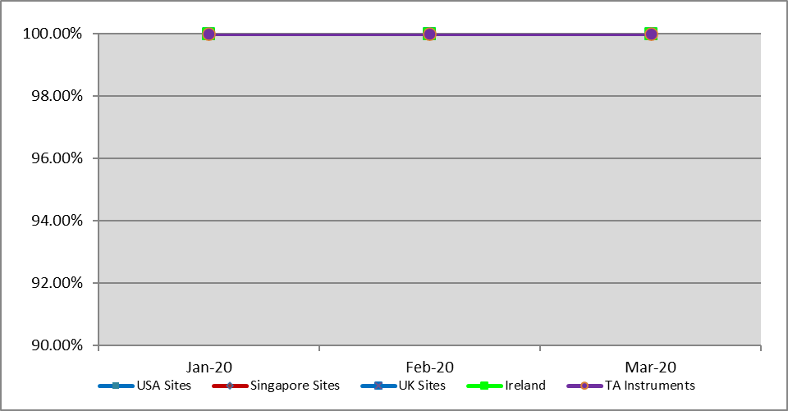
PCBA On Time Delivery Performance
Mth / Yr | Jan-20 | Feb-20 | Mar-20
USA Sites | 100.00% | 100.00% | 100.00%
Singapore Sites | 100.00% | 100.00% | 100.00%
UK Sites | 100.00% | 100.00% | 100.00%
Ireland | 100.00% | 100.00% | 100.00%
TA Instruments | 100.00% | 100.00% | 100.00%

Slide 8
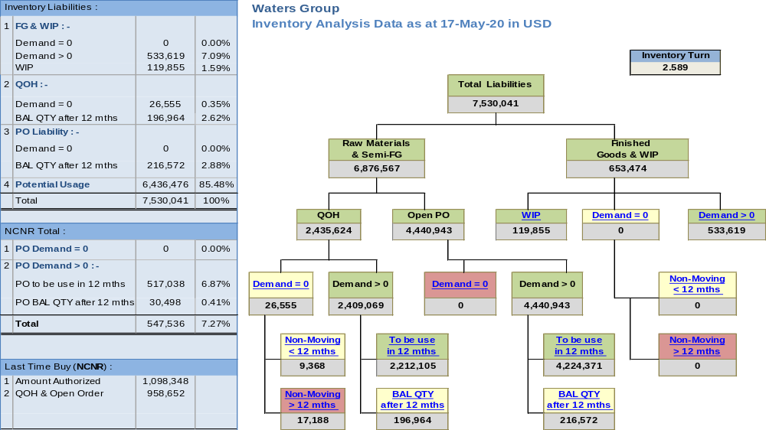
Waters PCBA Overall Inventory Analysis
Buffer of Long Lead Time Single Source components:
Liquid Chromatography 26 items, USD$87,199
Mass Spectrometry: 121 items, USD$76,654

Slide 9
PCBA New Models
Waters USA
Model | Description | FA Qty | EAU | Remarks
210001358 | Orion Pathfinder | 10 | 1,000 | FA shipped 09 Apr 2020
210001404 | Orion Pathfinder | 25 | 1,000 | FA target 12 Jun 2020
Waters UK
Model | Description | FA Qty | EAU | Remarks
279004222 | Vesper Project | 20 | 96 | FA target 14 Jul 2020 Replacement for 279003453
279004323 | Buzzard Project | 8 | 96 | FA target 21 Jul 2020

Slide 10
WATERS PCBA QUALITY PERFORMANCE
B & D increase
All Waters PCBA | Qtr 1-19 | Qtr 2-19 | Qtr 3-19 | Qtr 4-19 | Qtr 1_20
Total Shipped Qty | 17580 | 20175 | 21856 | 17956 | 14776
Total RMA Qty | 190 | 105 | 85 | 48 | 54
Overall PCBA Quality | 98.92% | 99.48% | 99.61% | 99.73% | 99.63%
LC Shipped Qty | 15786 | 17601 | 17975 | 16098 | 13185
LC RMA Qty | 154 | 63 | 33 | 27 | 27
LC PCBA Quality | 99.02% | 99.64% | 99.82% | 99.83% | 99.80%
MS Shipped Qty | 1794 | 2574 | 3881 | 1858 | 1591
MS RMA Qty | 36 | 42 | 52 | 21 | 27
MS PCBA Quality | 97.99% | 98.37% | 98.65% | 98.87% | 98.3%
All Waters PCBA | Qtr 1-19 |  | Qtr 2-19 |  | Qtr 3-19 |  | Qtr 4-19 |  | Qtr 1-20
 | Qty. | DPPM | Qty. | DPPM | Qty. | DPPM | Qty. | DPPM | Qty. | DPPM
Workmanship (A) | 3 | 171 | 3 | 149 | 1 | 46 | 0 | 0 | 0 | 0
Customer caused (B) | 23 | 1308 | 18 | 892 | 19 | 869 | 2 | 111 | 8 | 541
Mechanical Damage (C1) | 97 | 5518 | 8 | 397 | 4 | 183 | 5 | 278 | 4 | 271
Bad Component (C2) | 12 | 683 | 34 | 1685 | 28 | 1281 | 24 | 1337 | 24 | 1624
No Fault Found (D) | 55 | 3129 | 42 | 2082 | 33 | 1510 | 7 | 390 | 18 | 1218
Total RMA Qty | 190 | 10807 | 105 | 5204 | 85 | 3889 | 48 | 2673 | 54 | 3655
RMA DPPM = Total RMA received against total shipped
Effective DPPM = Sum of Workmanship (A), Mechanical Damage (C1) and Bad Component (C2) defects against Total Shipped.
Target DPPM is at 2000 for a Overall Quality Performance of 99.8%

Slide 11
ALL LC PCBAs RMA and Defect Distribution
ALL LC PCBA | Qtr 1-19 |  | Qtr 2-19 |  | Qtr 3-19 |  | Qtr 4-19 |  | Qtr 1-20
ALL LC PCBA Shipped | 15786 |  | 17601 |  | 17975 |  | 17956 |  | 13185
Workmanship (A) | 3 | 0.02% | 1 | 0.01% | 1 | 0.01% | 0 | 0.00% | 0 | 0.00%
Customer caused (B) | 18 | 0.12% | 10 | 0.06% | 2 | 0.01% | 2 | 0.01% | 6 | 0.05%
Mechanical Damage (C1) | 96 | 0.62% | 2 | 0.01% | 1 | 0.01% | 1 | 0.01% | 4 | 0.03%
Bad Component (C2) | 8 | 0.05% | 24 | 0.14% | 16 | 0.09% | 16 | 0.09% | 11 | 0.08%
No Fault Found (D) | 29 | 0.19% | 26 | 0.15% | 13 | 0.07% | 8 | 0.04% | 6 | 0.05%
Total LC RMA Qty | 154 | 0.99% | 63 | 0.36% | 33 | 0.18% | 27 | 0.15% | 27 | 0.20%
Top 5 PCBA - 210000520, 210000367, 210000903,210000422 and 210000345
TOP 5 – LC PCBA | Qtr 1-19 |  | Qtr 2-19 |  | Qtr 3-19 |  | Qtr 4-19 |  | Qtr 1-20
Workmanship (A) | 1 | 0.01% | 0 | 0.00% | 1 | 0.01% | 0 | 0.00% | 0 | 0.00%
Customer caused (B) | 3 | 0.02% | 2 | 0.01% | 1 | 0.01% | 2 | 0.01% | 6 | 0.05%
Mechanical Damage (C1) | 0 | 0.00% | 2 | 0.01% | 1 | 0.01% | 1 | 0.01% | 4 | 0.03%
Bad Component (C2) | 2 | 0.01% | 15 | 0.10% | 15 | 0.08% | 8 | 0.04% | 6 | 0.05%
No Fault Found (D) | 24 | 0.15% | 16 | 0.10% | 6 | 0.03% | 6 | 0.03% | 4 | 0.03%
Total | 30 | 0.19% | 35 | 0.22% | 24 | 0.13% | 17 | 0.09% | 20 | 0.15%

Slide 12
210000520 PCA RMA with NDF Return
Introduce CPSO analysis
1 pc NDF from Milford
2 pcs B from Milford
1 pc B from Venture/GES
2 pcs NDF from Milford
PING test start
1 pc1 NDF from FLEX
CPSO Test :
  Down trend for initial practice test with CPSO since May’19
  Highly Eliminate NDF return in the past 10 months (Quarterly 16 pcs reduce to 2 pcs)
    Key failure IC: U11 around 75% related with Ethernet, U25 around 13% related with Initialization
  Short term plan is monitoring and sustaining with verification by CPSO
PING Test :
  PTST apply PING screening test for Ethernet issue study since Jan 2020
    There are 8700 pcs have completed and another 2000 pcs are in progress for testing
  520 PING test result:
        There is no IP related issue found in PTST
        There is no (Serial/Ethernet) communication issue found in PTST
    PING test conclusion:
      There is no U11 and U25 related problem found in PTST
      CM’s PC able caused Ethernet related issue
      Base on Venture/GES onsite verification result

Slide 13
Time Line For Tripartite Quality Meeting
Q4
2018
Q2
2019
Q4
2019
Target for Zero RMA
Start Tripartite Quality meeting with Waters and Venture (GES )
Established 9 days lead-time for top priority boards – 367, 422 and 520
Successfully identified the root-cause of fuse F6 ‘open’ failure for 210000422 PCBA
Introduce CPSO for 520 RMA verification
In-Depth study on 520 PCA down to components level, U25 (19%) and U11 (81%) are key reject ICs
Highly eliminate 520 NDF return
Preparation for 520 screening test at PTST
Practice Field Return with 1st batch 520 PCA Test with CMs before normal process
520 RMA PCA with NDF have highly reduced by 95%
Start Tripartite quality meeting with FLEX
High NDF return with 520 RMA PCA
Process improvement on
210000903 (lead lifted/ wave solder) and 210000520 ( wetting )
Continues practice with CPSO for 520 RMA PCA for more data collection
Introduce PING screening test for 520 RMA PCA
Venture/GES onsite verification findings:
CMs PC could caused 520 not able get IP shows as 0.0.0.0
PTST have run PING test to study Ethernet RMA return, and there is NO reject related with Ethernet problems
Q1
2019
Q3
2019
Q1
2020
Update

Slide 14
Tripartite Quality Meeting
- WATERS / CEI / VENTURE (GES) / FLEX
Jan – 3 case from Venture/GES “C1”
Feb – 1 case from FLEX “C1”
Feb – 4 case from Venture/GES “B”
Mar – 1 case from Venture/GES “C2”
Year | 210000520 Improvement | Benefits / Results
2019 RMA | CPSO verification | Detect false NDF Highly reduce RMA return with NDF (Quarterly 16 pcs reduce to 2 pcs) Able define details failure related with U25 and U11
2020 Fresh PCBA & RMA | Upgrade PCBA transportation method in PTST | PCBA transportation method change from “hard contact” to “soft contact” Triger point is FLEX RMA return in Feb 2020, related with C174 drop-off
 | PING Test in PTST | No reject related with Ethernet problem within 8700 pcs fresh PCA. (there is 1 case fail is caused by RAW part issue) PTST have already done 8700 pcs, balance 2000 pcs will be done by end of May Venture/GES onsite verification shows us Ethernet problem may caused by CM’s PC
Notes:
F6 fuse failure on 210000422 PCBA identified to be caused by defective cable at Intelligent Intake Valve (I2V) assembly.
Damaged to chip components at solder-side on 210000422 PCBA cause by inserting PCBA during instrument assembly.
add 520 PCA able to verify those Fake NDF

Slide 15
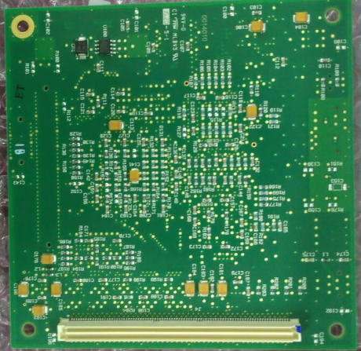
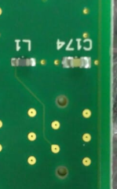
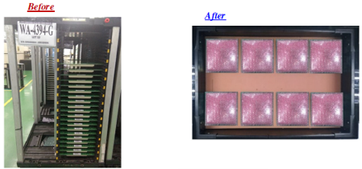
Process Improvement
Damage chip capacitor at loc C174 (210000520 CCPU AHCT (WA-4394-G) &
(210000691 CCPU FLR (WA-4960-G )
Root Cause Analysis:
Loc. C174 is located <3mm away from the pcb edge
During penalization, 2 side tab (10mm) is added on both of the pcb
After component pick & place, the pcb is loaded into the magazine storage whose guide slot varies from 3-6mm between different magazine model.
After tab breaking process, the pcb is loaded back into the magazine and thus potentially risking damage to the capacitor at loc C174
Improvement Action:
After tab breaking process, the pcb is pack into bubble bag and store into Tote box instead.
This eliminate the risk of damaging the capacitor at loc C174.

Slide 16
Step Stencil design
Stepped stencil design is required for fine pitch component when solder paste volume transfer from the aperture on the stencil to the pad on the pcb is either too little or too much.
Root Cause Analysis:
1. For micro BGA with 16mils pitch, the stencil aperture opening is 8 mils
2. But 8 mils aperture opening has Area Ratio of 0.394 using 5mils stencil
thickness for overall printing on the pcb. This resulted in insufficient solder
paste volume for the micro BGA.
3. Recommended Area Ratio for stable solder paste printing is 0.66
AR for 8mils opening:
Improvement Action:
16mils pitch micro BGA requires a 3mils stencil, but 3mils stencil may not provide
enough solder paste for other SMD components on the pcb.
The solution is to step down the stencil thickness at micro BGA location from 5mil
to 3 mil.
Stencil Thickness | Area Ratio
5mils | 0.394
4mils | 0.492
3mils | 0.656

Slide 17
Equipment (EQM)

Slide 18
Waters EQM Sales (,000K USD)
Percentage %
Sales (,000K USD)
Year | 2016 | 2017 | 2018 | 2019 | 2020(Projection)
Revenue (,000K USD) | 4.41 | 3.99 | 4.31 | 4.44 | 3.42
Year to Year Comparison (%) | NA | -9.52% | 8.02% | 3.02% | -22.97%

Slide 19
EQM On Time Delivery Performance
Year/ Month | Q2-19 | Q3-19 | Q4-19 | Q1-20
Target | 100% | 100% | 100% | 100%
Instruments | 100% | 100% | 100% | 100%
Spares | 100% | 100% | 100% | 100%
Despite the pandemic, CEI continues to perform 100% OTD.
Closely working with Waters as well as suppliers helps CEI to act timely.

Slide 20
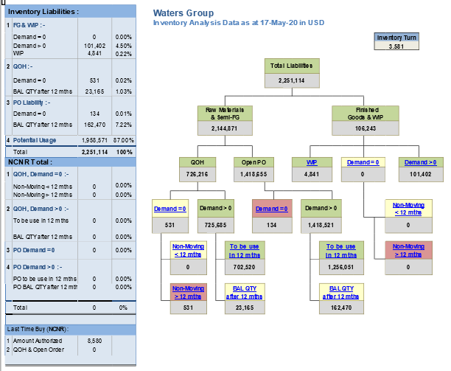
Waters EQM Overall Inventory Analysis
In Q4’19, EQM inventory turn was at 3.92 vs current 3.58 due to Waters has pushed out 20% of its demand in 2020 and due to Covid-19, CEI is holding buffer inventory in order to support 100% OTD. CEI will continues to work with Waters team and its key suppliers to improve our inventory holding

Slide 21
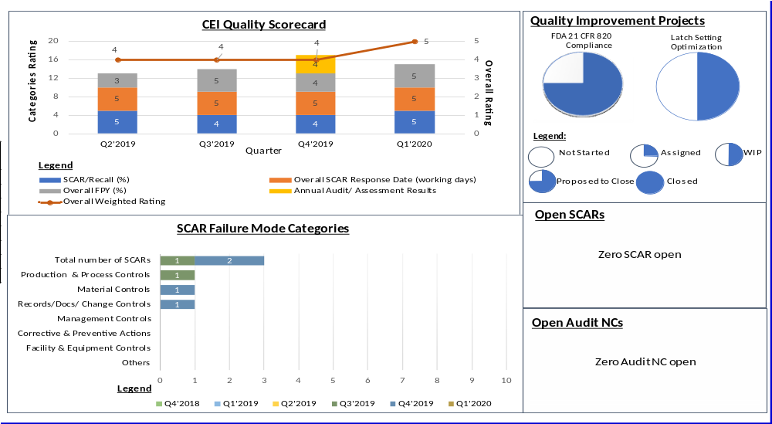
EQM Quality Dashboard Q1-2020
CEI achieved EXCELLENT overall weighted rating in Q1 2020.
CEI overall weighted rating in Q1 2020 has improved compared to previous 3 quarters.
Met monthly FPY target for all 3 months of Q1 2020.

Slide 22
New Business Opportunity for
EQM?
The transfer of PCM/TCM was a successful carried out, both PCM/TCM are now in mass production shipment.
Valuable lessons learned during above transfer can be further capitalise in the next transfer .
Is Waters ready to transfer the other models which using Racal test system to consolidate all to CEI?

Slide 23
Thank You

