Slide 1
Waters Overall Continuous Improvement Update
20 Dec 2019

Slide 2
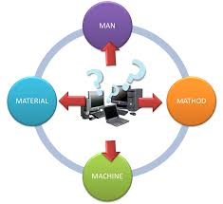
Continuous Improvements Plan for 2019
4M
Consigned Tester Repair/Upgrade

Slide 3
Consigned Test Equipment Repair/Upgrade
History & background:
The test equipment age is approx.8-13 years old at Flex Kallang and all test equipment were maintained unknown number of years (approx. 5-15 years ) at Customer site prior to transfer to Flex, Kallang.
  Tester Transfer history as shown below:
  2005 – Pumps Family (515, 1515 and 1525)
  2006- 2007 – Alliance Family
  2008 – 2489 and 2998 Family
  2009 – TUV / PDA and eLambda
  2010 – BSM / QSM / TUV/ PDA and eLambda
  2012- 2013 Refresh Alliance and Detectors, UPC2 Detectors
  2014 – PDA Detector with Taper Slit
  2015 – Perkin Elmer Arc Detector
  2017 – Arc Bio Detector
Experiencing frequent Downtime due to aging and wear & tear and most of the time unable to repair on time due to critical parts non availability
Example: Pump Tray Tester , Flow Cell Tester and 1500 Series Final Tester etc.
Initiated Consigned Tester Health review to assess the tester condition and plan for replacement / repair to prevent major breakdown / downtime issue.

Slide 4
Consigned Test Equipment Repair/Upgrade
Objective:
For all 10 testers identified as part of Health review , to identify and list down and get critical spare parts to replace as part of regular PM or repair in the event of test equipment down and recover.
Pre-Requests:
Obsoleted Hardware Ex: PCBA , Flow valve etc.
Obsoleted Software Ex: Windows Operating System
Schematic/Block diagram/BOM
Operational manual / PM documents
Supplier/ Vendor list for Spare parts

Slide 5
Consigned Test Equipment Health Assessment
In Progress
Complete
Overall Status of Consigned Equipment Health Review ( Test Equipment)
Identification
69
Review of Health of Consigned Equipment
69
Actions on the observation
10
Consigned Equipment Health Review Status :
Sl No. | Action | Apr | May | Jun | Jul | Aug | Sep | Oct | Nov | Dec
1. | Identify the list of consigned equipment.
2. | Identify & analyze downtime data on the consigned equipment.
3. | Establish a checklist to review the health of the equipment.
4. | Start the review of the health of the equipment. |  |  | Alliance | Alliance | Pumps | BSM/QSM | BSM/QSM | Detectors | Detectors
5. | Review the status of the health with Waters team. |  |  |  | Alliance | Pumps |  | BSM/QSM |  | Detectors
6. | Actions on the observation. |  |  |  |  |  | Alliance | Pumps | BSM/QSM | Detectors
22 Alliance testers reviewed.
6 under focus for actions.
> 14 RPN : 6
11 to 14 RPN : 0
5 to 10 RPN : 6
< 5 RPN : 10
5 Pump testers reviewed.
2 under focus for actions.
> 14 RPN : 2
11 to 14 RPN : 0
5 to 10 RPN : 0
< 5 RPN : 3
11 BSM/QSM testers reviewed.
0 under focus for actions.
> 14 RPN : 0
11 to 14 RPN : 10
5 to 10 RPN : 0
< 5 RPN : 1
31 Detectors testers reviewed.
2 under focus for actions.
> 14 RPN : 2
11 to 14 RPN : 0
5 to 10 RPN : 18
< 5 RPN : 11
Focus first on Pump model, to agree on actions for upgrade required.

Slide 6

Consigned Test Equipment Repair/Upgrade
In Progress
Complete
Overall Status of Consigned Equipment Health Review ( Test Equipment)
Spare Parts list creation
10
Source spare parts
10
PM update
10
Consigned Equipment Health Review Status :
Sl No. | Action | Jan19 | Feb 19 | Mar 19 | Apr 19 | May 19 | Jun 19 | Jul 19 | Aug 19 | Sep19 | Oct19 | Remarks
1 | Flow Cell Tester (TE82475) | Spare part list | Source parts | Source parts | Source parts | Source parts | Source parts | Source parts | PM Update | PM Update | System registration and execution | 6 parts – Source by Flex - Completed 4 parts – Source by Flex – Not critical and inside tester 2 parts – Source by WPPL (OESR 05 Dec 2018)
2 | 1500 Series Final Test Station (TE82705) |  | Spare part list | Spare part list | Source parts | Source parts | Source parts | Source parts | PM Update | PM Update | System registration and execution | 2 parts – Source by Flex – Completed 6 parts – Source by WPPL Raised OESR for Zilog Microcontroller / Pump Control Module
3 | 515 Final Tester (TE82534) |  | Spare part list | Spare part list | Source parts | Source parts | Source parts | Source parts | PM Update | PM Update | System registration and execution | 2 parts – Source by Flex – Completed 6 parts – Source by WPPL Raised OESR for Zilog Microcontroller / Pump Control Module
4 | 2690 Pump Head Tester (TE82519 ) |  |  |  | Spare part list | Spare part list | Source parts | Source parts | PM Update | PM Update | System registration and execution | - 3 parts – Source by WPPL - Raised OESR for obsolete Pump Head Tester PCBA (056451) Rev.0
5 | HPMV Tester (TE82625) |  |  |  | Spare part list | Spare part list | Source parts | Source parts | PM Update | PM Update | System registration and execution | - 3 parts – Source by WPPL - Raised OESR for Zilog Microcontroller / Keypad
6 | Carousel Carrier Drive Alignment Station (TE82520) |  |  |  | Spare part list | Spare part list | Source parts | Source parts | PM Update | PM Update | System registration and execution | WINDOWS XP (Need to upgrade RAM) - Need spare power supply - Claim to Waters later
7 | Fluidics Tray Tester (TE82523) |  |  |  | Spare part list | Spare part list | Source parts | Source parts | PM Update | PM Update | System registration and execution | - 3 parts – Source by WPPL - Raised OESR for Zilog Microcontroller / Keypad
8 | Injector Seal Pack Tester (TE82503) |  |  |  | Spare part list | Spare part list | Source parts | Source parts | PM Update | PM Update | System registration and execution | - 3 parts – Source by WPPL - Raised OESR for Zilog Microcontroller / Keypad
9 | Injector Seal Pack Tester |  |  |  | Spare part list | Spare part list | Source parts | Source parts | PM Update | PM Update | System registration and execution | - 3 parts – Source by WPPL - Raised OESR for Zilog Microcontroller / Keypad
10 | 2998 rough alignment CPU (TE82917-1) |  |  |  | Spare part list | Spare part list | Source parts | Source parts | PM Update | PM Update | System registration and execution | WINDOWS XP (Need to upgrade RAM) - Need spare power supply - Claim to Waters later
Completed Spare parts list creation for all identified tester.
Sourcing of spare parts in progress.
Notes:
- What is the target date for Source of parts by WPPL?

Slide 7
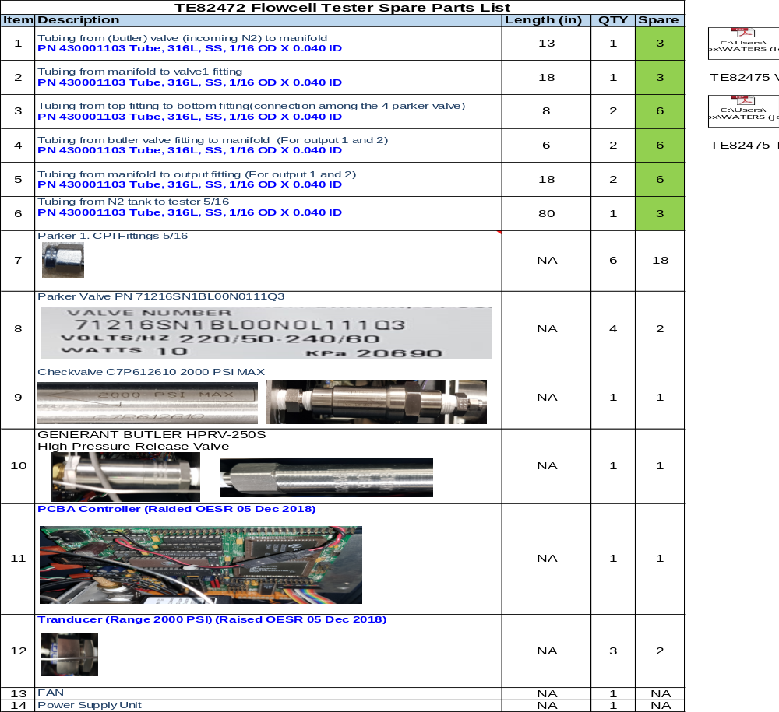
Flow cell Tester (TE82475 Spare Part List)

Slide 8
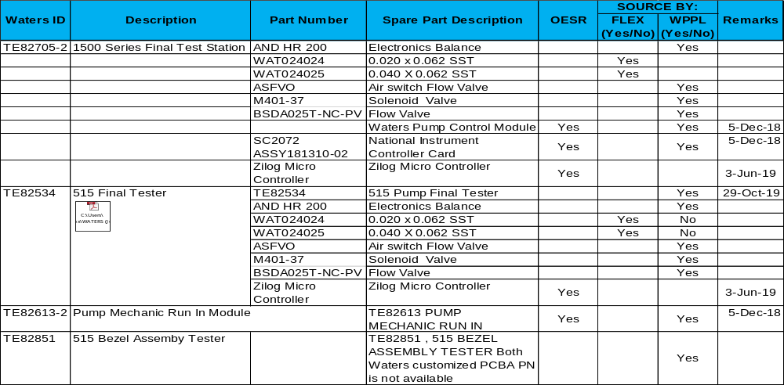
PUMP Family (TE82505, TE82534, TE8261 and TE82851 Tester)

Slide 9
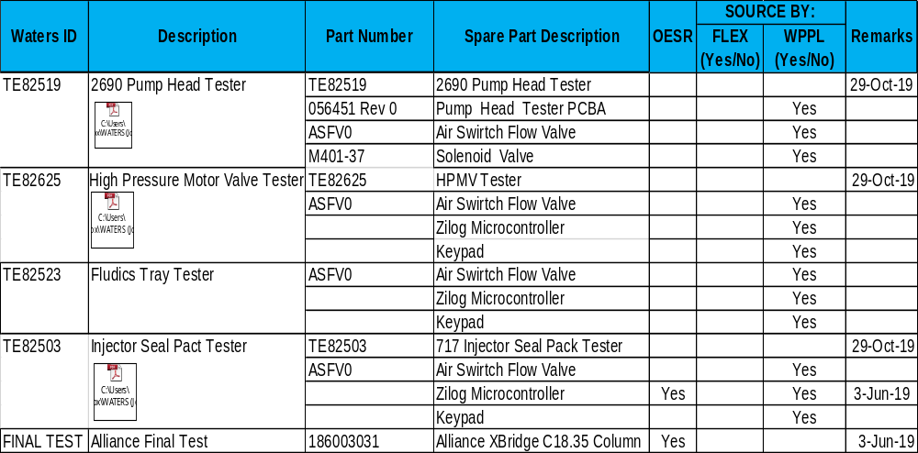
Alliance Family(TE82519, TE82625, TE82523, TE82503 and Final Tester

Slide 10
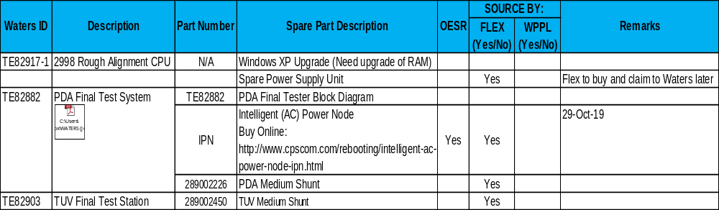
Detector Family(TE82917, TE82882 and TE82903 Tester

Slide 11
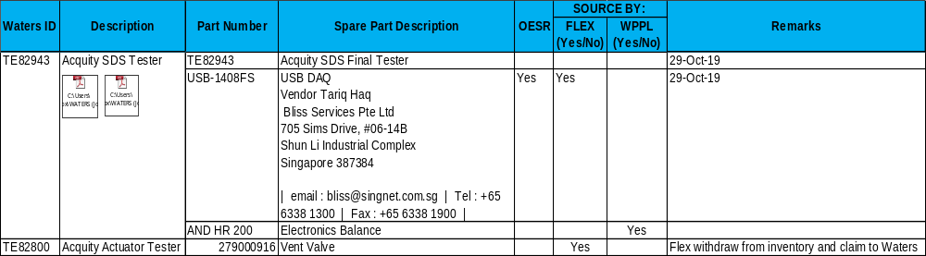
Acquity SDS Family(TE82800 and TE82943)

